Slide 1
MOOC Symposium
How Should Drexel Position Itself –
Relative to MOOCs?
Drexel University
August 13, 2013

Slide 2
Welcome
Dr. Mark Greenberg, Provost
Drexel University

Slide 3
MOOCs and the Online Learning Council (OLC) Focus to Date and Possibilities
Dr. Mike Scheuermann
AVP – ITS / IRT
Exec. Dir. Online Learning Council
Drexel University

Slide 4
OLC - Focal Points / Make-Up
Accessibility Committee
Captioning Task Force
Communication
INSPIRE Web Site
Quality
Academic Integrity
Retention
Scalability
MOOCs
Student Support & Engagement
DrexelExpress Web Site
OLC Fellows
Quality Matters
Course Design Reviews
Accessibility
F
Retention
Quality
F
F
Communication
F
F
Student Support
& Engagement
Scalability

Slide 5
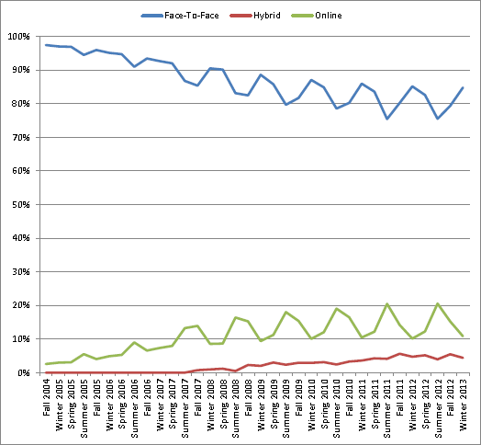
What’s Compelling about the MOOC Realm?
Align Drexel with top-level institutions
Continue Drexel’s close follower approach
Investigate new pedagogical approaches
Inform eLearning at Drexel
Face-to-Face courses – Web-enhanced
Hybrid courses – Web-enabled
Online courses – Web-delivered
Scale current offerings
25 students/class → 50 students/class
50 students/class → 200 students/class
200 students → ??? students

Slide 6
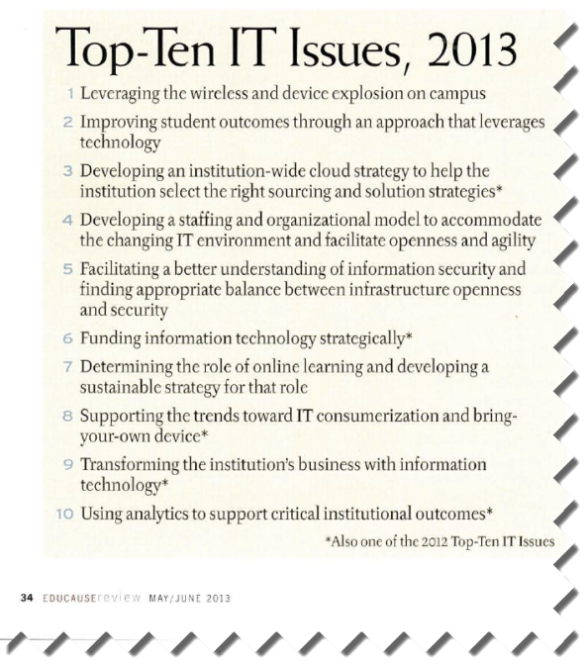

Slide 8
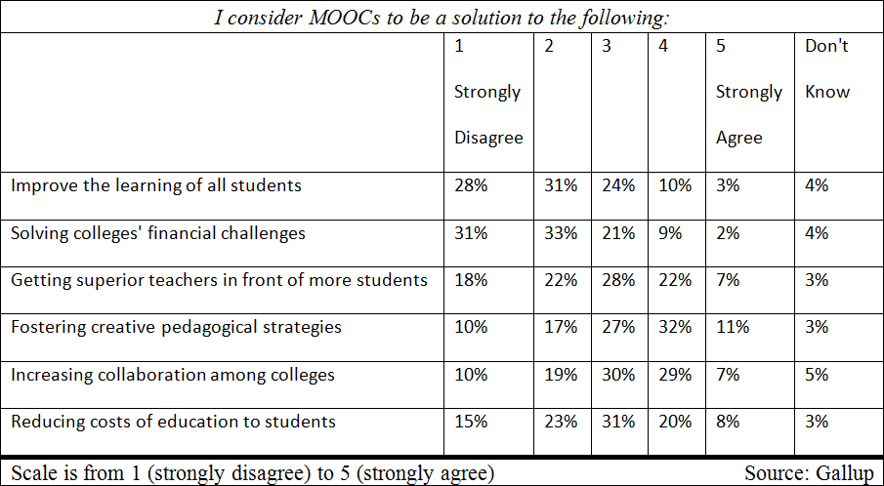
Disruption & Profound Change
How do we monetize MOOCs?
How do we (or, do we) offer MOOCs for credit?
How do we (or, do we) offer credit for MOOCs?
Are we giving away our content?
Are we undermining our existing programs?
Can we get faculty buy-in?
Can we maintain quality?
What about IP issues?
Who owns the course?
May 2013
Gallup Survey of college presidents (889)

Slide 9
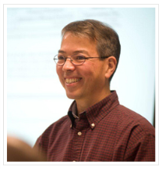
Institutional Benefits
Professors showcase novel approaches
Karl Okamoto – Earle Mack School of Law
GOAL: “Infuse engagement into large lecture classes”
Improvement in pedagogy and learning
Collaboration across disciplines
Collaboration between academic units
Collaboration across institutions
Increasing access

Slide 10
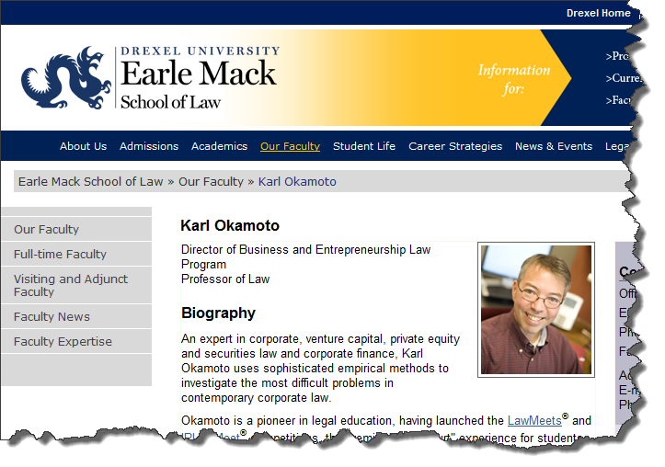
Drexel’s MOOC Pioneer – Interview Video Clip

Slide 11
MOOCs at Drexel’s CNHP and the iSchool Visions and Plans
Fran Cornelius, Clinical Professor College of Nursing and Health Professions
Linda Marion, Associate Teaching Professor, College of Information Science & Technology, Drexel University

Slide 12
College Nursing and Health Professions
The Background
The Culture
‘Needs’ and ‘Wish List’ Assessment

Slide 13
Toe in the Water
LOOCs: CNHP’s ‘Mini’ MOOCs
Needs and Wish List?
Outcomes
Plans

Slide 14
Moving Forward
Revisiting the ‘Need’
Cost-Benefit Analysis (Value Added??)
Able to test different educational strategies across large populations of students
On-Demand PBL/Active-Learning
Student Preparation/Skill Building/Remediation: Student-Driven

Slide 15
CNHP Plans
Mini MOOCs
MOOCs
Online Learning Success MOOC – Graduate Level
Clinical Prep/Orientation Simulation MOOC
MOOC Partnerships with Hospitals
Other Opportunities

Slide 16
The iSchool and MOOCs
Background
Goals
Plans

Slide 17
Why Get Involved in MOOCs?
Mission – Uniting people with information through technology
Goals
Public service
Research
Public awareness – marketing

Slide 18
Graduate
Undergraduate
Focus
Grad - MSLIS Program
Target audience
LIS professionals & potential students
Topic
Multicultural resources diverse populations
Focus
Undergrad – New BSI Program
Target audience
Potential BSI undergrads & parents
Topic
Intro to Informatics

Slide 19
Project Plan
Timeline
Duration - 5 weeks
Size - Limited to 250 in each
Platform - BB CourseSites
Special tool – ApprenNet
Staff – Faculty & grad students
Cost

Slide 20
MOOCs at The Wharton School The Coursera Experience at The Wharton School
Don Huesman, Managing Director of the Innovation Group, The Wharton School, University of Pennsylvania

Slide 21
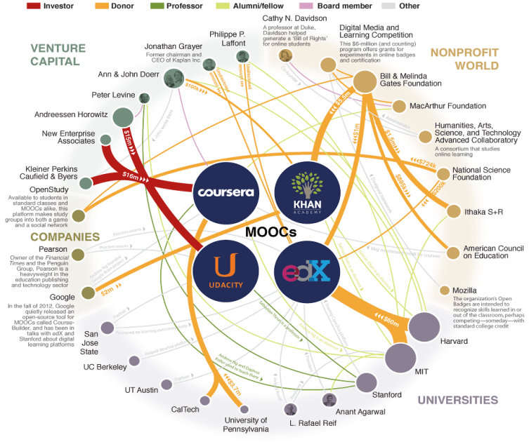
Source: Chronicle of Higher Education (http://chronicle.com/article/The-Major-Players-in-the-MOOC/138817

Slide 22
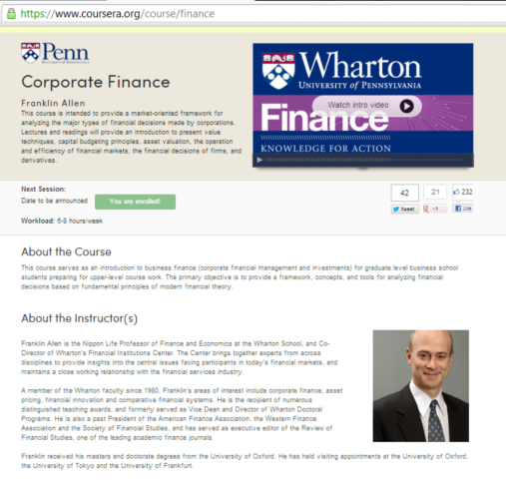
Wharton MOOC Courses on Coursera
Accounting Brian Bushee
Finance Franklin Allen
Marketing B. Khan, P. Fader, D. Bell
Operations Christian Terwiesch
Gamification Kevin Werbach
Design Karl Ulrich
Health Policy Zeke Emanuel
Sports Business Ken Shropshire

Slide 23
Top 10 Participant Home Countries
United States
India
Brazil
Spain
United Kingdom
Canada
Russia
Greece
Mexico
Ukraine

Slide 24
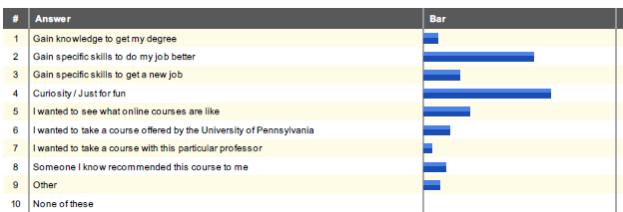
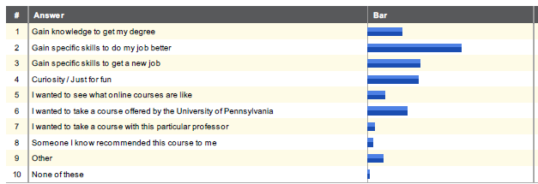
Why did you choose to enroll?
Gamification
Accounting

Slide 25
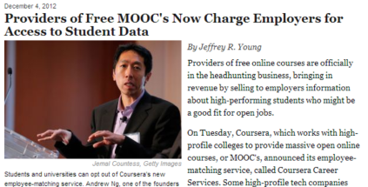
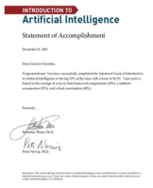
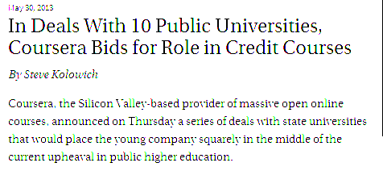
The Business Model Behind Giving It All Away

Slide 26
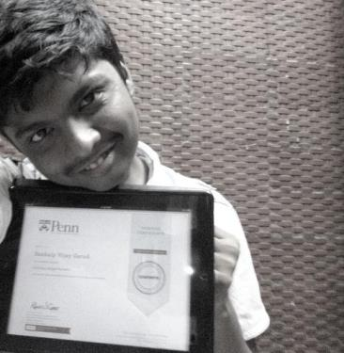
Finding the 410
Notes:
Meet Sankalp, who lives in Mumbai & just turned 17 this month! He has written a very thorough story on his journey in getting a Verified Certificate for Single Variable Calculus, what it was like to go through a virtually proctored exam, and how he is preparing for college with MOOCs. http://bit.ly/12rEvb8

Slide 27
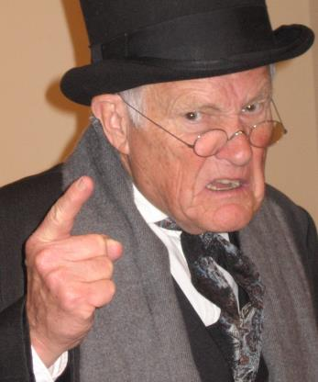
The Empire Strikes Back

Slide 28
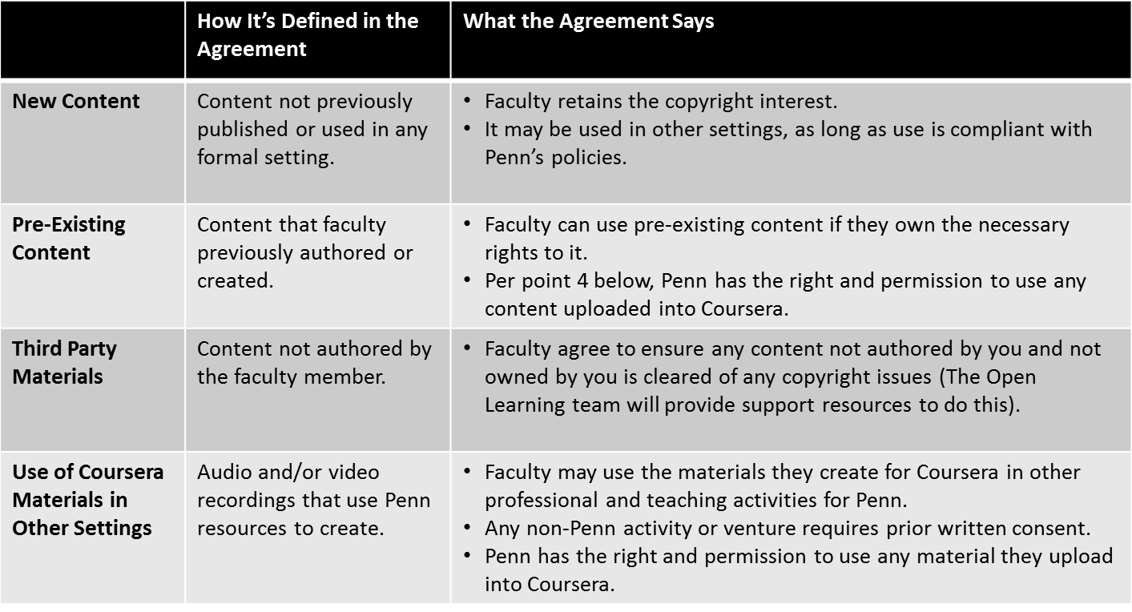
Faculty IP Agreements

Slide 29
Morning Break – 15 minutes !!!

Slide 30
MOOCs in the International Community The EDUlib Experience at HEC Montréal
Jean Talbot, Director – Center for Learning and Teaching Innovation, HEC Montréal, Canada

Slide 31
Plan
Some international MOOCs
EDUlib: HEC Montréal’s MOOC initiative
Pedagogical Approach
Responsibilities and Costs
Likes & Challenges
Value for HEC
Conclusion

Slide 32
AACSB, EQUIS, AMBA
12,000 registered students
250 professors
Full range of programs (Undergraduate, MBA, M.Sc., Ph.D., continuing education, executive education)
Teaching mostly in French; however bilingual and trilingual undergraduate and English MBA
Top 5 in the francophone world

Slide 33
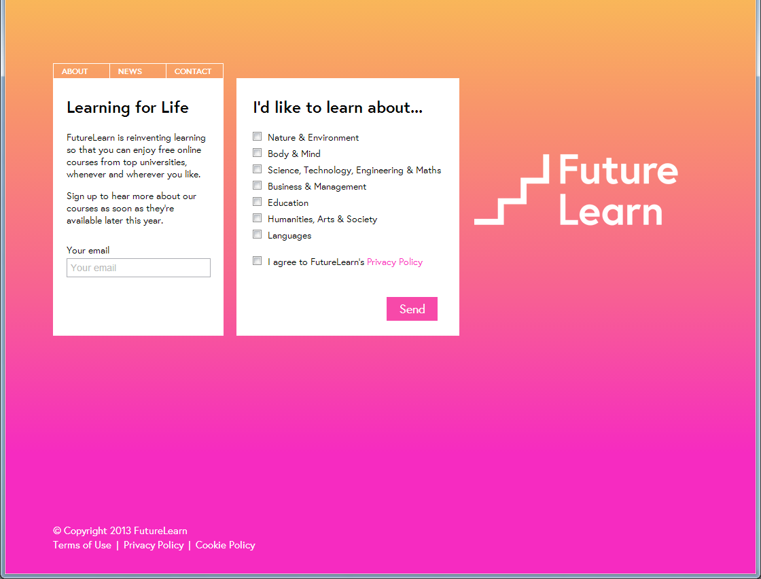
FutureLearn (December 2012) - UK

Slide 34
Open2Study (March 2013) - Australia

Slide 35
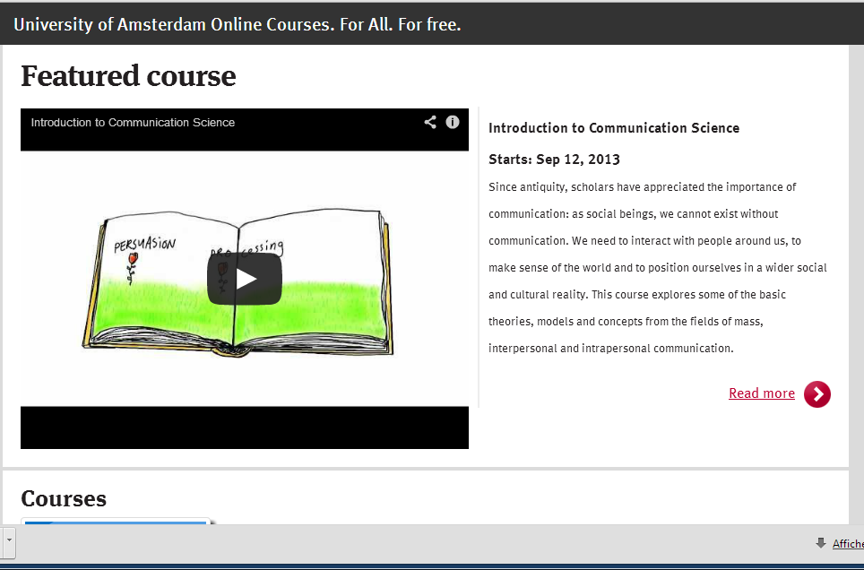
University of Amsterdam

Slide 36
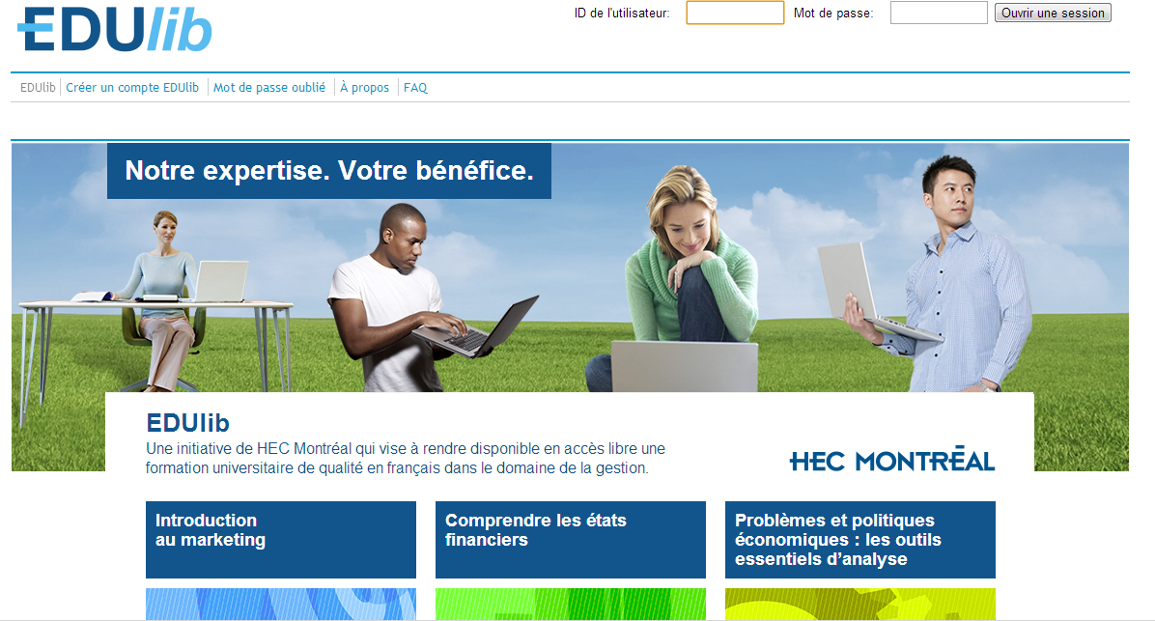
EDUlib (October 2012)

Slide 37
The Courses
2012-2013
Introduction to Marketing
Understanding Financial Statements
Economic Problems and Policies
2013-2014
Conflict Management
Entrepreneurship
Introduction to Marketing (repeat)

Slide 38
Why?
Important phenomenon that had the potential to be a disruptive innovation… so we just had to do it
3 main arguments
Branding
Learning
Giving back

Slide 39
The Platform
Different approach
Used our own platform based on SAKAI (open source LMS)
We wanted to be first in our market
We had good Sakai expertise
We wanted to keep control

Slide 40
Some Numbers
First page
More than 68,000 unique visitors
Mostly from French Canada but reached 150 different countries (Haiti, France, Algeria, Senegal, Burkina Faso, Morocco, Ivory Coast, Cameroun, Niger, …)
Introduction to Marketing
3,850 registered participants
1,759 did the first test
568 did the final exam
450 passed
Understanding Financial Statements
6,007 registered participants
1,465 did the first test
1,107 did the final exam
1,010 passed
Economic Problems and Policies
5,002 registered participants
623 did the first test
351 did the final exam

Slide 41
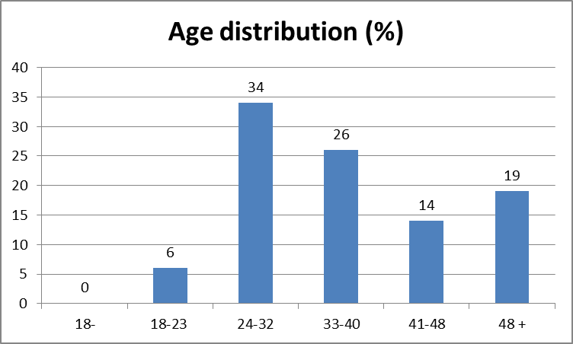
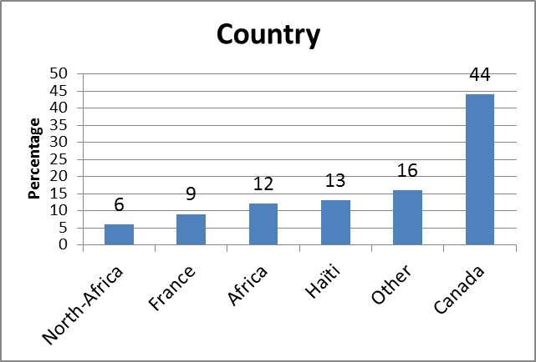
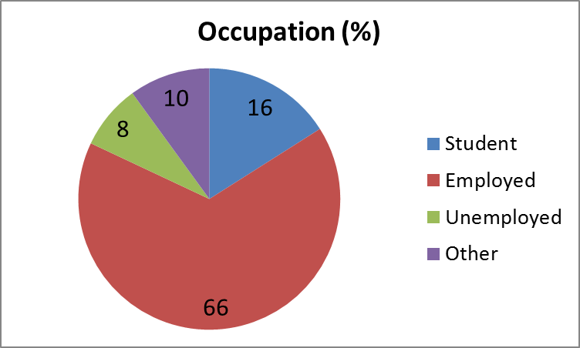
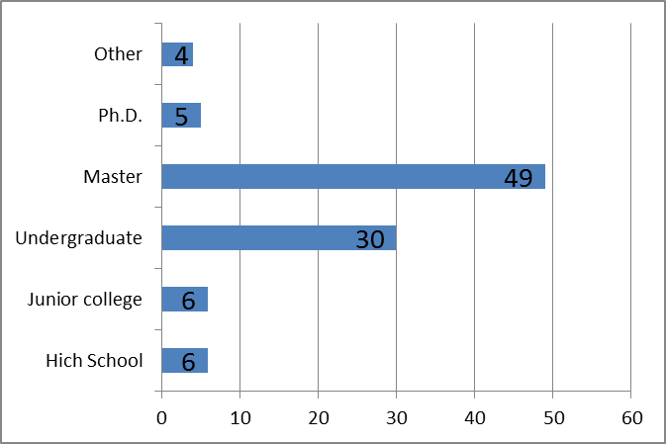

Slide 42
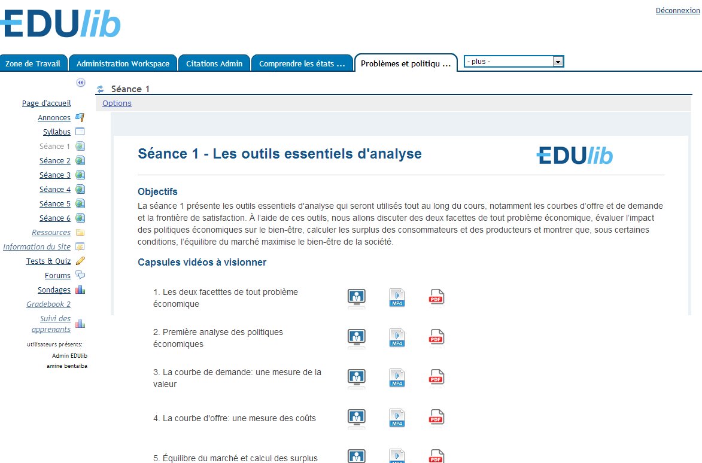
Pedagogical Approach

Slide 43
Responsibilities and Cost
Faculty: $12K
Teaching Innovation Workshop
Between 20 to 50 hours/video hour
Support ($10K to $15K)
Teaching assistant
Proof reading
Instructional Designers (50 hours)
Graphic Design (20 hours)
Web Page Development (25 hours)
Technical set-up (25 hours)
Video Production (200 hours)

Slide 44
Likes
Format (6 weeks, flexibility/structure)
Quality of the material produced by faculty
Collaboration between the different departments involved
Involvement of many students
A large number of participants is an advantage
Quality of contributions on the forums was surprising
Open access
Open door

Slide 45
Challenges
High drop-out rate
Student motivation
Mostly lectures and content focused
Little interaction with faculty
Interaction between participants
Validity of evaluations
Availability of proper technology
Financing

Slide 46
Value to HEC
Learn to teach differently
Learn to organize content differently
Obtain real-time data on the learning process
Learning and teaching innovation Lab
Transfer to existing programs
Branding

Slide 47
Success Factors: The Four Pillars of MOOCs
Faculty
Technology
Instructional designers
Audiovisual

Slide 48
Conclusion
« JUST DO IT »¹
But Keep It Simple
¹ with apologies to Nike

Slide 49
MOOCs – Faculty Perspective Experiences / SCAA Insights
Dr. Ludo Scheffer, Teaching Professor, Psychology, College of Arts & Sciences, Drexel University

Slide 50
To Award, or Not Award
Ludo Scheffer, Ph D
Chair, Senate Committee on Academic Affairs

Slide 51
To Award or Not Award
Fundamental Question asked:
Should Drexel award credit for students taking MOOC’s?

Slide 52
To Award or Not Award
Awarding Credit for MOOC’s, issues to consider:
Who certifies the courses?
How do (COOP) employers view, or understand MOOC’s?
How do accrediting agencies view MOOC’s and the issue of awarding credit?
And then: ….

Slide 53
To Award or Not Award
Other considerations:
Impact on online program?
Can current students take MOOC’s (target population?)
If so, how many?
Only electives, or also core courses?

Slide 54
To Award or Not Award
Finally, a question to ask:
How do MOOC’s align with the core mission and values of the university of Experiential and Entrepreneurial Learning?

Slide 55
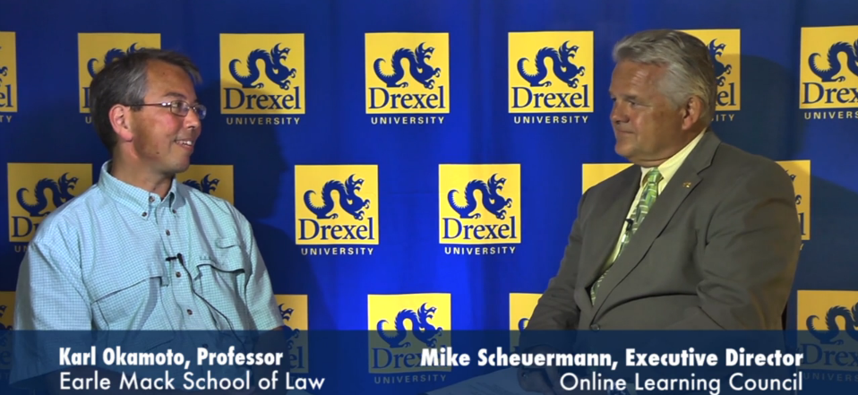
Lunch Break – 11:45am – 12:45pm

Slide 56
Panel Discussion – Q&A
Don Huesman
Jean Talbot
Fran Cornelius
Linda Marion
Ludo Scheffer
Moderator: Mike Scheuermann

Slide 57
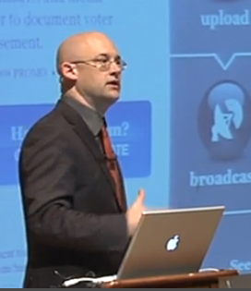
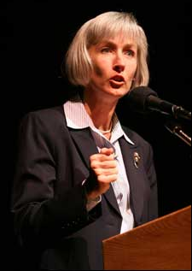
Augmenting the Panel Discussion
Full-length Mike-Karl discussion
Clay Shirky -
“MOOCS Will Matter but Worries about Corporate Players”
July 25, 2013
EDUCAUSE –
“MOOCs and Beyond”
July 29, 2013
2U – In the News Recently
“3 Universities Will Grant Credit for @U’s Online Courses”
The Chronicle of Higher Education
July 30, 2013

Slide 58
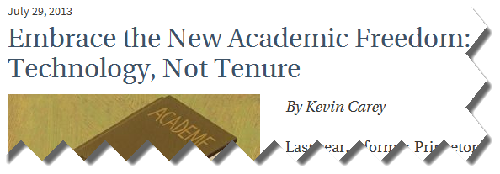
Augmenting the Panel Discussion

Slide 59
Thank You for Attending !!!
Don Huesman - huesman@wharton.upenn.edu
Jean Talbot - jean.talbot@hec.ca
Fran Cornelius - fc28@drexel.edu
Linda Marion - sg95etcm@drexel.edu
Ludo Scheffer - lcs22@drexel.edu
Mike Scheuermann - mikes@drexel.edu

