Slide 1


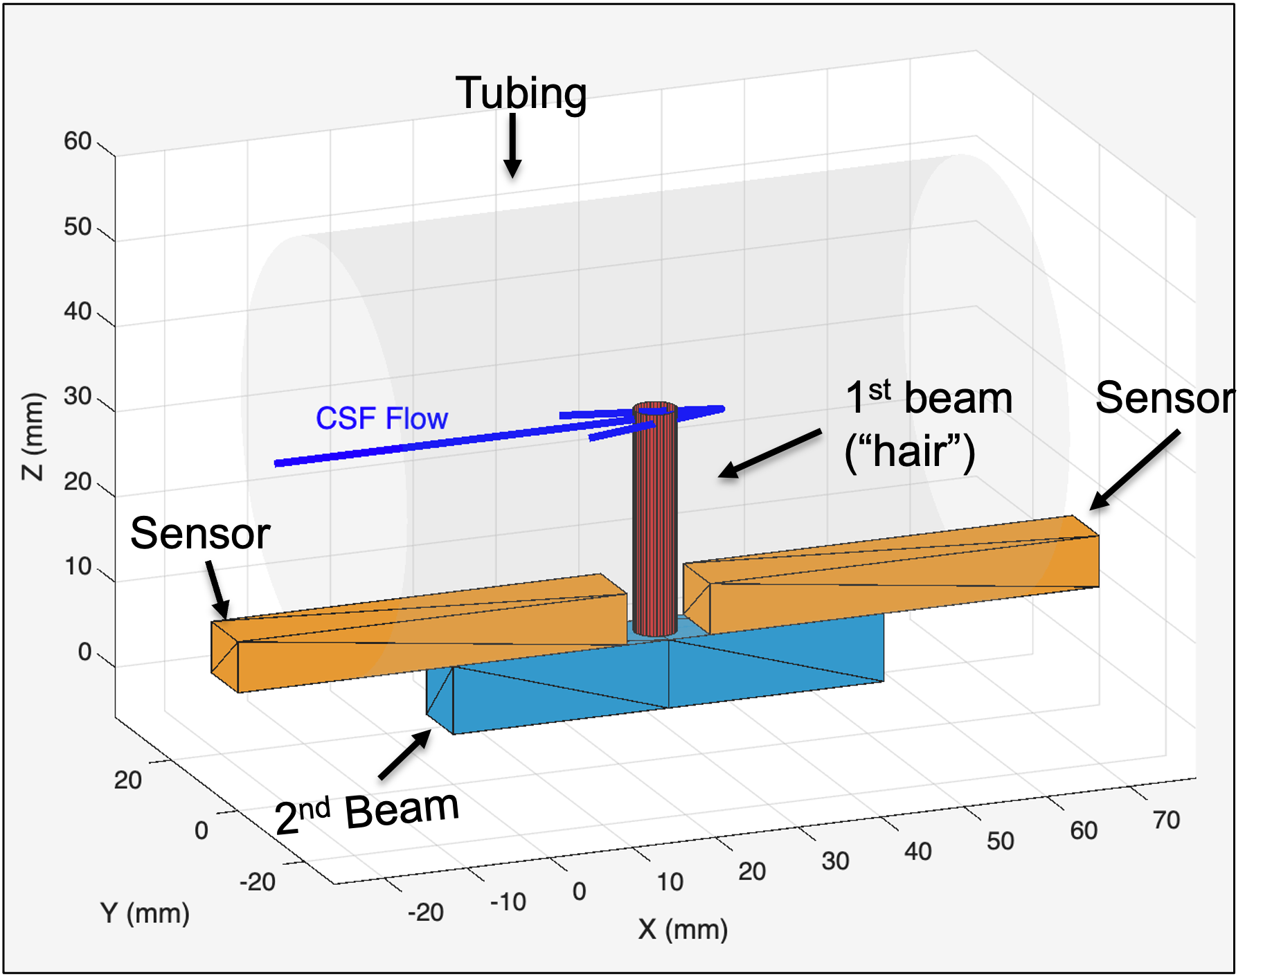
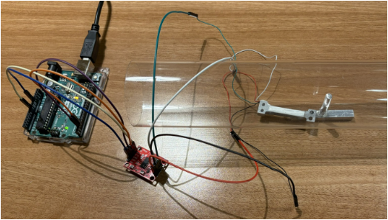
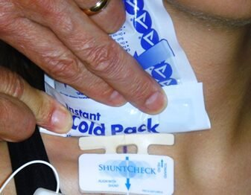
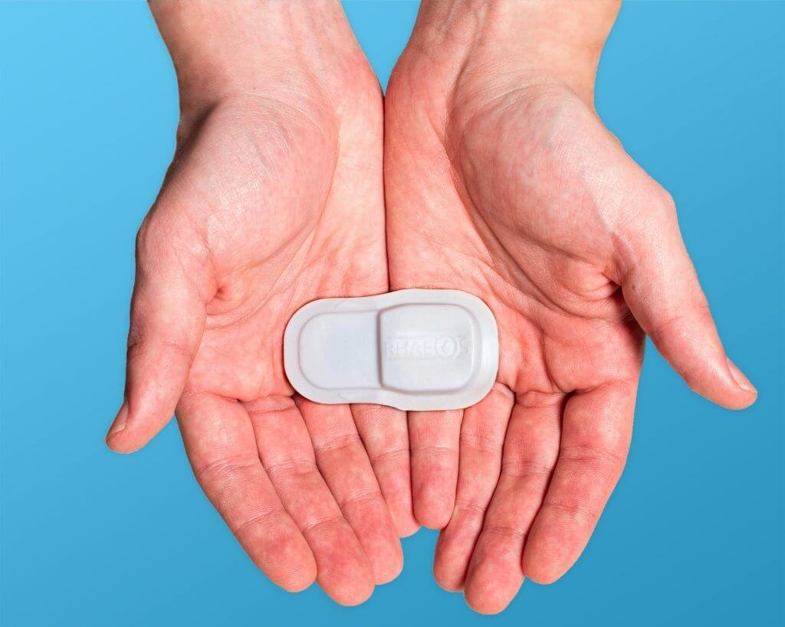
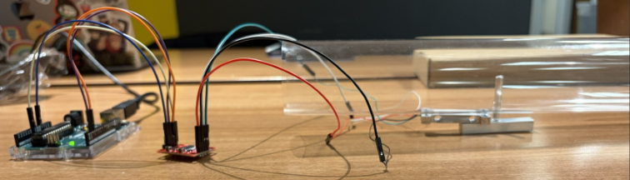
CSFlow: A Novel Device for Monitoring Cerebrospinal Fluid Flow in Shunts
Vidhi Patel¹, Madison Wilhelm¹, Meghan Wilhelm¹, Abdullah Belhadj², Rohan Chandraghatgi², Muhmmad Hozien², Jon Hsieh², Anthony Russo²
Project Advisor: Dr. Rudy Rahme, MD
¹School of Biomedical Engineering, Science, and Health Systems, Drexel University, Philadelphia PA ²Drexel University College of Medicine, Philadelphia PA
Need
Verification/Validation
Design Inputs
Flow Rate Test: Ensure the device can measure the correct flow, in addition to being able to measure flow rates between 0.01 - 0.9 mL/min (0.31 - 28 mL/min)
Results Time Test: Ensure that the device can return results by the target time of less than 10 minutes
Maintained Flow Test: Verify the device's ability to measure continuous flow in a low, medium, and high flow state
Future test 4: Skin Depth Test: Ensure the device works subcutaneously. Out of scope for this level of trial.
Hydrocephalus is the excess accumulation CSF in the brain's ventricles. It is more commonly seen in children and is most often treated with a ventriculoperitoneal (VP) shunt.
However, 30-51% shunts need surgical revisions within 1st year of placement. Currently, there is no accessible method to ensure the shunt is functioning normally.
Constraints
Time: 3 terms, 9 months total
Budget: $600 from Drexel BME + DrExcel
Size: Compatible with 1-1.6 mm catheter
Material: Does not block valve + biocompatible
Requirements
Sensitive between 0.01 mL/min to 0.9 mL/min
Measurement under 10 minutes
Measures flow without added restriction
Must work at skin and tissue depth up to 21mm
Design an implantable monitor to measure CSF flow through VP shunts in hydrocephalus patients to quantitatively assess shunt function and for early detection of shunt failure.
Objective
Prototype
Developed an accurate, implantable monitor which measures CSF flow through VP shunts for early detection of shunt failure, reducing the need for surgical revisions
Physicians can utilize continuous real-time monitoring, low power consumption, and direct mechanical sensing to enable timely recognition of shunt obstruction
The global hydrocephalus market is $456.1 million, and is currently in a high growth phase
30-51% of shunts require surgical revision within the first year of placement, increasing costs for the patients and hospital. The ability to reduce the number of revisions, is not only safer for patients, but also substantially lowers costs for patients and providers.
Conclusion and Impact
Existing Solutions
Macro-scale
proof-of-concept model
ShuntCheck
External single-use device to measure shunt functionality
Utilizes thermal dilution and cannot provide quantitative data
FlowSense
Wireless, wearable shunt monitor to measure flow
Still in production and trials
Product Characteristics
A micro-fabricated hair sensor embedded in shunt tubing to measure CSF flow in real time
Biomimetic approach inspired by how fish 'feel' water movement
Hair cell attached to two sensors, which degree of activation depends on CSF flow
Sensor stretch is translated into resistance, which is converted into flow data
Acknowledgements:
Dr. Rudy Rahme, DrExcel Health, Drexel University School of
Biomedical Engineering
References:
Wendling-Keim DS, Luz H, Kren E, Muensterer O, Lehner M. The long-term outcome of children with VP shunt and hydrocephalus: motor developmental outcome and QOL of patients with hydrocephalus is associated with the number of revisional procedures but is not impacted by the type of the valve. Front Surg. 2025 Jan 27;12:1530041. doi: 10.3389/fsurg.2025.1530041
Zhang, Lansheng, Yingchen Yang, Georgios A. Bertos, Chang Liu, and Huan Hu. 2023. "Bio-Inspired Micromachined Volumetric Flow Sensor with a Big Dynamic Range for Intravenous Systems" Sensors 23, no. 1: 234. https://doi.org/10.3390/s23010234

