Slide 1


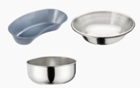
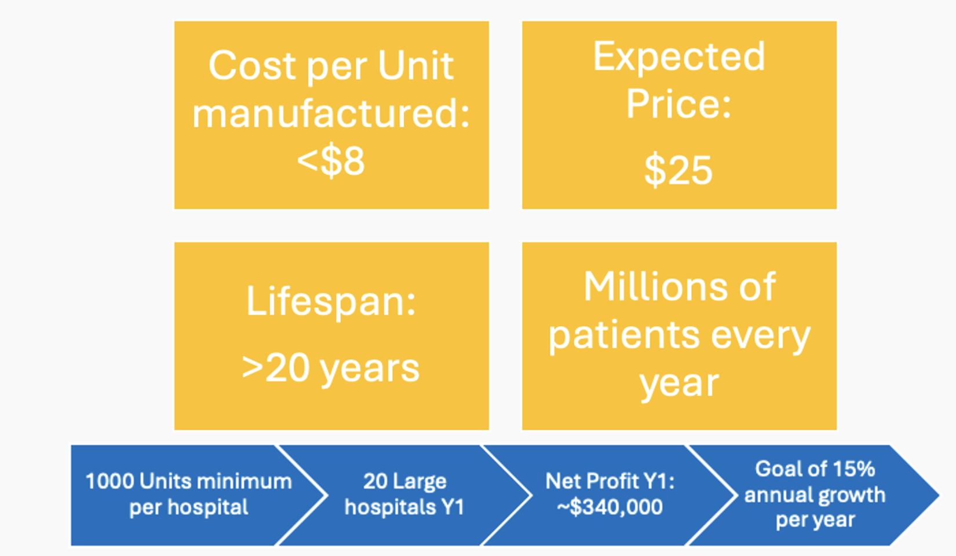
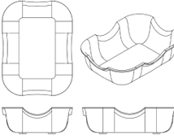
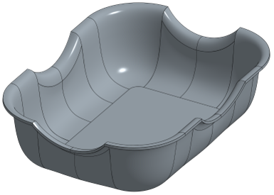
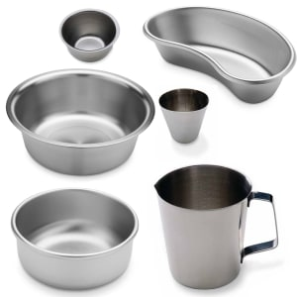
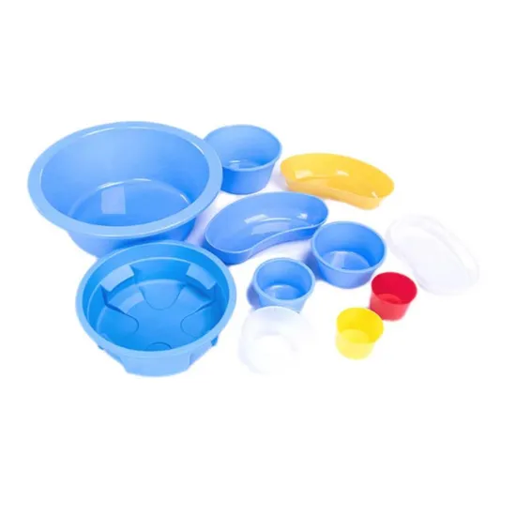
Ergonomic U-Shaped Irrigation Basin
Keyur Patel², Kirvani Buddhiraju², Anika Khandekar², Tanya Lulla², Tal Kibel², JJ Melillo, Dhruv Shevade, Hassan Ahmed, Dr. Amir Behnam³
¹ School of Biomedical Engineering, Science, and Health Systems, Drexel University, Philadelphia PA ² Drexel University College of Medicine, Philadelphia PA, ³Tower Health Medical Group Plastic Surgery, Wyomissing, PA
Need
Hihi
Design Inputs
Verification/Validation
Standard irrigation basins are not designed for limb support
Surgeons rely on improvised methods:
Manual stabilization
        Towels, drapes, additional suction
      Consequences:
        Spillage = Contamination risk
        Unstable positioning = Workflow inefficiency
        A purpose-built solution for extremity irrigation is lacking
Constraints
Manufacturer Consultation: determine maximum recommended fluid volume, depth, stainless grade, and finish of the basin
Ergonomic Pressure Testing: ensure the basin does not cause excessive pressure, discomfort, or tissue risk when limb is rested upon it
Spill Risk Testing: determine whether the basin withstands irrigation forces without slippage or splashing
Sterilization and Durability Testing: determine proper sterilization method and number of sterilization cycles the basin can undergo without signs of degradation
Durable materials
Manufacturable geometry
OR size/ workflow compatibility
Fluid volume limits (no overflow)
Cost vs. disposable basin cost
Requirements
Stable limb support (arm + leg)
Allows joint flexion
Maintains sterile field
Effective fluid containment
Withstands repeated sterilization
Minimizes tissue pressure
Objective
Financial Projections
Plea
Design a reusable, ergonomic irrigation basin that:
Supports limb positioning (bent or straight)
Reduces fluid spillage
Maintains sterile workflow
Minimizes environmental waste
Prototype
Existing Solutions
Standard Basins
The ergonomic irrigation basin is designed to enhance patient limb support and minimize tissue pressure during prolonged procedures. It enables stable yet adjustable positioning with controlled joint flexion and limb manipulation during surgery, while reducing slippage. By improving limb stability, it decreases the need for continuous repositioning and ad hoc stabilization, thereby streamlining operating room workflow and reducing unnecessary use of resources in plastic and reconstructive surgery. Overall, this innovation has the potential to improve surgical efficiency, enhance patient outcomes, and increase surgeon comfort.
Durable, sterilizable
Not designed for limb positioning
Design Feature | Function/ Benefit
U-shaped cutouts | Supports stable limb positioning
Sloped basin floor | Directs fluid, reduces spillage
Stainless steel body | Reusable, durable, sterilizable
Multi-position design | Accommodates arm and leg
Conclusion and Impact
Plastic Limb Basins
Designed for extremities
Small, unstable, disposable
Ergonomic stainless steel irrigation basin with four U-shaped cutouts designed to support extremities while improving fluid control and reducing operative inefficiencies
Acknowledgements:
Amir Behnam M.D., DrExcel Health, Drexel School of Biomedical Engineering

