Slide 1


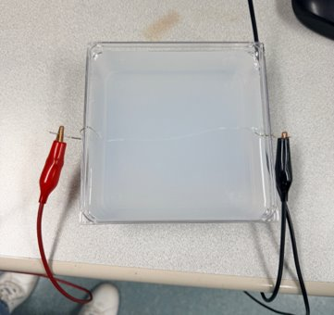
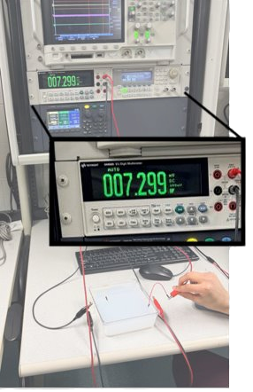
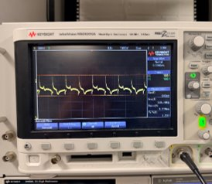
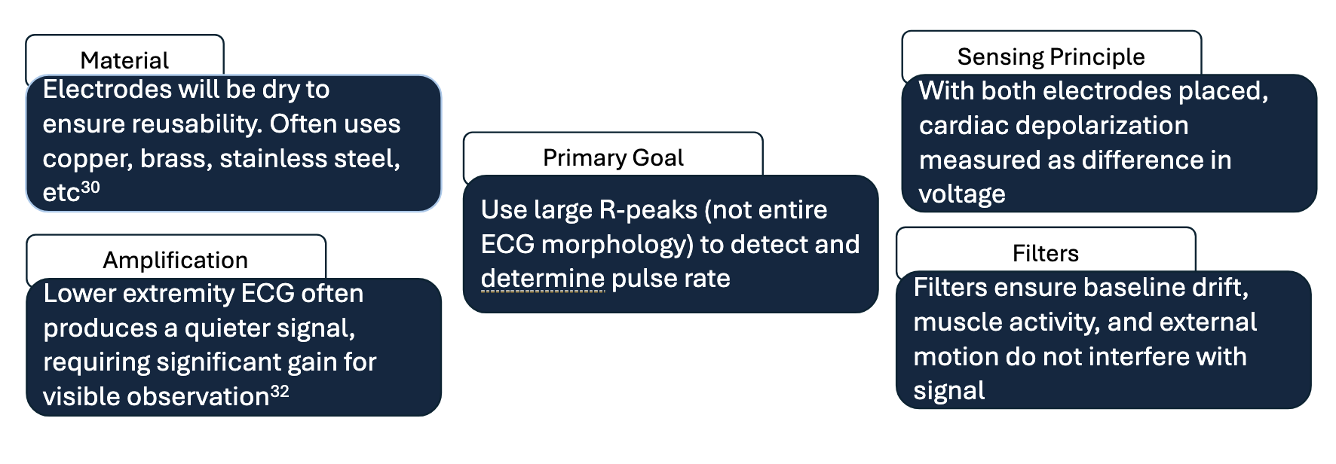
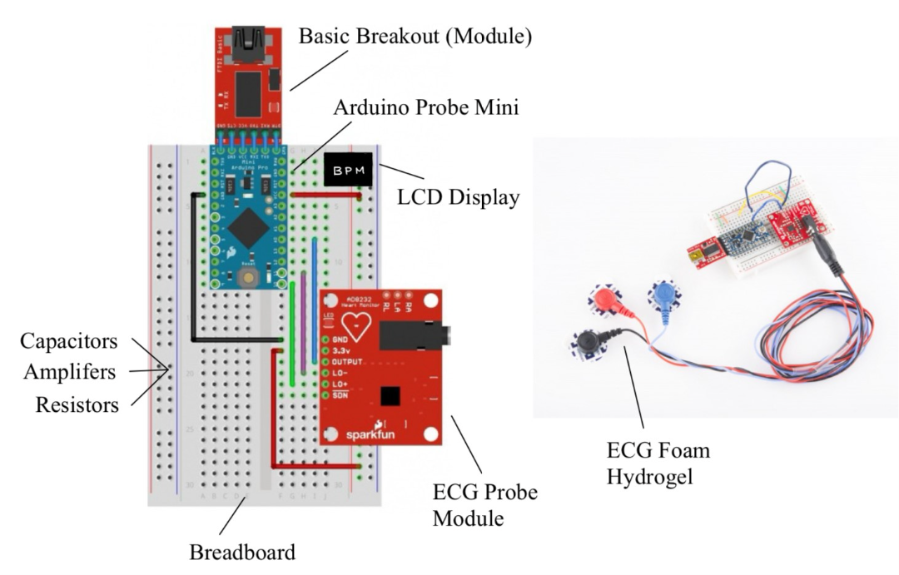
NeoRhythm: A Pediatric Arterial Pen Device For Pulse Detection
Jasmin Jerry¹, Jay Kannan¹, Ajay Santiago¹, Shannon Shih¹, Dr. Adiran Shieh, PhD¹
Shaliny Ambroise², Ruthi Gandhi², Ryan Keithley², Shayla Murray², Sukethram Sivakumar², Dr. Pramath Nath, MD²
¹ School of Biomedical Engineering, Science, and Health Systems, Drexel University, Philadelphia PA² Drexel University College of Medicine, Philadelphia PA
sS
Need
Design Inputs
Verification/Validation
During pediatric cardiac arrest, healthcare providers are restricted to a 10-second window to manually assess pulses at the brachial or femoral arteries; however, manual palpation is notoriously unreliable, especially in high-stress or low-perfusion states. There is an urgent need for an objective, rapid-assessment tool that eliminates the cognitive burden of manual checks and prevents critical delays in the initiation of life-saving chest compressions.
Constraints
Accurate Pulse Detection
Ensures device can correctly detect presence or absence of pulse to determine intervention necessity
Initial Testing: Electrodes on phantom gel surface and record detection of electrical signal at different signal strengths
Accurate Heart Rate Reading
Ensures device can accurately detect pulse rate when an electrical signal is presence
Initial Testing: Electrodes on phantom gel surface record electrical activity and compare to validated ECG machine
Time for Pulse Detection
Ensure device can be applied and detect pulse faster than conventional manual palpation
Initial Testing: Time process of device set up to output of pulse value and compare to value of 10 seconds
All testing is conducted over a multitude of trials to ensure accuracy of measurements and provide reliability data for the device
Time: ~30 weeks max (Fall, Winter, Spring)
Budget: $500 (DrExcel Health)
Regulatory: Comply with FDA Class II Guidelines and waive IRB
Age Range: up to 2 years
Application Site: optimal site other than axial torso region
Size and Weight: 4 x 10 x 5 inches; 2.3 kg
Skin: material contact must be non-irritating, sterilizable
Environment: maintain signal integrity in loud environments
Requirements
Objective
(1) Time Efficient: pulse detection must be completed within 15 s
(2) Accurate Pulse Detection: accurately detect presence or absence of pulse
(3) Accurate HR Reading: measured value should be within range of error
(4) Ergonomic: able to be held easily high stress environment
The NeoRhythm is a handheld, ergonomic single-lead ECG device that provides a binary 'CPR/No CPR' decision and real-time heart rate data within seconds, independent of the patient’s peripheral perfusion status.
d
Prototype
df
Existing Solutions
Existing Solutions | Pros | Cons
Manual Palpation (at radial, femoral, or brachial artery) | Readily available No equipment needed Quick to detect if pulse is strong | Mistake one’s own pulse for neonate’s pulse ~30 seconds to determine pulse False-positives or false negatives common² Provider-dependent Difficult to detect during CPR/movement
Stethoscope (Auscultation) | Familiar, standard-of-care device Fast detection (~7-19 seconds) | External noise masks heart sounds Overestimates heart rates under 60 BPM Causes delays in decision making under stress
ECG Monitor | Detects QRS waveforms for high accuracy Effective in low perfusion conditions | Measures electrical activity, not blood flow so false positives during pulseless electrical activity (PEA) Lead placement slows measurement time Risk of skin damage in infants
Pulse Oximeter | Non-invasive & standard Measures heart rate + oxygen saturation Low risk to the patient | Requires strong perfusion to detect pulse Fails in detection for hypotensive infants 8 Slower signal acquisition (~30-90 seconds) Motion artifact and wet skin reduce accuracy
Doppler Ultrasound | Detects mechanical flow in low perfusion conditions Real-time feedback | Bulky and expensive Requires gel and trained technologist Potential noise and motion interferes with readings
Conclusion and Impact
Our product aims to improve outcomes in a high-stress, emergency situation in regard to pulse assessment in neonates and infants.
More rapid pulse assessment will lead to quicker initiation of CPR, which can help prevent hypoxia-related complications.
Throughout the United States, roughly 16,000 pediatric cardiac arrests occur in children under 2 years old.
Our product will enter a $14.5B emergency medical product spending market, a $2.1B ECG equipment market, and a $160M-$250M neonatal and pediatric electrode market.
Acknowledgements:
This project was created in collaboration with the DrExcel Health Program at the Drexel University College of Medicine under Sling Health and Dr. Pramath Nath of St. Christopher's Hospital for Children.

