Slide 1


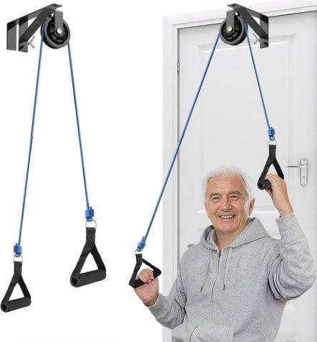
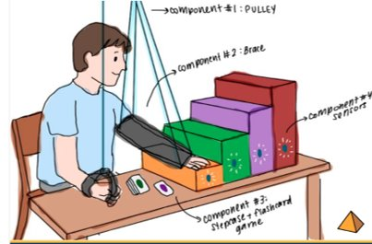
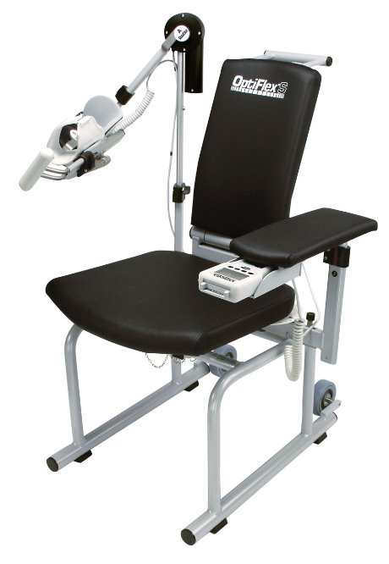
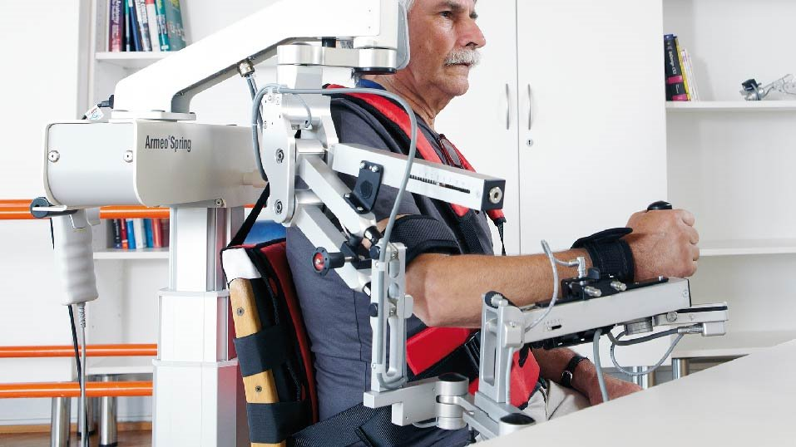
PULSE: Pulley-Based Upper Limb Strength & Elevation
Trevor Tran¹ Isha Gadgil¹, Anvi Brahmbhatt¹, Rahul Rawat¹, Rahma Osman¹, Shanmathee Arya², Shaniya Gohel², Tanha Patel², Tanvi Patel², Kelly Heath³
¹Drexel University College of Medicine, Philadelphia PA ²School of Biomedical Engineering, Science, and Health Systems, Drexel University, Philadelphia PA, ³University of Pennsylvania Perelman School of Medicine
ghjhv
Design Inputs
Need
Verification/Validation
60-80% of stroke survivors experience an acute loss of upper limb function
40% of stroke survivors report chronic upper limb disability
Veterans exhibit an increased risk of stroke
Current upper limb orthotics present challenges of cost, ease of use, and comfort for patients
Constraints
Total System Weight: 5 pound maximum
Anatomical Variability and Hygiene: Accommodates differences in arm length; non-irritating and easy to clean
Time: ~30 weeks max
Policies: FDA Class II device with product code PKS
Budget: $600
Completed Tests:
Test 1 — Therapeutic Angle Accuracy: Using a digital goniometer, staircase steps were verified to provide precise flexion angles ranging from 61.8° to 89.8°, with a percent error of <2%, surpassing the ≤3% required threshold
Test 2 — Bilateral Symmetry: Confirmed 100% accuracy in mirroring displacement between the unaffected and affected limbs, ensuring consistent 1:1 mechanical coupling required for effective bilateral training
Upcoming Validation:
Test 3 — Static Load Safety: Bench-testing to confirm the staircase and structural components can withstand a minimum load of 50 N (~11.2 lbs) without deformation or failure
Test 4 — Data Collection Accuracy: Verifying that the Arduino-integrated system detects and records reach attempts with ≥95% accuracy to provide reliable metrics for clinician tracking
Requirements
Bilateral Assisted Movement: Motion of the unaffected arm produces a 1:1 mirrored displacement of the affected arm
Static Load Safety: Device withstands a minimum static load of 50N
Effective Therapeutic Movement: Restricts motion to 90° of flexion
Target Angle Detection: Tracks if the target angle was reached
Data Storage: Device stores live data during therapy
Objective
Develop a gamified pulley system for shoulder rehabilitation that patients can use from the comfort of their own homes.
Existing Solutions
Prototype
Simple devices like the over door pulley
system:
No targeted assistance for movement
Does not track progress
Hocoma ArmeoSpring ($999/mo) and
Chattanooga Optiflex S Shoulder CPM
($9,750):
Large, expensive, clinic-based system
Transfer to daily activities are limited
At-home pulley-assisted arm lift with a modular multi-level, color coordinated arm support that can be sold directly to patients
Patients will have flashcards with a certain color and will use the pulley to lift the affected arm onto the corresponding color on the arm support for a specified number of repetitions
Sensors on each level will detect successful task completion and light up for instant feedback to the user.
Conclusion and Impact
PULSE enables safe, accurate, and repeatable upper limb rehabilitation through controlled motion, targeted angle feedback, and bilateral symmetry. Its gamified, sensor-integrated design supports engaging, at-home therapy while tracking patient progress. This approach may improve adherence and lead to better long-term functional recovery for stroke survivors.
Financial Market
We are developing a niche device that does not fit neatly into any existing market category and have determined the global rotator cuff injury treatment market is the closest fit. The projected 2026 global market size is 1.24 billion USD, growing at a compound annual growth rate of 4.7%. North America is the largest regional market.
Features that existing solutions lack:​
Gamified design (Arduino board, arcade buttons, digital flashcards, etc.)​
Interactive elements that keep patients engaged ​
Non-mechanical (portability)​
One size fits all (effective and user-friendly)​
Acknowledgements:
Dr. Kelly Heath
Dr. Jaimie Dougherty

