Slide 1


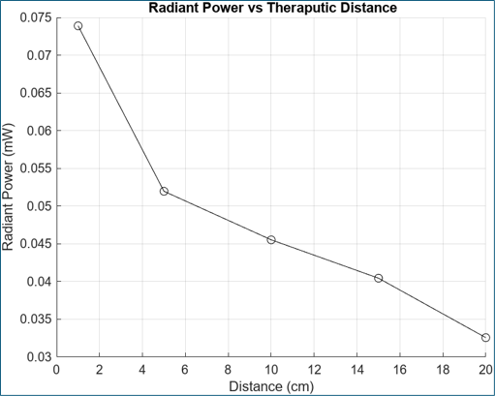
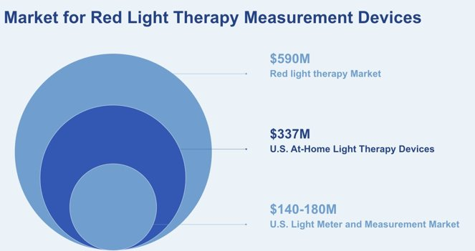
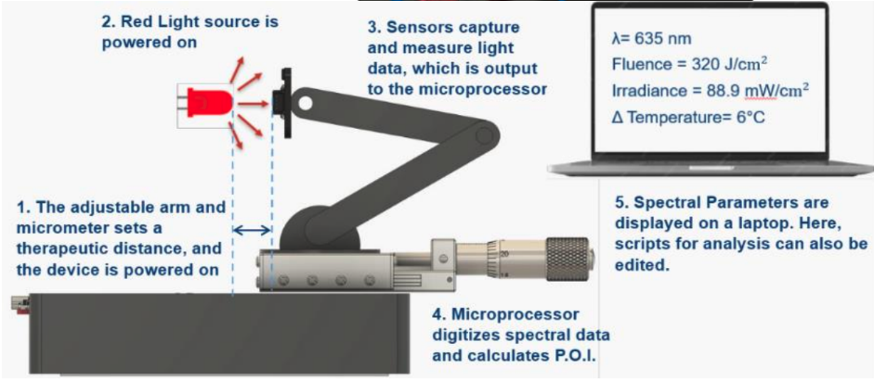
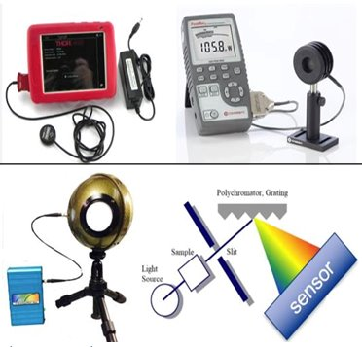
Improving Reliability of Red Light Anti-Aging Therapy
Jeremy Cafritz², Kushal Shah², Mata Stilp², Samantha Efobi², Katherine Landry², Adam Nevrotski¹, Dev Patel¹, John-Luke Cadogan¹, Dr. Erum N. Ilyas, MD, MBE², Dr. Fred Allen, PhD¹
¹ School of Biomedical Engineering, Science, and Health Systems, Drexel University, Philadelphia PA ² Drexel University College of Medicine, Philadelphia PA
Need
Verification/Validation
Design Inputs
Preliminary verification testing results revealed that the measuring device is currently detecting the proper wavelength and light intensity of red light, as well as with other color lights
Additional testing is needed to ensure that the device aligns with results from a spectrometer and power meter
Red Light Therapy (RLT) is emerging as a powerful tool in medicine
  Dermatology: reducing wrinkles, scars, redness, acne, psoriasis, hair loss
  Other: TMJ pain treatment, chronic pain and musculoskeletal disorders
Many products emit incorrect wavelengths, power, or excessive heat, resulting in ineffective treatment or potential skin burns above 40°C
$100-$500 devices with no assurance of efficacy
Lack of standardized data, reducing patient trust and slowing regulatory progress
Constraint | Description
Time | ~13 weeks
Budget | $600 USD
Policy Compliance | All development and testing must comply with Drexel laboratory safety protocols and FDA Class II Low Level Laser/Light system special controls
Fixed Point Measurement | Device must measure one LED at a time at a fixed, controlled distance (mm)
Resources | Equipment and workspace from Drexel Health and Innovation Studio
Distance (cm) | Wavelength (nm) | Response (V) | Radiant Power (mW) | Irradiance (mW/cm^2)
1 | 616 | 0.280786 | 0.073891053 | 1.055586466
5 | 616 | 0.197458 | 0.051962632 | 0.742323308
10 | 616 | 0.172997 | 0.045525526 | 0.650364662
15 | 616 | 0.153669 | 0.040439211 | 0.577703008
20 | 616 | 0.123715 | 0.032556579 | 0.465093985
Requirements
Wavelength accuracy
Radiant power at therapeutic distance
Parameter calculation
Objective
We aim to engineer a SINGLE device that...
Detects
Computes
Market and Financial Projections
  Wavelength (635±10 nm)
  Optical power (0.05-2.55 W)
  Total fluence (≤480 J/cm2)
  Power density (≤88.9 mW/cm2)
  Heat output (Δ6°C)
There is a demand for reliable measurement tools among device manufacturers, as well as third-party standards and certification labs that validate product performance
As RLT continues to grow in popularity, our device is positioned to support the safety, credibility, and long-term expansion of the market
Existing Solutions
Prototype
Multiple devices needed
Positioning difficulties
Fragmented measurements
Expensive and time consuming
Our current prototype cost is $126.25, and we are open to working with investors to determine an appropriate sales markup.
Future Impact:
Establish standards for photo-biomodulation devices
Reduced misinformation, improved marketing and RLT reputation
Clinical Impact:
Reduced rate of skin reactions/injury and increased treatment reliability
Conclusion and Impact
First, our device includes an adjustable arm and micrometer to allow for precise aiming of the sensors towards an individual point
Second, a sensor board composed of both a spectral sensor and photodiode captures optical power and wavelength respectively
Third, a microprocessor digitizes this data and calculates POI, transmitting this data to a computer in real time
Spectrometer for wavelength (Top) and Optical Power Meter for intensity (Bottom)
Acknowledgements:
This project was created through the DrExcel Health Program as part of the National Sling Health Program and was supported by Dr. Erum N. Ilyas, MD, MBE and Dr. Fred Allen, PhD.

