Slide 1
Choosing a Plan When Permanently Working Remote
October 26, 2021

Slide 2
General Overview
I.

Slide 3
Drexel University Health Plans
Drexel University offers four Medical plan options through Independence Blue Cross (IBC)
Plan options include:
Preferred Provider Organization (PPO) High
Preferred Provider Organization (PPO) Basic
Consumer Directed Health Plan (PPO) – CDHP
Keystone/AmeriHealth Point of Service (POS)
PPO vs. POS
Aside from the cost, the largest difference between a PPO and POS is that an employee needs to select a Primary Care Physician (PCP) under the POS plan and use referrals for specialist visits
Under the POS plan, the PCP is then the “gatekeeper” and directs care accordingly to specialists in the network
The PPO offers flexibility and the ability to see specialists as you see fit
CDHP
The CDHP offers the same network of providers as the PPO options
CDHP offers flexibility and the ability to see specialists without referrals
The CDHP can be paired with a Health Savings Account (HSA) that allows members to set aside pre-tax dollars to use for out-of-pocket medical expenses
Drexel University contributes to your HSA each year* ($500 for single coverage; $1,000 for family coverage) *prorated for mid-year enrollments
$3,650 contribution limit for self-only HSAs for 2022
$7,300 contribution limit for family HSAs for 2022
Lower premiums and higher deductibles relative to the POS and PPO options

Slide 4
Drexel University Prescription Benefits
Regardless of which medical plan you are enrolled in, all prescriptions are managed through OptumRX
Enrollment is automatic once you have chosen your medical plan
OptumRx provides prescription benefits nationwide

Slide 5
PPO Plan Summary
With the Personal Choice PPO insurance options, you can choose to see any doctor or visit any hospital in the Personal Choice network
You’ll pay less when you choose doctors and hospitals in the Personal Choice network, and more if you choose to see doctors and hospitals out-of-network
You don’t need to get referrals, so you can see any specialist you want without needing permission from a primary care physician (PCP), or family doctor
You will also enjoy in-network coverage anywhere in the United States when you use providers who participate in the national BlueCard® PPO network
An Independence Blue Cross Personal Choice PPO health plan may be the best option for you and your family if:
You want health coverage for both in-network and out-of-network providers
You would like in-network coverage across the country through BlueCard PPO (i.e. best for those who work remote outside of the POS service area)
You want the flexibility to pay less for medical costs when you choose in-network providers
You would like access to one of the largest networks of providers in the Philadelphia region
You want the freedom to see doctors and other health care specialists without a referral from a primary care physician

Slide 6
Point of Service Plan Summary
Drexel offers two Point of Service (POS) options to employees who live in or around the Greater Philadelphia area
Keystone
AmeriHealth
Home zip codes will determine your eligibility in either the Keystone or the AmeriHealth POS plan
You will see your benefit options in the enrollment system based on your zip code, so if where you live is not listed, you will only have access to the PPO plans. Be sure that your address is current and up to date!
Both POS plans require participants to designate a Primary Care Physician (PCP) for yourself and covered dependents
The PCP manages your care and provides referrals if you need to visit a Specialist
If you need to change providers mid-year, please call 1800-ASK-BLUE to update your Primary Care Physician. You can also create an account at www.ibx.com to make changes throughout the year

Slide 7
Point of Service Plan Summary
Benefits under the AmeriHealth POS mirror the Keystone POS
Difference is the network providers you will have access to based on where you reside
If you are enrolled in a Point of Service plan, but are covering dependents in areas of the country outside of the Greater Philadelphia area, you should be aware that the Keystone/AmeriHealth Point of Service plan will have limited out of network availability and may not fit your needs.
If you travel, note that under the POS plan you will have access to emergency only coverage while outside of the area

Slide 8
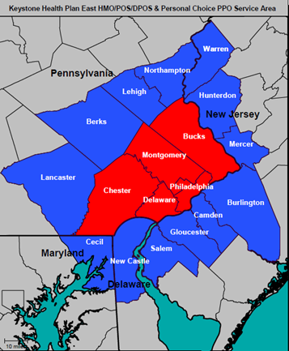
Keystone Point of Service Plan
Drexel’s Point of Service plans are zip code driven and only available to certain counties in or around the Greater Philadelphia area
The Keystone POS service area includes the Greater Philadelphia five counties of Philadelphia, Montgomery, Bucks, Chester, and Delaware
The Keystone POS service area also includes the respective contiguous counties that border the five counties. Those contiguous counties are: Warren, Northampton, Lehigh, Berks, Hunterdon, Lancaster, Mercer, Burlington, Camden, Gloucester, Salem, New Castle, and Cecil

Slide 9
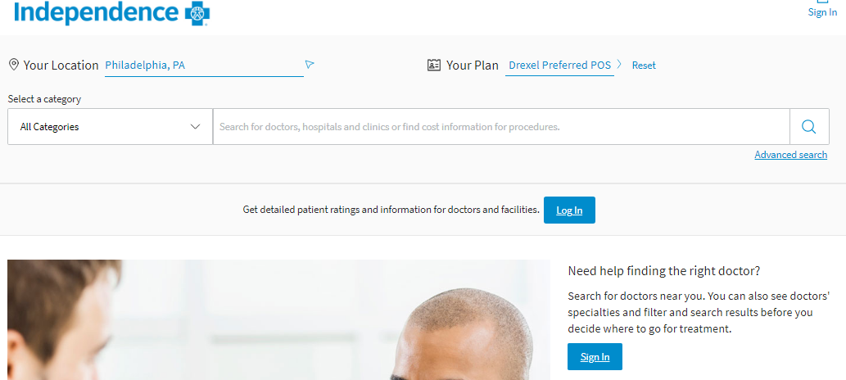
Keystone Point of Service Plan
Those enrolled in the Keystone POS will receive an Independence Blue Cross ID Card
Enrollment in the Keystone Point of Service Plan can be elected within the enrollment system
Your prescription drug coverage will still be the same formulary through Optum RX
How to Find a Provider:
https://www.ibx.com/
Find a Doctor (top right hand corner)
Click Learn More under Doctors, hospitals, medical equipment, and specialty services…
Click All Plans under Your Plan:
Company Specific Networks
Drexel Preferred POS (for those enrolled in the Keystone POS plan)

Slide 10
AmeriHealth Point of Service Plan
If members live in a noncontiguous county and enroll in the POS plan, those members will be covered by the AmeriHealth POS plan
The following states/counties would be eligible for the AmeriHealth POS plan:
New Jersey: Atlantic, Bergen, Cape May, Cumberland, Essex, Hudson, Middlesex, Monmouth, Morris, Ocean, Passaic, Somerset, Sussex, Union
Delaware: Kent; Sussex
Maryland: Caroline, Harford, Kent, Wicomico, Worcester
Benefit options in the enrollment system will be based on zip code, so if where you live is not listed, you will only have access to the PPO plans (Basic, High and CDHP). Be sure that your address is current and up to date!

Slide 11
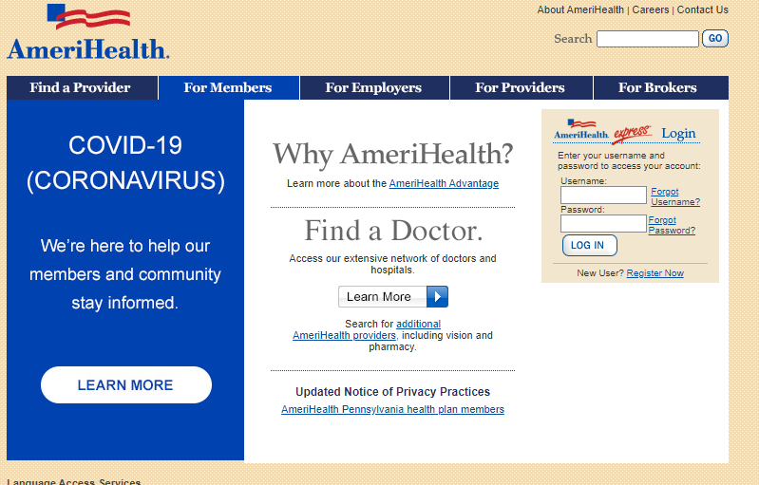
AmeriHealth Point of Service Plan
Those enrolled in the AmeriHealth Point of Service plan will receive an AmeriHealth ID card (different than IBC)
Enrollment in the AmeriHealth Point of Service Plan can be elected within the enrollment system
Your prescription drug coverage will still be the same formulary through Optum RX
How to Find a Provider:
https://www.amerihealth.com/index.jsp
Find a Doctor (middle of the page)
Click “Learn More” under Doctors, hospitals, medical equipment, and specialty services…
Click All Plans under Your Plan:
Company Specific Networks
Drexel Preferred POS

Slide 12
Relocation Outside Point of Service Area
What happens if I move to a location outside the Point of Service Geographic Region?
Benefit Express will be notified of your address change and will open an enrollment window allowing you 31 days to take action
An email notification will be sent to your Drexel account on file
You will be required to elect a new medical plan, or waive participation
Be sure to review the plan comparison charts and the rate sheets to ensure that you are making the best decision for you and your family (if applicable)
If no choice is made within in the 31 day enrollment window, you will be auto enrolled into Personal Choice PPO Basic at the employee only level, with payroll deduction applied to the next pay

Slide 13
Relocation Outside Point of Service Area
What plans may be right for those who reside outside of the Greater Philadelphia region?
The Personal Choice PPO Basic, High and Consumer Directed Health Plans all have access to in-network coverage anywhere in the United States for providers who participate in the BlueCard PPO Network
Who do I contact about my address change?
Employee’s can update their home address and/or telephone number, tax work location address, and work location phone number via DrexelOne. For more information on how to update your address, please visit: https://drexel.edu/hr/management/staffing/empinfochanges.
For questions on how to update your benefits once your new address has been processed, please contact the Drexel University Benefit Service Center at 1.844.690.3992

Slide 15
THANK YOU
Questions? Comments?
Senior Sales Leader
Senior Vice President
P: 267-702-1476
C: 609-410-2888
jackerman@connerstrong.com

