Slide 1
Globally Empowering Women Through Media
－－Team: Lei Guo, Lindsay Strott, Danni Yang, Brenda Turner

Slide 2
The 10 Biggest Issues for Women Around the World

Slide 3
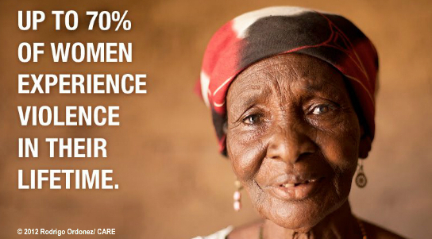
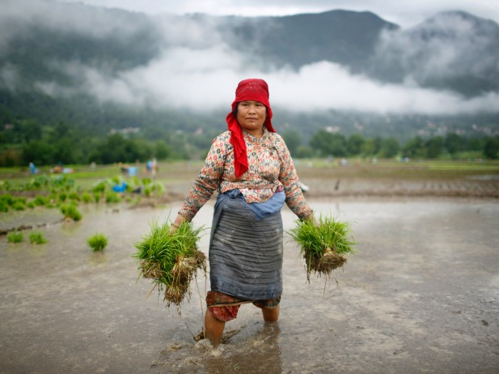
Violence
Infanticide/Feticide
Feminization
of Poverty

Slide 4
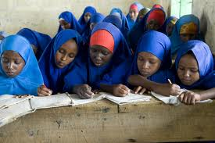
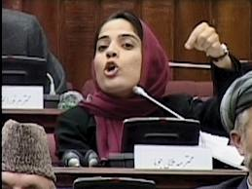
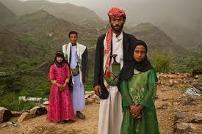
Access to Education
Political Participation
Freedom to
Marry
or
Divorce

Slide 5
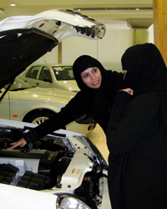
Health Care Access
Restricted Land Ownership
Limited Mobility
Professional Obstacles

Slide 6
Importance of Radio in Afghanistan
As a country with 28% Adult literacy rate, the female literacy rate is only 14%
Barely 4% of the population has electricity, and television and telephones are rare outside a handful of cities.
Most Afghans do have access to radio receivers and are accustomed to using them as a source of news, information, education and entertainment.

Slide 7
Radio Sahar
Means “Radio Dawn" in English
Began broadcasting live in October 2003
Today, the voices of Radio Sahar's female journalists are regularly transmitted across the airwaves. Brave and outspoken women can be heard discussing issues concerning women's rights and conditions, as well as reporting on the daily challenges that women continue to face in Afghanistan.

Slide 8
Afghan Woman’s Hour
Broadcast from 2005-2010, the weekly radio show highlighted the role of women in Afghan society.
Segments looked issues including inequality in the home, regional cooking, female role models in politics and business, drama and real life stories
Research by BBC Media Action found 55% of women surveyed had listened to the show and 39% of listeners were men
91% of listeners agreed that the program helped them solve problems and 83% agreed that the program inspired them to endeavor to change their own situation
65% of female listeners agreed that they often would talk about things they heard on the show with friends and family.

Slide 9
Cable in India
In 1991, the Indian government started a series of economic reforms including the liberalization of the broadcasting industry, opening it up to cable television.
The most popular cable programming features urban settings where lifestyles differ in prominent and salient ways from those in rural areas. They have had large effects on a wide range of day-to-day lifestyle behaviors

Slide 10
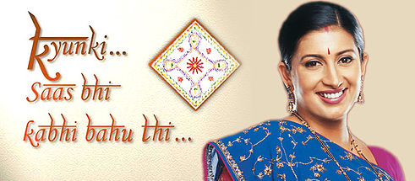
How did cable television change women’s status in rural India?
Kyunki Saas Bhi Kabhi Bahu Thi (Because a mother-in-law was once a daughter-in-law, too) is one of the most popular soap operas based around the life of a middle-class woman who marries into a rich family and becomes the ideal wife, daughter-in-law, mother, mother-in-law, grandmother and grandmother-in-law, solving all the intricate problems within the family and never deterring from the path of righteousness.
Effects of cable television programming
Cable programming featuring educational and independent women performing actively in authority positions adds to the preference of daughters. Evidences shows a 12% decrease in the preference for the next child to be a boy.
There is a 10% decrease in wife beating situations.

Slide 11
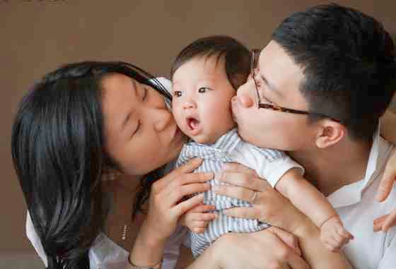
One Child Policy in China
The one-child policy, officially the family planning policy, is the population control policy of the People's Republic of China. This policy was introduced in 1979 to alleviate social, economic, and environmental problems in China.
The policy is controversial both within and outside China because of the manner in which the policy has been implemented, and because of concerns about negative social consequences.

Slide 12
Forced Abortion of Jianmei Feng
6/2/2012
Ms. Feng who was seven months pregnant with her second child and
was forced by the local government to abort
10 days
6/11/2012
Feng’s husband launched Sina Weibo，
China’s most popular social media, to expose the case
3 days
6/12/2012
Major websites reported this news.
Numerous Internet users criticized the local government’s behavior
6/14/2012
The municipal government apologized and
promised a thorough investigation.

Slide 13
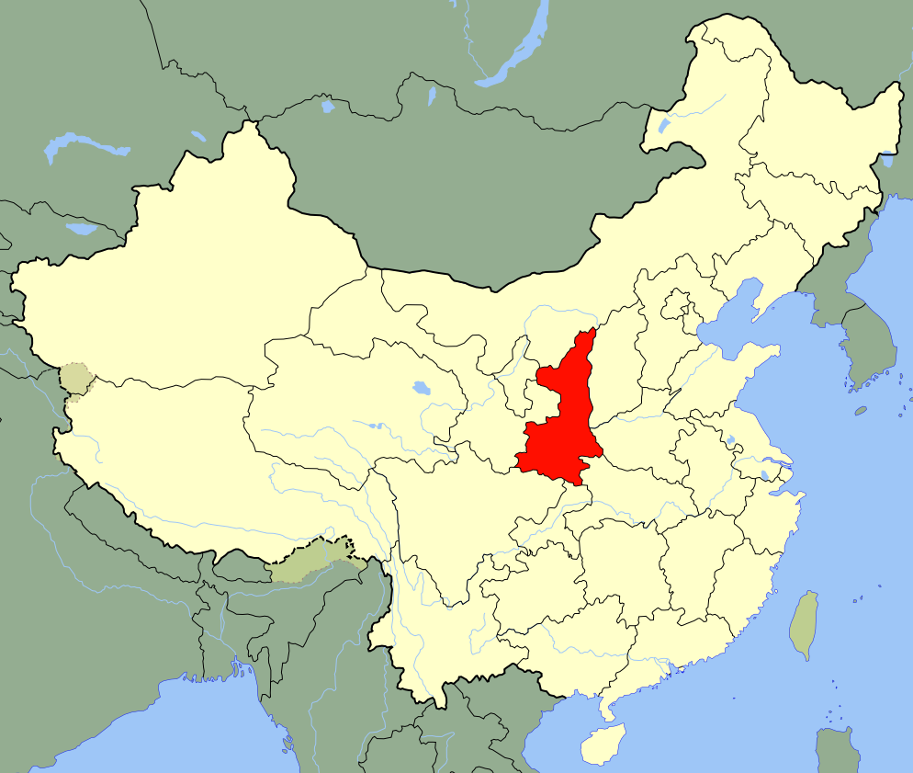
How does Social Media work for women?
User-generated media like social media, gave Ms. Feng and her supporters an outlet for expression that is equal to the government’s.
Media can speak for people who cannot speak for themselves, and it mobilizes people have become aware of the issues.
Shan Xi

Slide 14
Using a Video Game to Combat Gender Violence
http://www.youtube.com/watch?v=e_jD7mGxu1Y

Slide 15
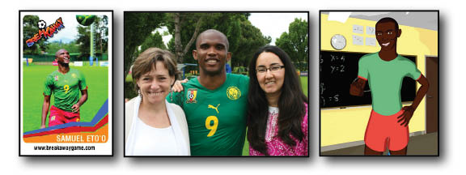
Created by the Population Media Center, the Emergent Media Center at Champlain College and the United Nations Fund for Population Awareness.
Currently being tested in South America and Africa with boys 10-12 years old.
Presents itself as a soccer-based action game. Players are eased into the story and begin learning basic soccer skills and familiarizing themselves with the other story characters.
Spokes person is world-famous football star Samuel Eto’o, team captain of Cameroon’s national team

Slide 16
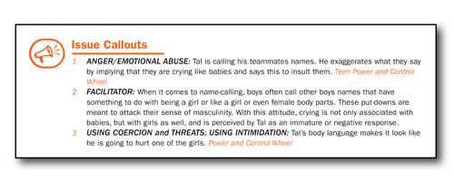
Throughout the gaming experience, BREAKAWAY players encounter critical decisions and consequences regarding gender stereotypes.
BREAKAWAY balances immersive narrative game-play with messages that denounce violence against women and girls, while players develop a sense of team membership. Reflective narrative is reinforced throughout skill-based football play.
This strategy is based on the Sabido methodology that utilizes narrative and role modeling to encourage behavior change.

Slide 17
Breakaway Summer Camp
El Salvador 2013

Slide 18
Tell the whole story of women
Don’t see women as just housewives.

Slide 19
Tell the whole story of women
Don’t just highlight their bodies.
2014 January VOGUE BRAZIL
2014 March MAXIM THAILAND

Slide 20
Give women an equal voice.
In the developing world, nearly 25% fewer girls and women are online than boys and men – closing this gap will change their futures.
Discrimination, lack of confidence, and lack of basic language skills all affect teenage girls’ access to media through the Internet.

Slide 21
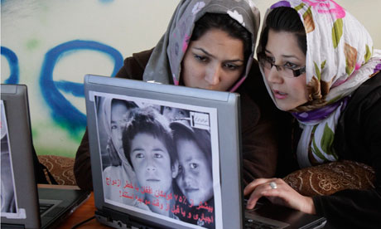
Media is the future of women.
We need to make a difference today!

Slide 22
Thank you for listening!

