Slide 1
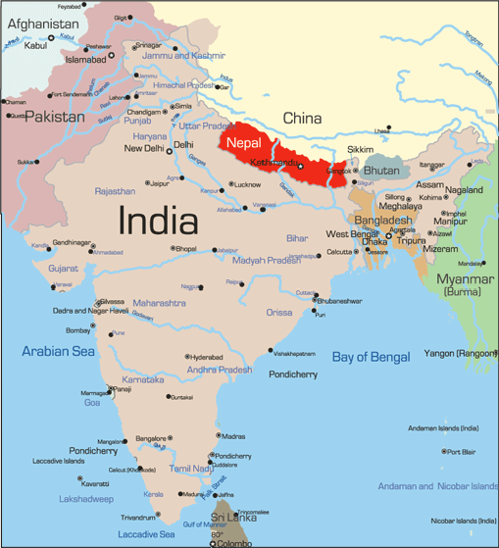
Uncovering gendered social norms: Findings from a field visit to Parsa, Nepal
Carmen Cronin
2nd year masters student
Department of Community health & Prevention
School of public health

Slide 2
Project Overview
Behavior and Social Change
1000 Golden Days
Violence Against Children
Open Defecation Free
Goal: to improve the health and well-being of women and children
My role: developing the participatory behavioral monitoring plan (to track behavior change)

Slide 3
Field Visit
Where: Parsa, Nepal
Objective: to test the feasibility of various behavioral monitoring activities
Activities:
Activity maps
Spatial mapping/Mobility lists
Social network mapping

Slide 4
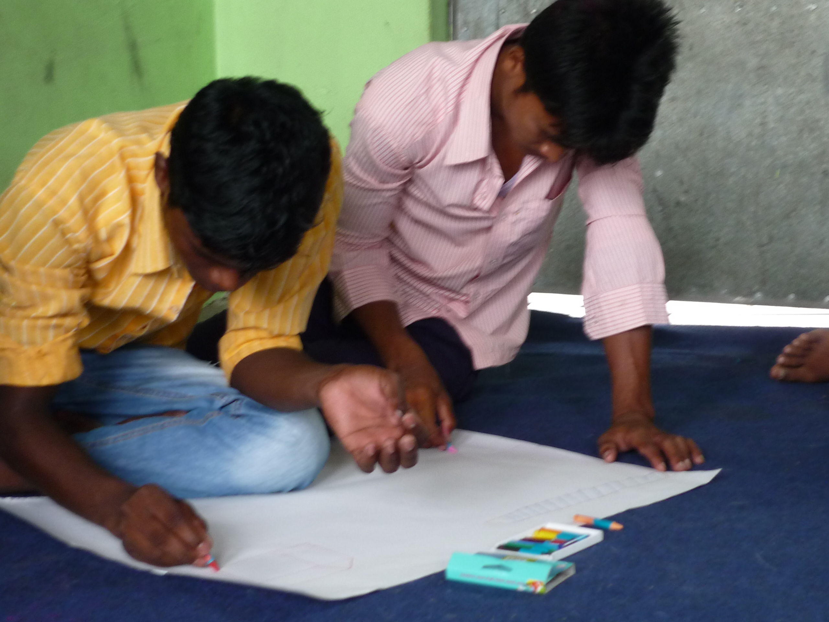
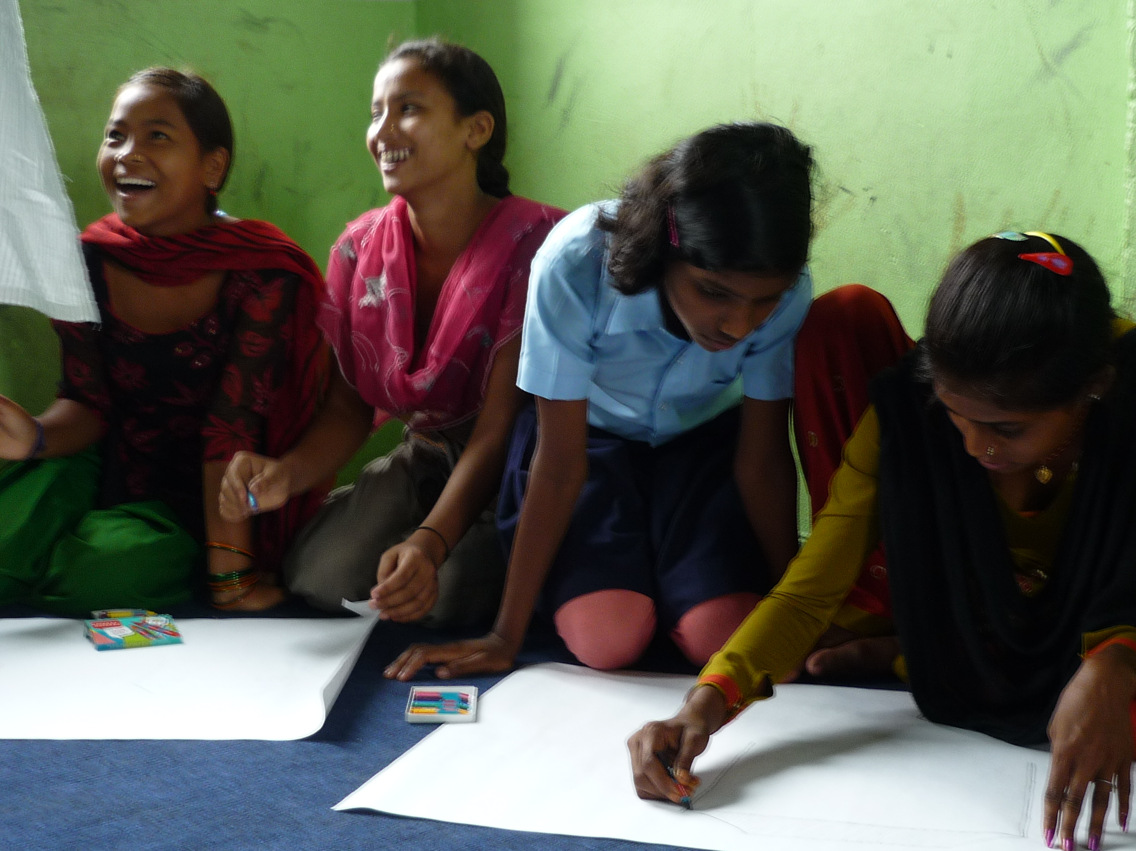
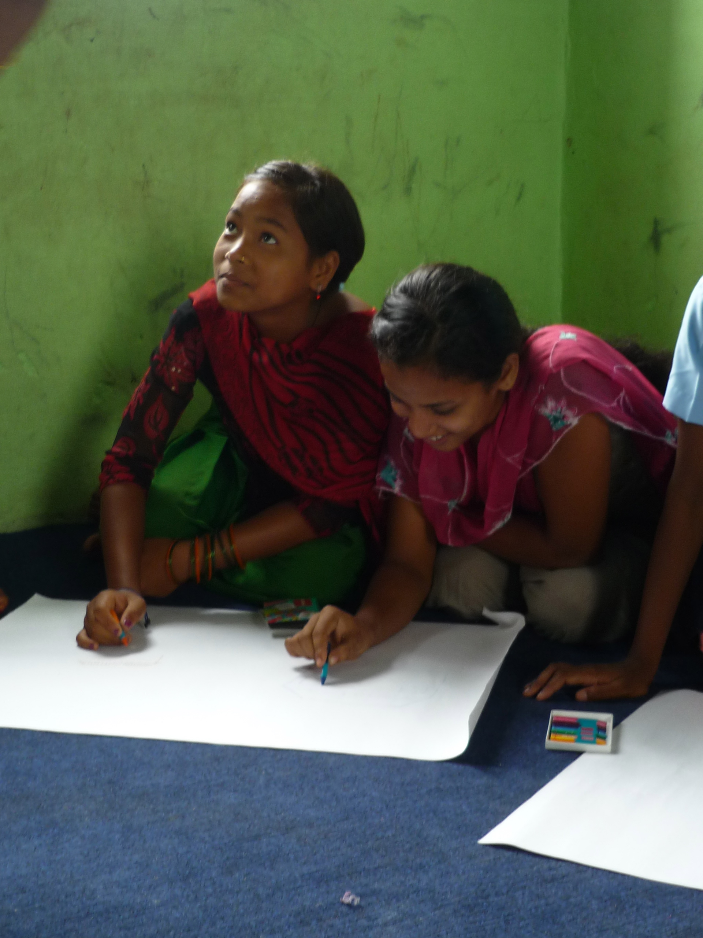
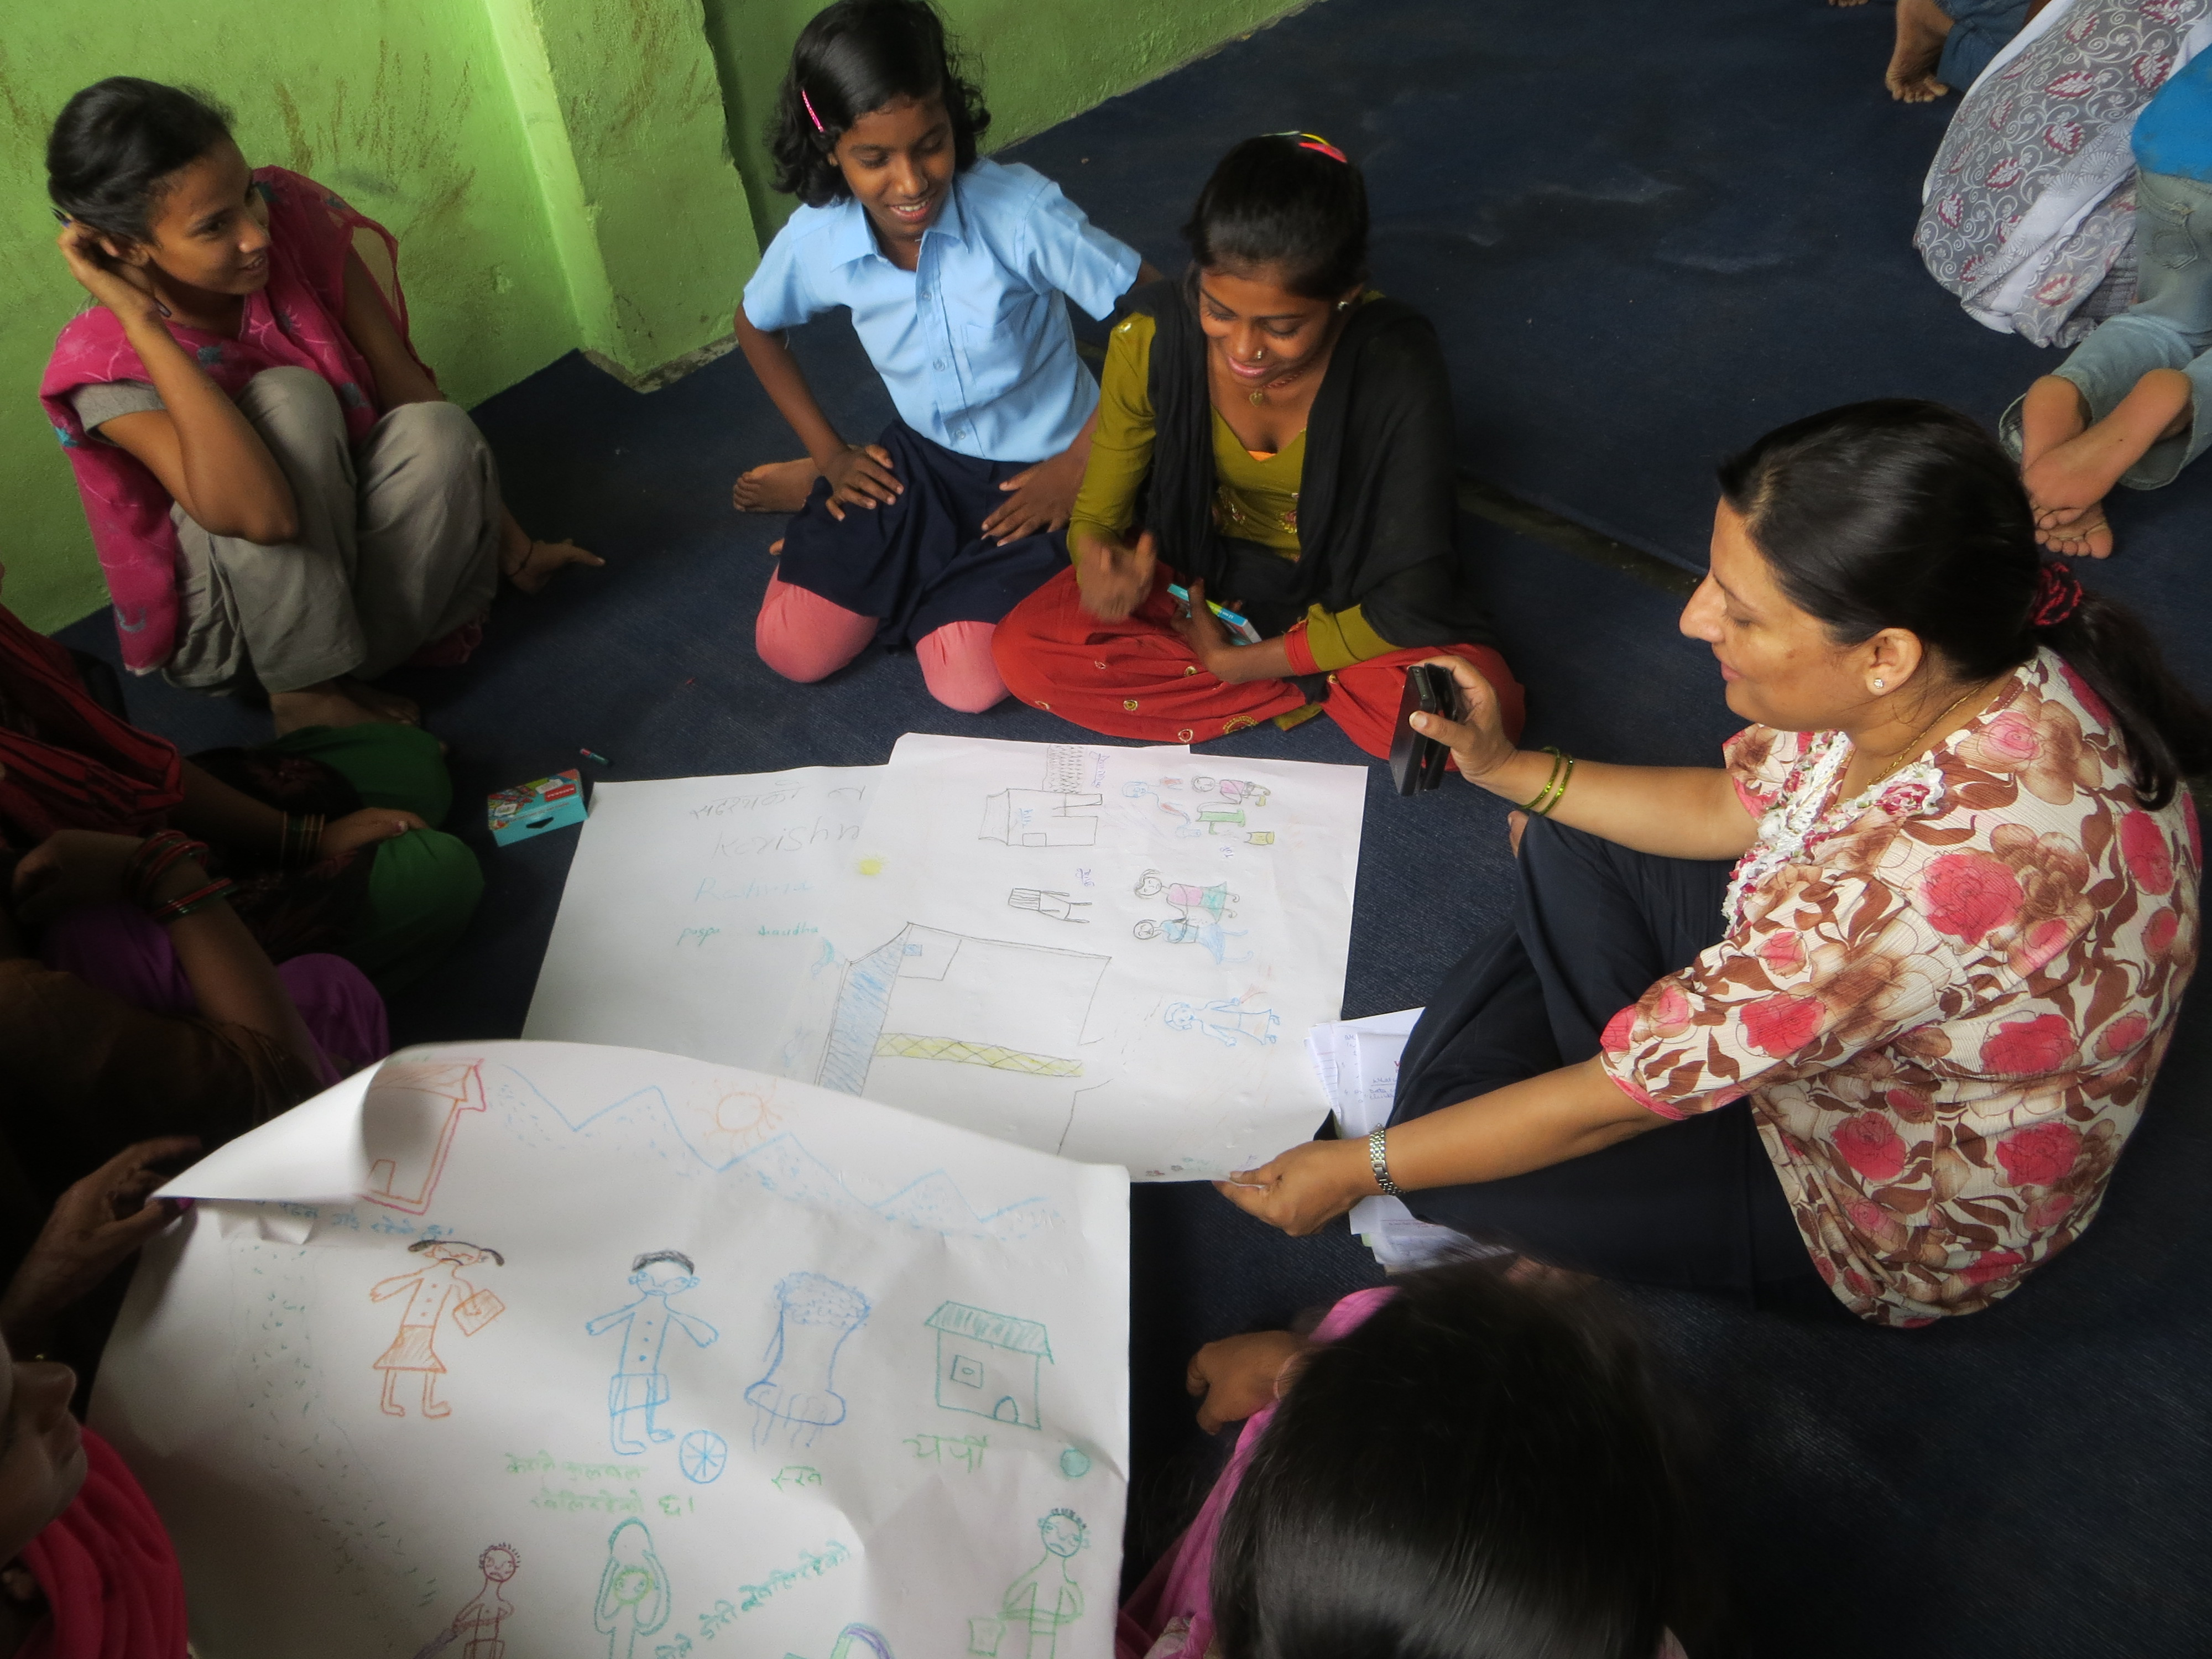
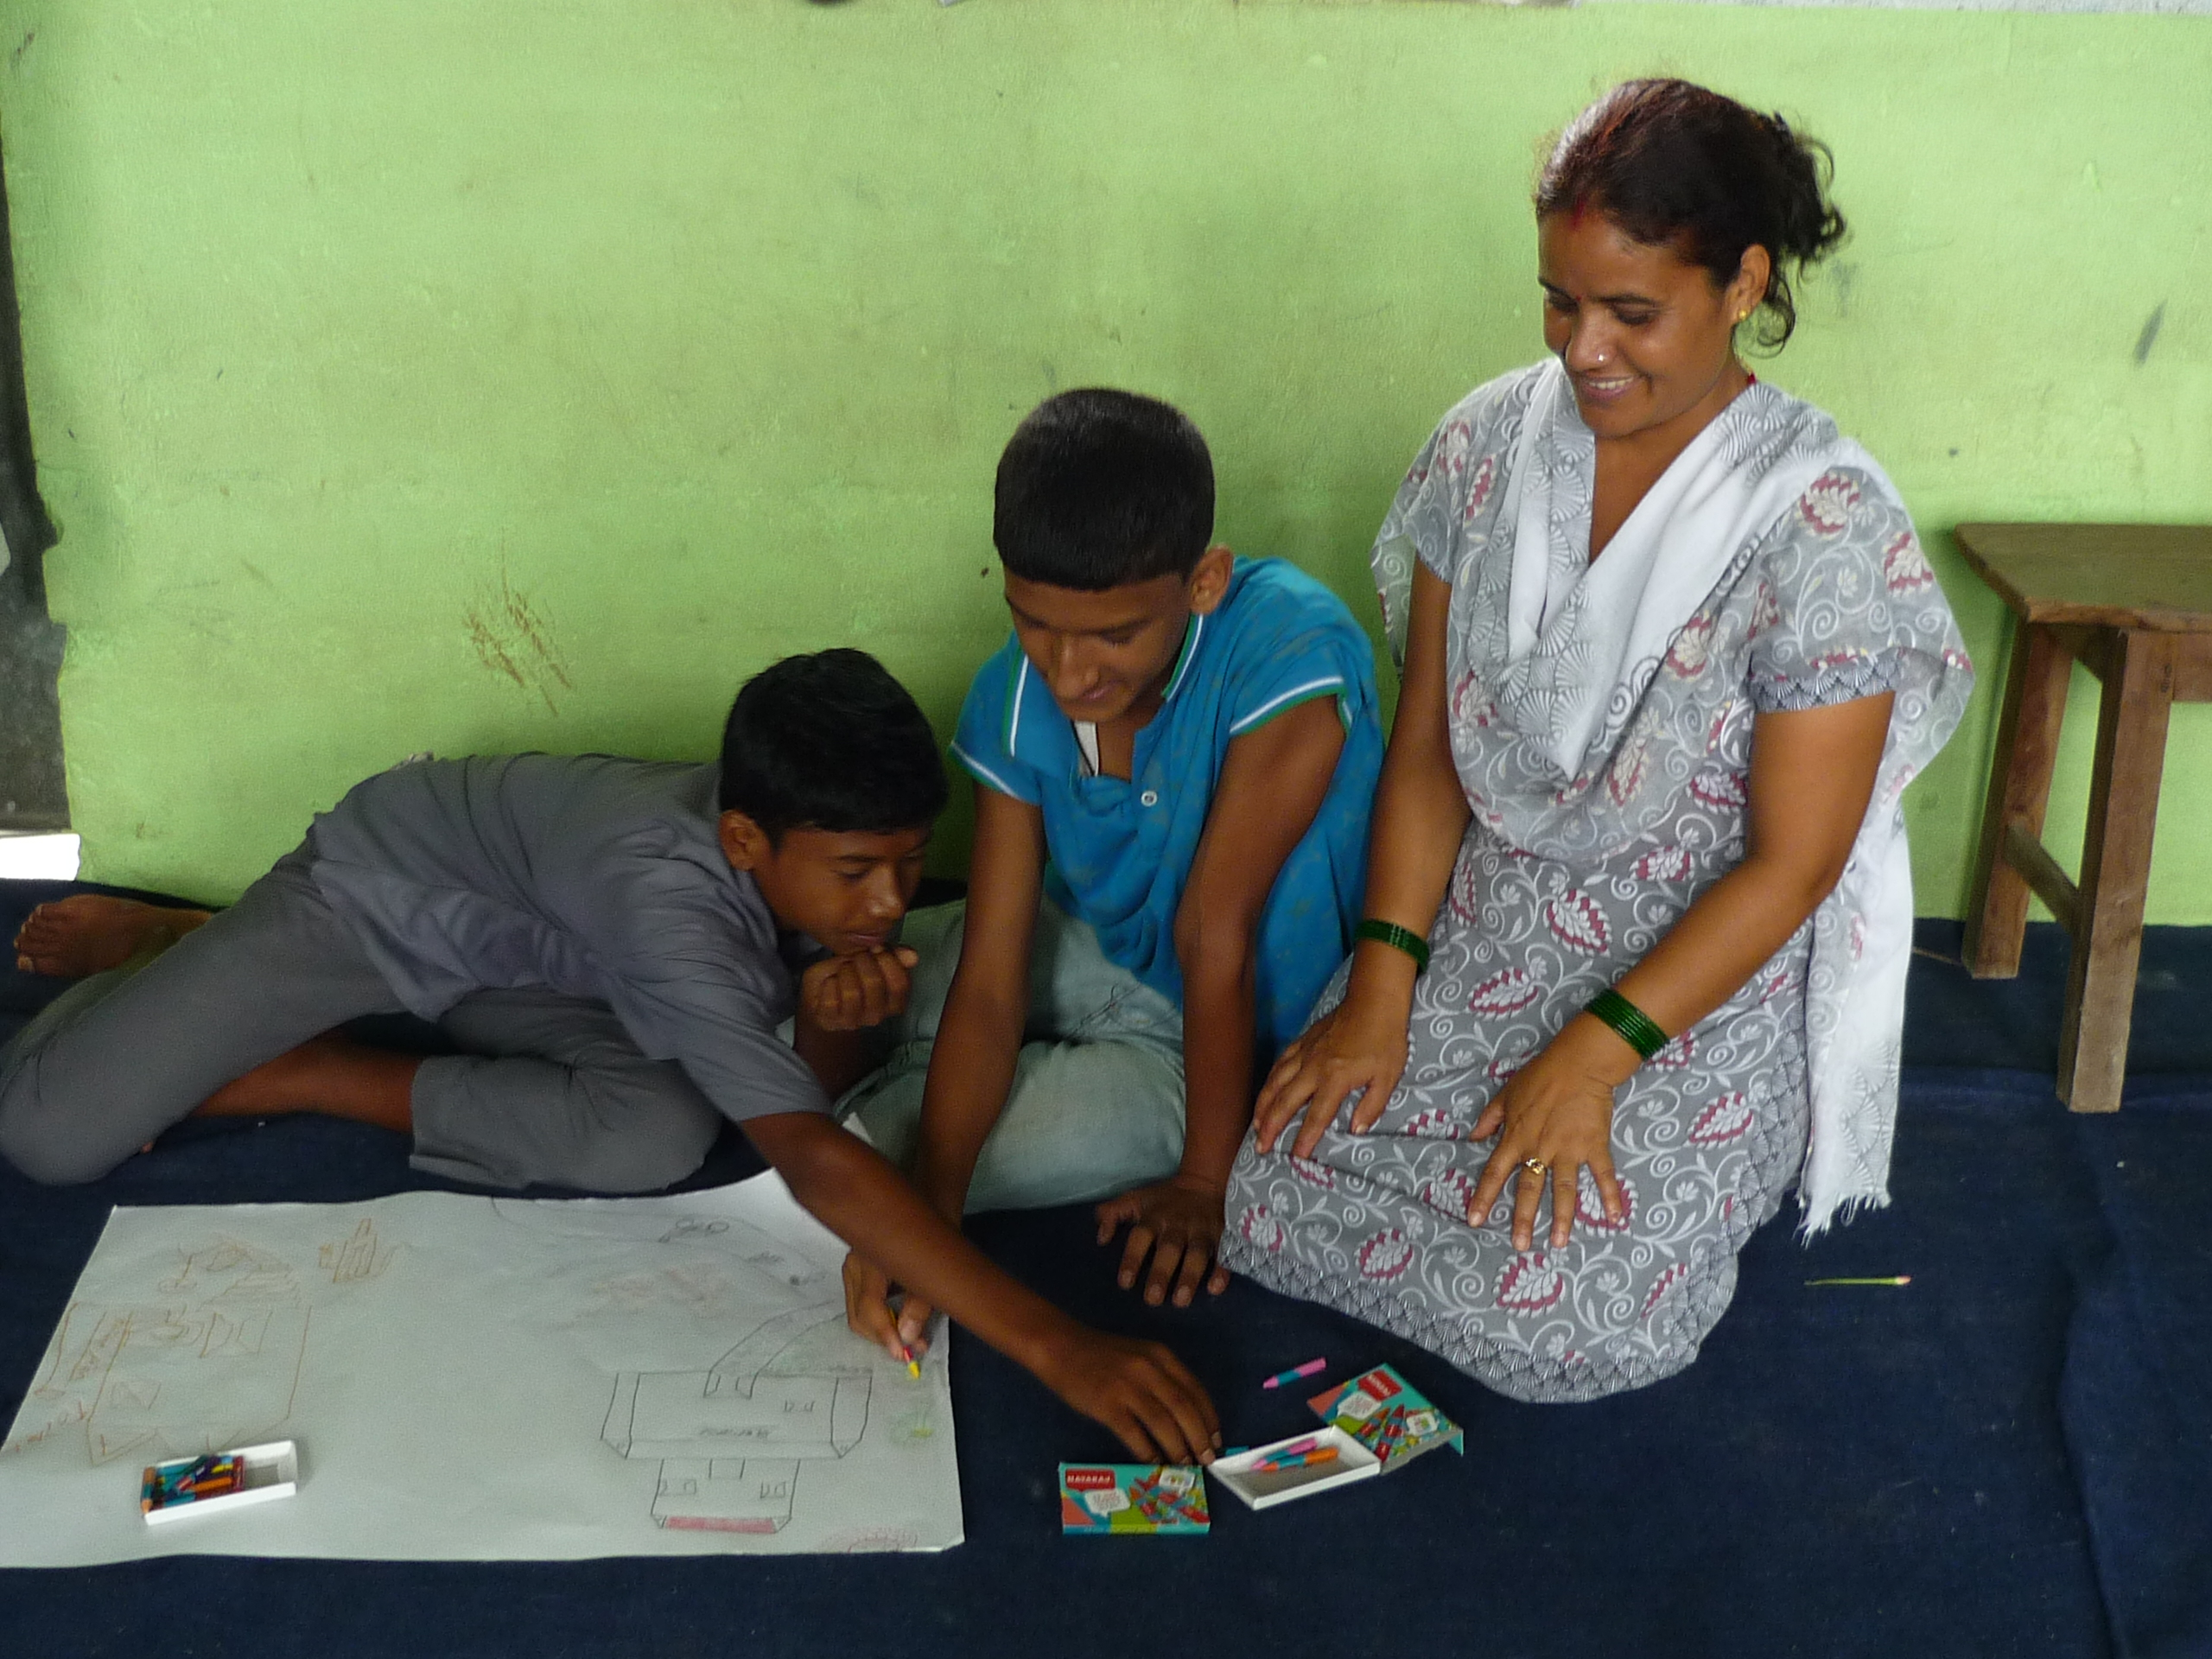
Child Clubs “Activity Maps”

Slide 5
By: Dinesh, Jumar and Mahato

Slide 6
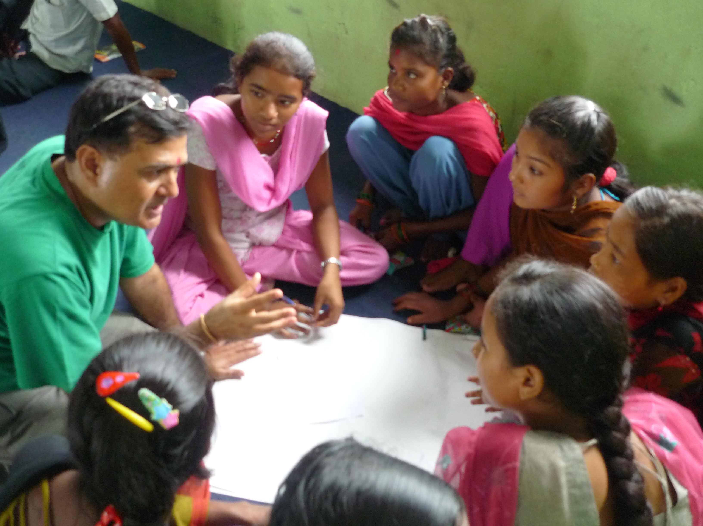
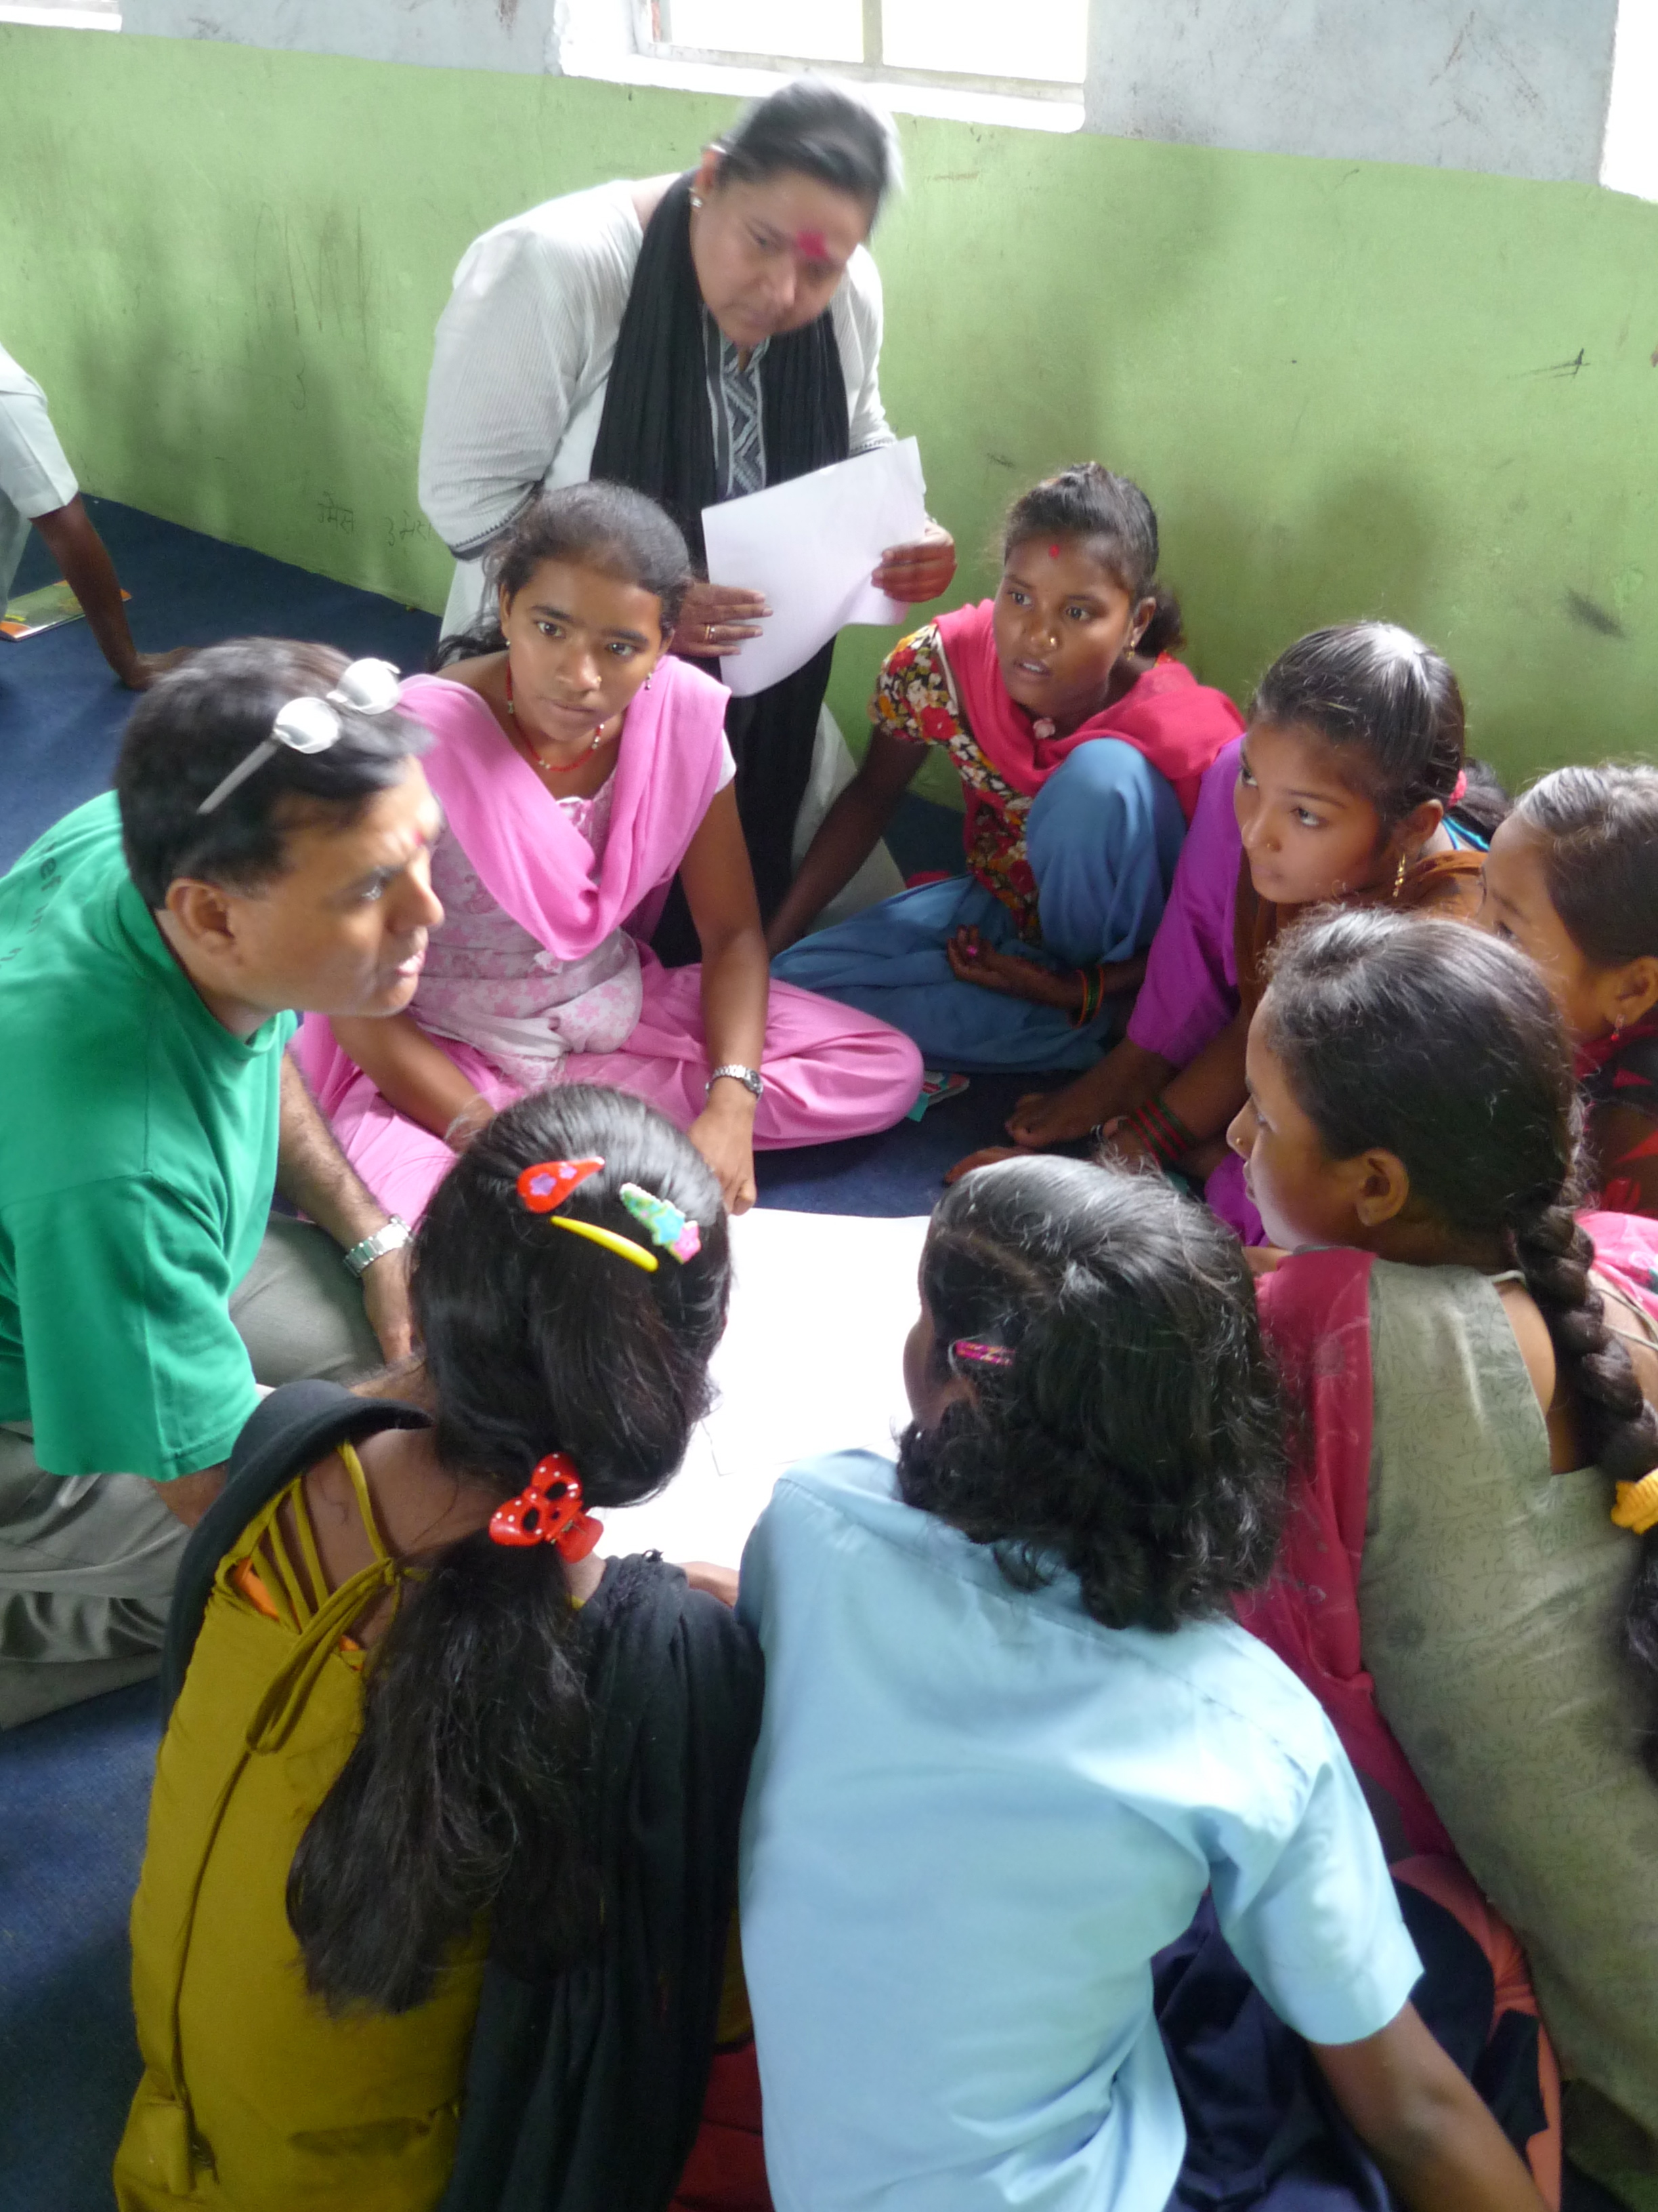
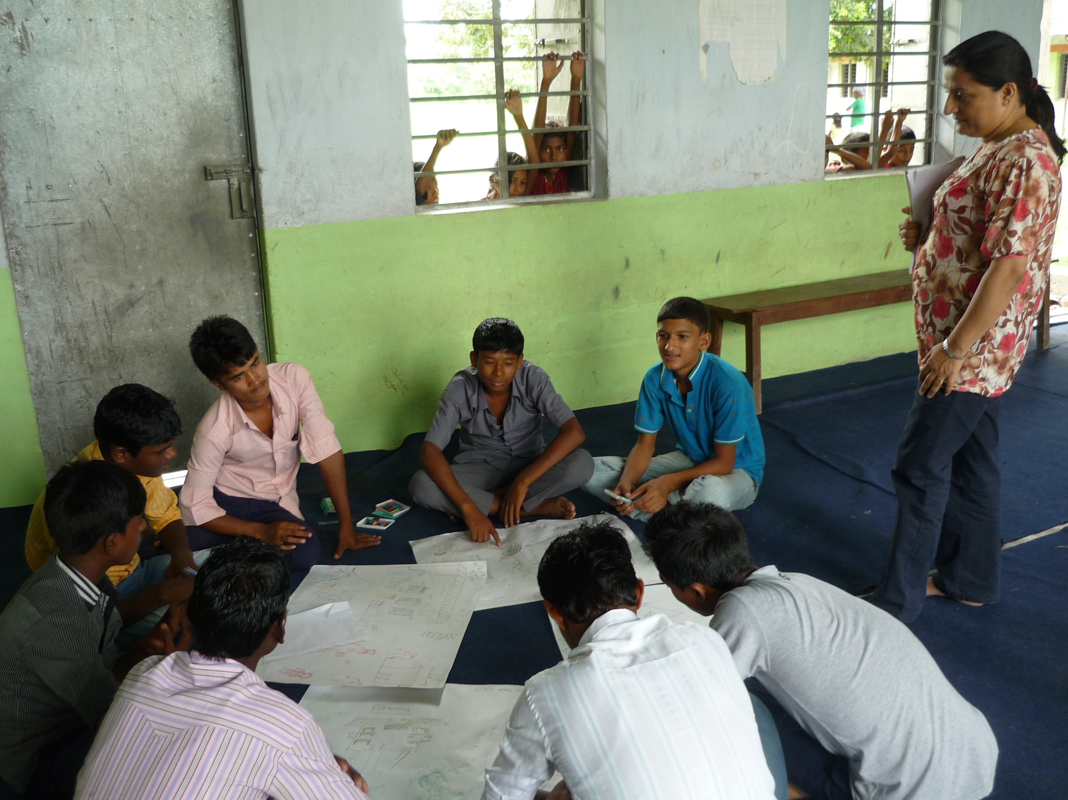
Child Clubs “Mobility Lists”

Slide 7
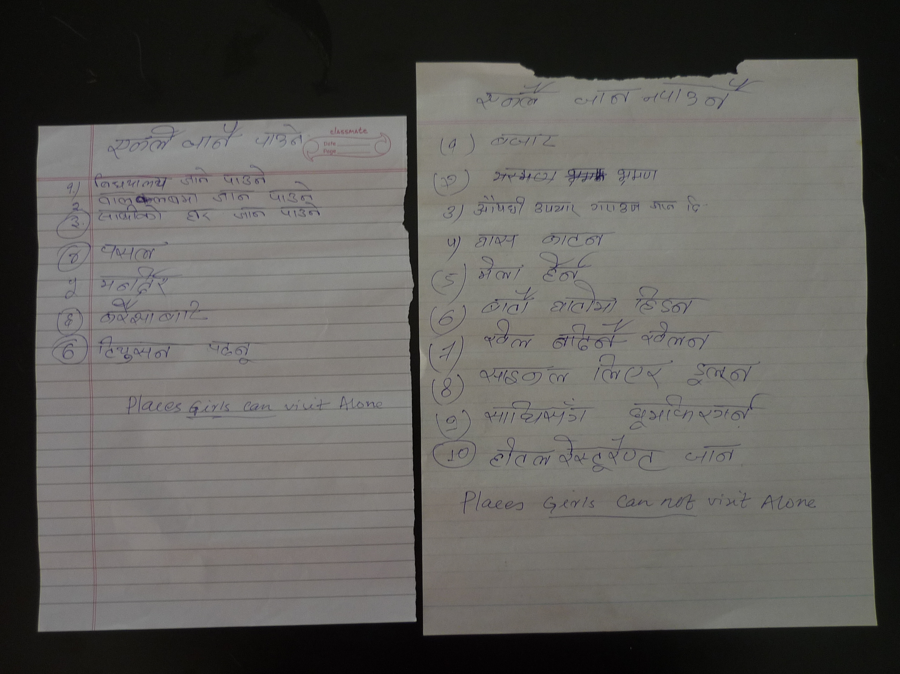
Mobility Lists: Girls

Slide 8
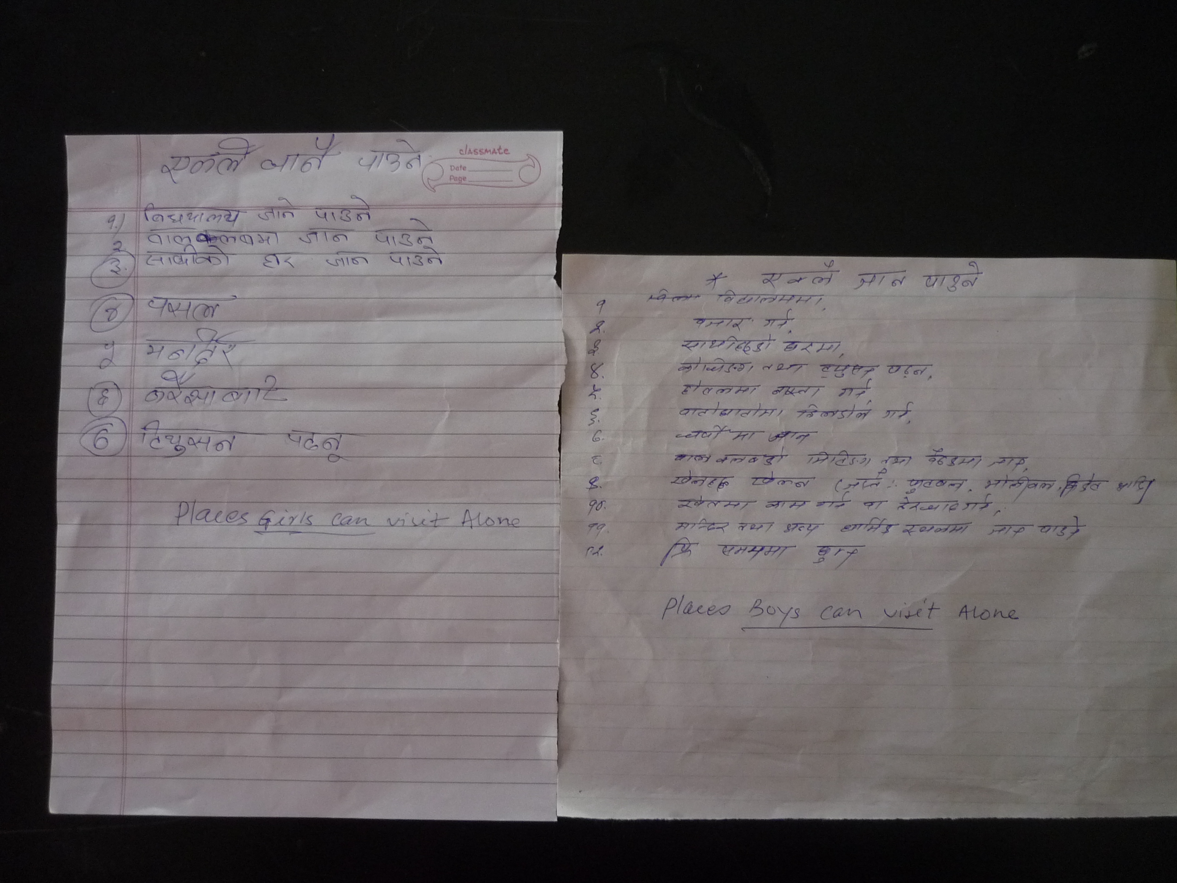
Mobility Lists: Girls and Boys

Slide 9
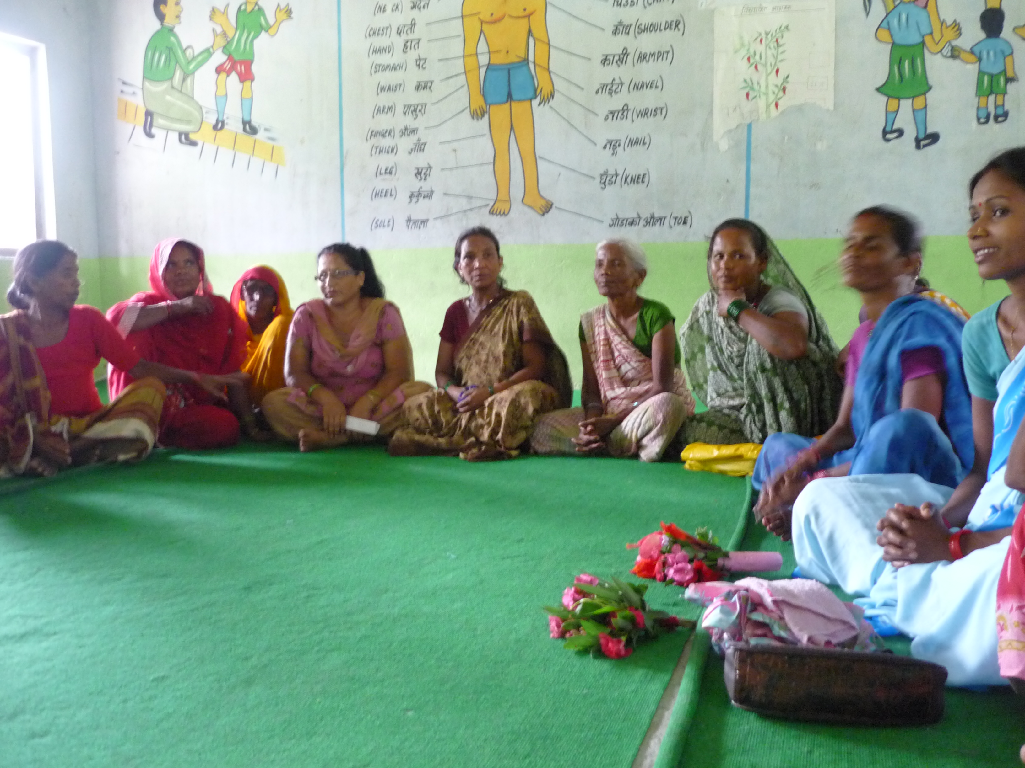
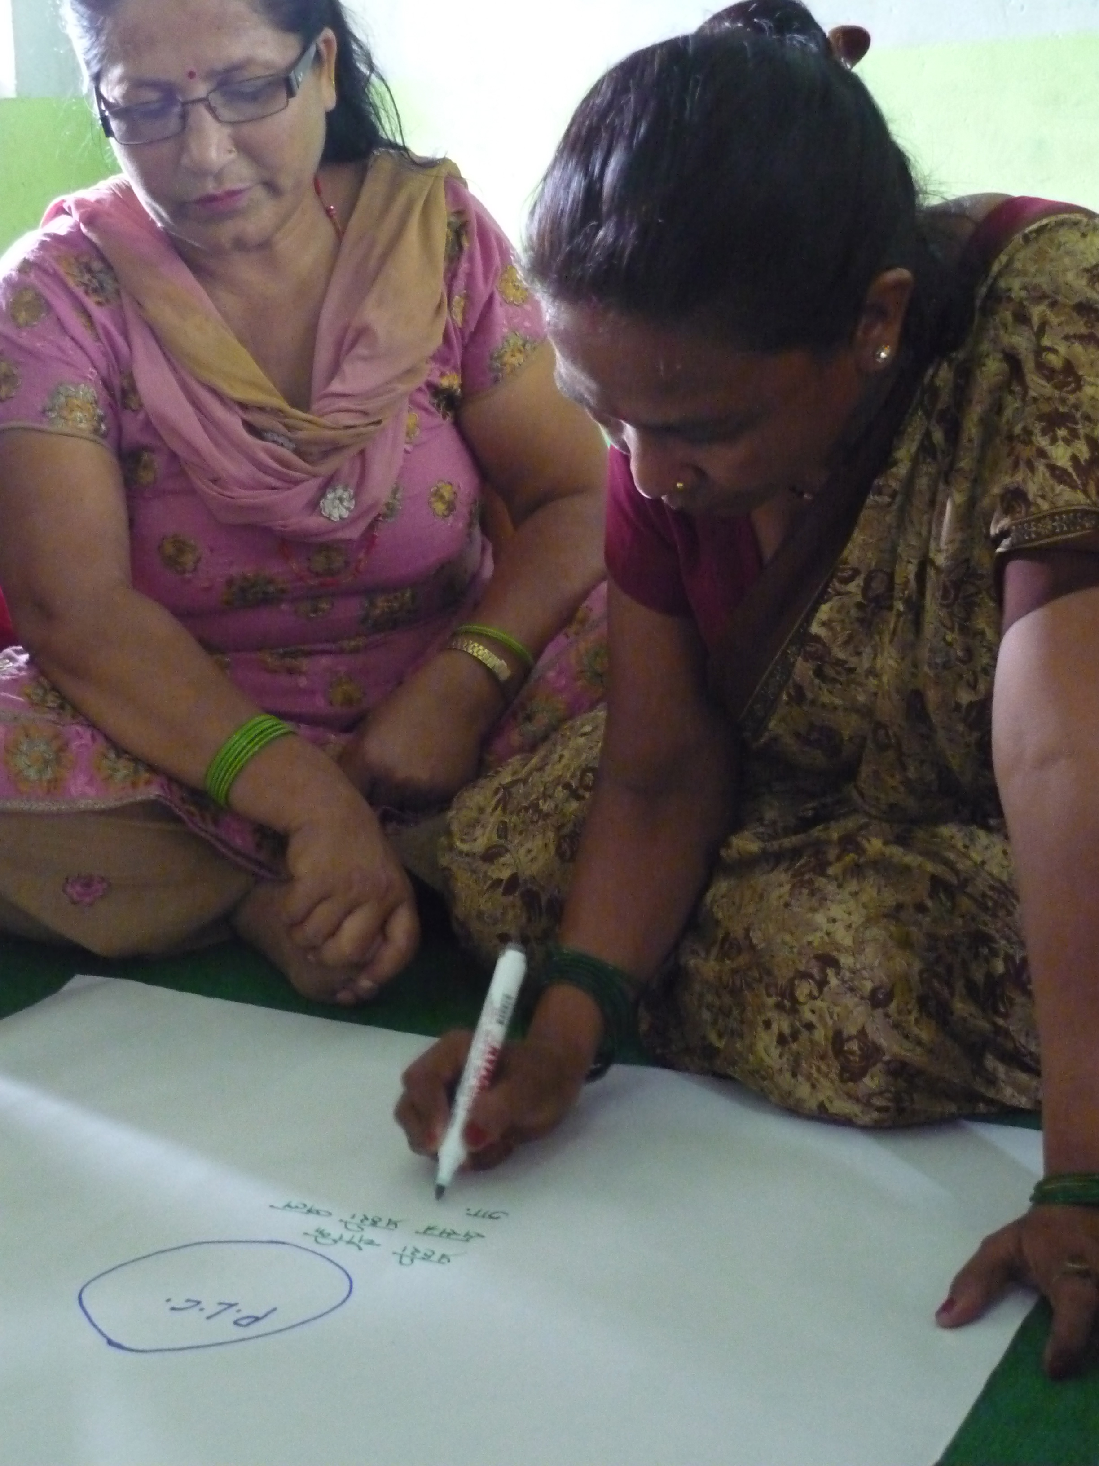
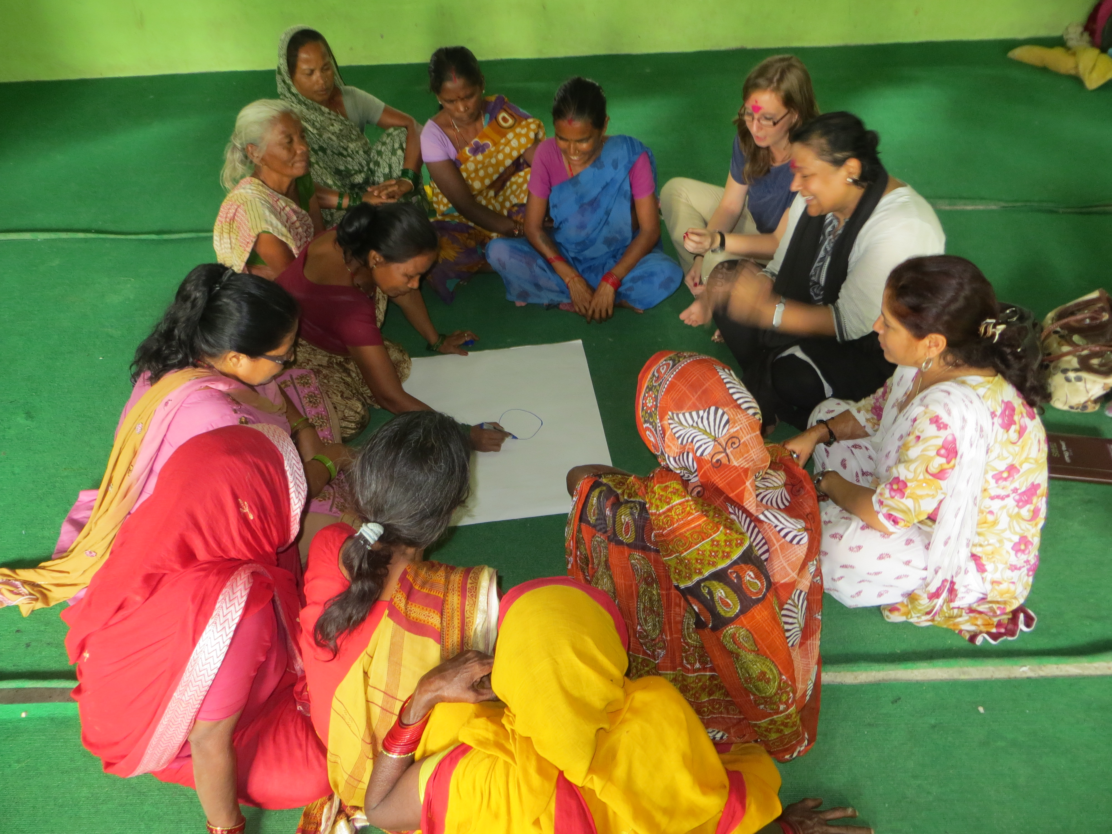
Para-Legal Committee “Social Network Maps” Barriers and Motivators

Slide 11
Final Thoughts
Visual data = powerful, empowering, accessible
Innovative and simple techniques to uncover the processes leading to behavior and social change

Slide 12
Partners & Funders
UNICEF Nepal
Rain Barrel Communication
Drexel University School of Public Health
Opening Doors Health Disparities Training Program

