Slide 1
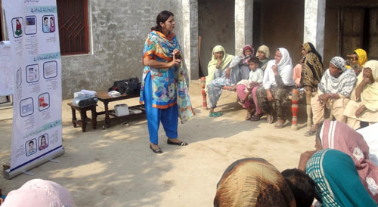
Women as the Face of Healthcare in the Developing World
http://www.usaid.gov/sites/default/files/nodeimage/B_Pakistan_LHWRESIZED.jpg
Rebecca Platoff, MSc
Drexel University College of Medicine, MSI

Slide 2
Community Health Workers
https://www.ghdonline.org/uploads/PIH_Program_Management_Guide_Unit_7_-_Improving_outcomes_with_community_health_workers.pdf

Slide 3
~65% of CHWs in Afghanistan are female
http://www.worldbank.org/en/results/2013/04/18/afghanistan-better-health-outcomes-women-children-poor
http://www.brac.net/node/678#.UyDJGv0mUds

Slide 4
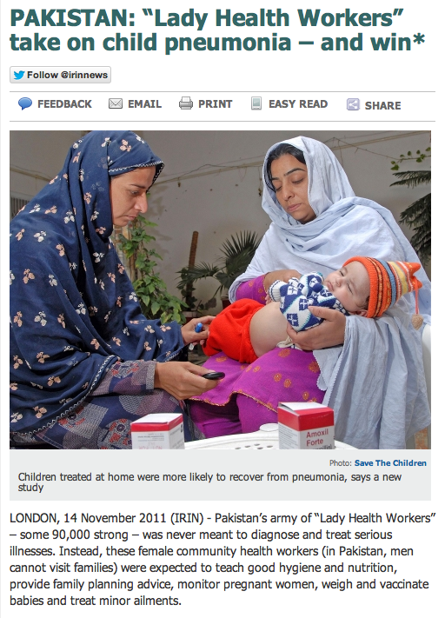
http://www.irinnews.org/report/96462/nepal-key-role-for-female-health-volunteers
http://www.irinnews.org/report/94200/pakistan-lady-health-workers-take-on-child-pneumonia-and-win

Slide 5
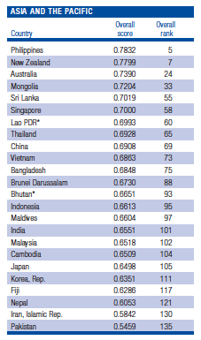
http://www3.weforum.org/docs/WEF_GenderGap_Report_2013.pdf

Slide 6
Interview with a Lady Health Worker in Pakistan
http://www.plosmedicine.org/article/info%3Adoi%2F10.1371%2Fjournal.pmed.1001528

