Slide 1
Hip Hop Lit
An intersectional analysis of 3 novels
Jeaná E. Morrison, Doctoral Student
Drexel University School of Education

Slide 2
What is Hip Hop Lit?
Literary genre that presents one perspective of inner city American life.
Rooted in Black pulp fiction of the 1960’s and 1970’s and Hip Hop culture of the 1970’s and 1980’s.
Content
Often includes a female protagonist who is confronted with challenge(s).
Drugs, sex, violence, and manipulation
Black vernacular (non-standard English), grammatical errors, plot inconsistencies
Authorship
Majority female who claim the stories are cautionary.
Most stories are based on lived experiences and sometimes penned from jail cells.
Entrepreneurial publishing

Slide 3
What is Hip Hop Lit?
Readers
Females ages 14 – 35 (Morris, 2010)
Access books formally and informally
aka
ghetto lit
gangsta lit
street lit
urban fiction
street fiction
hip hop fiction

Slide 4
History & context
Inner city life is a reflection of
Deindustrialization – loss of jobs
Decentralization of Education – poor quality schools
White flight – segregation and gross inequities
Reduced resources
Hip Hop Lit rewrites this space as ownership, control, and empowerment.
Notes:
All these are global issues as well
Hip hop lit mirrors hip hop culture

Slide 5
Research questions
How is Black female sexuality constructed and negotiated within street fiction?
What can educators learn from the increasing readership of street fiction by young people of color in general and young Black females in particular?

Slide 6
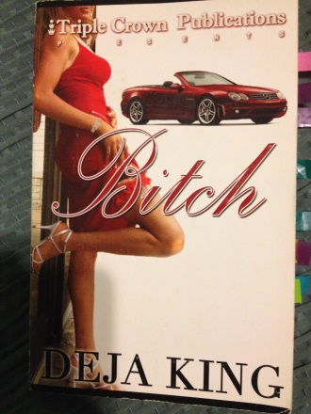
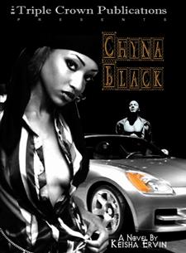
theoretical framework & methodology
Black Feminist Thought (BFT)
Critical Race Theory (CRT)
Qualitative Document Analysis (QDA)
Bitch (Deja King, 2006)
Crack Head (Lisa Lennox, 2005)
Chyna Black (Keisha Ervin, 2004)

Slide 7
Emerging themes
Physical Appearance and Body Description
Expression of Female Sexual Desire
Females’ Interactions with Males
Personal Gain
Revenge
Notes:
Black Female Identity provided the overarching frame for the themes that emerged:

Slide 8
Physical Appearance and the Body
“Damn near every cent I made, I used to pay bills and maintain my appearance...Luckily, I inherited my mom’s beauty and body so I could just about make a potato sack look sexy” (King, 2004, p.4).
“I mean if you want one of these niggas out here to spend some serious paper on you, you gotta learn to sex them real good. You know you’re a beautiful girl, so attracting a big timer’s attention is the easy part. But to have a nigga willing to spend the way you want, your head and pussy game have to be on point” (King, 2004, p. 7-8).
Notes:
Great emphasis on looking good and the ability to use the body for personal gain.
Descriptors found within the first ten pages of each book.
Reduces characters to superficial and mindless beings.

Slide 9
Expression of Female Sexual Desire
“G-i-r-r-r-l, I had lust in my eyes and larceny in my heart. The two of us were horny just thinkin’ ‘bout it. We didn’t even waste time trying to find a hotel” (p.39).
“Once we parked, he got a blanket…and led me over to an old mattress [in an abandoned building] ” (p.40).
“The girls sighed and relaxed their bodies that had been so tense with ecstasy” (p. 41).
Notes:
Numerous accounts of sexual activity that highlight infidelity, risky behavior, and
Frequently discussed among characters = a communal act.
Repeatedly performed and explicitly described in detail.
Almost always hetero dominant
Despite confidence in expressing themselves sexually, the females lacked advocacy for positive sexual health and the desire to be seen as more than just a physical entity.
Lacy does offer a different view when she chooses to remain silent about her sex life but her friends simply dismiss her as thinking she’s better than them and somehow not “normal”.

Slide 10
Females’ Interactions with Males
-PERSONAL GAIN-
“In this world, money talks so you had to pay to be with me. I wasn’t some old broke down chick. Hell no, I was an exquisite piece of china…you had to trick mad money to have me on your arm, ya dig” (p.2).
-REVENGE-
“I watched closely as he helped his bitch get out of the truck…I could still see them leaning against the truck hugging and kissing... [This] made my stomach hurt...she led him up the steps to her loft. I waited a couple more minutes...Grabbing my mini bat, crowbar, and keys, I headed up the street to his truck” (p.11).
Notes:
Personal Gain & Status
Use of the body as a control mechanism
Revenge
Motivator to deal sexually with a man to get back at a former partner or men as a group.
In charge on one hand but pimped on the other.
Offers a narrow solution to problematic relationships.
Normalizes infidelity and male dominance in heterosexual relationships.

Slide 11
Analysis
How is Black female sexuality constructed and negotiated within street fiction?
Simultaneously strong, confident, lewd, and mindless
Hetero-normative; less emphasis on pleasure than on material gain
What can educators learn from the increasing readership of street fiction by young people of color in general and young Black females in particular?
Street fiction provides a point of departure to discuss issues of race, class, gender, sexuality and the relevance of their intersection in the lives of youth.
Brings marginalized voices to the center and offers a space for underprivileged students to see their realities in dominant school discourse.
Notes:
Sexuality is a place of contention within the books
Sex often times is viewed as a site of pleasure and at time it is in the books but more often expressed as a means to an end.
Provides a starting point for critical conversations about race, class, and gender and how these categories intersect to create a variety of experiences.
Offers space for marginalized students to see themselves in dominant school narratives.

Slide 12
This is A global issue because…
The American context must be included in global discussions.
Hip Hop culture has become “glocalized” (Motley & Henderson, 2008).
Hip Hop literary movement of Kenya (Journo, 2009)
Sites of learning are everywhere.
Notes:
Urban areas in some places around the world are considered wealthy and affluent.
There is no one size fit all approach. Context is very important to consider.
Over 100 million fans world wide who consume some sort of hip hop culture.
Hip Hop transcends race, class, gender, and geographic borders to resonate with young disenfranchised populations. The essence and elements of the culture are the same but differs aesthetically to fit the cultural context of the location.
Kenyan literature written in Sheng, the language of kenyan hip hop. Faces the same critiques and challenges of street fiction.

Slide 13
Thank YOu
Contact Info:
Jeaná E. Morrison
jem398@drexel.edu

