Slide 1
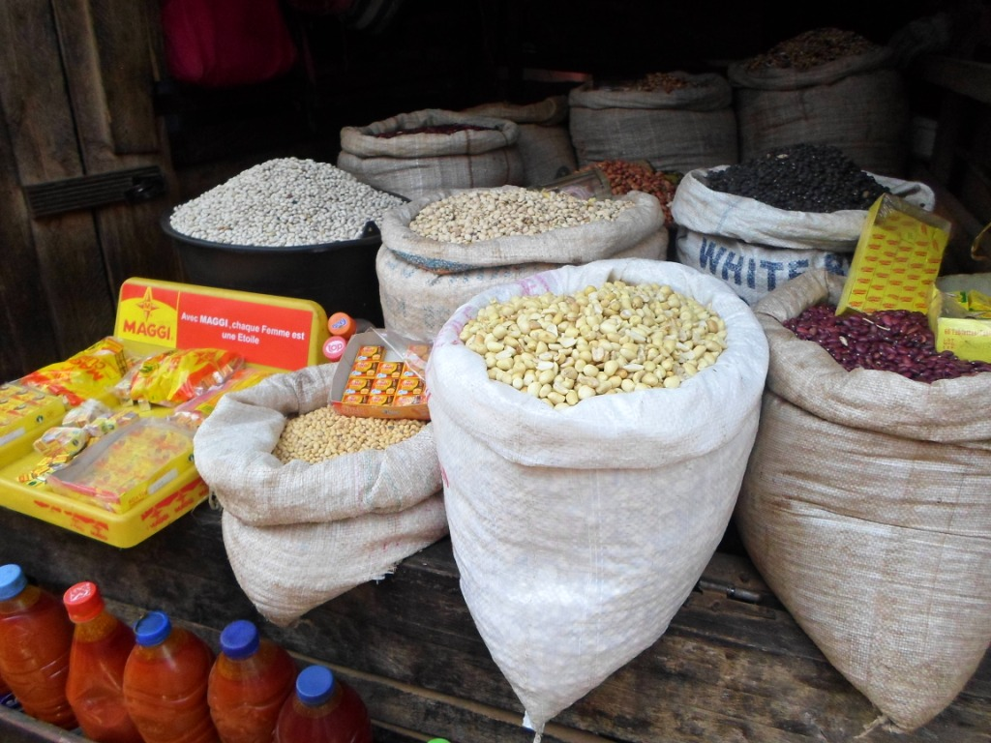
Patience Ajoff-Foster
Global Citizenship Through Business & Education:
Case Study of Microfinance & Rural Market Women in Cameroon, Africa
Presented at the Drexel University Student Conference on Global Challenges: GENDER
Thursday, March 13, 2014
9:15am – 10:45am

Slide 2
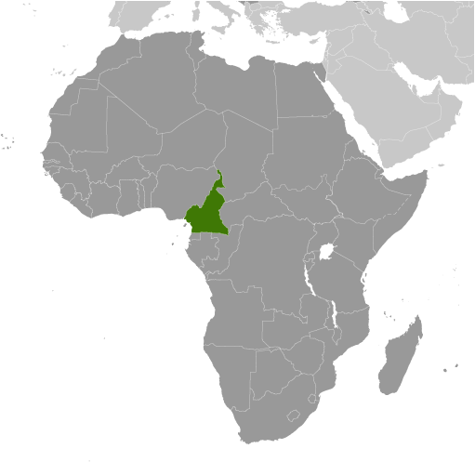
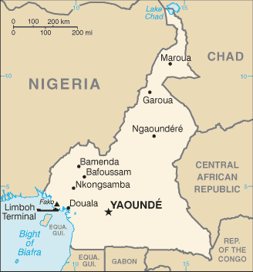
ABOUT CAMEROON – GEOGRAPHY
CIA World Factbook

Slide 3
MORE COUNTRY INFORMATION…
Capital | Yaoundé
Population | 22,534,532 (July 2013 est.)
Geographic Area | Slightly Larger than California
GDP Per Capita | $2,400 (2013 est.)
Unemployment Rates | 30% (2001 est.)
Age structure | 0-14 years: 40% 15-24 years: 20.3% 25-54 years: 31.9% 55-64 years: 4.3% 65 years and over: 3.4% (2013 est.)
Life expectancy at birth | Total population: 55.02 Male: 54.1 years Female: 55.95 years (2013 est.)
Literacy – definition: age 15 and over can read and write | Total population: 71.3% Male: 78.3% Female: 64.8% (2010 est.)
Population below poverty line | 48% (2000 est.)
CIA World Factbook
Notes:
Data retrieved on March 9, 2014 from www.cia.gov

Slide 4
What is the GCTBE Microfinance Project?
A research based project which seeks to transition rural market women from the informal to the formal market sector
Market Women
Formal and Informal Market Sector
Cameroon Formal/Informal Sector in 2012
World Bank Report (2012)

Slide 5
The GCTBE PROGRAM AT A GLANCE
Phase I
Participant Selection
Phase II
Training sessions
Phase III
Grants/Loan awards
Funded recipients’ monitoring
Program assessment and evaluation
Selection of sophomore cohort

Slide 6
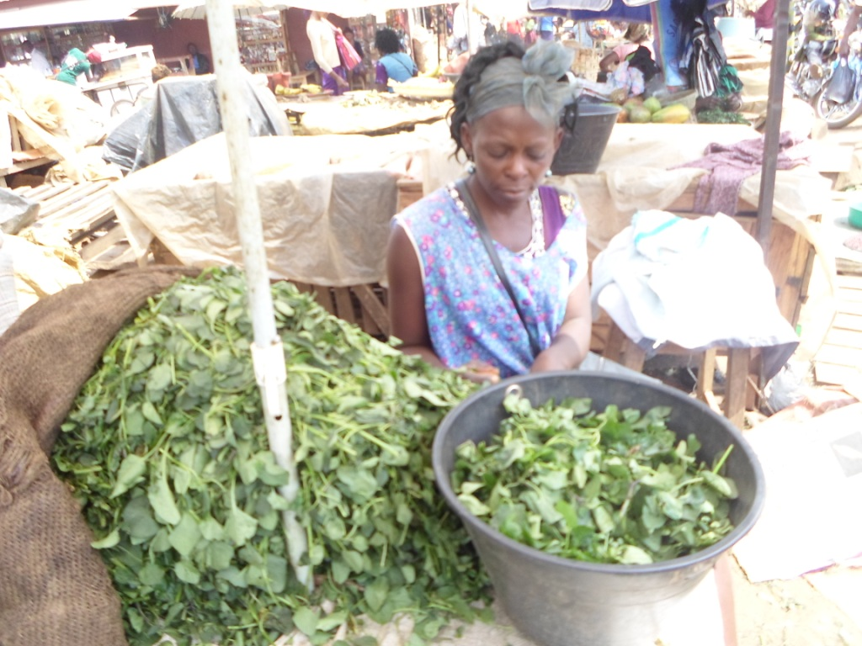
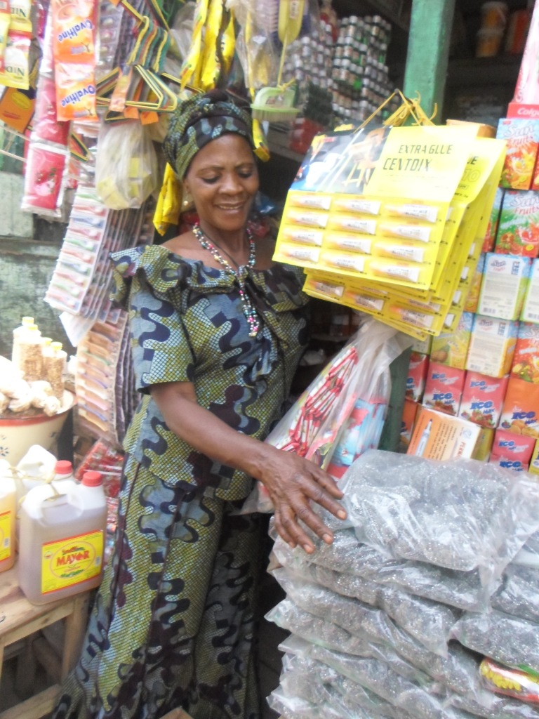
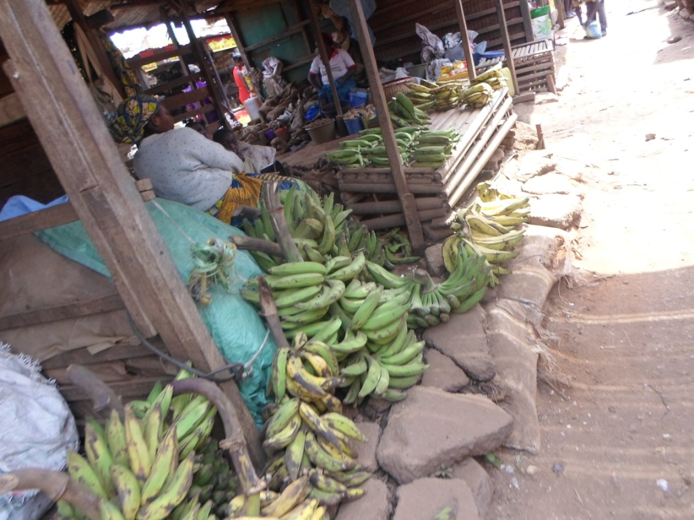
The Pilot/Case Study – Microfinance & Rural Market Women in Cameroon
Partnership with Bamenda University of Science and Technology and Bonazah Community Development of Africa
2 students selected from the Faculty of Economics, Law & Management Sciences
Faculty Assignment
Selected 15 market women for the inaugural class

Slide 7
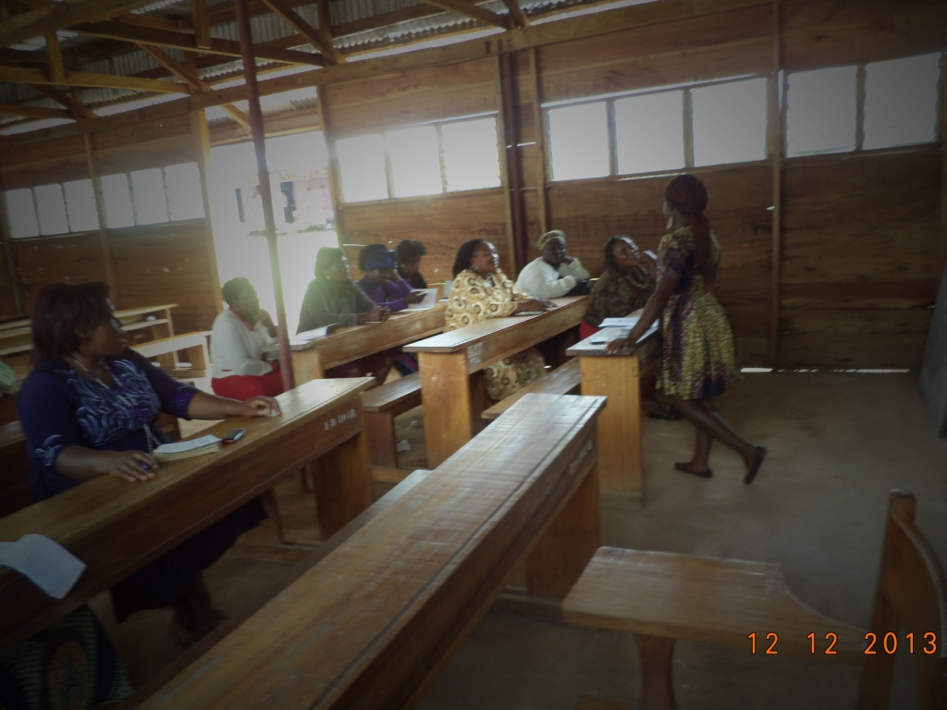
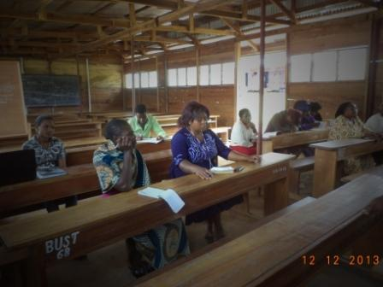
PILOT PROGRAM IMPLEMENTATION
Pre-training Survey
Women received assistance with completion of survey as needed
Six week customized business training
Based on results of survey
Entrepreneurship
Management
Business/marketing/financial plan
Financial statements/balance sheet
Bookkeeping – cash payment/cash receipt
Funding
Grants
Loans

Slide 8
SURVEY RESULTS – Personal information
N = 15
Average age group | 36-40
Average number of children | 4.3

Slide 9
Business capital
Current business capital vs original amount borrowed

Slide 10
Type of business and experience

Slide 11
Training and Labor

Slide 12
Other Business Information

Slide 13
What would you like to gain from the training?
Learn how to manage my money
How to manage my workers
All things on marketing
Everything about business
Keep capital from other expenses
Keep money in financial institution
Business management, loan management, resource management (human and product)
To sell and manage my business well and the money
How to take care of livestock
Business expansion
Improve business situation

Slide 14
How do you see yourself in two years?
Growing in my business and able to educate my children
Increase in capital and longevity in business
Great improvement in business
Expanding greatly in business because of what I have learned
I will grow because this knowledge will not go in vain
By 2015, my business will/must grow because I always put back part of my capital into my business
I will improve my business from the money received
I will make sure I expand my business
Expand my business, increase my production to meet up with demands in my community

Slide 15
MONITORING & EVALUATION
Continue work with four women who are funded
One, three, and six month follow-up to monitor progress
Program evaluation to determine areas for improvement
Selection of next group of women

Slide 16
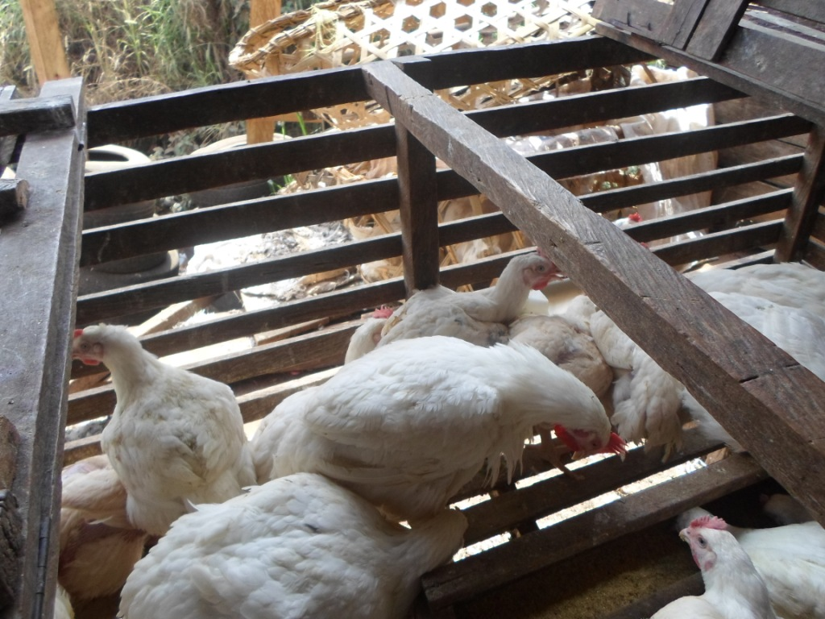
GCBTE PROGRAM OPPORTUNITIES
Transferability
Can be replicated in other parts of Sub-Saharan Africa
Partnerships can be extended to local and foreign institutions
Impact on Microfinance sector

Slide 17
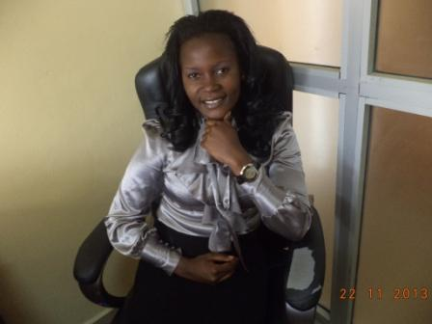
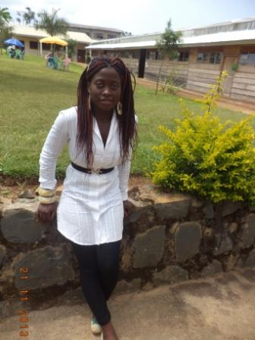
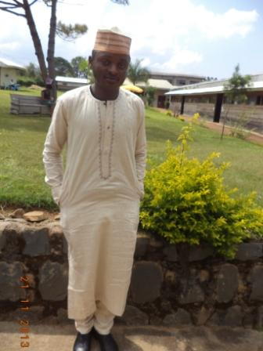
ACKNOWLEDGEMENTS
Professor Emmanuel Akotia
Evadine Tembeik
Immanuela Lum Che
Jibril Ibrahim Ringnyu

Slide 18
More information
Website: www.ruralmarketdevelopers.org
Email: ajoffpat@alumni.upenn.edu

