Slide 1
Climate Destruction in Nauru:
‘Gendering’ the Environment
Presented By: Mik Schulte
Custom Designed Major: Corporate Policy & Environmental Risk Management ‘15

Slide 2
What is “Climate Destruction”?
Eugene Linden’s The Winds of Change: Climate, Weather, and the Destruction of Civilizations
“Evokes intentionality and a deliberate act against the environment.”

Slide 3
Nauru
Western Pacific
Smallest Republic
10,065 people
50/50 sex ratio
21 square kilometers
highest point 65 meters
“green zone”
97% of men & 93% of women obese or overweight
> 40% Type II Diabetes

Slide 4
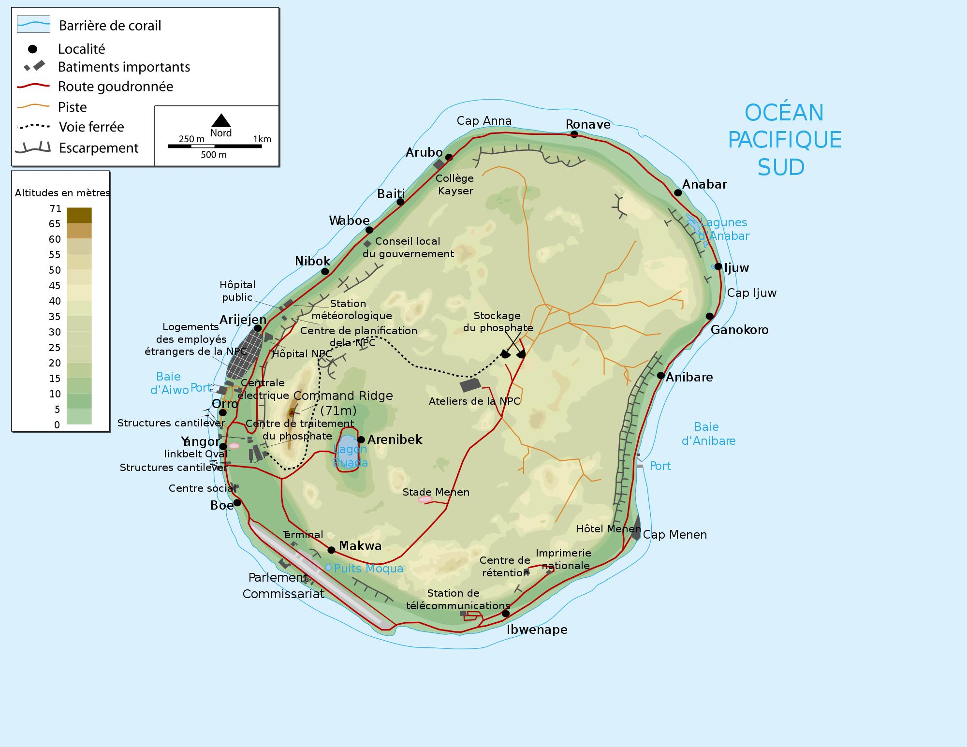
Image Courtesy of: www.vidani.com

Slide 5
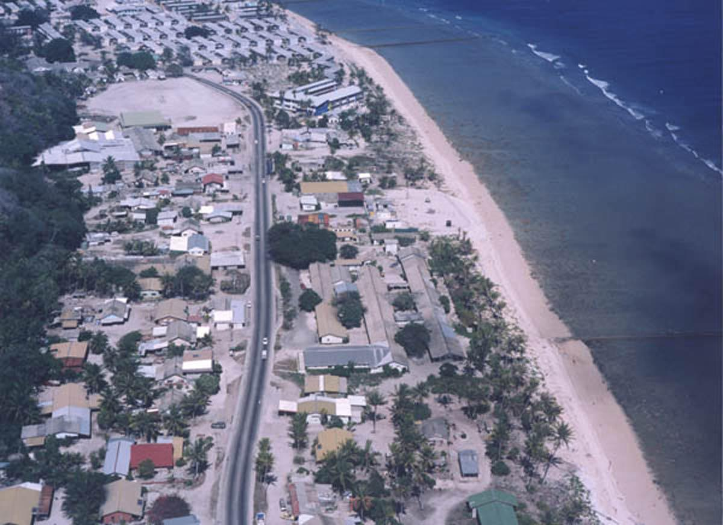
Denigomod and Nibok Districts
Courtesy: Wikimedia Commons

Slide 6
Factors for Envrionmental Destruction
Phosphate ‘strip mining’
Aging de-salination plant
Lack of agricultural resources
RISING SEA LEVELS
ACIDIFICATION OF THE OCEAN
DISRUPTION OF FISH MIGRATION PATTERNS

Slide 7
Role of the AOSIS and Sea Level Rise
Alliance of Small Island States (43 nations)
Petitioned UN Security Council to Recommit to Kyoto Protocol (Failed)
average air temp will rise 2.2-3.8 C by 2090
average sea level will rise 21-60 cm by 2090
WHO: “Highly vulnerable” to climate change

Slide 8
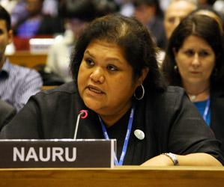
Ambassador Marlene Moses (Courtesy of the Government of Nauru)

Slide 9
Gendering the Environment: EGI
Environment and Gender Index
“monitors government progress toward gender equality and women’s empowerment in the environmental area”
Survey of 72 Countries
Project of the International Union for Conservation of Nature’s Global Gender Office
www.environmentgenderindex.org

Slide 10
Brief Summary of Findings
Info about women’s role and access in environment-related sectors is limited
Implementation of global agreements is lacking
Global average for women’s participation in intergovernmental negotiations on the environment peaked at 36%

Slide 11
The Good, the Bad, and the Awful
Top 5: Iceland, Netherlands, Norway, Sweden, France (US #14)
Brazil # 24, China #34, Malawi #36, Fiji # 40
India #46, Saudi Arabia #56, Syria #69
Dem Rep Congo #72

Slide 12
Take Aways
Climate Destruction is REAL
Future of a Nation is Dependent on Its Vulnerability to Climate Destruction
Equal Gender Access, Livelihood, Education Reduces Vulnerability to Climate Destruction

Slide 13
Acknowledgments
Dr. Kevin Egan, Dr. Scott Knowles, Dr. Amy Slaton, Dr. Jennifer Yusin, Dr. Robert Brulle, Dr. Maria delaluz Matus-Mendoza, Dr. Lydia Pyne
Ms. Tamar Abrams
Adam Zahn and OIP

