Slide 1
The Environment as a Motivator and Barrier of Women Breastfeeding Infants < 2 Years Of Age in Ethiopia
Cecilia Sara Alcala
Drexel University School Of Public Health
Opening Doors Health Disparities Research Trainee
2nd Year MPH, Environmental And Occupational Health
Global Health Certificate

Slide 2
Malnutrition
One of the main child survival challenges facing children and affecting women in Ethiopia and around the world.
Contributes both directly and indirectly towards infant morbidity and mortality.
Not only the direct cause of about one-fifth of the overall deaths in childhood, but is also an associated factor in over half of childhood deaths.
Notes:
At 470 deaths/100,000 live births, Ethiopia ranks 29th in the world in maternal mortality
Ethiopia ranks 17th in the world on infant mortality with 77.12 death/1,000 live births.
Life expectancy at birth in Ethiopia is 56.19 years
Health related expenditure accounts for 3.6 percent of the GDP

Slide 3
Background Information
ENGINE is a five year (2011-2016) USAID funded nutrition program implemented in Ethiopia.
ENGINE is a partnership of numerous international and governmental organizations and being implemented with ownership of the Ministry of Health and the Ministry of Agriculture in Ethiopia.
Notes:
ENGINE- Empowering the New Generations to Improve Nutrition and Economic opportunities
Save the Children is the main implementer of this project with help from the Johns Hopkins University Center for Communication Programs.

Slide 4
Objective
To use qualitative investigative techniques to understand perceptions and beliefs that influence priority behaviors affecting the nutritional status of adolescent and adult women, and young children.
Notes:
Information I am presenting from the formative research

Slide 5
Methods
The project was implemented in four regions in Ethiopia.
Tigray
Oromiya
Amhara
SNNPR
4 coordinated methods that were utilized are:
Transect Walk with Community Mapping
Focus Group Discussions
In-depth Interviews
Observations
Notes:
Ethiopia has eleven geographic/administrative regions: nine regional states (Tigray, Affar, Amhara, Oromiya, Somali, Benishangul-Gumuz, SNNP, Gambela and Harari) and two city administrations (Addis Ababa and Dire Dawa).
ENGINE will be implemented in 100 woredas including 83 AGP (Agricultural Growth Program) woredas of Amhara, Oromiya, Tigray and SNNPR.

Slide 6
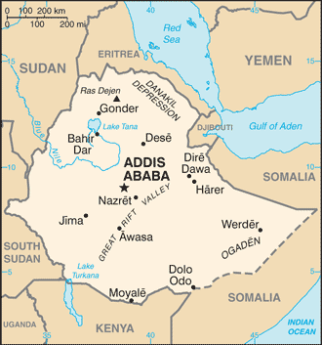
Map Of Ethiopia
Notes:
Show the different regions

Slide 7
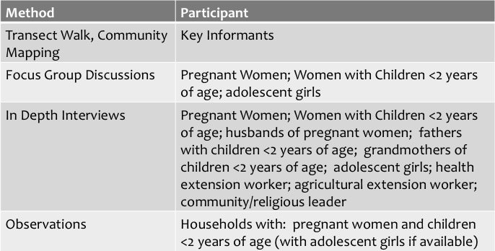
Study Participants

Slide 8
Research Question
How is the environment a motivator and barrier of optimal behaviors for women who breastfeed children less than two years of age?

Slide 9
Analysis
Questions were focused on:
Diet
Complementary Feeding
Social Network (Mapping)
Perception of Service Providers (Free-listing)
Sample Questions:
Can you tell me about your experience in breastfeeding?
Does anyone advise you about your diet? Who? What do they say? Do you follow their advice?
Who in your family provides support for your child’s diet and nutrition such as advising you about breastfeeding and complementary foods?
Can you describe what role these workers play in the community?
Notes:
An example of questions asked were :What kinds of foods does your family produce itself?

Slide 10
Results
Gender dynamics
“My husband’s support is also important because he is the one who brings what to eat”
“For family consumption it is us who decide what to sale and what to purchase but since we are housewives it is husbands who sale and bring the exchange at household level”
“No one I consult except my husband, I don't have anyone. He advises me to save and not to waste too much. I do respect his advice since we do respect one another”
“Most of the time my husband and I decide on things but in many cases it is men who decide on big issues at household level and we involve in a consultation role”
Possible Changes
“I want to change the diet and feed him variety of foods. The types of foods and the frequency of eating have to be changed”
It is difficult since my income is low, preparing the food is not difficult at all but affording the food item is very difficult”
Worker Role in the Community (Health Worker vs. Agricultural Worker)
Notes:
Women would like to provide more variety to their children instead of feeding them the same foods often. More fruits and vegetables
Women rely on the advice and physical help from health workers more than agricultural workers.

Slide 11
Questions

Slide 12
Resources
Center for Communication Programs; Save the Children; USAID. (2011). ENGINE Program Desk Review for Social and Behavioral Change Interventions.
Optimal duration of exclusive breastfeeding: what is the evidence to support current recommendations. Mary S Fewtrell, Jane B Morgan, Christopher Duggan, Geir Gunnlaugsson, Patricia L Hibberd, Alan Lucas, and Ronald E Kleinman
Maternal Knowledge and Use of a Micronutrient Supplement Was Improved with a Programmatically Feasible Intervention in Mexico¹. Anabelle Bonvecchio^{2,*}, Gretel H. Pelto³, Erika Escalante², Erick Monterrubio², J. P. Habicht³, Fernanda Nava², Maria-Angeles Villanueva², Margarita Safdie², and J. A. Rivera²
Ruel MT, Levin CE, Armar-Klemesu M, Maxwell DG, Morris SS. Good care practices mitigate the negative effects of poverty and low maternal schooling on children’s nutritional status: evi- dence from Accra. World Development 1999;27:1993-2009.
Recommendations for the complementary feeding of the breastfed child. Cristina M. G. Monte; Elsa R. J. Giugliani
Complementary Feeding: Introduction of solid food to an Infants Diet/ April 2013/ The British Dietetic Association

