Slide 1
SETTLING THE SCORE: Comparing IELTS and TOEFL iBT score gains in
an international undergraduate conditional admissions program
Reese M. Heitner, PhD rmh54@drexel.edu
DREXEL UNIVERSITY English Language Center

Slide 2
Settling the Score: Comparing IELTS and TOEFL iBT score gains in an international undergraduate conditional admissions program
I. AY 2011-2012 INTERNATIONAL GATEWAY PROGRAM
A. Program Design
B. Program Participants
C. Program Outcomes
D. Historical Enrollment and Retention Rates E. Research Questions
II. ASSESSMENT
A. English Language Proficiency
1. IEP level placement
2. IEP level progression
3. Standardized examination
4. Relationship between IEP placement levels and entry scores
B. University Courses
1. Gateway CoAS performance
2. Relationship between Gateway CoAS GPAs and entry scores
C. Standardized Test Progress
1. Composite score gains across intervals
2. Composite score gains by subgroups
3. Score gains by module
D. Repeat Test-Taking: Estimating an iBT Familiarity Effect
E. Matriculated University Performance
F. Comparison among Gateway Matriculated GPAs and Direct Admission GPAs
III. CONCLUSIONS A. Research Answers
1. Concurrent validity
2. Predictive validity
3. Score gains
4. Familiarity effect
B. References

Slide 3
Settling the Score: Comparing IELTS and TOEFL iBT score gains in an international undergraduate conditional admissions program
I. THE INTERNATIONAL GATEWAY PROGRAM
A. Program Design
Table 1
AY 2011-2012 Gateway Curriculum
 | English Language/ Communication Skills (hours/week) | CoAS Credit Courses | Test Preparation (hours/week) | End of Term Benchmark |  | ELC Support | University Support
 |  |  |  | IELTS 5.0 | iBT 53
Term 1 Fall 2011 | 15 hours ELC Oral (L/S) Communication Written (R/W) Communication | Math placement test | 6 hours IELTS/iBT preparation | IELTS 5.5 | iBT 62 | Advising
 |  |  |  | December 2011
Term 2 Winter 2012 | 15 hours ELC Oral (L/S) Communication Written (R/W) Communication | MATH (3-4) credits | 6 hours IELTS/iBT preparation | IELTS 6.0 | iBT 70 | Advising | Math Resource Center
 |  |  |  | March 2012
Term 3 Spring 2012 | 7.5 hours ELC Foundations of Academic Writing (CHEM support) | MATH (3-4 credits) CHEM (3 credits) | 3 hours IELTS/iBT preparation or Skills for College Success | IELTS 6.0 | iBT 73 | Advising | Math Resource Center
 |  |  |  | June 2012
Term 4 Summer 2012 | 10.5 hours ELC Skills for College Success Oral (L/S) Communication | MATH (3-4 credits) PHIL (3 credits) |  | IELTS 6.5 | iBT 79 | Advising | Math Resource Center
 |  |  |  | August 2012

Slide 4
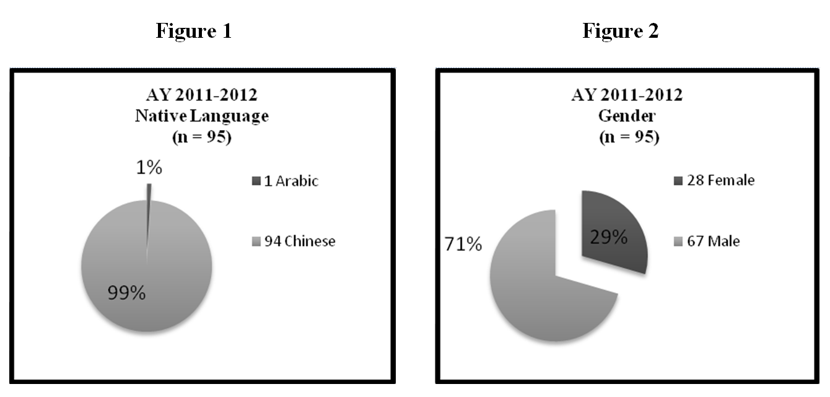
Settling the Score: Comparing IELTS and TOEFL iBT score gains in an international undergraduate conditional admissions program
I. THE INTERNATIONAL GATEWAY PROGRAM
B. Program Participants

Slide 5
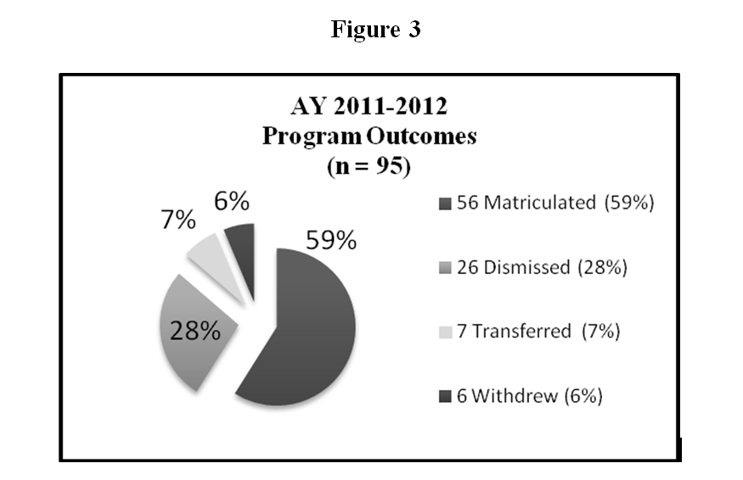
Settling the Score: Comparing IELTS and TOEFL iBT score gains in an international undergraduate conditional admissions program
I. THE INTERNATIONAL GATEWAY PROGRAM
C. Program Outcomes

Slide 6
Settling the Score: Comparing IELTS and TOEFL iBT score gains in an international undergraduate conditional admissions program
I. THE INTERNATIONAL GATEWAY PROGRAM
D. Historical Enrollment and Retention Rates
Table 2
Gateway Student Enrollment and Retention 2009-2014
PRE-MATRICULATION |  |  |  | MATRICULATION
COHORT | GATEWAY YEAR | GATEWAY ENROLLMENT | COUNTRIES OF ORIGIN | ACADEMIC YEAR | DREXEL ENROLLMENT | RETENTION (returning for 2nd year)
Pilot | 2009-2010 | 6 | Kuwait Saudi Arabia | 2010-2011 | 5 | 3
Cohort I | 2010-2011 | 44 | China Columbia Saudi Arabia | 2011-2012 | 32 | 30
Cohort II | 2011-2012 | 95 | China Saudi Arabia Taiwan | 2012-2013 | 56 | 54
Cohort III | 2012-2013 | 74 | China Saudi Arabia Taiwan | 2013-2014 | 45 | 45
Cohort IV | 2013-2014 | 72 | China Japan Korea Oman Thailand | 2014-2015 | 42 | Available September 2015
Cohort V | 2014-2015 | 71 | China Japan Venezuela | 2015-2016 | Available August 2015 | Available September 2016
75
43-50

Slide 7
Settling the Score: Comparing IELTS and TOEFL iBT score gains in an international undergraduate conditional admissions program
I. THE INTERNATIONAL GATEWAY PROGRAM
E. Research Questions
1. What is the relationship between measurements of English language proficiency and standardized IELTS and iBT scores?
CONCURRENT VALIDITY
2. What is the relationship between standardized IELTS and iBT scores and GPA performance?
PREDICTIVE VALIDITY
3. What is the quantity and rate of IELTS and iBT score gains across multiple testing intervals and the relative balance among modules?
SCORE GAINS
4. What is the iBT score-gain effect of repeat test-taking—merely sitting for the test again?
FAMILIARITY EFFECT

Slide 8
Settling the Score: Comparing IELTS and TOEFL iBT score gains in an international undergraduate conditional admissions program
II. ASSESSMENT
A. English Language Proficiency
1. IEP level placement
Figure 4

Slide 9
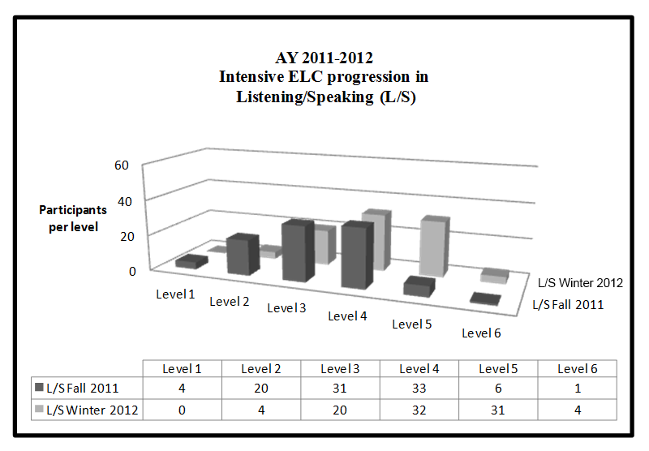
Settling the Score: Comparing IELTS and TOEFL iBT score gains in an international undergraduate conditional admissions program
II. ASSESSMENT
A. English Language Proficiency
2. IEP level progression
Figure 5

Slide 10
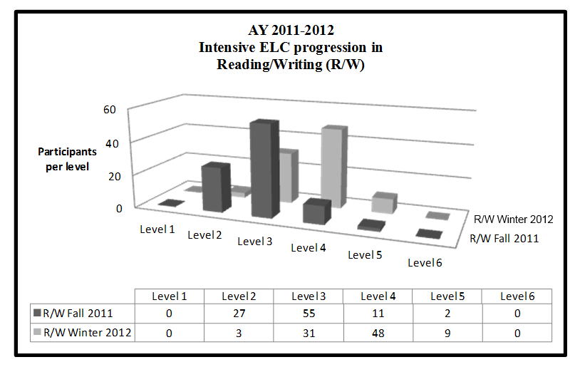
Settling the Score: Comparing IELTS and TOEFL iBT score gains in an international undergraduate conditional admissions program
II. ASSESSMENT
A. English Language Proficiency
2. IEP level progression
Figure 6

Slide 11
Settling the Score: Comparing IELTS and TOEFL iBT score gains in an international undergraduate conditional admissions program
II. ASSESSMENT
A. English Language Proficiency
2. IEP level progression
Table 3
AY 2011-2012 Average placement and rates of IEP progression in Listening/Speaking (L/S) and Reading/Writing (R/W) in levels 1-6
 | Average L/S level Fall 2011 | Average L/S level Winter 2012 | Average rate of L/S progression | Average R/W level Fall 2011 | Average R/W level Winter 2012 | Average rate of R/W progression
Full cohort (n = 91) | 3.16 | 4.12 | 0.96 | 2.82 | 3.69 | 0.87
Matriculated (n = 56) | 3.41 | 4.38 | 0.97 | 2.93 | 3.89 | 0.96
Dismissed (n = 24) | 2.71 | 3.63 | 0.92 | 2.63 | 3.29 | 0.66
Transferred (n = 5) | 3.80 | 4.80 | 1.00 | 2.80 | 3.80 | 1.00
Withdrew (n = 6) | 2.17 | 3.17 | 1.00 | 2.67 | 3.33 | 0.66

Slide 12
Settling the Score: Comparing IELTS and TOEFL iBT score gains in an international undergraduate conditional admissions program
II. ASSESSMENT
A. English Language Proficiency
3. Standardized examination
Table 4
AY 2011-2012 Descriptive statistics of IELTS entry scores grouped by outcome
 | Mean | Median | Mode | Range | Standard deviation
IELTS cohort (n = 41) | 4.98 | 5.0 | 5.0 | 4.5—6.5 | .386
Matriculated (n = 17) | 5.12 | 5.0 | 5.0 | 4.5—5.5 | .332
Dismissed (n = 14) | 4.82 | 5.0 | 5.0 | 4.5—5.0 | .316
Transferred (n = 6) | 5.16 | 5.0 | 5.0 | 4.5—6.0 | .516
Withdrew (n = 4) | 4.62 | 4.5 | 4.5 | 4.5—5.0 | .250
AY 2011-2012 Descriptive statistics of iBT entry scores grouped by outcome
 | Mean | Median | Mode | Range | Standard deviation
iBT cohort (n = 54) | 59.74 | 58.00 | 57.00 | 49—82 | 7.910
Matriculated (n = 39) | 60.28 | 59.00 | 57.00 | 49—77 | 7.272
Dismissed (n = 12) | 56.66 | 56.00 | 49.00 | 49—73 | 7.773
Transferred (n = 1) | 82.00 | 82.00 | 82.00 | 0 | 0
Withdrew (n = 2) | 56.50 | 56.5 | 56.00 | 56—57 | .707

Slide 13
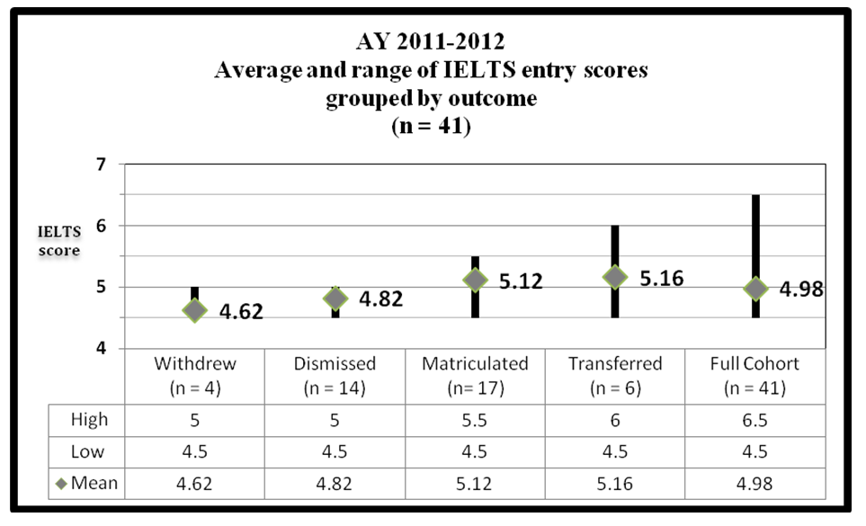
Settling the Score: Comparing IELTS and TOEFL iBT score gains in an international undergraduate conditional admissions program
II. ASSESSMENT
A. English Language Proficiency
3. Standardized examination
Figure 7
NOT
significant
statistically
significant
statistically
p<.05
p>.05

Slide 14
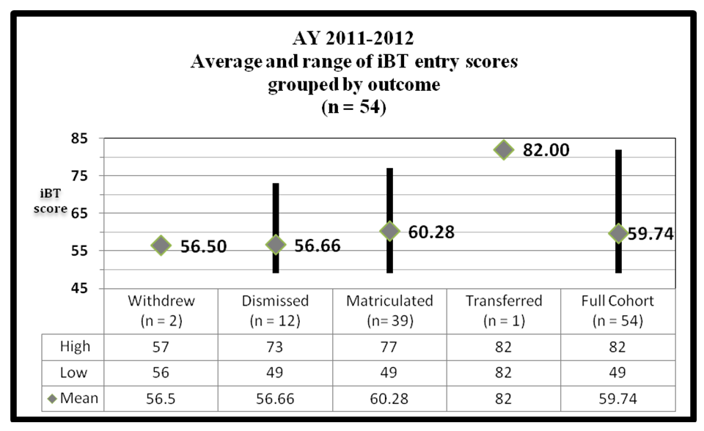
Settling the Score: Comparing IELTS and TOEFL iBT score gains in an international undergraduate conditional admissions program
II. ASSESSMENT
A. English Language Proficiency
3. Standardized examination
Figure 8
NOT
significant
statistically
p>.05

Slide 15
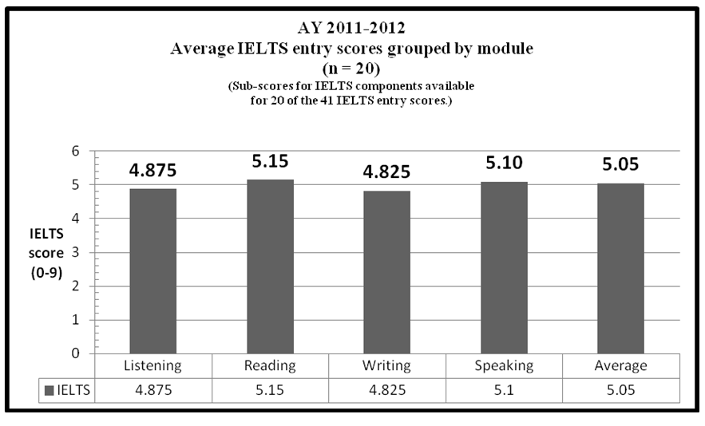
Settling the Score: Comparing IELTS and TOEFL iBT score gains in an international undergraduate conditional admissions program
II. ASSESSMENT
A. English Language Proficiency
3. Standardized examination
Figure 9

Slide 16
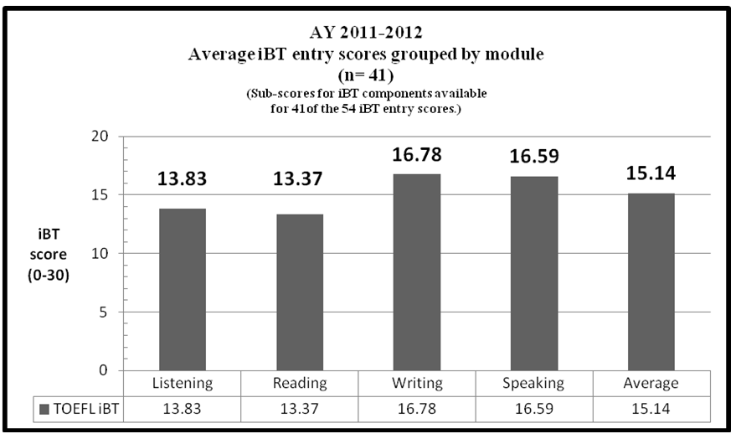
Settling the Score: Comparing IELTS and TOEFL iBT score gains in an international undergraduate conditional admissions program
II. ASSESSMENT
A. English Language Proficiency
3. Standardized examination
Figure 10

Slide 17
Settling the Score: Comparing IELTS and TOEFL iBT score gains in an international undergraduate conditional admissions program
II. ASSESSMENT
A. English Language Proficiency
3. Standardized examination
Table 5
AY 2011-2012 IELTS versus iBT entry score module rankings
 | LOWER HIGHER entry scores entry scores
IELTS | Writing (4.825) | Listening (4.875) | Speaking (5.10) | Reading (5.15)
iBT | Reading (13.37) | Listening (13.83) | Speaking (16.59) | Writing (16.78)

Slide 18
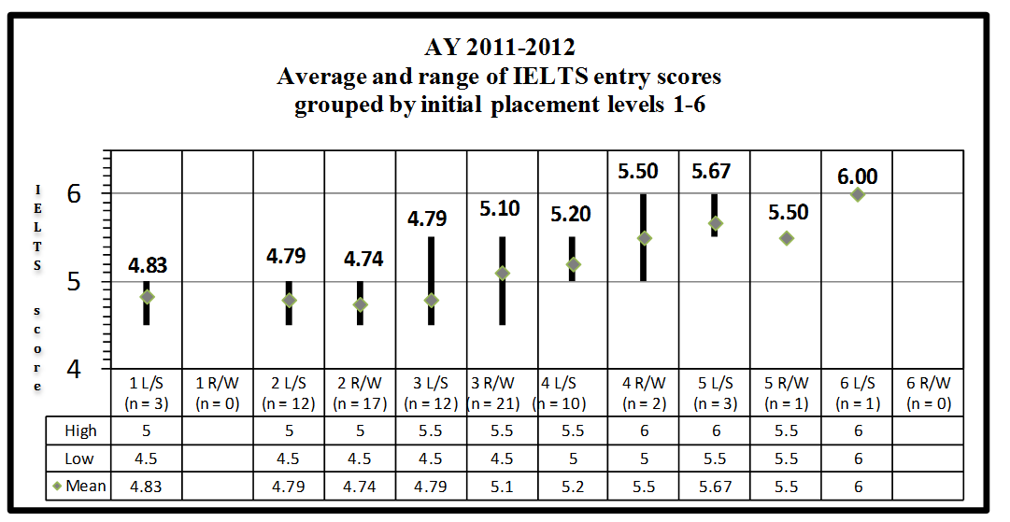
Settling the Score: Comparing IELTS and TOEFL iBT score gains in an international undergraduate conditional admissions program
II. ASSESSMENT
A. English Language Proficiency
4. Relationship between IEP placement levels and entry scores
Figure 11
L/S : IELTS .608 (p < .01)
R/W : IELTS .582 (p < .01)
L/S : R/W .508 (p < .01)

Slide 19
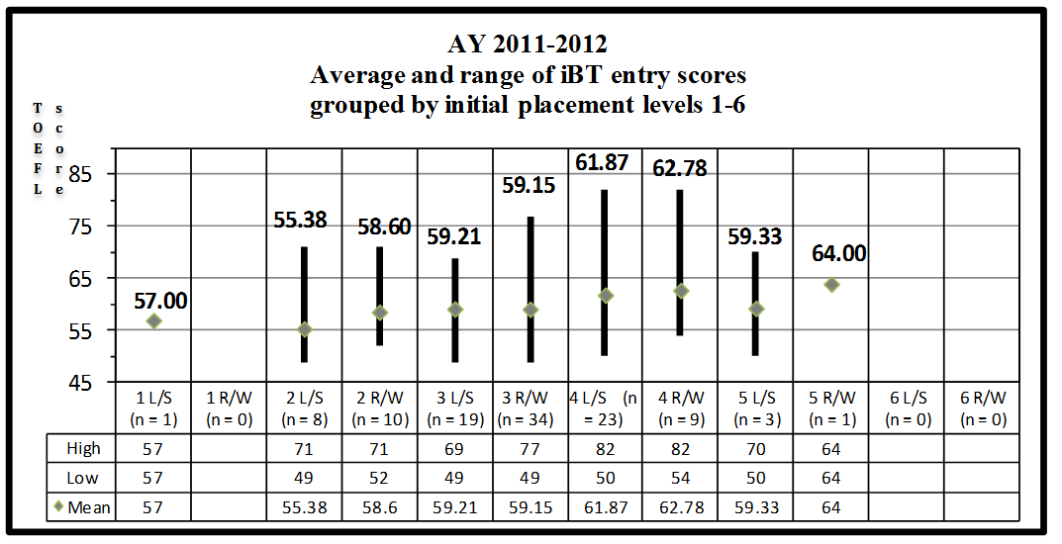
Settling the Score: Comparing IELTS and TOEFL iBT score gains in an international undergraduate conditional admissions program
II. ASSESSMENT
A. English Language Proficiency
4. Relationship between IEP placement levels and entry scores
Figure 12
L/S : IELTS .238 (p > .05)
R/W : iBT .171 (p > .05)
L/S : R/W .508 (p < .01)
L/S : iBT .238 (p > .05)
L/S : iBT .325 (p < .05)

Slide 20
Settling the Score: Comparing IELTS and TOEFL iBT score gains in an international undergraduate conditional admissions program
II. ASSESSMENT
A. English Language Proficiency
4. Relationship between IEP placement levels and entry scores
Figure 13
L/S : LISTENING IELTS r < .4 (p > .05)
L/S : SPEAKING IELTS .641 (p < .01)
R/W: READING IELTS r < .4 (p > .05)
R/W: WRITING IELTS r < .4 (p > .05)

Slide 21
Settling the Score: Comparing IELTS and TOEFL iBT score gains in an international undergraduate conditional admissions program
II. ASSESSMENT
A. English Language Proficiency
4. Relationship between IEP placement levels and entry scores
Figure 14
PRODUCTIVE
TASKS
L/S : LISTENING iBT r < .2 (p > .05)
L/S : SPEAKING iBT .355 (p <.05)
R/W: READING iBT r < .2 (p > .05)
R/W: WRITING iBT .451 (p < .01)

Slide 22
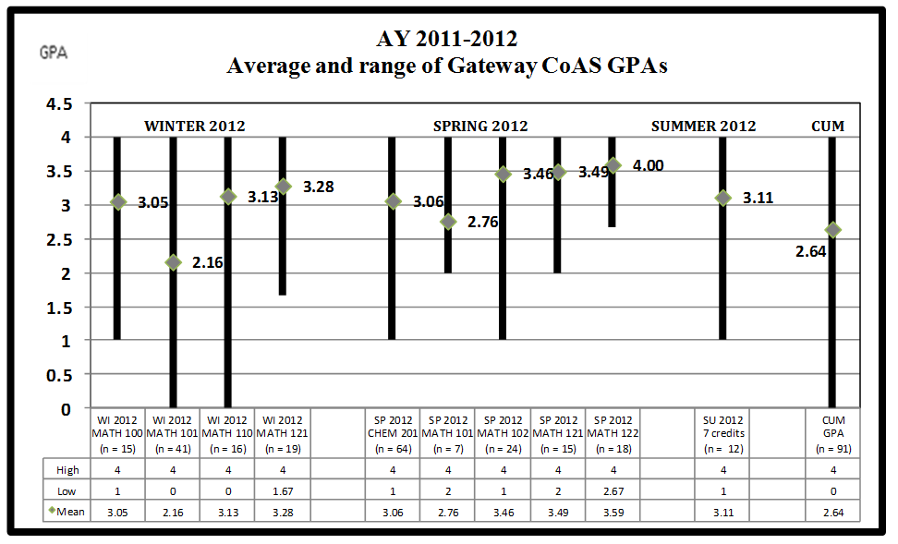
Settling the Score: Comparing IELTS and TOEFL iBT score gains in an international undergraduate conditional admissions program
II. ASSESSMENT
B. University Courses
1. Gateway CoAS performance
Figure 15

Slide 23
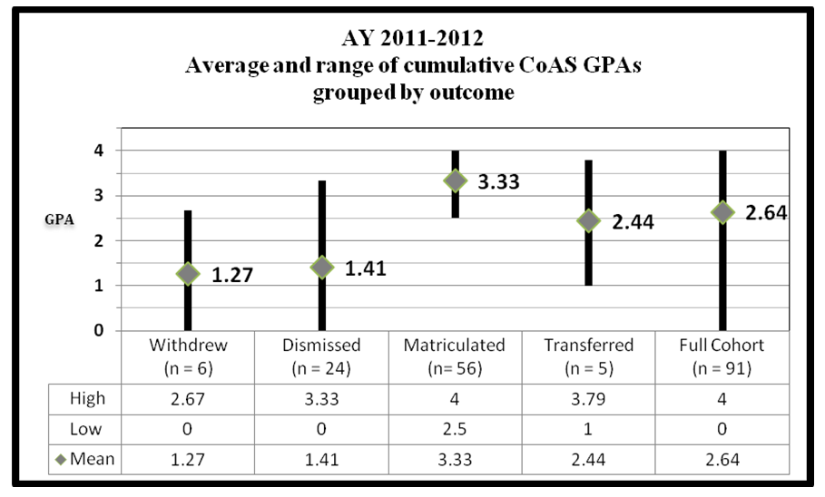
Settling the Score: Comparing IELTS and TOEFL iBT score gains in an international undergraduate conditional admissions program
II. ASSESSMENT
B. University Courses
1. Gateway CoAS performance
Figure 16
statistically
significant
NOT
statistically
significant
p<.01
p>.05

Slide 24
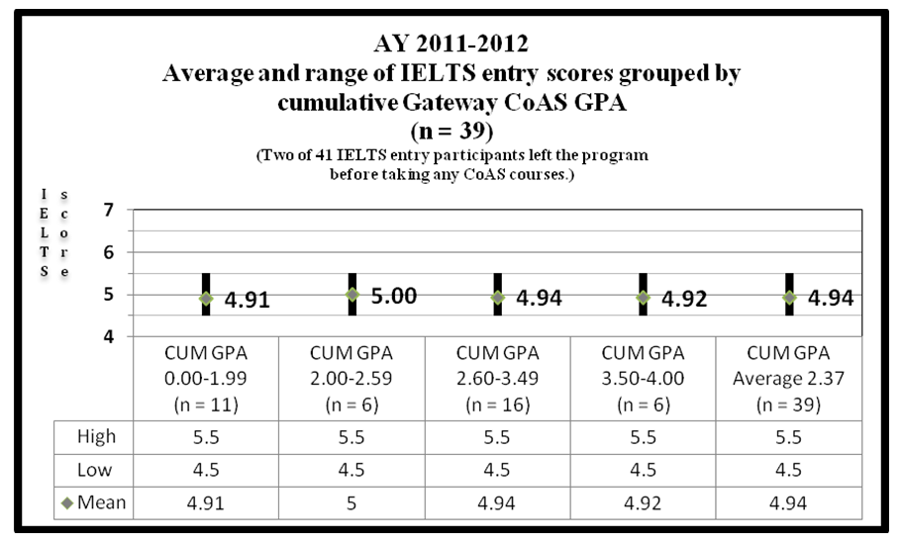
Settling the Score: Comparing IELTS and TOEFL iBT score gains in an international undergraduate conditional admissions program
II. ASSESSMENT
B. University Courses
2. Relationship between Gateway CoAS GPAs and entry scores
Figure 17
GPA : IELTS r < .1 (p > .05)

Slide 25
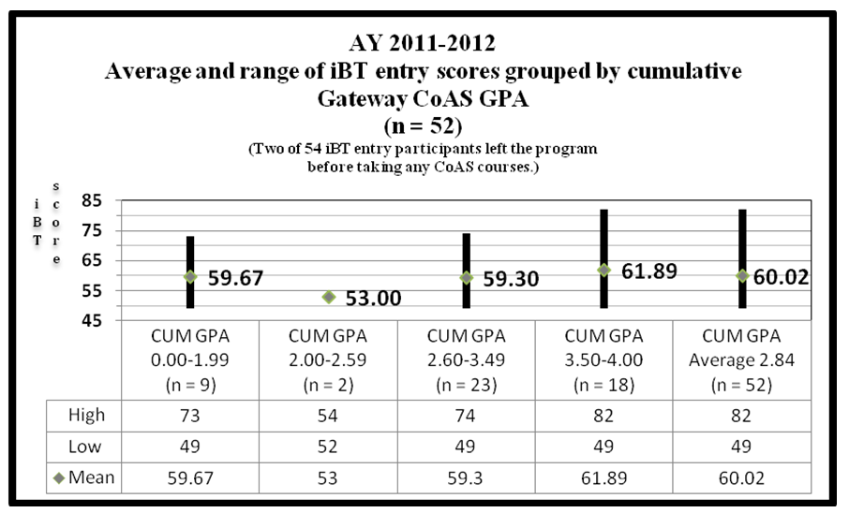
Settling the Score: Comparing IELTS and TOEFL iBT score gains in an international undergraduate conditional admissions program
II. ASSESSMENT
B. University Courses
2. Relationship between Gateway CoAS GPAs and entry scores
Figure 18
GPA : IELTS r < .1 (p > .05)

Slide 26
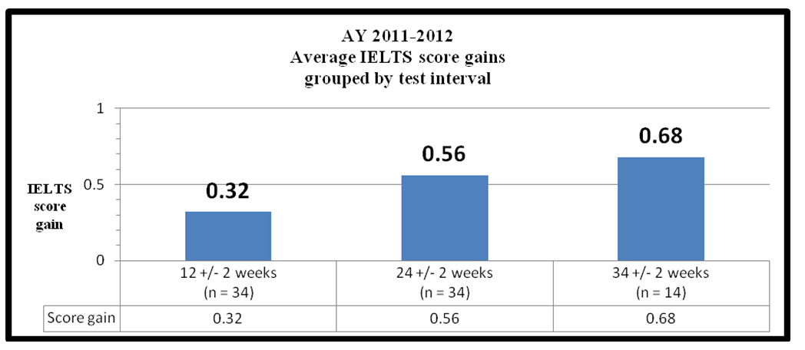
Settling the Score: Comparing IELTS and TOEFL iBT score gains in an international undergraduate conditional admissions program
II. ASSESSMENT
C. Standardized Test Progress
1. Composite score gains across intervals
Figure 19
.28
.23
The grouping of IELTS scores into specific testing intervals resulted in a loss of some data points. The IELTS attrition rate was 15 data points out of 97 (15%).

Slide 27
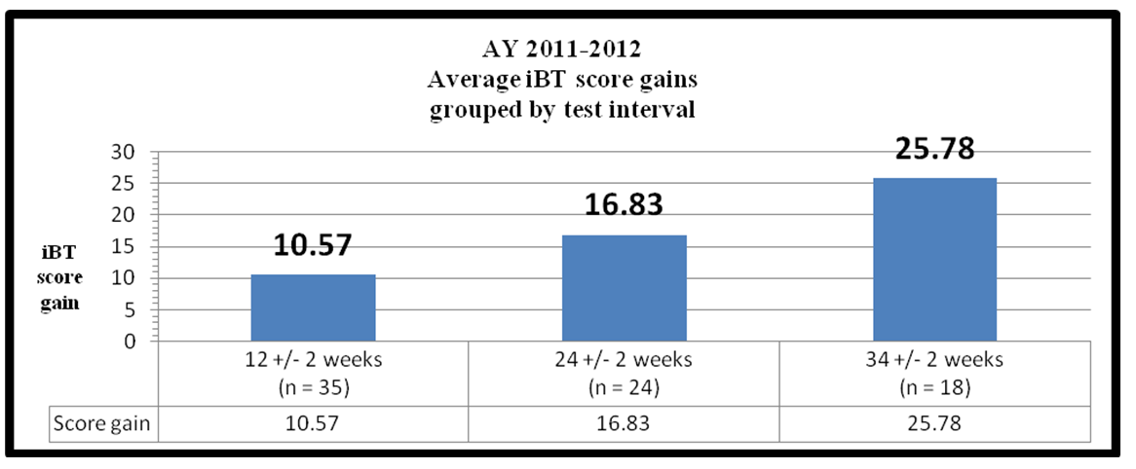
Settling the Score: Comparing IELTS and TOEFL iBT score gains in an international undergraduate conditional admissions program
II. ASSESSMENT
C. Standardized Test Progress
1. Composite score gains across intervals
Figure 20
8.42
8.59
The grouping of iBT scores into specific testing intervals resulted in a loss of some data points. The iBT attrition rate was 47 data points out of 121 (39%).

Slide 28
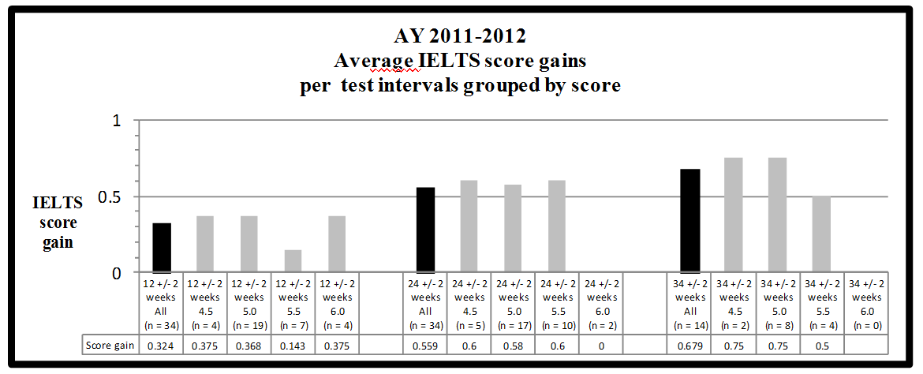
Settling the Score: Comparing IELTS and TOEFL iBT score gains in an international undergraduate conditional admissions program
II. ASSESSMENT
C. Standardized Test Progress
2. Composite score gains by subgroups
Figure 21

Slide 29
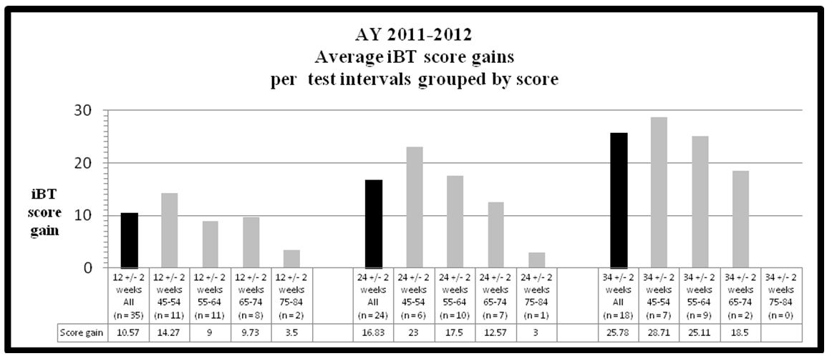
Settling the Score: Comparing IELTS and TOEFL iBT score gains in an international undergraduate conditional admissions program
II. ASSESSMENT
C. Standardized Test Progress
2. Composite score gains by subgroups
Figure 22

Slide 30
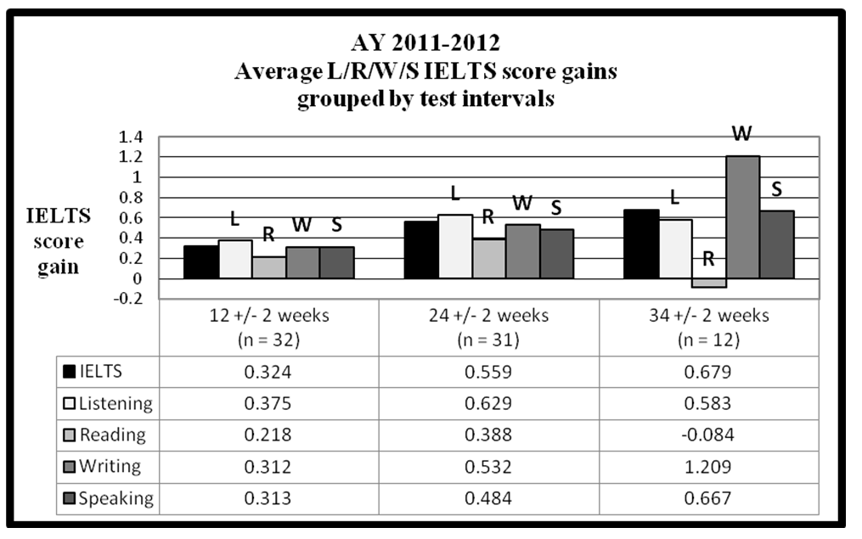
Settling the Score: Comparing IELTS and TOEFL iBT score gains in an international undergraduate conditional admissions program
II. ASSESSMENT
C. Standardized Test Progress
3. Score gains by module
Figure 23

Slide 31
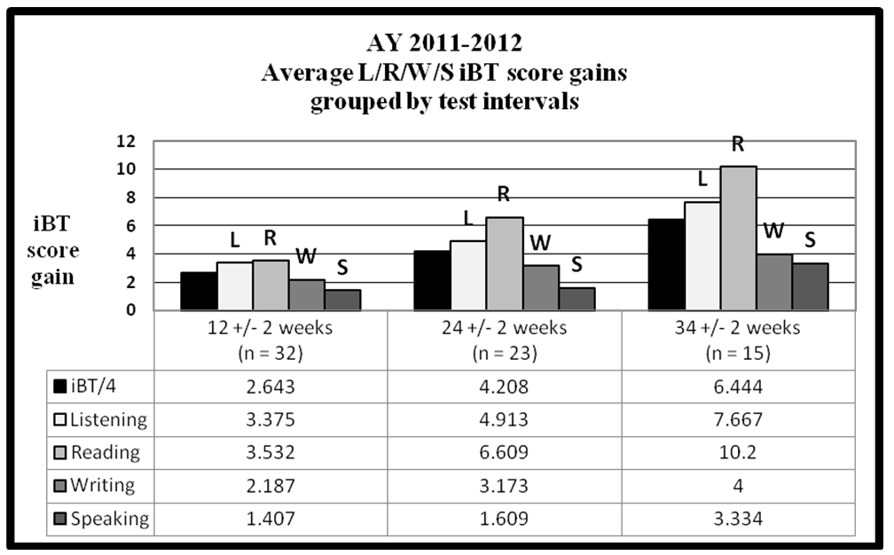
Settling the Score: Comparing IELTS and TOEFL iBT score gains in an international undergraduate conditional admissions program
II. ASSESSMENT
C. Standardized Test Progress
3. Score gains by module
Figure 24

Slide 32
Settling the Score: Comparing IELTS and TOEFL iBT score gains in an international undergraduate conditional admissions program
II. ASSESSMENT
C. Standardized Test Progress
3. Score gains by module
Table 6
AY 2011-2012 IELTS versus iBT score-gain module rankings
 | LOWER HIGHER score gains score gains
IELTS | Reading | Speaking | Writing | Listening
iBT | Speaking | Writing | Listening | Reading
HIGHER ENTRY SCORES LEAD TO SMALLER GAINS
LOWER ENTRY SCORES LEAD TO GREATER GAINS
1st entry
2nd entry
4th entry
3rd entry
2nd entry
1st entry
3rd entry
4th entry

Slide 33
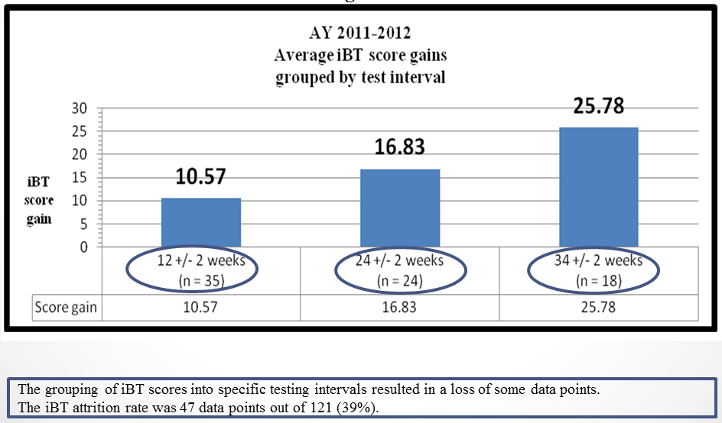
Settling the Score: Comparing IELTS and TOEFL iBT score gains in an international undergraduate conditional admissions program
II. ASSESSMENT
D. Repeat Test-Taking: Estimating an iBT Familiarity Effect
Figure 20
?

Slide 34
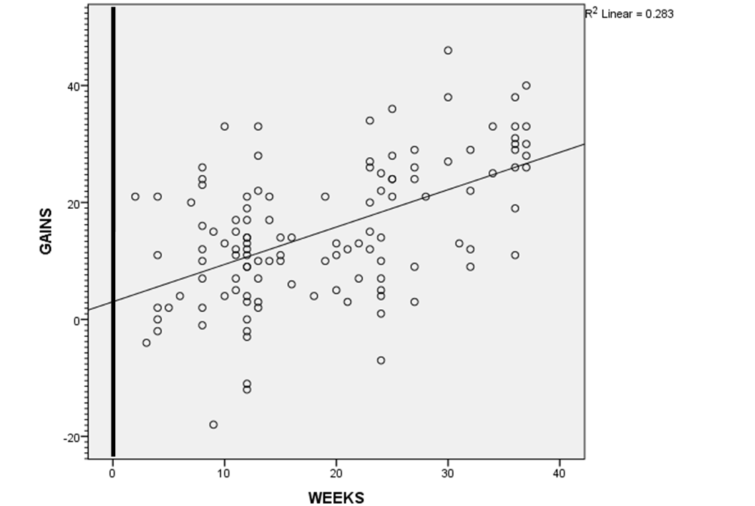
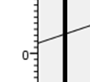
Settling the Score: Comparing IELTS and TOEFL iBT score gains in an international undergraduate conditional admissions program
II. ASSESSMENT
D. Repeat Test-Taking: Estimating an iBT Familiarity Effect
Figure 25
n = 121
WEEKS : iBT GAINS .532 (p < .01)
3.03
Model |  | Unstandardized Coefficients |  | Standardized Coefficients | t | Sig. | Correlations |  |  | Collinearity Statistics
 |  | B | Std. Error | Beta |  |  | Zero-order | Partial | Part | Tolerance | VIF
1 | (Constant) | 3.030 | 1.979 |  | 1.531 | .129
 | WEEKS | .639 | .093 | .532 | 6.859 | .000 | .532 | .532 | .532 | 1.000 | 1.000

Slide 35
Settling the Score: Comparing IELTS and TOEFL iBT score gains in an international undergraduate conditional admissions program
II. ASSESSMENT
E. Matriculated University Performance
Table 7
AY 2011-2012 Gateway GPA
 | CoAS Gateway GPA |  |  |  | Matriculated Gateway GPA
Term | Winter 2011 | Spring 2012 | Summer 2012 | CUM GW | Fall 2012 | Winter 2013 | Spring 2013 | CUM MAT
n | 91 | 64 | 12 | 91 | 56 | 56 | 56 | 56
GPA | 2.71 | 3.24 | 3.11 | 2.64 | 2.80 | 3.17 | 3.16 | 3.10

Slide 36
Settling the Score: Comparing IELTS and TOEFL iBT score gains in an international undergraduate conditional admissions program
II. ASSESSMENT
F. Comparison among Gateway Matriculated GPAs and Direct Admission GPAs
Table 8
AY 2011-2012 Matriculated Gateway GPA compared to first- and second-year direct admission GPA
Term | Direct international | Gateway | Direct domestic
Fall 2012 | 2.85 (n = 424) | 2.80 (n = 56) | 3.12 (n = 2,636)
Winter 2013 | 2.88 (n = 415) | 3.17 (n = 56) | 3.03 (n = 2,556)
Spring 2013 | 3.01 (n = 400) | 3.16 (n = 56) | 3.05 (n = 2,468)
CUM 1st Year 2012-2013 | 2.87 (n = 424) | 3.10 (n = 56) | 3.04 (n = 2,640)
CUM 2nd Year 2013-2014 | 3.04 (n = 358) | 3.14 (n = 54) | 3.18 (n = 2,283)
>
<
<
>
<
>
<
>
<
<

Slide 37
Settling the Score: Comparing IELTS and TOEFL iBT score gains in an international undergraduate conditional admissions program
III. CONCLUSIONS
A. Research Answers
1. What is the relationship between measurements of English language proficiency and standardized IELTS and iBT scores?
CONCURRENT VALIDITY
Correlations between IELTS/iBT entry scores and IEP placement are variable ranging from statistically significant (p < .01) highs (r > .6) to insignificant (p > .05) lows (r < .2).
High IELTS: r = .641 (p < .01) IELTS Speaking entry scores to IEP L/S placement
High iBT r = .451 (p < .01) iBT Writing entry scores to IEP R/W placement
Across four exam modules and two IEP placement instruments:
IELTS entry scores appear to track IEP placement more closely than iBT entry scores.
Speaking and Writing modules (productive tasks) on both exams match IEP placement more closely than Listening and Reading (receptive tasks).
Drexel IEP placement exams are based upon speaking and writing samples.
Related research
Geranpayeh, A. (1994). Are score comparisons across language proficiency test batteries justified? An IELTS-TOEFL comparability study. Edinburgh Working Papers in Applied Linguistics, 5: 50–65.

Slide 38
Settling the Score: Comparing IELTS and TOEFL iBT score gains in an international undergraduate conditional admissions program
III. CONCLUSIONS
A. Research Answers
1. What is the relationship among IEP progression rates, IELTS and iBT entry scores, CoAS GPAs and successful matriculation?
CONCURRENT VALIDITY
Figure 26
Across several measures, successful Gateway participants are uniformly (and occasionally statistically) superior to their dismissed or withdrawn peers.
Related research Bellingham, L. (1993). The relationship of language proficiency to academic success for international
students. New Zealand Journal of Educational Studies 30(2): 229-232.
NOT

Slide 39
Settling the Score: Comparing IELTS and TOEFL iBT score gains in an international undergraduate conditional admissions program
III. CONCLUSIONS
A. Research Answers
1. What is the relationship between English language proficiency and standardized IELTS and iBT scores?
CONCURRENT VALIDITY
IELTS
Craven, E. (2012). The quest for IELTS Band 7.0: Investigating English language proficiency development of international students at an Australian university. IELTS Research Reports, vol. 13: 1-61.
Elder, C. & O’Loughlin, K. (2003). Investigating the relationship between intensive English language study and band score gain on IELTS. IELTS Research Reports, vol. 4: 207-241.
Ingram, D. & Bayliss, A. (2007). IELTS as a predictor of academic language performance, Part 1. IELTS Research Reports, vol. 7: 137-191.
O’Loughlin, K. & Arkoudis, S. (2009). Investigating IELTS exit score gains in higher education. IELTS Research Reports 10: 95-180.
Paul, A. (2007). IELTS as a predictor of academic language performance: Part 2. IELTS Research Reports, vol. 7: 205-240.
iBT
Ling, G., Powers, D. & Adler, R. (2014). Do TOEFL iBT Scores Reflect Improvement in English-Language Proficiency? Extending the TOEFL iBT Validity Argument. ETS Research Report, RR-14-09. Princeton, NJ: ETS.

Slide 40
Settling the Score: Comparing IELTS and TOEFL iBT score gains in an international undergraduate conditional admissions program
III. CONCLUSIONS
A. Research Answers
2. What is the relationship between standardized IELTS and iBT scores and GPA performance?
PREDICTIVE VALIDITY
CoAS GPAs issued during the program do not correlate with IELTS and iBT entry scores.
Unlike increasing IELTS and iBT scores, CoAS GPAs do not (and should not be expected) to increase on a term-by-term basis.
Both dynamics deflate correlations between standardized IELTS and iBT scores and CoAS GPAs.
Moreover, neither entry scores nor rates of score gain correlate with post-program GPAs.
This suggests that once a minimal threshold of linguistic proficiency has been achieved. GPAs reflect mastery of course content (and other factors)—not language skills.

Slide 41
Settling the Score: Comparing IELTS and TOEFL iBT score gains in an international undergraduate conditional admissions program
III. CONCLUSIONS
A. Research Answers
2. How do first-year and second-year post-Gateway matriculated students compare against directly admitted students in terms of GPAs?
PREDICTIVE VALIDITY
Figure 27
Gateway alumni often exhibit a slight (but not statistically significant) edge over direct peers.

Slide 42
Settling the Score: Comparing IELTS and TOEFL iBT score gains in an international undergraduate conditional admissions program
III. CONCLUSIONS
A. Research Answers
2. How do first-year and second-year post-Gateway matriculated students compare against directly admitted students in terms of GPAs?
PREDICTIVE VALIDITY
IELTS
Cotton, F. & Conrow, F. (1998). An investigation of the predictive validity of IELTS amongst a sample of international students studying at the University of Tasmania. IELTS Research Reports, vol. 1: 72-115.
Dooey, P. & Oliver, R. (2002). An investigation into the predictive validity of the IELTS test as an indicator of future academic success. Prospect 17(1), 36‐54.
Humphreys, P., Haugh, M., Fenton-Smith, B., Lobo, A., Michael, R. & Walkenshaw, I. (2012). Tracking international students’ English proficiency over the first semester of undergraduate study. IELTS Online Series 2012/1.
Kerstjens, M & Nery, C. (2000). Predictive validity in the IELTS test: A study of the relationship between IELTS scores and students’ subsequent academic performance. IELTS Research Reports, vol. 3: 85-108.
iBT
Cho, Y. & Bridgeman, B. (2012). Relationship of TOEFL iBT scores to academic performance: Some evidence from American universities. Language Testing 29(3), 421-442.
BOTH
Arcuino, C. (2013). The Relationship between the Test of English as a Foreign Language (TOEFL), the International English Language Testing System (IELTS) Scores and Academic Success of International Master’s Students. Unpublished dissertation. Colorado State University, Fort Collins, Colorado.
Hill, K., Storch, N., & Lynch, B. (1999). A comparison of IELTS and TOEFL as predictors of academic success. IELTS Research Reports, vol. 2: 53-63.

Slide 43
Settling the Score: Comparing IELTS and TOEFL iBT score gains in an international undergraduate conditional admissions program
III. CONCLUSIONS
A. Research Answers
3. What is the quantity and rate of IELTS and iBT score gains across multiple testing intervals and the relative balance among modules?
SCORE GAINS
IELTS: .32 to .23 points (12 ± 2 week period)
iBT: 10.57 to 8.42 points (12 ± 2 week period)
Longer intervals predictably produce higher score gains, but higher scores produce leveling effects.
Bear in mind the SEM values for these tests: 0.23 for IELTS (2013, www.ielts.org)
5.64 for iBT TOEFL (2011, www.ets.org)
This means that there is only a 68% chance IELTS scores are accurate within 0.23 points and iBT scores within 5.64 points.
Estimates of IEP hours of study to score gains are rough extrapolations.
IEP progression: approaches 1 level/11-week term
Extrapolation:
IELTS: ≈ 1 point/3 terms
iBT: ≈ 30 points/3 terms
Hours/points:
IELTS: ≈ 600 contact hours/1 point
iBT: ≈ 600 contact hours/30 points

Slide 44
Settling the Score: Comparing IELTS and TOEFL iBT score gains in an international undergraduate conditional admissions program
III. CONCLUSIONS
A. Research Answers
3. What is the quantity and rate of IELTS and iBT score gains across multiple testing intervals and the relative balance among modules?
SCORE GAINS
IELTS: .32 to .23 points (12 ± 2 week period)
Table 9
IELTS Average Score Gains
 | Score gain | n | Interval
Gateway AY 2011-2012 | .32 | 34 | ≈ 3 months
Heitner, Hoekje & Braciszewski (2014) (Gateway AY 2010-2011) | .35 | 32 | ≈ 3 months
Craven (2012) | .30 | 40 | ≈ 19 to 36 months
Elder & O’Loughlin (2003) | .598 | 112 | ≈ 3 months
Green (2004) (only Writing) | .29 | 3,052 | at least 3 months
Green (2004) (only Writing) | .37 | 15,380 | at least 3 months
Humphreys, et al. (2012) | .107 | 51 | ≈ 4 months
O’Loughlin & Arkoudis (2009) | .413 | 63 | ≈ 12 to 36 months
Read & Hayes (2003) (excluding Speaking) | .36 | 17 | 1 month

Slide 45
Settling the Score: Comparing IELTS and TOEFL iBT score gains in an international undergraduate conditional admissions program
III. CONCLUSIONS
A. Research Answers
3. What is the quantity and rate of IELTS and iBT score gains across multiple testing intervals and the relative balance among modules?
SCORE GAINS
iBT: 10.57 to 8.42 points (12 ± 2 week period)
Table 10
For pre-iBT (pre-2005) TOEFL score-gain research, see
Wilson, K. (1987). Patterns of test taking and score change for examinees who repeat the Test of English as a Foreign Language. TOEFL research report #22. Princeton, NJ: Educational Testing Service.
Des Brisay, M., and Ready, D. (1995). Defining an appropriate role for language tests in intensive English programs. In A. Srainee (Ed.). Issues in language program evaluation in the 1990s. Anthology series 27. Singapore: Southeast Asian Regional Language Center.
iBT Average Score Gains
 |  | Score gain | n | Interval
Gateway AY 2011-2012 |  | 25.78 | 35 | ≈ 9 months
Ling, Powers & Adler (2014) | China | 12.19 | 90 | 9 months
 | USA | 23.11 | 21 | 9 months

Slide 46
Settling the Score: Comparing IELTS and TOEFL iBT score gains in an international undergraduate conditional admissions program
III. CONCLUSIONS
A. Research Answers
3. What is the quantity and rate of IELTS and iBT score gains across multiple testing intervals and the relative balance among modules?
SCORE GAINS
Table 11
IELTS and iBT score gain module rankings
 | LOWER HIGHER
IELTS | GW AY 2011-2012 | Reading | Speaking | Writing | Listening
 | GW AY 2010-2011 | Reading | Listening | Writing | Speaking
 | Craven (2012) | Writing | Speaking | Listening | Reading
 | Elder & O’Loughlin (2003) | Reading | Speaking | Writing | Listening
 | Humphreys, et al. 2012) | Listening | Writing | Reading | Speaking
 | O’Loughlin & Arkoudis (2009) | Writing | Speaking | Listening | Reading
iBT | GW AY 2011-2012 | Speaking | Writing | Listening | Reading
 | Ling, Powers & Adler (2014) China | Speaking | Writing | Listening | Reading
 | Ling, Powers & Adler (2014) USA | Listening | Reading | Speaking | Writing
 | Norton (2011) | Speaking | Listening | Writing | Reading
 | Zhang (2008) | Speaking | Writing | Listening | Reading

Slide 47
Settling the Score: Comparing IELTS and TOEFL iBT score gains in an international undergraduate conditional admissions program
III. CONCLUSIONS
A. Research Answers
3. What is the quantity and rate of IELTS and iBT score gains across multiple testing intervals and the relative balance among modules?
SCORE GAINS
Among IELTS modules, no clear patterns of language advancement. In particular, no obvious distinction between receptive skills (Listening and Writing) and productive skills (Writing and Speaking).
However, among iBT modules, Reading appears to be a leading indicator and Speaking a lagging indicator.
Stricker & Attali (2010) report candidates rate iBT Speaking least favorably. Why? Perhaps because the Speaking test is not a human conversation? But causality is not obvious: Disfavorability may be the result of receiving lower score gains, or lower score gains may be the result of disfavorable attitudes. Or perhaps something about the module is responsible for both lower favorability and lower score gains.
Related research
Suryaningsih, H. (2014). Students' perceptions of International English Language Testing System (IELTS) and Test of English as a Foreign Language (TOEFL) tests. Unpublished master’s thesis. Indiana University of Pennsylvania, Indiana, Pennsylvania.
Score gains are inversely related to entry scores.

Slide 48
Settling the Score: Comparing IELTS and TOEFL iBT score gains in an international undergraduate conditional admissions program
III. CONCLUSIONS
A. Research Answers
4. What is the iBT score-gain effect of repeat test-taking—merely sitting for the test again?
FAMILIARITY EFFECT
As should be expected, there is a quantifiable iBT familiarity effect.
3.03 “free” points for merely retaking the iBT exam, comparable to other findings.
Table 12
Average short-term iBT score gains
 | AY 2011-2012 | Zhang (2008) | Norton (2011)
Score gain | 3.03 | 3.74 | 4.36
n | 121 | 12,000 | 25
Interval | 0 days | within 30 days | within 30 days

Slide 49
Settling the Score: Comparing IELTS and TOEFL iBT score gains in an international undergraduate conditional admissions program
III. CONCLUSIONS
A. Research Answers
4. What is the iBT score-gain effect of repeat test-taking—merely sitting for the test again?
FAMILIARITY EFFECT
Both Zhang (2008) and Norton (2011) were short-interval “stability studies.” The latter designed “to reduce as far as possible the effect of a real increase in language skill” (Norton 2011, p. 36).
Given a measurable familiarity effect, should “test-wiseness” be discouraged? Should the effects of test experience be discounted?
Consider that test experience can improve rather than undermine validity. As argued by Messick (1996), repeat test-taking can more accurately reveal true language abilities—by reducing the novelty of the test and the anxiety of the test-taker. Repeat test-taking can, in this way, be a factor increasing—not an artifact decreasing—test validity.
Related research Kokhan & Lin (2014) review repeat test-taking score-gain research relative to iBT TOEFL and other standardized exams (e.g., SAT, LSAT, MCAT).

Slide 50
Settling the Score: Comparing IELTS and TOEFL iBT score gains in an international undergraduate conditional admissions program
III. CONCLUSIONS
B. References
Arcuino, C. (2013). The Relationship between the Test of English as a Foreign Language (TOEFL), the International English Language Testing System (IELTS) Scores and Academic Success of International Master’s Students. Unpublished dissertation. Colorado State University, Fort Collins, Colorado.
Bellingham, L. (1993). The relationship of language proficiency to academic success for international students. New Zealand Journal of Educational Studies 30(2): 229-232.
Cho, Y. & Bridgeman, B. (2012). Relationship of TOEFL iBT scores to academic performance: Some evidence from American universities. Language Testing 29(3), 421-442.
Cotton, F. & Conrow, F. (1998). An investigation of the predictive validity of IELTS amongst a sample of international students studying at the University of Tasmania. IELTS Research Reports, vol. 1: 72-115.
Craven, E. (2012). The quest for IELTS Band 7.0: Investigating English language proficiency development of international students at an Australian university. IELTS Research Reports, vol. 13: 1-61.
Des Brisay, M., and Ready, D. (1995). Defining an appropriate role for language tests in intensive English programs. In A. Srainee (Ed.). Issues in language program evaluation in the 1990s. Anthology series 27. Singapore: Southeast Asian Regional Language Center.
Dooey, P. & Oliver, R. (2002). An investigation into the predictive validity of the IELTS test as an indicator of future academic success. Prospect 17(1), 36‐54.
Elder, C. & O’Loughlin, K. (2003). Investigating the relationship between intensive English language study and band score gain on IELTS. IELTS Research Reports, vol. 4: 207-241.
Geranpayeh, A. (1994). Are score comparisons across language proficiency test batteries justified?: An IELTS-TOEFL comparability study. Edinburgh Working Papers in Applied Linguistics 5: 50–65.
Green, A. (2004). Making the grade: Score gains on the IELTS writing test. IELTS Research Notes 16: 9-13.
Heitner, R., Hoekje, B. & Braciszewski, P. (2014). Keys to College: IELTS Score Gains among International Students in an Undergraduate Conditional Admission Program. In J. Connor-Linton and L. Amoroso (Eds.), Georgetown University Round Table on Languages and Linguistics 2012: Measured Language: Quantitative Approaches to Acquisition, Assessment, Processing and Variation. Washington, DC: Georgetown University Press.
Hill, K., Storch, N., & Lynch, B. (1999). A comparison of IELTS and TOEFL as predictors of academic success. IELTS Research Reports, vol. 2: 53-63.
Humphreys, P., Haugh, M., Fenton-Smith, B., Lobo, A., Michael, R. & Walkenshaw, I. (2012).Tracking international students’ English proficiency over the first semester of undergraduate study. IELTS Online Series 2012/1.
Ingram, D. & Bayliss, A. (2007). IELTS as a predictor of academic language performance, Part 1. IELTS Research Reports, vol. 7: 137-191.
Kerstjens, M & Nery, C. (2000). Predictive validity in the IELTS test: A study of the relationship between IELTS scores and students’ subsequent academic performance. IELTS Research Reports, vol. 3: 85-108.
Kokhan, K. & Lin, C. (2014). Test of English as a Foreign Language (TOEFL): Interpretation of multiple score reports for ESL placement. Papers in Language Testing and Assessment, vol. 3(1): 1-23.
Ling, G., Powers, D. & Adler, R. (2014). Do TOEFL iBT Scores Reflect Improvement in English-Language Proficiency? Extending the TOEFL iBT Validity Argument. ETS Research Report, RR-14-09. Princeton, NJ: ETS.
Norton, D. (2011). Exploring discrepancies in the iBT scores of repeat test takers. Doshisha Women's College of Liberal Arts Academic Research Annual Report 62: 35-41.
O’Loughlin, K. & Arkoudis, S. (2009). Investigating IELTS exit score gains in higher education. IELTS Research Reports 10: 95-180.
Paul, A. (2007). IELTS as a predictor of academic language performance: Part 2. IELTS Research Reports, vol. 7: 205-240.
Read, J. & Hayes, B. (2003). The impact of the IELTS test on preparation for academic study in New Zealand. IELTS Research Reports, vol. 4: 153-206.
Stricker, L. & Attali, Y. (2010). Test takers’ attitudes about the iBT. iBT Research Report, TOEFLiBT-1, RR-10-02.
Suryaningsih, H. (2014). Students' perceptions of International English Language Testing System (IELTS) and Test of English as a Foreign Language (TOEFL) tests. Unpublished master’s thesis. Indiana University of Pennsylvania, Indiana, Pennsylvania.
Wilson, K. (1987). Patterns of test taking and score change for examinees who repeat the Test of English as a Foreign Language. TOEFL Research Report #22. Princeton, NJ: Educational Testing Service.
Zhang, Y. (2008). Repeater analyses for iBT. ETS Research Memorandum. RM-08-05.

Slide 51
SETTLING THE SCORE: Comparing IELTS and TOEFL iBT score gains in
an international undergraduate conditional admissions program
Reese M. Heitner, PhD rmh54@drexel.edu
DREXEL UNIVERSITY English Language Center

