Slide 1
Interpreting Assessment Process as Expressions of Culture and Identity
Irvin Peckham
Director of First-Year Writing
Drexel University

Slide 2
My History & Interest in Assessment
High school and Minimum Competency Movement
California Assessment Program—teaching to the test
Directing writing and large-scale assessment programs at the University of Nebraska, Omaha; Louisiana State University, and now at Drexel

Slide 3
Necessity of Assessment and How It Can Go Wrong
Assessment as a part of teaching
Factors making it go wrong:
Degree of removal from the classroom
Negative influence of outside stakeholders
Political and administrative posturing
Money—National testing organizations (like College Board and Pearson [Core Curriculum])

Slide 4
Fundamentals of Assessment
Genres of Assessment
Placement, classroom, program, institutional, accreditation, national. Mixed genres and sub-genres
For writing: complications of the writing construct.
Validity: consequential (in)validity—validity as consequence vs face validity (Messick, 1979)

Slide 5
Example of Non-Validity: SAT/ACT Writing Task for Placement (60 % of schools)
The Construct:
explicitly state a thesis, a position to be argued
anticipate counter arguments
counter-counter arguments
recognize claims that need substantiation from authoritative sources
assert and provide evidence for their claims
summarize in a final paragraph the argument
do this in twenty-five minutes
pretend they are invested in this argument addressed to a non-specified audience (in other words, pretend to be engaged in fake writing)

Slide 6
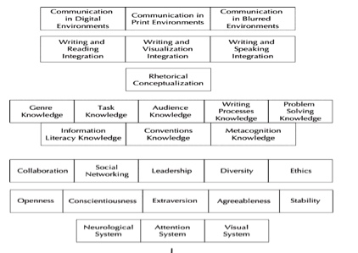
School Writing Construct: White, Elliott and Peckham: Very Like a Whale
Notes:
Domains: different domains of the post-secondary writing construct: environmental, language-arts framework, rhetorical, kinds of knowledge (fourth and fifth layers), interpersonal, intrapersonal, bodily.

Slide 7
School vs. Real-World Writing
This is only school writing—not the kind of writing one does after-school.
One can imagine the variations of the construct if we were to include diaries (nullifying several layers and elements of the construct—e.g., the entire first three layers, most of the fourth layer, most of the fifth layer (save metacognition), all of the sixth, and most of the seventh). If we move to rap poetry, fiction, song writing, texting, love emails, twittering, we further complicate the notion of “the writing construct.”

Slide 8
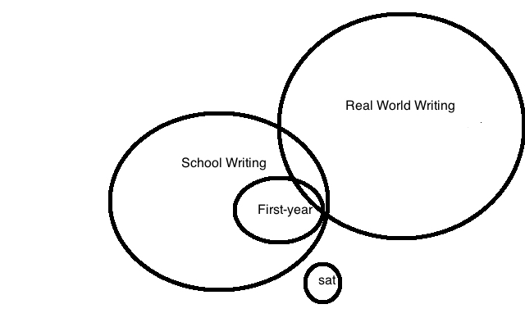
Universes of Writing

Slide 9
Misuse (Invalidity) of Assessment
Using SAT/ACT (isolated writing construct) for placement
Students on the basis of SES being assigned to non-credit writing classes
17 % of them achieve a bachelor’s
Mis-teaching of remedial writing to reproduce social-class privilege
Role of grades and standards in this misuse.
This is consequential invalidity (Messick) with unintended consequences (Bourdieu: Distinction—alladoxia)

Slide 10
Influence of Outside Stakeholders
In Small Groups [Someone take notes and report]
What is the influence of culture on your school’s/disciplines interpretation/use/misuse of assessment? Can you imagine an alternative interpretation?
To what degree do you agreed with the ideology of standards/grades?
How has this ideology influenced your institution’s (and your program’s) implementation of assessment?
Large Group Discussion

Slide 11
Drexel’s Shift
Discarding notion of writing as performance (a social class ability)
Using writing as communication in writing program (move toward real-world writing)
Writing as communication as the backbone of our program assessment—discarding the notion of standards (Imagine the departmental/institutional blowback). What—no standards???

Slide 12
Our Project
Ask students about what is and isn’t working—this is direct program assessment (students as collaborators).
Initial Inventory
Week 5 survey
102 looking back at 101
103 looking back at 102
Volunteer teachers: end of 103, looking back at the full year
Summaries of research sent to teachers and students

Slide 13
Part of initial inventory—about 1/3 of student’s response
Throughout my education, my opinions of English class has fluctuated from bad to good. Although it is not my favorite course, I have become more fond of English class and writing all together. Some of the things that effected my outlook on writing have been past experiences with writing and more importantly my English teachers.
While I was in grade school, English class was always one of the most painful class periods for me. I think the thing that bothered me the most were the tedious short stories that we always read in class. With little interest in them, my mind always seemed to wander somewhere else while all the other students rigorously read and answered the questions that immediately followed the conclusion of the story. In addition the short stories, each year we were assigned a new vocabulary book. Each week would be tested on another section of the book. This always was a nuisance to me. I would take the time to sit and learn each word and their definition just to forget it all the moment after the test was over. With the same pattern reoccurring year after year at Holy Spirit Grade School, I had little hope for my appreciation for English Class, writing, and reading all together.

Slide 14
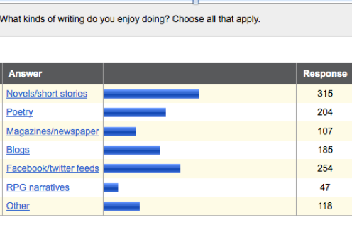
Out-of-School Writing (out of 600)

Slide 15
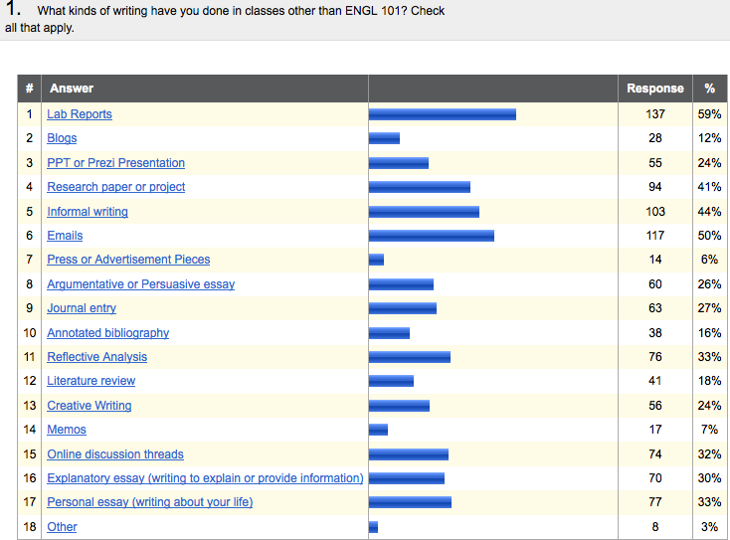
Kinds of Writing in Other Classes
So Why Are We Teaching Argument (a Class-Privileged Discourse)?

Slide 16
Argument—Evidence-based Writing
Why have we bought into this?
What has been the institutional/cultural influence influencing school-genres?
What has been the institutional/cultural influence elevating “assessment” and what are the dangers of this game?

Slide 17
Take-Away
Be careful of the contradictory link between real and fake assessment (like real and fake writing).
Interrogate your own position—can you link your assessment positions to actual classroom practices? Have you tried them out in the classroom? Or do they only sound good because they fit the ideology of a meritocratic culture?
Pay attention to Will Richardson—he’s in the New Jersey: creativity vs. five-paragraph thinking.

