Slide 1
Engaging Faculty Meaningfully in Assessment through Shared Governance Lori Simons, Janine Utell, and Brigitte Valesey Widener University Drexel University’s 2nd Annual Conference on Teaching and Learning Assessment Assessment for Student Success : Building Academic Innovation and Renewal September 9, 2015

Slide 2
Introductions: Who are we?
Lori Simons, Chair, Student Learning Assessment Committee and Professor of Psychology
Janine Utell, Middle States Tri-chair and Professor and Chair of English
Brigitte Valesey, Assistant Provost for Teaching, Learning and Assessment
Notes:
JMU

Slide 3
Session Outcomes
Describe effective shared governance approaches for assessment.
Identify shared governance approaches for assessment that can be implemented at your own institutions.
Notes:
JMU

Slide 4
Peer Group Discussion #1
Why are you interested in this session topic?
What are some strengths and gaps in engaging faculty in assessment through your current governance committees? How well is it working?
How does your institution currently close the loop on assessment? How does closing the loop impact program curriculum and general education?
Notes:
JMU

Slide 5
Share Your Thoughts
Notes:
JMU:

Slide 6
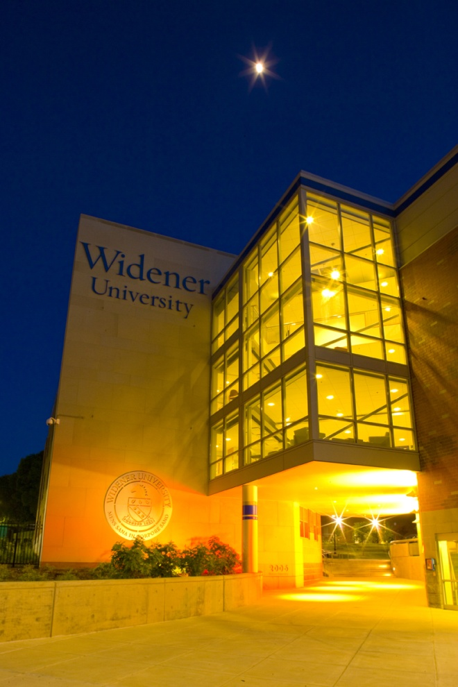
Case Example: Widener University
Private, doctoral intensive
8 schools and colleges; 4 campuses
6500 students
300+ full time faculty
Shared governance structure
Institutional support for assessment
Notes:
BV

Slide 7
What are we assessing? Institutional Learning Objectives (ILOs)-Students will
Demonstrate knowledge, skills, and scholarship appropriate to their major field of study.
Think critically and communicate effectively.
Demonstrate the attributes of professional and civic leadership.
Demonstrate characteristics of responsible citizenship.

Slide 8
What are we assessing? General Education Goals and Objectives (GEGOs) A liberally educated graduate:
Communicates effectively.
2. Thinks critically.
3. Uses quantitative methods effectively.
4. Has developed a wide range of intellectual perspectives and methodologies.
Notes:
LS: made larger, fixed alignment

Slide 9
Faculty Engagement in Assessment: Planning, Implementation, and Progress
Preparing
Piloting
Piloting plans
Doing
Leveraging
Embedding processes and practices
Seeking commitments
Tweaking processes
Building culture
Engaging faculty governance
Recognizing faculty scholarship
Revising measures
Sharing findings
Focusing on improving learning
Planning for assessment
Reporting results
Developing assessment habits of mind
Examining status of assessment
(2004-2007)
(2007-2010)
(2012-2014)
(2010-2012)
Notes:
BV

Slide 10
Faculty Engagement in Assessment: Changing Roles in Assessment
Preparing
Piloting
Implementation Committee for Assessment of Student Learning (ICASL)
Doing
Leveraging
Faculty Council Student Learning Assessment Committee (FC-SLAC)
ICASL
Task Force for Assessment of Student Learning
Assistant Provost (AP) for Student Learning Assessment
AP for Student Learning Assessment
Program Assessment Coordinators
AP for Teaching, Learning, Assessment
Deans and Program Chairs
FC Subcommittees-Gen Ed, ILO#3, ILO#4, Diversity
AP for Teaching, Learning, Assessment
Program Assessment Coordinators & Committees
Faculty, Staff
(2004-2007)
(2007-2010)
(2012-2014)
(2010-2012)
Notes:
Connecting Roles with Assessment activities

Slide 11
Shared Governance: Faculty Council
Faculty Council Executive Committee
Student Learning Assessment Committee
Gen Ed Subcommittee
Ad Hoc Committee
ILO#3
Ad Hoc Committee
ILO#4
Ad Hoc Committee
Diversity
Notes:
BV

Slide 12
Faculty Assessment Committee Charge
A. The charge to the Faculty Council Student Learning Assessment Committee (FC-SLA) is to:
(1). Gather information and review assessment reports relating to university-wide student learning goals and objectives;
(2). Make recommendations on university policies, academic requirements, and assessment processes to improve achievement of university-wide student learning outcomes;
(3). Report to Executive Committee and Council on assessment of university-wide student learning goals and objectives, and on recommendations to improve student learning;
(4). Collaborate with the Provost on the implementation of recommendations regarding learning goals and objectives that are endorsed by Faculty Council.
Notes:
LS

Slide 13
Case Example: Widener University
Examples of FC-SLA Activities (2014-2015)
Expanded the composition of the committee
Reviewed the University Diversity Assessment
Developed and approved the charge for and the composition of ILO #3 (Leadership) and #4 (Citizenship) Subcommittees
Gathered data on High Impact Practices
Reviewed the ILO #1 (Knowledge) reports and made recommendations about University assessment of student learning
Aligned the National Survey Student Engagement (NSSE) questions with the ILOs, analyzed the data, and made recommendations.
Notes:
LS
Diversity report and made the recommendation to have the General Education Subcommittee review this report. The General Education Subcommittee reviewed the report, refined the diversity assessment rubric, and formed the University Diversity Ad Hoc Committee. FC-SLA approved the formation for this Ad Hoc Committee. FC-SLA proposed the formation of the Ad Hoc Committee to FC-Executive Committee; the Ad Hoc committee was approved and formed.
Developed a High Impact Practice (HIP) tool to gather data, gathered analyzed data to make summaries about where HIPs are occurring in the different curricula and co-curricula activities across the University

Slide 14
Collection of Data/Actions on Findings
Planning
University-wide assessment agenda
Doing
Student work samples, data
Acting
Recommendations to FC-Executive Committee
Common rubrics
Analysis and summary of findings
Executive Committee specifies followup actions
Shared commitment for improving learning
Agreed-upon outcomes and priorities
Notes:
BV-overall scope of work

Slide 15
Case Example: Widener University
Incentives/Rewards for Faculty
Examples
Service through participation in shared governance is rewarded in promotion/tenure and merit.
Faculty can make clear connections between their work in governance and their work in teaching.
Service becomes a form of professional development.
Continuous improvement of teaching becomes an institutional priority.
Notes:
JMU

Slide 16
Peer Group Discussion #2
What do you need to effect change on your campus?
What are the obstacles to faculty participation in assessment via shared governance?
How do you engage faculty and how do you train faculty?
Notes:
JMU

Slide 17
Share Your Thoughts

Slide 18
Conclusion: Benefits of Effective Shared Governance
Communication
Transparency
Shared expectations
Shared goals
Shared mission
Clear agenda/action items
All voices/stakeholders represented
Scholarship
Cross-disciplinary collaborations
Notes:
JMU

Slide 19
Conclusion: Benefits of Effective Shared Governance
Additional benefits????
Notes:
JMU

Slide 20
Conclusion: Benefits of Effective Shared Governance
Shared governance means faculty members are accountable to each other for meaningful assessment of student learning.
Notes:
BV—I put the assessment spin on this slide

