Slide 1
COHORTING: When a Course is Used to Assess Multiple Degree Programs
Snapshot Presentation:
PATRICIA AWERBUCH
School of Economics
Drexel University
Annual Conference on Teaching and Learning Assessment, Drexel University, Philadelphia, PA
September 9 to 11, 2015

Slide 2
Degree Programs Assessed by the School of Economics:
Bachelor of Science in Economics (BSEC)
Bachelor of Arts in Economics (BAEC)
Bachelor of Science in Business Administration (BSBA)
In coming Academic Year:
Bachelor of Science in Business Administration Online (BSBA-ONL)

Slide 3
Program Objective and Goal
Shared Program-Level Objective:
Upon graduation, student will understand basic economic concepts
Shared Goal:
Student demonstrates an understanding of basic economic concepts

Slide 4
Courses in Which Assessment Takes Place:
Econ 201 – Principles of Microeconomics
Econ 202 – Principles of Macroeconomics
Fifty to sixty sections of these courses (in total) run every academic year, 60 students per section.

Slide 5
The Challenge: Voluminous Data
How do we extract data by degree program from the >2000 Business and non-Business students who are enrolled? (What are the mechanics of it?)
Do our course-level objectives serve the needs of the degree programs for which we are responsible? (Or are we ‘pitching to the middle’ and getting low outcomes as a result?)
Is the voluminous data even telling us what we want to know about low outcomes? (Is end-of-term assessment informative?)

Slide 6
Early Stumble and Correction:
2006-2014: data collected and reported by course rather than by degree program.
Assess two to four sections every two years (approximately) and assemble outcomes without regard to degree program.
Winter 2014: began attempts to extract data by degree program, needing an efficient way to do this.
Assess as many sections as necessary to get adequate results from our three degree programs

Slide 7
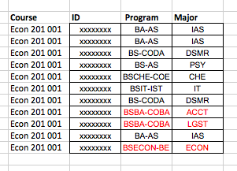
Phase 1: Hyperion
Drexel University uses Hyperion performance management system to manage course registrations. The School secretary furnished class lists to the assessment coordinator on an Excel spreadsheet.
Hyperion
Records:

Slide 8
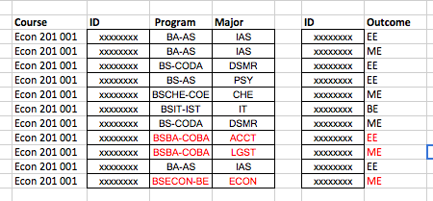
Phase 1: Hyperion
Hyperion output (left) was compared to assessment outcomes reported by faculty (right), by aligning student i.d. numbers. Outcomes for relevant degree programs were extracted and reassembled by assessment coordinator.

Slide 9
Phase 1: Hyperion
Not an efficient system for thousands of records!
In order to get a respectable sample of the degree program we wanted, we had to assess all 8-9 sections of each course, throwing away at least 40% of the data after processing it.
Assessment coordinator needed six days to process the data for recording.

Slide 10
A Serendipitous Change in Procedure
In AY 2013-14 Drexel began cohorting its incoming freshman by degree program, major, and learning communities, primarily to promote acclimation and peer-to-peer assistance.
Although initiated for a different reason, cohorting greatly eased the pressure on assurance of learning:

Slide 11
Phase 2: Cohorting
The mechanism:
Our Director of College Operations receives the list of enrolled students from the registrars office.
He assigns them to sections of their courses based on College criteria for degree program, major, participation in learning communities, block-scheduling, etc.
Faculty are assigned to sections in collaboration with the school or department, e.g. BSEC and BAEC students are always taught by a tenured or tenure-track Ph.D. professor.

Slide 12
Phase 2: Cohorting
BSEC and BAEC students are now in one section
One sorting gives us data on two degree programs, and all the data we gather is used
Mastery of economics can be assessed at a deeper level for Economics majors. We now assess course-level outcomes at the midterm and at the final, giving deeper insight into where exactly any problem arises
Two sections with BSBA students are assessed each term instead of assessing 8-9 sections to capture enough BSBA students
Sections chosen for assessment can be ‘rotated’ among the faculty, so that not all faculty are having to perform assessment every term.
We can do assessment every term without burdening the faculty.

Slide 13
Big School, Small School
Data management was an issue for us because of the number of students enrolled in Economics Principles classes. With cohorting, the problem became its own solution because we can fill a section from a single degree program.
Smaller schools may not have an independent reason for cohorting, but might benefit from selected cohorting into courses used for Assurance of Learning.

Slide 14
Mechanism for Selected Cohorting
Smaller schools might implement cohorting for select courses by combining the “registration training” process with the cohorting process.
Drexel puts small groups of students in coaching sessions with their academic advisors to learn the mechanics of registration.
A participating representative from College Operations can assure that students register for the correct section of relevant courses by degree program(s). Any necessary block-scheduling would have to be prepared in advance.

Slide 15
Ultimate Goal
Ease of Implementation!
Because the assessment process is so important to achievement of learning goals and to re-accreditation, we want it to be a fluid as possible for both faculty and assessment coordinators
Many thanks to Kevin Montgomery, Director, College Operations in LeBow College of Business, for consulting on the registration process at Drexel and for offering a way to implement the cohort in a smaller environment.

