Slide 1
2015 Assessment Conference Assessment For Student Success Building Academic Innovation & Renewal
Employing the Paulian Framework & Paideia Socratic Teaching Methods to Assess & Enhance Critical Thinking
September 10, 2015
Millicent Carvalho-Grevious, Ph.D., LSW Research Associate, Bryn Mawr College Graduate School of Social Work and Social Research
\

Slide 2
My Background and Thinking
Training
Doctoral-level social worker
Ph.D., MSS & MLSP (Bryn Mawr College) and ME.d. (Boston University)
Systems thinker
Collaborative methods
Person-in-environment perspective
Professional mediator and conflict resolver
Facilitative, Transformative & RJ Conferencing
Facilitating the Paideia Socratic Seminar
Experience
Full-time teaching (SW)
Department chair (SW)
Fully funded innovative teaching grant
30-years of experience mediating conflict
School, employment & community
Assessment
Accreditation site visitor
Diversity & Inclusion Trainer and facilitator and Specialist

Slide 3
Agenda
Assess critical thinking using the Paulian framework (Dr. Richard Paul, Co-founder, Center for Critical Thinking, criticalthinking.org)
Employing the Paulian critical thinking framework to enhance “thinking about one’s own thinking” (metacognition)
Employing the Paulian critical thinking framework to integrate diversity and inclusion into curricular and co-curricular activities
Critical thinking as a roadmap for employing a relational-cultural perspective for enhancing student engagement and participation in their own learning—utilizing Paideia Socratic Seminar teaching methods

Slide 4
What were they thinking?
It wasn’t critical thinking...

Slide 5
My Research: Breaking the Silence of Shame and Enhancing Critical Thinking
This innovative teaching study examined the process of increasing the critical thinking proficiency of academically underprepared millennial students using the Paideia Socratic Seminar (PSS).
It explored both students’ dispositions toward engaging in critical thinking and what occurs when they do not fully comprehend or read course materials. Additionally, it explored how students managed the pressures of coursework and the conflict management methods they used.

Slide 6
What does critical thinking achieve?
Critical thinking:
Takes thinking apart
Generates new comprehension, new thoughts and rational thinking
Empowers students
Increases metacognition
and resilience
Clarifies one’s own worldview
Facilitates respect for perspectives other than one’s own

Slide 7
Critical Thinking Points Everything Together to Make Sense of the World
Reevaluation and self-reflection
Questions lead to greater questions
Answers takes thinking to a new level
Students take charge of their thinking and become more disciplined thinkers
Breaks the silence of shame, especially when students have gaps in their learning
Encourages collaboration among students and between students and the instructor

Slide 8
What if you don’t…
Manage uncertainty and aversion to ambiguity
Enhance reading comprehension
Address resistance to engaging the text—particularly helpful when there is no right answer
Encourage constructive risk-taking

Slide 9
Critical thinking is power!
“Education is the most powerful weapon which you can use to change the world.”
- Nelson Mandela

Slide 10
A Quick Introduction to the Paulian Framework
https://www.youtube.com/watch?v=Z8Duz6MzB1U
https://www.youtube.com/watch?v=Z8Duz6MzB1U&feature=em-share_video_user

Slide 11
-
Critical Thinking
Paideia Socratic Seminar
Based on the critical thinking framework developed by Richard Paul and Linda Elder
Offer 21 Critical Thinking Guides
8 Elements of Thought
9 Intellectual Standards
8 Intellectual Traits
Based on the educational philosophy of Mortimer Adler
a) acquisition of new knowledge (didactic teaching)
b) development of intellectual skills (coaching)
c) reevaluation and self-reflection that increases the skill of thinking and understanding of ideas and values (dialogue)

Slide 12
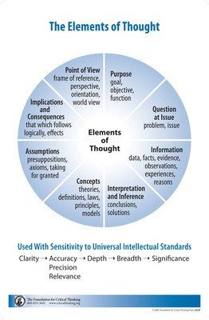
-
-

Slide 13
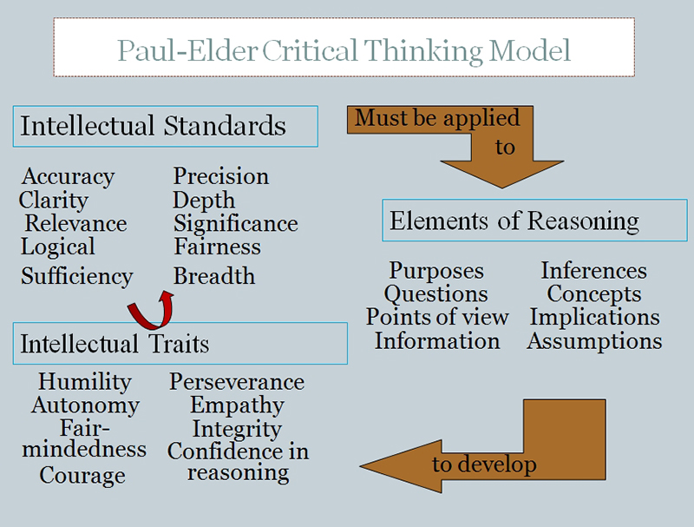
http://louisville.edu/ideastoaction/about/criticalthinking/framework

Slide 14
Socratic Questioning
Takes thinking apart
What is the point of view?
What is the most significant issue?
Why is this question worth asking or what might be a good question to ask?
What are the implications and consequences of these responses?

Slide 15
Intellectual Standards
Tell us what to look for:
Clarity—Could you elaborate further, i.e., etc.?
Precision—How do we find out if that’s true?
Accuracy—Could you be more specific?
Relevance—How does that bear on the question?
Depth—What are some of the complexities of the question? Breath—Do we need to consider another point of view?
Logic—Does this make sense together?
Significance—Which of these facts are most important?
Fairness—Do I have a vested interest in this issue?
Activated knowledge (“true and insightfully understood”)

Slide 16
The Intellectual Traits
Humility
Autonomy
Integrity
Courage
Perseverance
Confidence in Reason
Intellectuality Empathy
Fair-mindedness
criticalthinking.org

Slide 17
Critical Thinking Enhances Diversity in Curricular and Co-curricular Learning
Instructors send messages—including micro-messages. It doesn’t matter what you say—what matters is what people hear (e.g., their perception of what they hear—can become their reality). Students act on micro-messages, and they can influence how they perform. “Bottom line: the micro-messages that are sent and received affect perceptions and performance.”
Steve Young, Power of Small
Notes:
Why should I stay and listen to this presentation--introduce the 2:00 minute tutorial

Slide 18
Perception
Top 4 Judgments
Skin color
Gender
Age
Physical Ability
What are some others?
Who you are has an influence over what you know…Identities that you hold can influence your perceptions and understanding of the world around you.
Joe-

Slide 19
Relational-Cultural Theory
A relational-cultural approach (or mutual empowerment approach) to teaching and learning helps to actualize core values. The goal is to enhance critical thinking about the nature of relationships and promote positive connections.
Baker Miller Training Institute, Wellesley Center for Women (Wellesley College)

Slide 20
“I've learned that people will forget what you said, people will forget what you did, but people will never forget how you made them feel.”
― Maya Angelou

Slide 21
8-Step Conflict Transformation Model
Pause 5 seconds to notice and calculate your own emotions
Focus on repairing the relationship (disconnections)
Address shame responses
Fight or flight responses
Assume a leadership role
Facilitate a fair process
Fair rules
Fair play
Fair outcomes
Listen to understand--listen for
Emotions
Content-process
Inquire (conversationally)
What happened?—
Can I share my/others perspective(s)?
Identify shared interest & challenges
Model cooperative behaviors and be creative

Slide 22
Review the Agenda: Did we...
Assess critical thinking using the Paulian framework (Dr. Richard Paul, Co-founder Center for Critical Thinking)
Employ the Paulian critical thinking framework to enhance “thinking about one’s own thinking” (metacognition)
Employ the Paulian critical thinking framework to integrate diversity and inclusion into curricular and co-curricular activities
Provide a roadmap for employing a relational-cultural approach to enhancing student engagement and participation in their own learning—utilizing the Paideia Socratic Seminar conflict transforming methods

Slide 23
Resources
Google Images: Slides #4, 6 and #17
www.criticalthinking.org (Foundation for Critical Thinking)—download the miniature guide to critical thinking
www.paideia.org/about-paideia/socratic-seminar/
Carvalho-Grevious, M. (2013). Breaking the cycle of shame: Socratic teaching methods to enhance critical thinking. Journal of Baccalaureate Social Work, 18 (Supplement 1), 77-94.
Contact information:
Millicent.Carvalho-Grevious@gmail.com
mcarvalh@brynmawr.edu (through December 2015)

