Slide 1
Assessment Fellows Program An Inside-Out Approach
Drexel University Annual Conference on Teaching & Learning Assessment 2015
Joanna Campbell, jcampbell@bergen.edu
Gail Fernandez, gfernandez@bergen.edu
Jill Rivera, jrivera@bergen.edu

Slide 2
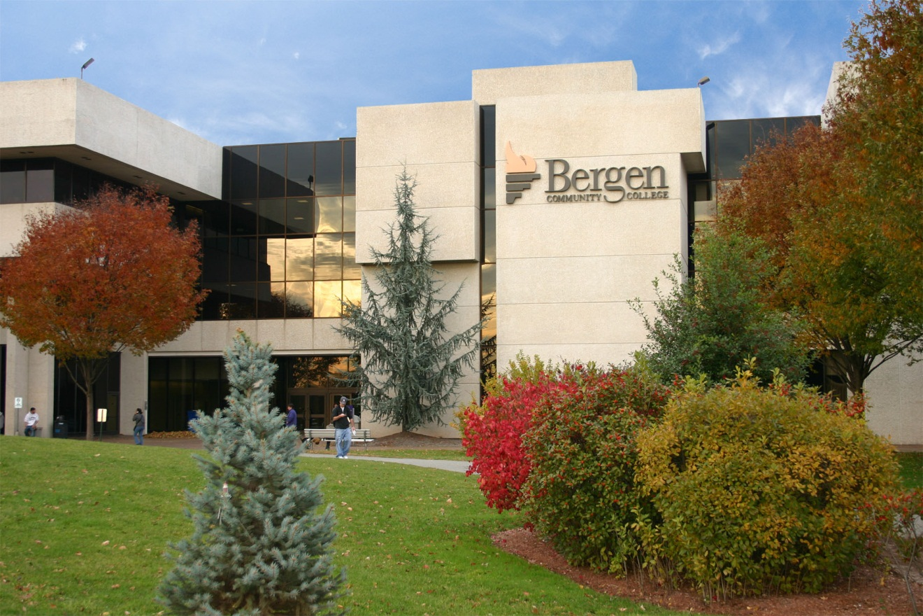
Notes:
We are located approximately 15 miles northwest of New York City.
Paramus is the shopping mecca of the U.S.
We have almost 16,000 full-time and part-time students in over 140 programs and certificates.
There are three locations: Main campus and two locations

Slide 3
Historical Perspective
2007 The Center for Institutional Effectiveness (CIE) established
Facilitates and supports
Institutional Research
Strategic Planning
Assessment
Notes:
The Center for Institutional Effectiveness opened in 2005. It was intentionally called a Center to make it disarming, collegial, collaborative …

Slide 4
You want me to do what????

Slide 5
Historical Perspective
2008 Vice President leads CIE
Assessment Fellow Position created
Two from Administrative and Educational Support (AES)
Two from Academic areas (ACAD)
Notes:
In 2008, the coordinator position was turned into a VP position. The VP needed more than just departmental assessment liaisons so he came up with the idea to add fellows to the Center. 2 AES & 2 ACAD
By placing leadership and responsibility for the CIE at the senior staff level and developing a formal assessment strategy, the College demonstrates that it understands the importance of assessment, and that it is committed to institutionalizing it.

Slide 6
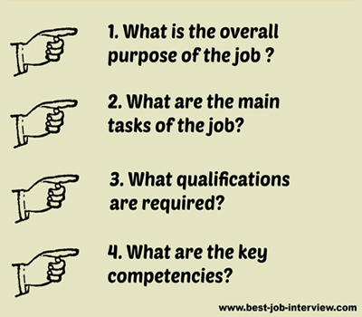
Role of Assessment Fellows

Slide 7
Academic Program Assessment
Identifying Program Learning Outcomes
Designing the Assessment Project
Selecting Assessment Methods
Analyzing and Reporting Results
Evaluating the Process
Notes:
A clear statement of program learning outcomes serve as the foundation for the assessment plan.

Slide 8
Administrative & Educational Support Assessment
Identifying Departmental/Unit Outcomes
Designing the Assessment Project
Selecting Assessment Methods
Analyzing and Reporting Results
Evaluating the Process
Notes:
A clear statement of program learning outcomes serve as the foundation for the assessment plan.

Slide 9
Why The Assessment Fellow Program Works
Strong Institutional Support
Established Foundation (CIE)
Collegial Relationship
Dedicated members
Structure allows for continuity, flexibility, and
improvement
Notes:
The Fellows Model at BCC is the result of a productive collaboration for more than a decade between the Administration, faculty, and staff.
There is leadership at all levels of the Institution; BOT, President, VP, Deans, Faculty and Staff. College supports scholarship of assessment.
There is a good foundation of assessment at College; CIE has clear mission tied into institutional goals and there is direct, supportive leadership within CIE; there is an organized and systematic approach to assessment. All departments/units use a standardized assessment framework; feedback is provided throughout assessment cycle including rubric used to evaluate reports.
Strong working relationship exists between the fellows, liaisons, and departments/units (Receptive, nurturing, and supportive environment; trust between fellows and departments/units because we are faculty and staff; collegiality

Slide 10
Why It Works

Slide 11
Challenges

Slide 14
Thank you!

