Slide 1
Moneyball: The Art of Statistical Analysis in Health-Related Professions
Bradley D. Marcum
University of Pikeville
Kentucky College of Osteopathic Medicine

Slide 2
Session Goals
Following this session:
Participants will have a better understanding of what steps to follow to engage faculty in using data to improve their teaching.
Participants will be able to identify learning outcomes for their field of study
Participants will be able to identify test questions that address the learning outcomes.

Slide 3
Student Learning Outcome
The National Board of Osteopathic Medical Examiners’ (NBOME) COMLEX-USA examination series provide the primary assessment method to measure the following student learning outcome:
Candidate shall demonstrate a comprehension of the concepts and principles of the biomedical, biomechanical, and clinical aspects of osteopathic medicine and related sciences by recognizing the key elements of the patient presentations.

Slide 4
Background

Slide 5
Formative Assessment
The success of using statistical analysis to make important decisions to help improve student learning within individual courses

Slide 6
Formative Assessment
First-year students began taking their block exams as computer-based using ExamSoft. This software allows for the incorporation of color graphics into exam questions, provides a timed component, and randomizes all questions and answer choices for each student.

Slide 7
Example Report
StudentID | Start Time | End Time | Total Time
0161247 | 08:29 | 12:54 | 4h 25m
162942 | 08:30 | 11:04 | 2h 34m
0105606 | 08:29 | 11:14 | 2h 45m
0158621 | 08:30 | 12:55 | 4h 25m
0162026 | 08:39 | 13:01 | 4h 22m
0160395 | 08:29 | 11:20 | 2h 51m
0162716 | 08:29 | 11:10 | 2h 41m
0162703 | 08:30 | 10:44 | 2h 14m
0158626 | 08:31 | 11:50 | 3h 19m
0160132 | 08:28 | 11:06 | 2h 38m
0158868 | 08:29 | 12:08 | 3h 39m
162027 | 08:29 | 12:03 | 3h 34m
0159739 | 08:30 | 12:09 | 3h 39m
0158869 | 08:30 | 12:02 | 3h 32m
0160173 | 08:30 | 11:03 | 2h 33m
0159743 | 08:29 | 11:12 | 2h 43m
0157253 | 08:29 | 10:43 | 2h 14m
0160133 | 08:28 | 11:26 | 2h 58m
0160134 | 08:29 | 11:32 | 3h 03m
154177 | 08:29 | 12:55 | 4h 26m
0157255 | 08:29 | 11:02 | 2h 33m
35731 | 08:30 | 12:54 | 4h 24m
0159746 | 08:29 | 11:14 | 2h 45m
0161248 | 08:29 | 10:45 | 2h 16m

Slide 8
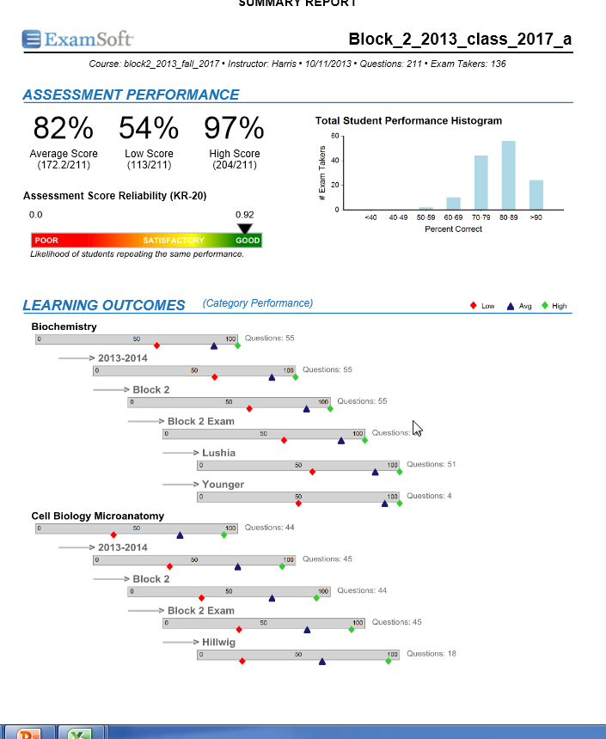
Sample Report

Slide 9
Formative Assessment
The software makes tracking student performance much easier and provides substantially more data to both faculty and students for use in improving performance.

Slide 10
Example Report
The unit has created a number of reports that include indicators or early warning signs for students who need additional support.

Slide 11
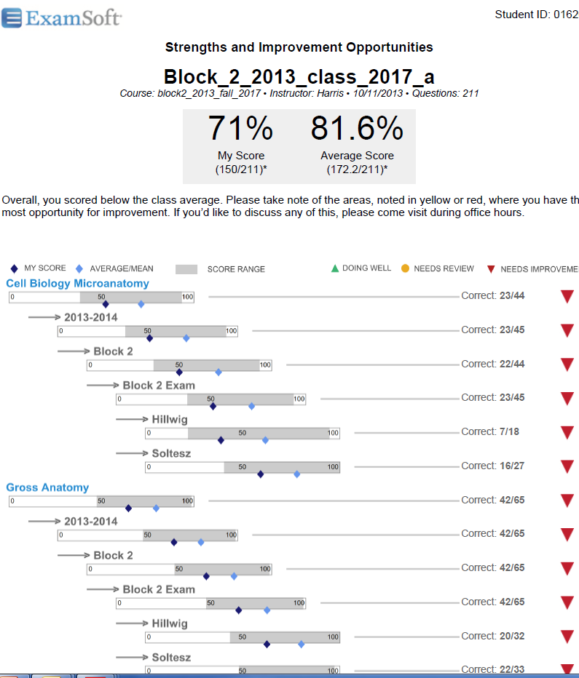

Slide 12
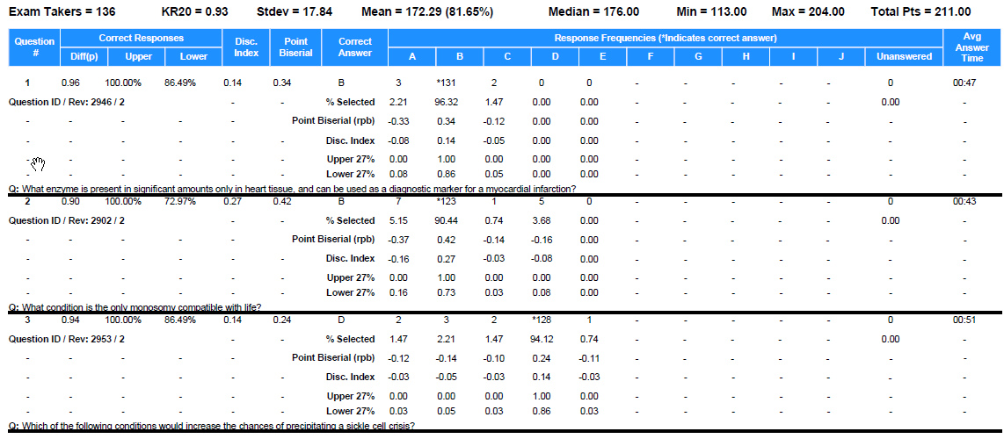

Slide 13
Formative Assessment
We were able to use the data to make decisions on questions with regards to performance and adjustment, and to more effectively assess the achievement of student learning outcomes within courses.

Slide 14
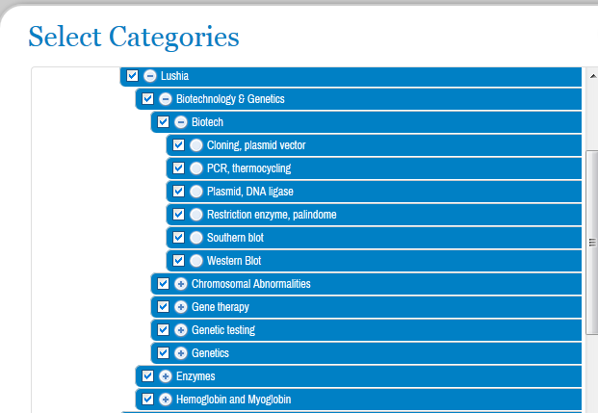
Example Report

Slide 15
Professional Development
How a small academic support staff was able to transform a seasoned faculty who had spent many years teaching medical students using information based on assessing student learning using tools that was not based on data.

Slide 16
Written Exercise
Take a few minutes to think of what categories you would like to track for one your exams.

Slide 17
Small Group Discussion
In groups of three or four, discuss what categories you came up with and discuss how that would help you better assess your questions and how that would help your program.

Slide 18
Professional Development
Continue to assist the faculty on using the data from ExamSoft to improve lecture and question-writing performance, and to assist in student advising.

Slide 19
Summative Assessment
First-time pass rates on the COMLEX exams have historically been lower than national averages and one of KYCOM’s strategic planning goals.
Faculty on Admissions Committee continued to believe that admissions criteria (e.g., MCAT scores, college grades) were the best predictors of how students would perform on the COMLEX Level 1 exam.
OMS-II students take the COMSAE to gauge the base of their knowledge and ability as they prepare to take the COMLEX Level 1 beginning with the Class of 2014. (r = .80)

Slide 20
Summative Assessment
None of the admissions’ criteria fit into the model of predicting how students perform on the COMSAE test
Student performance in first year courses Cell Biology/Developmental Microanatomy & Immunology and second year course Pharmacology II explain 59.8% of the variation in the COMSAE score (based on 127 students from the Classes of 2014 and 2015).
Maybe these courses could prove useful as even earlier warning signals to improve student performance on the COMLEX Level 1. For example, test items in ExamSoft for these 3 courses could include learning outcomes that would help faculty to see where within these courses students are needing to improve so that they are better prepared for the COMLEX exam.

Slide 21
Written Exercise
What are Your Needs: Formative or Summative?
How Could You Get at the Underlying Issue?
Who on Your Campus Needs to be Involved?

Slide 22
Small Group Discussion
In groups of three or four, discuss what you came up with and discuss issues that you are facing at your particular institution.

Slide 23
Thank you for attending
Bradley D. Marcum bradleymarcum@upike.edu
margaretsidle@upike.edu

