Slide 1
Uncovering the Learning Experience Hidden by GPA: A Story of Partnerships
Karen Nulton, Ph.D
Director of Writing Assessment
Barbara Hoekje, Ph.D
Director of the English Language Center
Drexel University
September 11, 2014
Writing Assessment Advisory Committee: Rebecca Ingalls, Valerie Fox, Anne Erickson, Fred Siegel, Mariana Mendez, Marshall Warfield

Slide 2
Communication Learning Priority
Students will employ an understanding of audience, purpose and context to communicate effectively in a range of situations using appropriate media.

Slide 3
Assessing Writing at Drexel: Overview

Slide 4
Looking for evidence of writing skills
First year writing program
  Overall (and by college)
  By international status
Co-op
  By Co-op (and by college)
  By International status

Slide 5
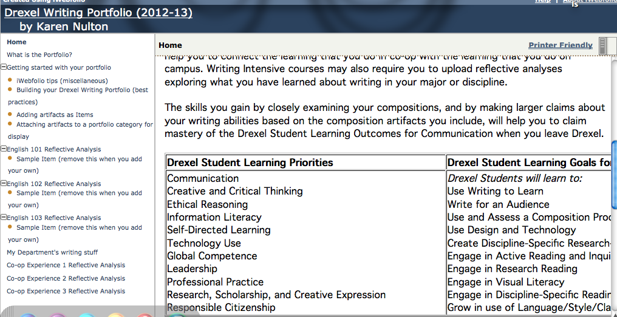
Writing Portfolio

Slide 6
Tools to answer questions for FWP
ENGL 103 Portfolio task
Task: Create an evidence based argument to a chosen audience about whether you have met one of the FWP learning goals. Use your own writing as evidence. Use MLA.
  Pulled samples from iWebfolio: scored 376
  Scored reflective analysis as evidence-based argument using 5-pt rubric
  Scored “Audience” separately using 4-pt rubric
  Scored in-text and Works Cited documentation separately (binary-yes/no)

Slide 7
What did we find?
Notes:
Inter-rater reliability adequate (three pre-scored essays)

Slide 8
University as an organizational ecology
2011 Change in Drexel language ecology
Terms: “International”=F1 visa
English medium of instruction (EMI) and non-EMI
ESL, “second language”

Slide 9
COMPARISON OF EMI AND NON-EMI SCORES
(103 Portfolio Scoring)
Aggregate Scores by EMI status: 5-pt Evidence-based Analysis
5-point evidence-based analysis score:
  EMI students: 3.1
  Non-EMI students: 2.2

Slide 10
Citation: In text

Slide 11
Citation: Works Cited

Slide 12
Standard Setting
How do we talk about these results? Setting the FWP standard. . .
Scores of 5, 4, 3 meet FWP standards
Scores of 2, 1 do not meet standards

Slide 13
Standard Setting Results

Slide 14
Nature of cognitive & academic language proficiency (“CALP”)
Do the students have sufficient language resources to manage a cognitively complex (decontextualized, metalinguistic) task?
Language Form & Meaning (LFM) 5 point
Dr. Barbara Hoekje, Director, English Language Center

Slide 15
Level 4: Threshold level
Level at which the writer is able to effectively use language resources to create meaning
Only 30% of ENGL 101 (ESL) essays reached threshold proficiency level
Corresponds with FWP analysis of not meeting cut score

Slide 16
Actions based on FWP results
Intense focus on First-Year Writing Program ESL sections (faculty meetings, faculty discussing samples, new Associate Director with ELL Ph.D.)
Lang 180 (partnership: English Language Center, First-Year Writing Program, Academic Advising Retention and Diversity, Writing assessment)

Slide 17
LANG 180
Precursor to ENGL 101, 102, 103 (ESL sections)
Added value to students’ ability to describe (pre/post assessment)
Added value to slow acculturation process (faculty evaluations, student evaluations)
Did not add significant value to students’ language skills
Revealed students NOT on sequence to complete ENGL 101, 102, 103
  Recommend credit limit to complete FWP sequence
  Recommend higher TOEFL scores or more supports for non-EMI students

Slide 18
Looking at Writing in Co-op (Partnership with Steinbright Career Development Center)
Tool: Co-op Reflective Analysis
  “Please submit a 400 word reflective analysis on how one aspect of this co-op experience relates to a personal, academic, or professional goal that you are pursuing at Drexel. Be specific about both your goal and how one aspect of the co-op relates to this goal.”
  Scoring: 2010-2012, internal and Drexel-wide (N=2619)

Slide 19
What did we find? 2010 n=890

Slide 20
2011 n=1640

Slide 21
Language/clarity

Slide 22
Do the 2010-11 Co-op writing data support FWP interpretations? N=1640

Slide 23
Co-op cut score by EMI status

Slide 24
Language/clarity

Slide 25
Language/clarity
Notes:
Explains my ENGL 360 experience

Slide 26
GPA: Fall term, 2011 n=2,867
329=Int’l students
  term GPA 3.07 winter, 2014 Cum GPA 3.13
205=ESL sections
  term GPA 3.01 winter, 2014 Cum GPA 3.09
124=Int’l regular track
  term GPA 3.17 winter, 2014 Cum GPA 3.19
2538=Domestic
  term GPA 3.08 winter, 2014 Cum GPA 3.02

Slide 27
Study Conclusions
GPA hides an important story. International students from non-EMI countries need more language skills on entrance or more support while they are here
  Need to change discussion from language deficit to cultural exchange
Credit-limit needed to complete ENGL 101-103 sequence
Partnering with Steinbright Career Development Center to look at employer/student EMI status and communication skills

Slide 28
Conversations? Comments? Questions?

