Slide 1
Aligning Assessment to Broader Strategic Goals Using Iterative Curriculum Design
Dr. Donald L. McEachron
Teaching Professor
Coordinator, Academic Assessment and Quality Improvement
School of Biomedical Engineering, Science and Health Systems
Drexel University

Slide 2
Why?
What is the purpose of higher education?
To acquire and disseminate advanced knowledge,skills and wisdom

Slide 3
What is a Curriculum?
A curriculum is a properly sequenced and implemented series of educational experiences which transform students into productive members of a global society

Slide 4
Therefore:
Curriculum design is the means by which faculty establish the processes that facilitate students attaining the specific knowledge, skills and wisdom necessary to transform them into productive members of a global society
Step 1: Establish the goals and objectives: What knowledge, skills, attitudes, abilities, etc. are needed?

Slide 5
Step 1 – Define the Goals
Principle of Alignment

Slide 6
Drexel University fulfills our founder's vision of preparing each new generation of students for productive professional and civic lives¹ while also focusing our collective expertise on solving society's greatest problems². Drexel is an academically comprehensive and globally engaged³ urban research⁴ university, dedicated to advancing knowledge and society and to providing every student with a valuable, rigorous, experiential, technology-infused⁵ education, enriched by the nation's premier co-operative education program.
Step 2 – Mission Alignment
The mission of the School of Biomedical Engineering, Science and Health Systems is to promote health and quality of life¹ through education, research⁴ and innovation² that integrates engineering and life sciences⁵ in a global context³.

Slide 7
Step 3: Establish Aligned Program Educational Objectives
PEO’s are achievements demonstrated consistently by alumni from an educational program that fulfill academic program mission
Developed in collaboration with various stakeholders
  External
  Faculty
  Students
Should be measureable so that success can be monitored

Slide 8
Reflection/Review/Revision Cycle for Program Educational Objectives

Slide 9
Example of an Aligned PEO
Workforce Skilled in Integrating Engineering, Design, and Life Sciences. As a result, graduates will identify opportunities to contribute to society from a variety of positions, ranging from biomedical engineering, biotechnology design and development to practicing physicians, lawyers, innovators, entrepreneurs and business managers. The graduate may also pursue further education in the form of graduate and professional degrees.(Drexel - productive professional and civic lives; Biomed - promote health and quality of life)

Slide 10
How to Measure (Assess)?
Traditional method – Alumni Surveys
  Limited response rate
    Small Sample Size
    Volunteer Bias
Potential Alternatives
  Social Networking – LinkedIn, etc.
  Internet Search/Data Mining

Slide 11
Step 4: Establish Aligned Student Learning Outcomes
SLOs characteristics of students at the time of graduation. These characteristics can include knowledge, skills, attitudes, etc.
Can be Measured on Students while Still in Program
Alignment - Must Map to and Support PEOs
Primary Objects of Assessment and Evaluation and thus Curriculum Design

Slide 12
Sources and Characteristics of SLOs
Sources
  External
    Professional Accreditors (ex. ABET, AACSB, CCNE, etc.)
    Regional accreditors – Middle States
  Internal
    Drexel Student Learning Priorities
    Program level outcomes from stakeholders
Characteristics and Limitations
  SLOs are Usually Broad
  Need to be Decomposed into Measureable Components for Assessment and Evaluation
  Learning Indicators (also known as performance criteria or performance indicators)

Slide 13
Ensure Relationship Between PEOs and SLOs through Mapping

Slide 14
Example of SLOs Aligned to Workforce Skills
Innovation and Design – The graduate often asks questions and makes observations that lead to new ideas or hypotheses. He or she formulates highly original solutions while moving beyond the conventional to new methods blending creative and practical approaches, methods and designs which may involve pioneering applications along the interface of engineering and biology. The graduate has the ability to create quality products and processes that are state-of-the-practice in his or her field.
Problem-Solving Abilities– The graduate is able to creatively solve problems from both analytic and synthetic perspectives using multiple approaches, integrating the life sciences, engineering, and the humanities. The graduate is able to recognize, incorporate and adapt to the limitations and consequences of applying various problem solutions.
Technological Skills – The graduate makes appropriate use of technologies to communicate, collaborate, solve problems, make decisions, and conduct research, as well as foster creativity and life-­‐long learning. The graduate is able to use state-of-the-art technological resources and tools and keeps up on advancements in her or her field of study and/or practice.

Slide 15
Non – Engineering Examples of SLOs
Understand accounting and business terminology used in business scenarios, and be proficient with commonly used office software programs (Butte College, Business Education Program http://www.butte.edu/departments/careertech/businessed/slos.html)
Students demonstrate growth in their intellectual courage and curiosity by posing critical questions concerning the place and relevance of the philosophical theories in their lives. (Pitzer College, http://www.pitzer.edu/academics/field_groups/philosophy/slo.asp)
Demonstrate an understanding of contemporary art trends, major artist's works, and historical movements. (Arkansas Tech University, https://www.atu.edu/art/student-learning.php)
Perform laboratory techniques (such as light microscopy, gel electrophoresis and keeping a laboratory notebook and understanding of principles of laboratory safety). (University of San Francisco, http://www.usfca.edu/artsci/biol/program_outcomes/)

Slide 16
Step 4.1 Decompose SLOs into Learning Indicators

Slide 17
Why Create Learning Indicators?
Depends upon specific SLOs that are used
Many SLOs (DSLPs, ABET a-k) are too broadly defined to measure effectively
Decomposing SLOs into LIs allows for the creation of measureable characteristics of student performance and behavior
Rubric development is one such approach

Slide 18
Example of Rubrics Associated
with Problem-Solving Abilities

Slide 19
ABET Criteria School SLOs School PEOs

Slide 20
DSLPs School SLOs School PEOs

Slide 21
Resolution and Applications of SLOs
SLOs can be very generic – ABET/DSLPs designed to fit multiple programs
Faculty may not be satisfied
  Example – ability to solve engineering problems not specific enough
  Want more detailed measurements
    Ex. solve electrical engineering or circuit problems
    Process of curriculum mapping

Slide 22
Step 5 – Initial Curriculum Design
Guiding Principles
Alignment-Centered (Quality Matters Initiative): each aspect of the curriculum supports student learning in order to achieve program goals
Assessment-Driven: Assessments guide development of educational methodologies
Evidence-Based: Alumni and student performance guide re-design and quality improvement

Slide 23
Curriculum Redefined
A curriculum is a set of inter-related and integrated activities which facilitate student learning in a developmentally appropriate manner in order to foster satisfactory achievement of student learning outcomes which, in turn, generate alumni who successfully attain program educational objectives.

Slide 24
What Are The Issues To Overcome?
Functional Silo Syndrome (Phil Ensor, 1988)
Faculty Issues
  Lack of Understanding of Curriculum Design
  Lack of Knowledge Outside of Field
  Lack of Appreciation of Other Disciplines (ex: Engineering and so-called ‘soft’ (humanities) subjects)
  Course Ownership – Belief that course is property of instructor
  Fear of Accountability – Assessment Data will inappropriately drive personnel decisions
Administrative Issues
  Lack of resources and training
  Lack commitment to the process
  Inappropriate use of data

Slide 25
Proposition
The functional silo syndrome of faculty teaching courses in isolation without a coherent curriculum design promotes student learning silos. These learning silos reduce the retention and transfer of knowledge and skills from educational experience to another, significantly limiting the efficacy of higher education in general. The students which result may actually have less creativity, flexibility and adaptability after 4-5 years of undergraduate education than they had when they began.
Thus, appropriate curriculum design is not a luxury, it is an absolute necessity.

Slide 26
In terms of the failures of student learning, we should quote Pogo:
‘We have Met the Enemy and He is Us’

Slide 27
Step 5.1 – Understanding the Current Curriculum
Collect Course Materials
  Description
  Syllabus
  Assignments, examinations, etc.
Determine how SLOs or LIs are mapped to the current educational experiences
  Do not forget non-classroom experiences
  Co-Op and extra-curricular experiences are critical to overall result in terms of student learning
Job of the Program’s Curriculum Committee

Slide 28
Step 5.2 : Create Initial Curriculum Map
Outcomes vs. Educational Experiences

Slide 29
Step 5.3 – Map 2
Educational Experiences vs. Outcomes

Slide 30
Step 5.4 – Map 3
Outcomes in Classes vs. Term

Slide 31
Flow Chart for SLO-Driven Course Design
Team Effort between Curriculum Committee
(or equivalent)
And Faculty Instructors

Slide 32
Paradigm Shift with Curriculum Design
Every Course Now Consists of Three Levels
Level One: University Level
    Catalog Description
    Credits
    Presentation Timing/Style
    Changes Require SCAA, Senate and Provost Approval
Level Three: Instructor Level
    Additional Objectives
    Course Calendar of Lectures; Assignments, etc
    Office Hours
    Grading Information
Level Two: Department/Programmatic Level
    Assignment of Student Learning Outcomes/Indicators
    Changes Require Curriculum Committee, Faculty and Department Head Approval

Slide 33
Mapping with AEFIS
Mapping can be done manually – not recommended
AEFIS provides for mapping and pivots for all three types of maps
Assessments can be incorporated into the mapping

Slide 34
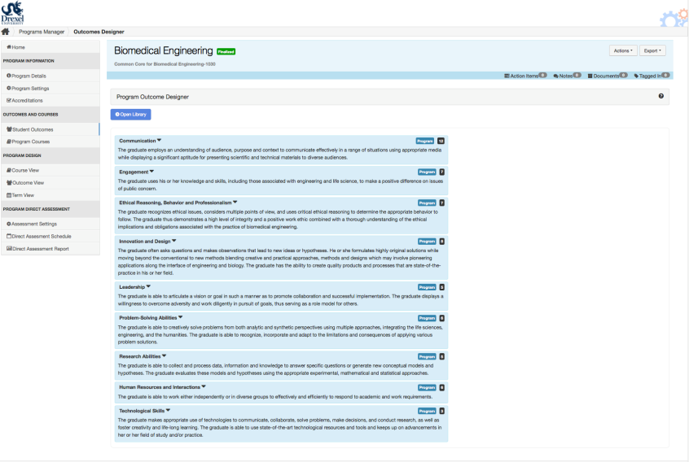
Enter or Import Required SLOs (ABET, DSLPs, etc.)into AEFIS

Slide 35
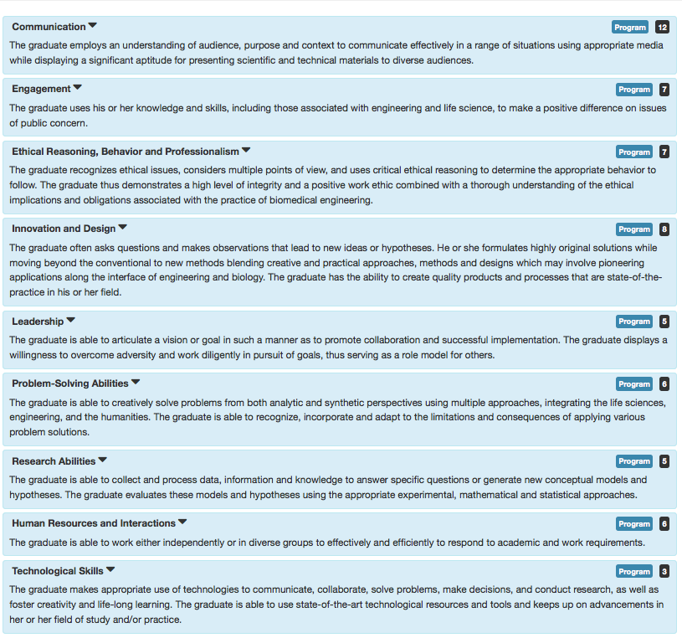

Slide 36
Create Measurable Sub-elements Capable of being Mapped into Curriculum (Performance criteria; Performance Indicators; Learning Indicators, etc.)

Slide 37
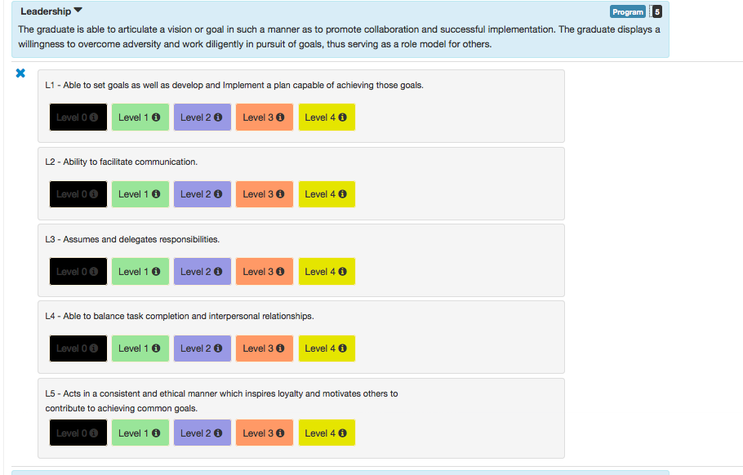

Slide 38
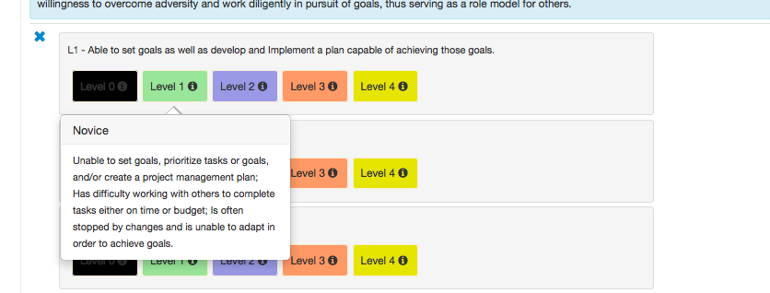

Slide 39
What Are the Targets? – Student Learning Outcomes (SLOs):
School Developed 9 Intellectual Pathways Incorporating
both ABET (external accreditor) criteria and Drexel Student Learning Priorities

Slide 40
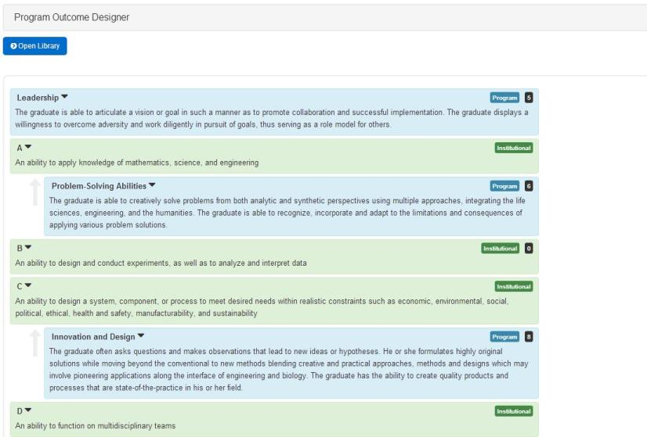
Align Required SLOs to Program Level SLOs

Slide 41
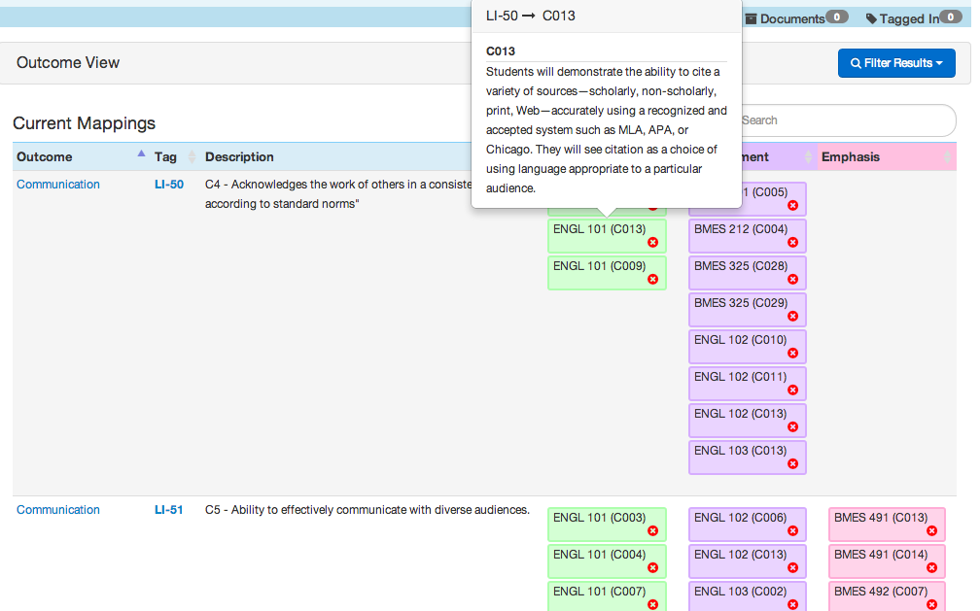
Map SLOs or Subcomponents to Courses

Slide 42
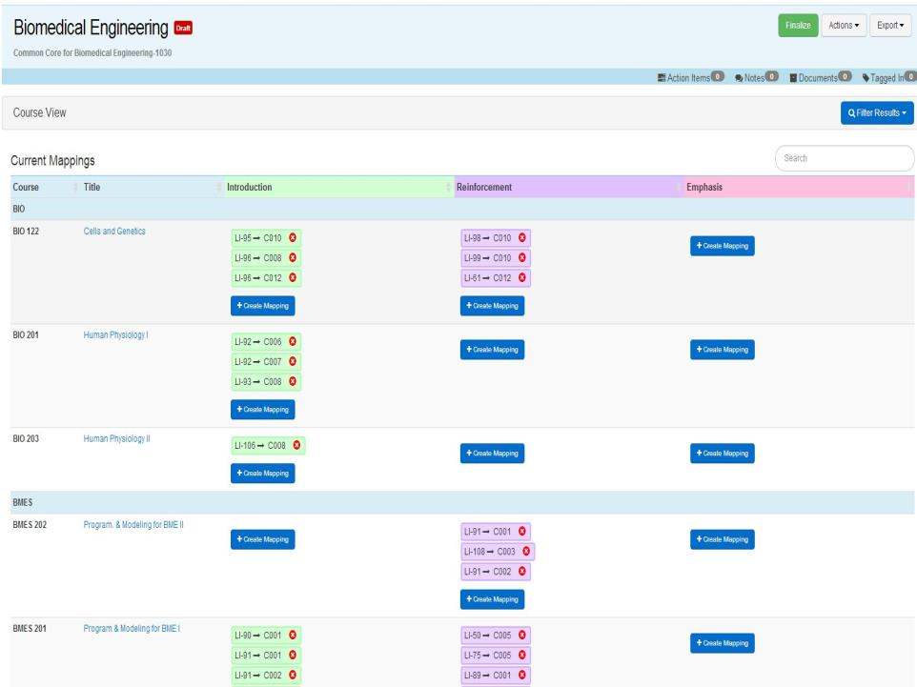
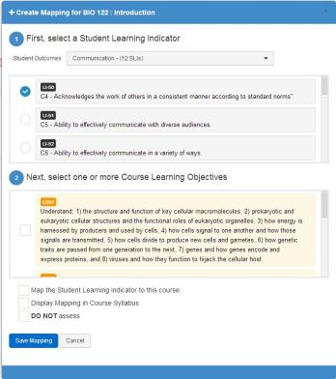

Slide 43
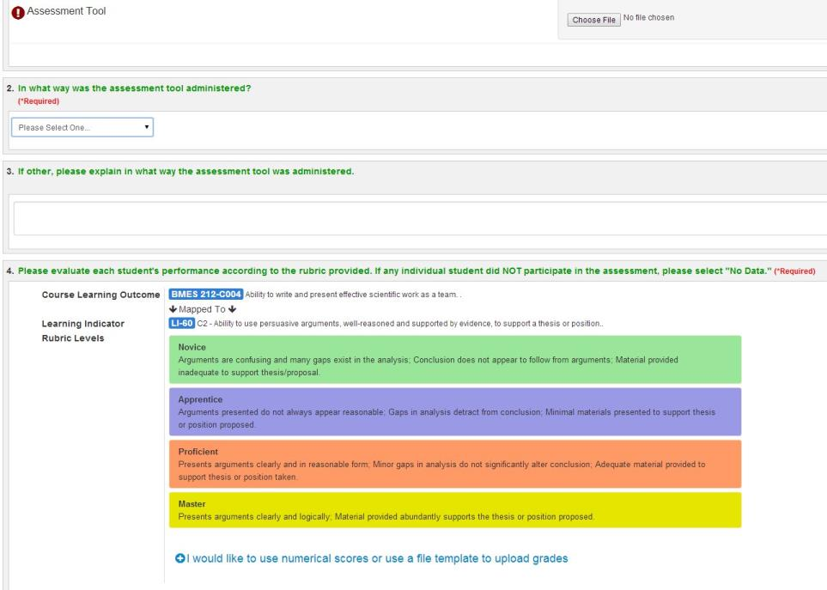
Collect Direct Assessment Data

Slide 44
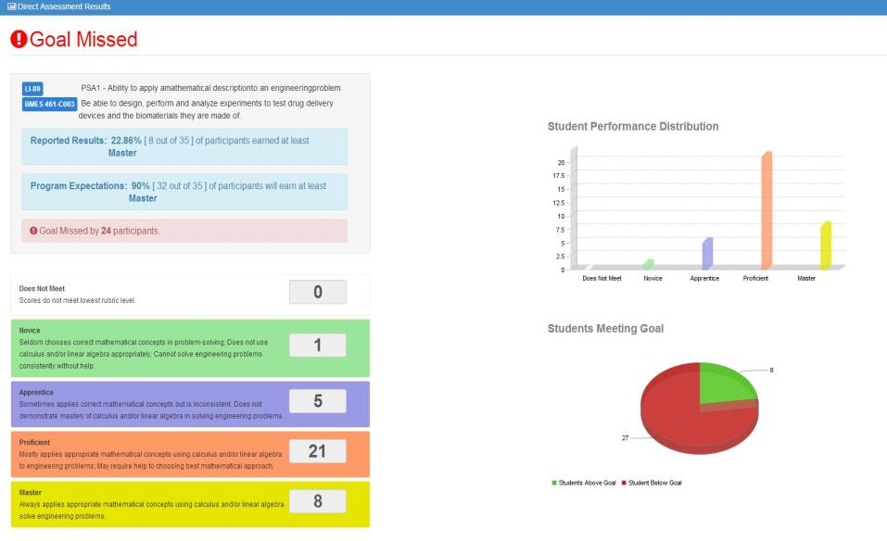
Display Direct Assessment Data

Slide 45
Revisit Flow Chart for SLO-Driven Course Design
Alternative Pathways for Curriculum Redesign and Enhancement or
Couse Enhancement

Slide 46
Questions?
Discussion

