Slide 1
Customizing Student Competencies through Direct Learning Assessment of Program Outcomes
By
Ray Lum, MPhil, MS
Jennifer Breaux, DrPH, MPH
Shannon Marquez, PhD, MEng
September 11, 2014

Slide 2
The achievement of customized student competencies is (1) the aspiration of academic institutes, (2) the dream of students and (3) the expectation of employers. The delivery of uniform competencies across face-to-face, hybrid and online formats is critical to ensure quality education for all students independent of the mode of delivery. The focus of this session is to demonstrate how direct and indirect assessment of program level outcomes can enhance the quality of student competencies.
Description

Slide 3
Objective
Identify models that show how university, school, program policies can be modified to create a narrative and framework for learning assessment.
Apply techniques and templates to support other academic units who wish navigate their organizational structures towards a learning assessment initiative.
Apply competency documents that yield quality customize student outcomes and changes the culture and relationship between the student, faculty, staff and employer.

Slide 4
Presentation Outline
First illustrate how program policies can be reframed to align programs level outcomes to course outcomes.
Secondly, it demonstrates how course assessments can be aligned to direct program level assessment to support the learning assessment narrative. In addition, it will show how grading rubrics and the grade book in Blackboard Learn can be utilized for direct program level assessments of student competencies through the use of the Academic Evaluation Feedback Intervention System (AEFIS).
Thirdly, the session demonstrates how the transparency of these learning outcomes develops an assessment culture and tone in the classroom and in faculty-student advising towards competencies.
Lastly, the session investigates interventions to improve and align course to program level outcomes that improve the quality measures in the breadth and depth of student competencies.

Slide 5
Objective 1: Identify models that show how university, school, program policies can be modified to create a narrative and framework for learning assessment. Outline 1: Illustrate how program policies can be reframed to align programs level outcomes to course outcomes.
Internal Stakeholders
Provost Office
Faculty Senate
Deans Office
College/School Curriculum Committee
Department Chairs
Program Directors
Course Directors
Faculty
External Stakeholders
Middle States
Professional Accreditation Bodies
Employers

Slide 6
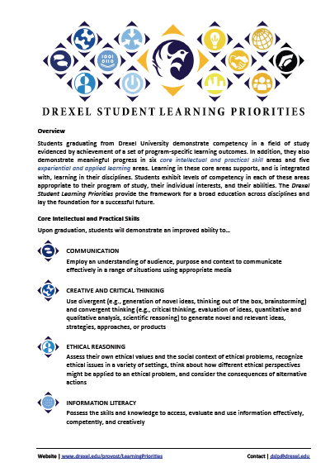
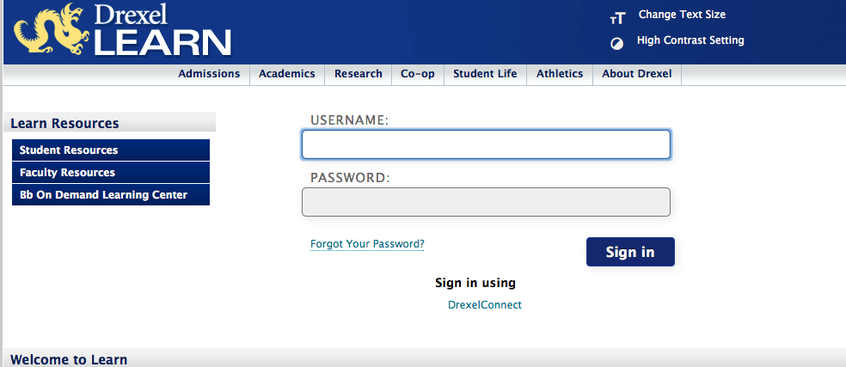
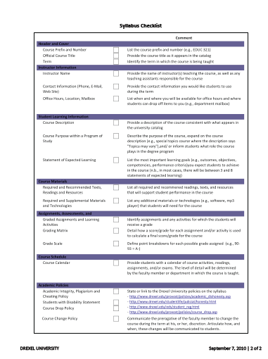
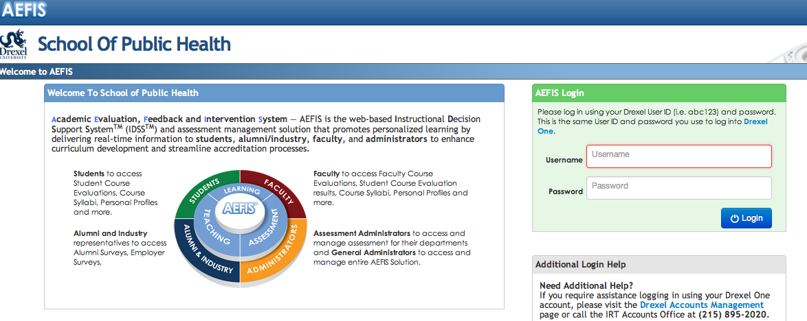
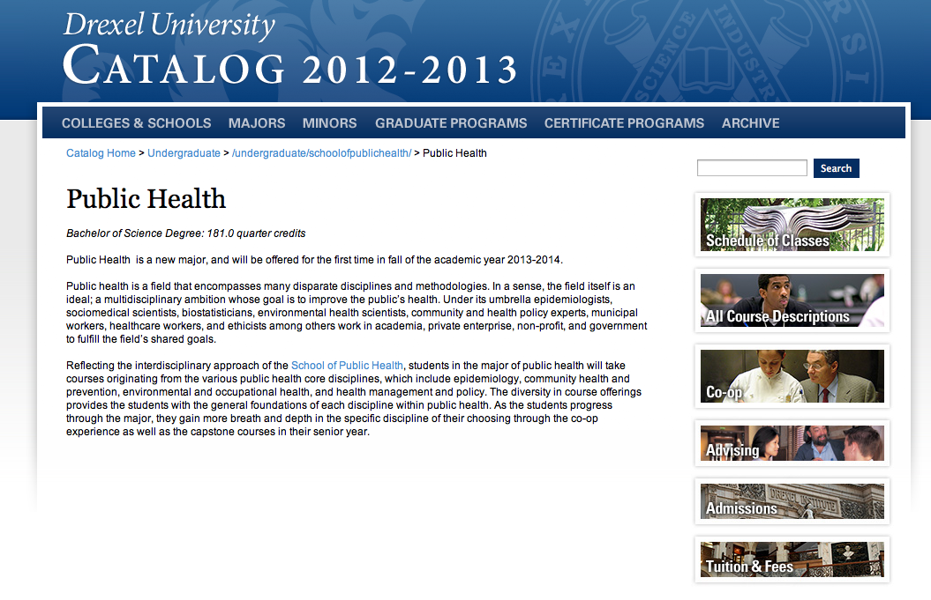
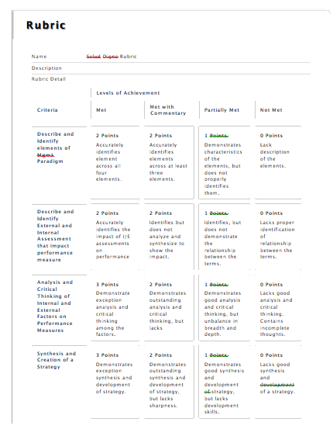
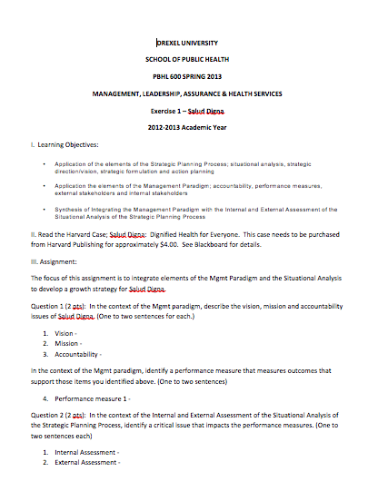
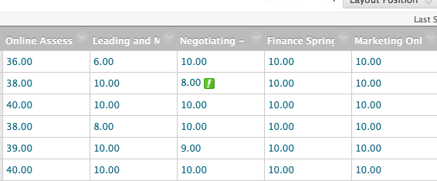
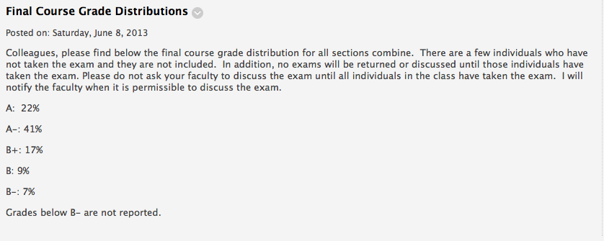
A Need for a Simpler Overview…
DSLPs
BBLearn
Banner
Programs
AEFIS
Course
Direct
Assessments
Learner Centered
Syllabus
Surveys
Notes:
Provide an overview roadmap in the next few slides that illustrate the building blocks and the process with commentaries on how faculty and program directors have altered their narrative, framework and value of their course syllabus through integrating tools/techniques such as
Drexel Student Learning Priorities (DSLPs)
Drexel Learner Centered Syllabus
Assessment Evaluation Feedback and Intervention System (AEFIS)
Blackboard Learn Building Blocks

Slide 7
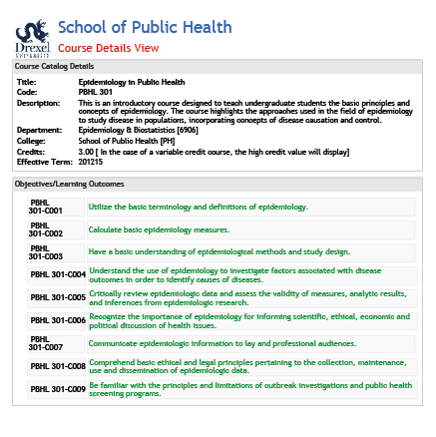
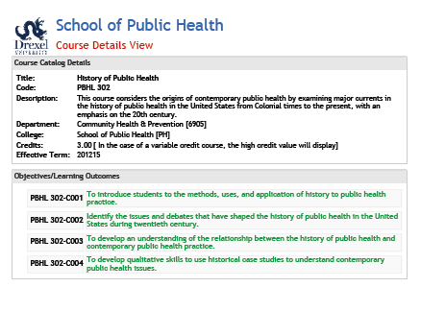
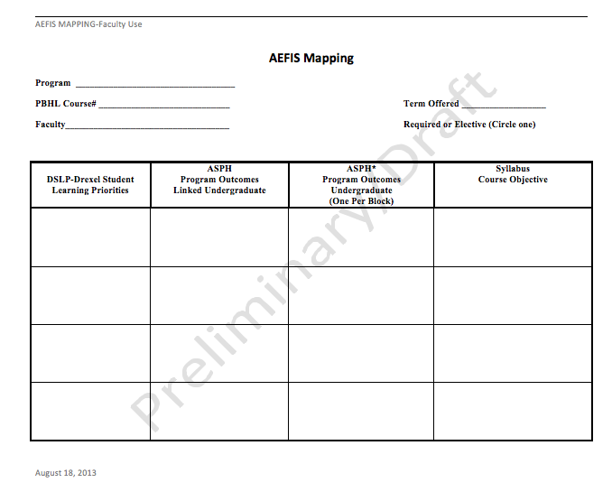
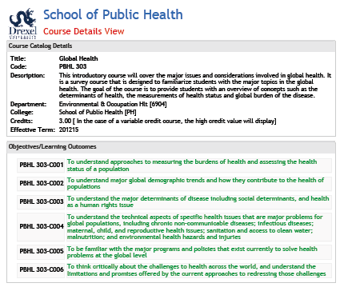
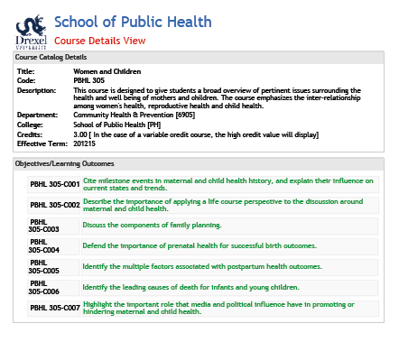
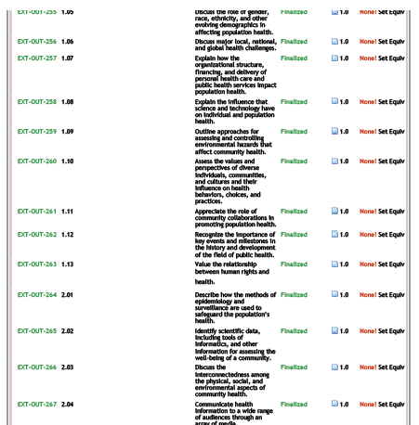
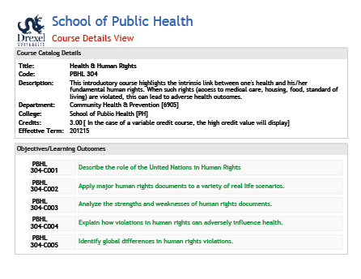
Program Mapping Package for SPH
Drexel Student Learning Priorities – DSLP’s
Course Catalog Details in AEFIS
Manual Mapping Template
Program Outcomes
in AEFIS

Slide 8
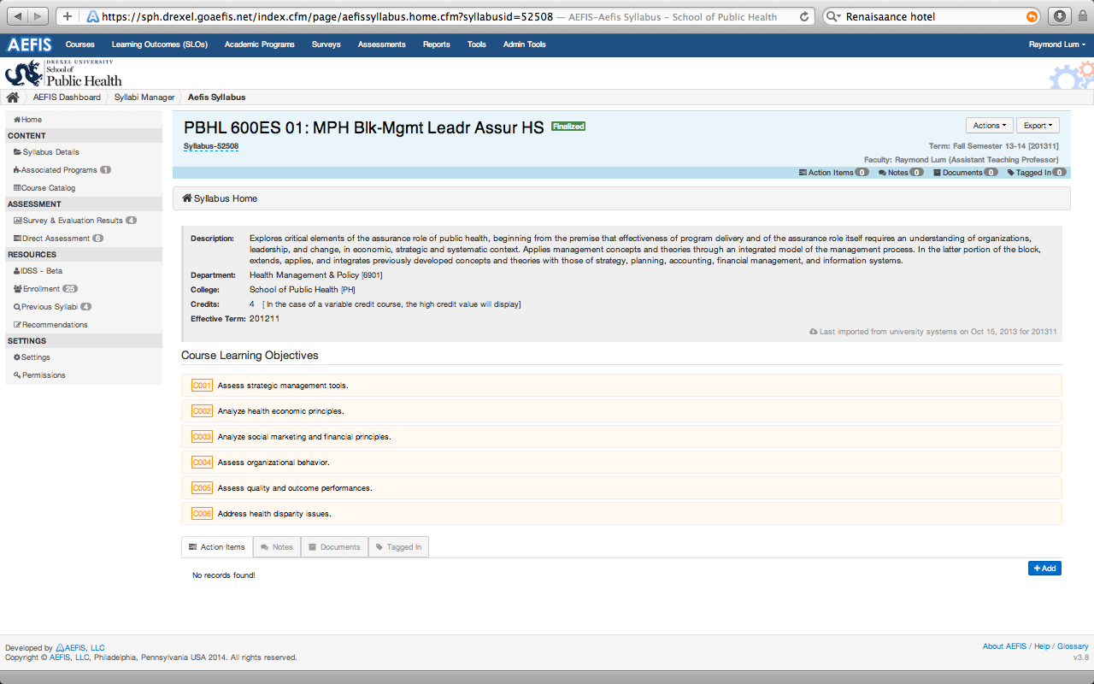
AEFIS Course Catalog
Access Historical Data
In AEFIS
Syllabus Defaults
In AEFIS
Course Wide Objectives
In AEFIS

Slide 9
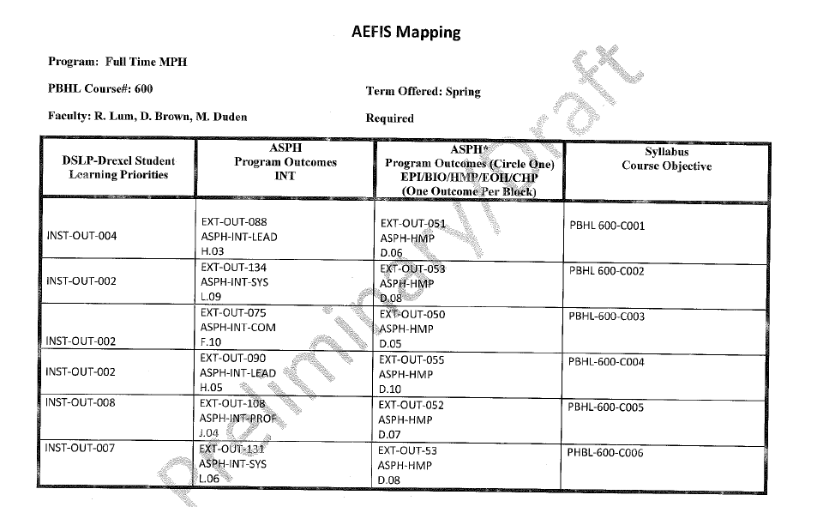
Program Mapping
Manual Mapping Template

Slide 10
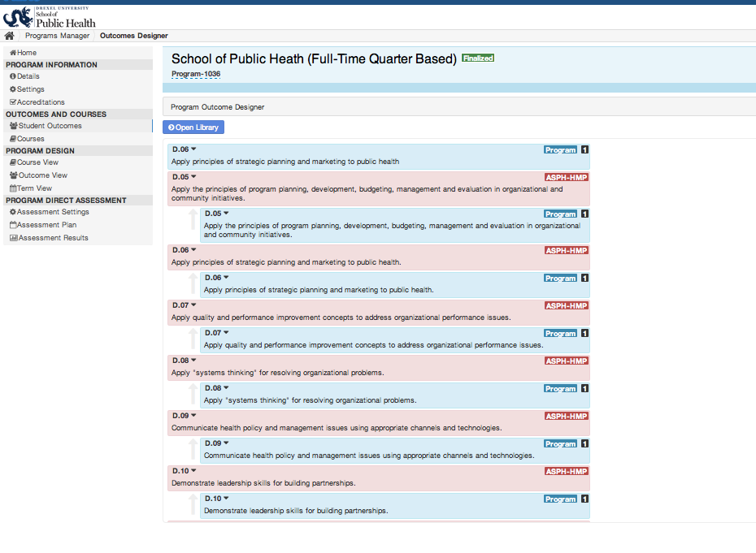
Grouping Program Outcomes Program

Slide 11
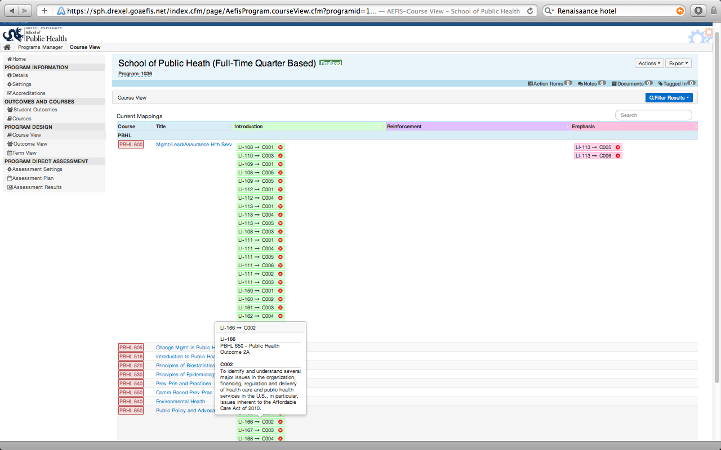
Mapping Program Outcomes to Courses

Slide 12
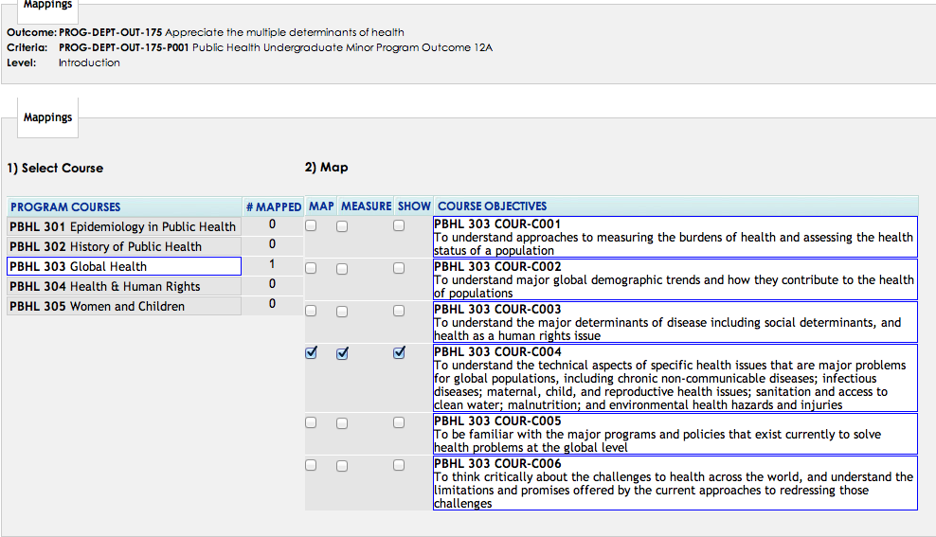
Map Program Outcomes to Course Objectives

Slide 13
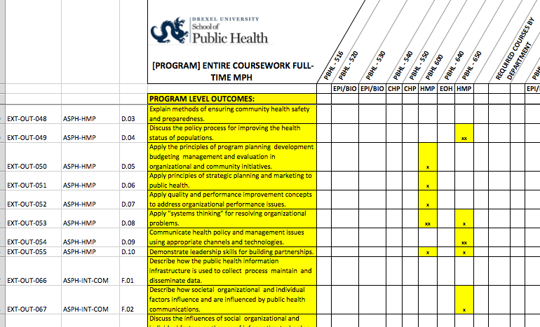
Map Program Outcomes to Course Objectives

Slide 14
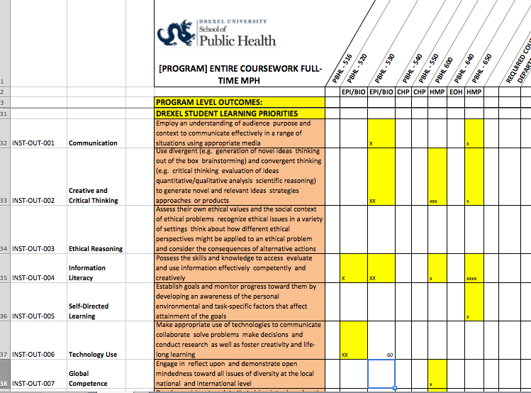
Map Program Outcomes to Course Objectives

Slide 15
Objective
Identify models that show how university, school, program policies can be modified to create a narrative and framework for learning assessment.
Apply techniques and templates to support other academic units who wish navigate their organizational structures towards a learning assessment initiative.
Apply competency documents that yield quality customize student outcomes and changes the culture and relationship between the student, faculty, staff and employer.

Slide 16
Presentation Outline
First illustrate how program policies can be reframed to align programs level outcomes to course outcomes.
Secondly, it demonstrates how course assessments can be aligned to direct program level assessment to support the learning assessment narrative. In addition, it will show how grading rubrics and the grade book in Blackboard Learn can be utilized for direct program level assessments of student competencies through the use of the Academic Evaluation Feedback Intervention System (AEFIS).
Thirdly, the session demonstrates how the transparency of these learning outcomes develops an assessment culture and tone in the classroom and in faculty-student advising towards competencies.
Lastly, the session investigates interventions to improve and align course to program level outcomes that improve the quality measures in the breadth and depth of student competencies.

Slide 17
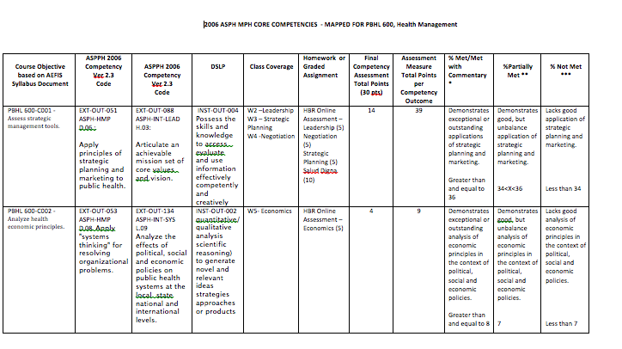
Updated Mapping Template with Direct Assessment

Slide 18
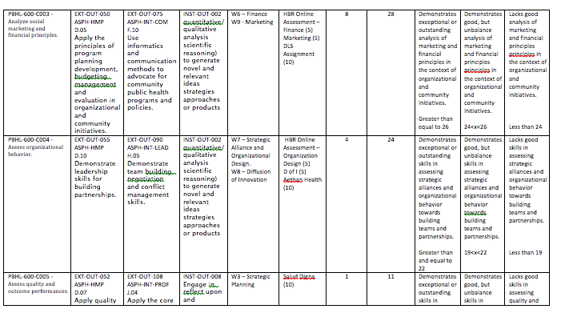
Updated Mapping Template with Direct Assessment

Slide 19
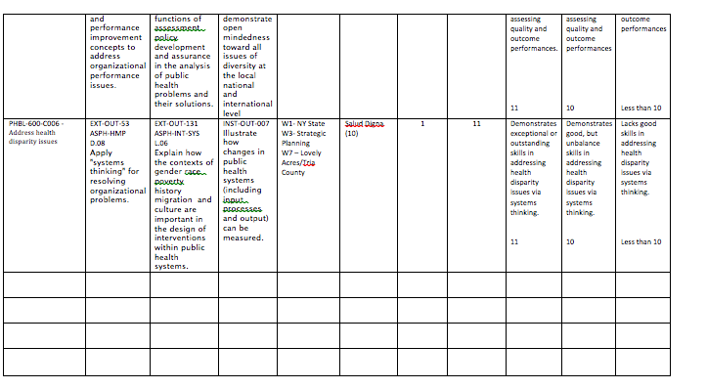
Updated Mapping Template with Direct Assessment

Slide 20
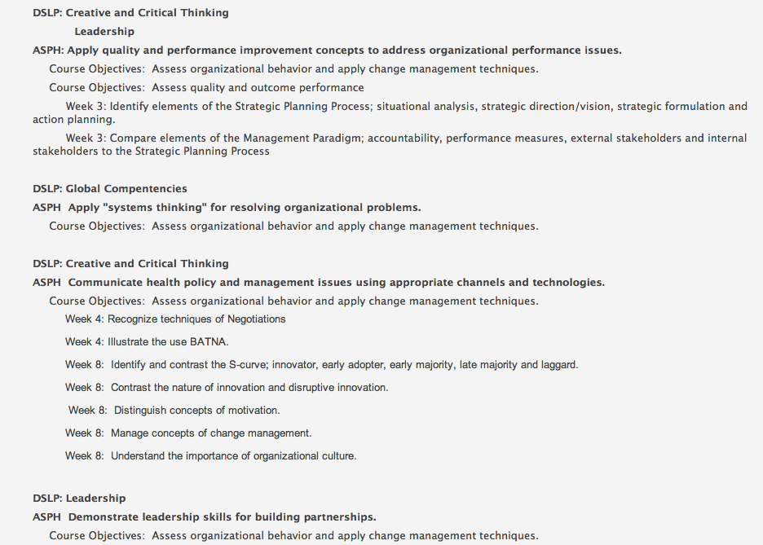
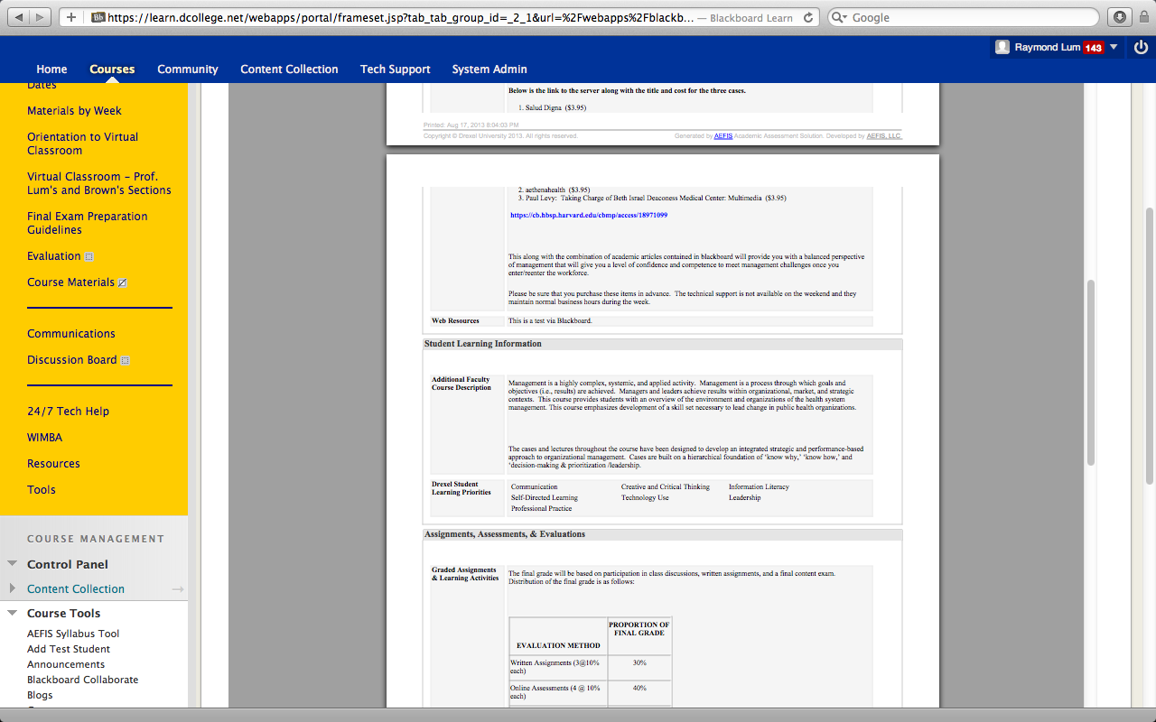
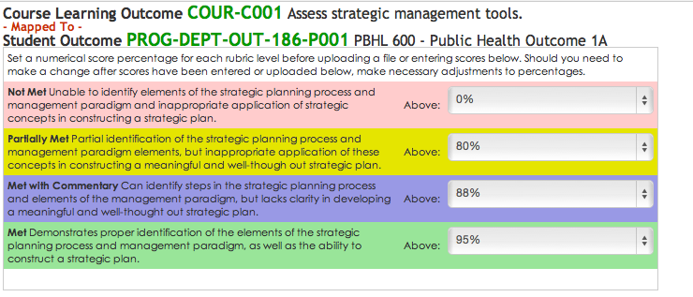
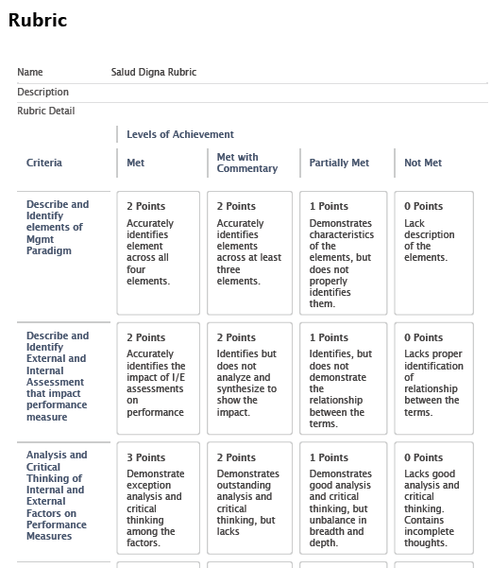
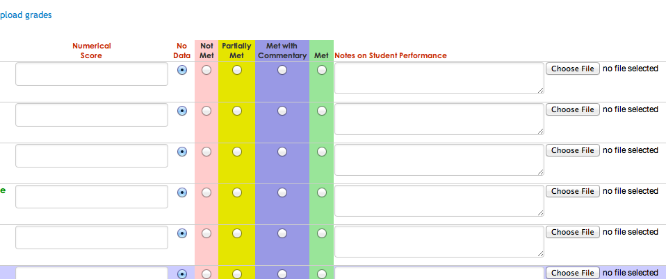
Managing Direct Assessments

Slide 21
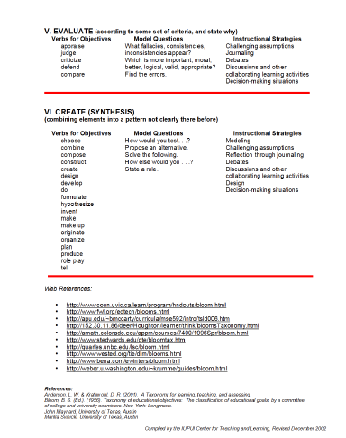
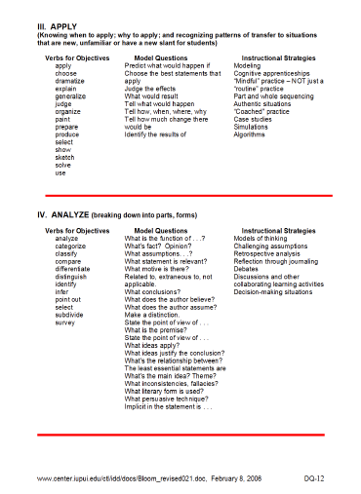
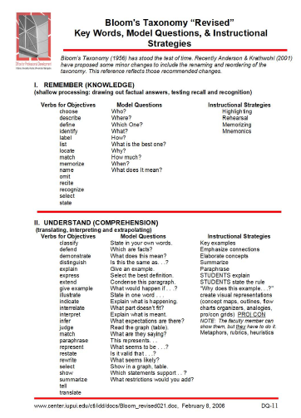
Blooms Taxonomy
Create
Synthesize
Analyze
Describe

Slide 22
Quality Matters Rubric

Slide 23
Alignment to Direct Assessments

Slide 24
Transitioning from Grades to Competencies

Slide 25
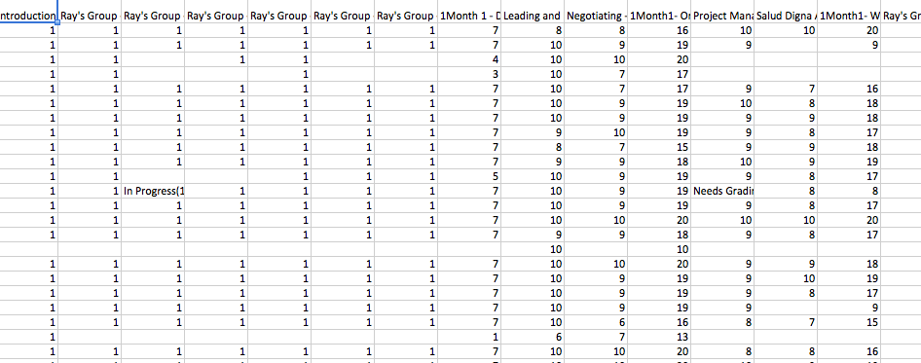
Grade book

Slide 26
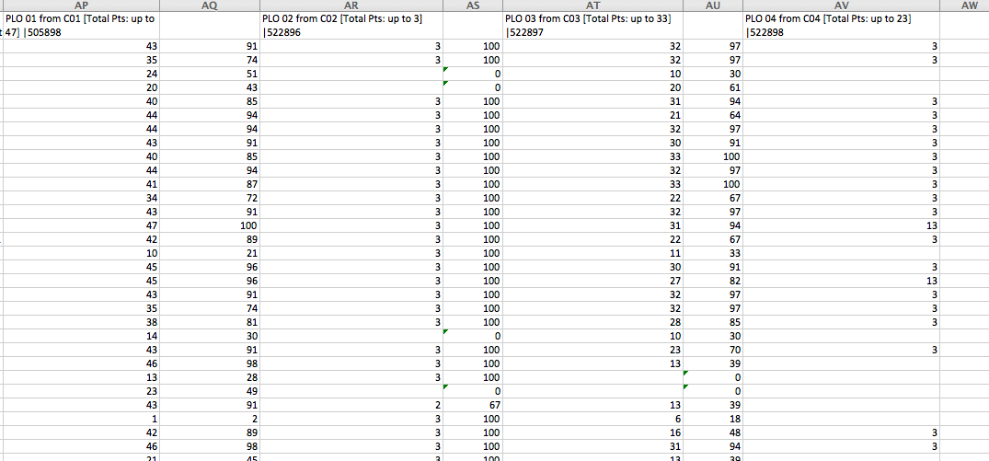
Program Outcome Columns in Grade book

Slide 27
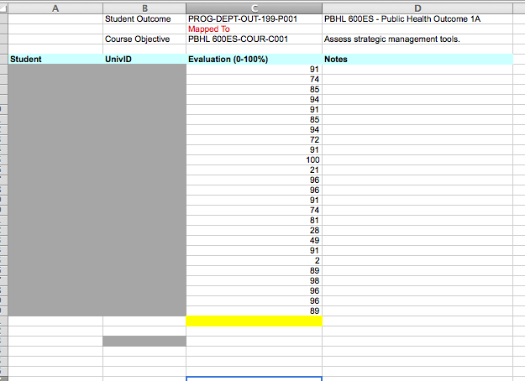
AEFIS Direct Assessment Template

Slide 28
Direct Assessment in AEFIS

Slide 29
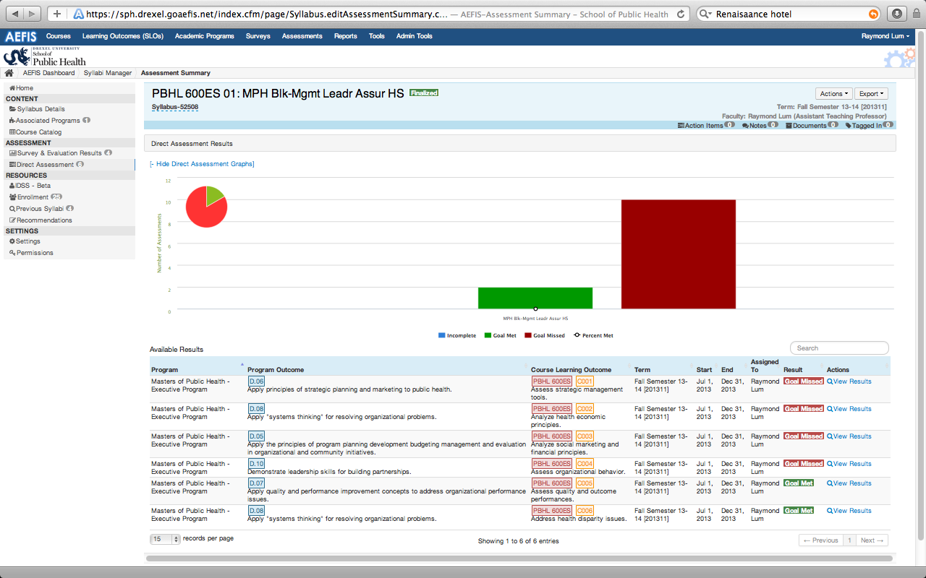
Summary Dashboard of Direct Assessments

Slide 30
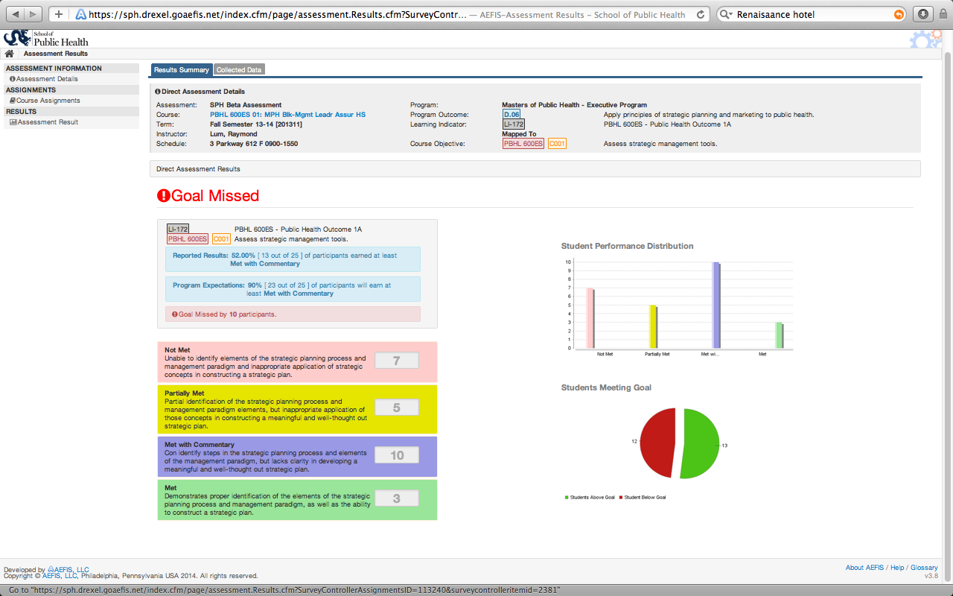
Program Outcome 1

Slide 31
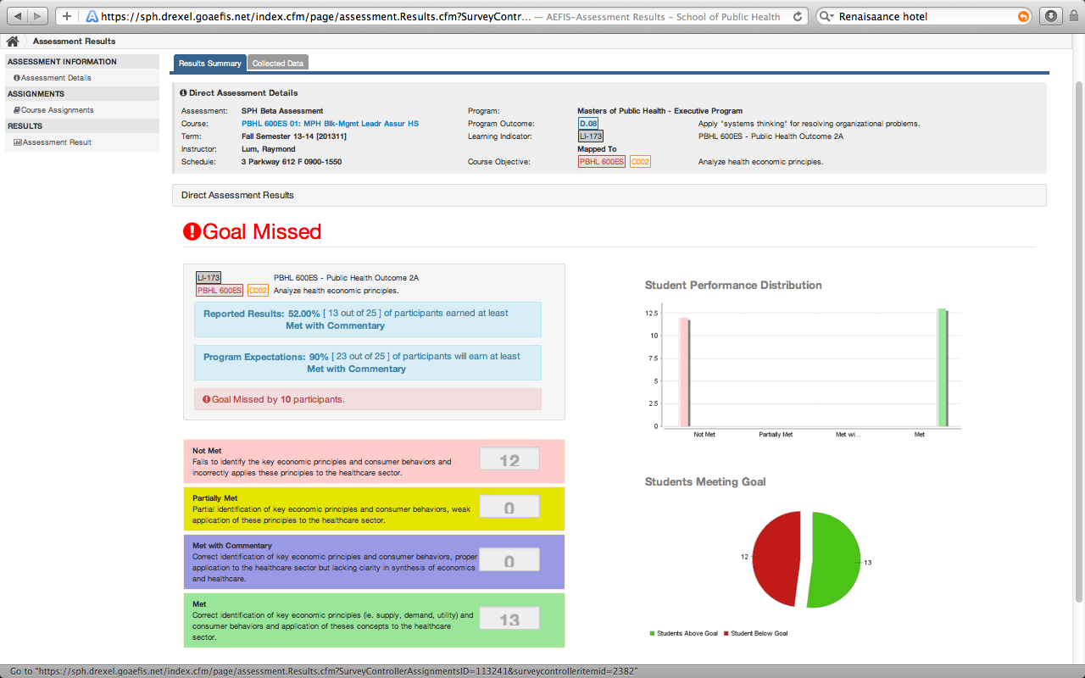
Program Outcome 2

Slide 32
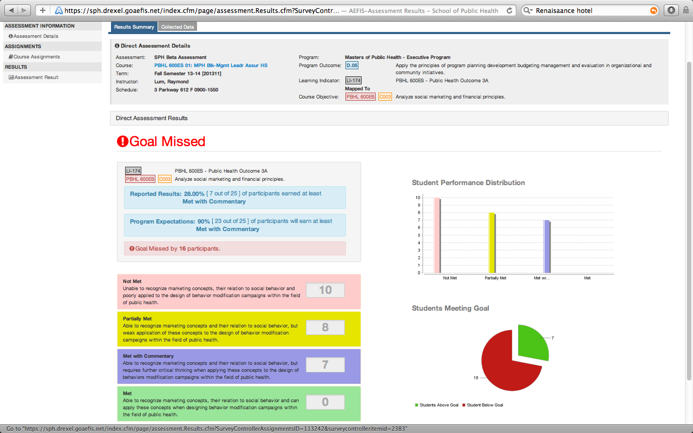
Program Outcome 3

Slide 33
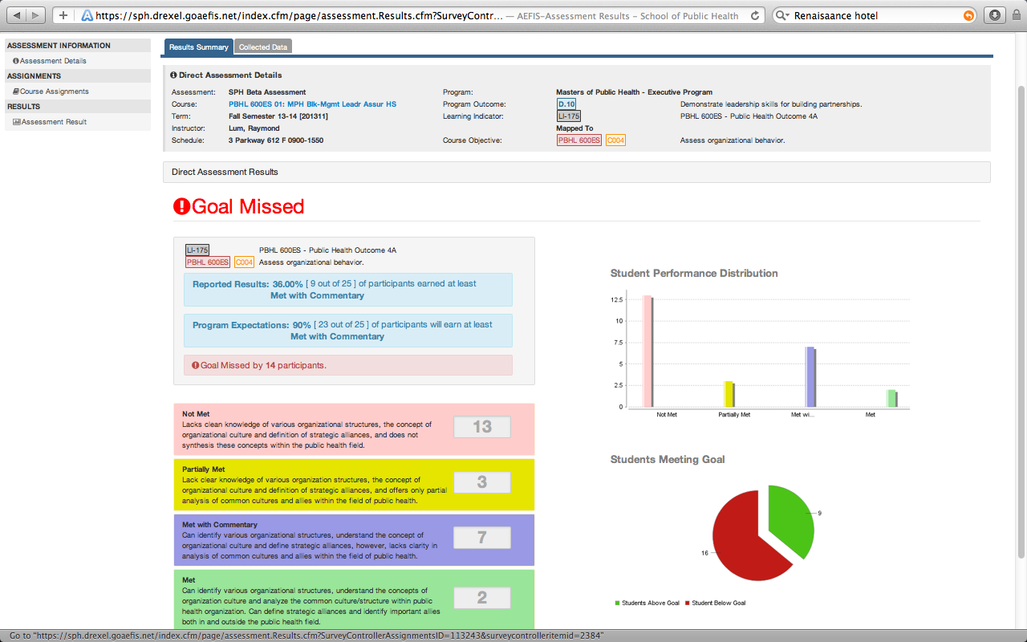
Program Outcome 4

Slide 34
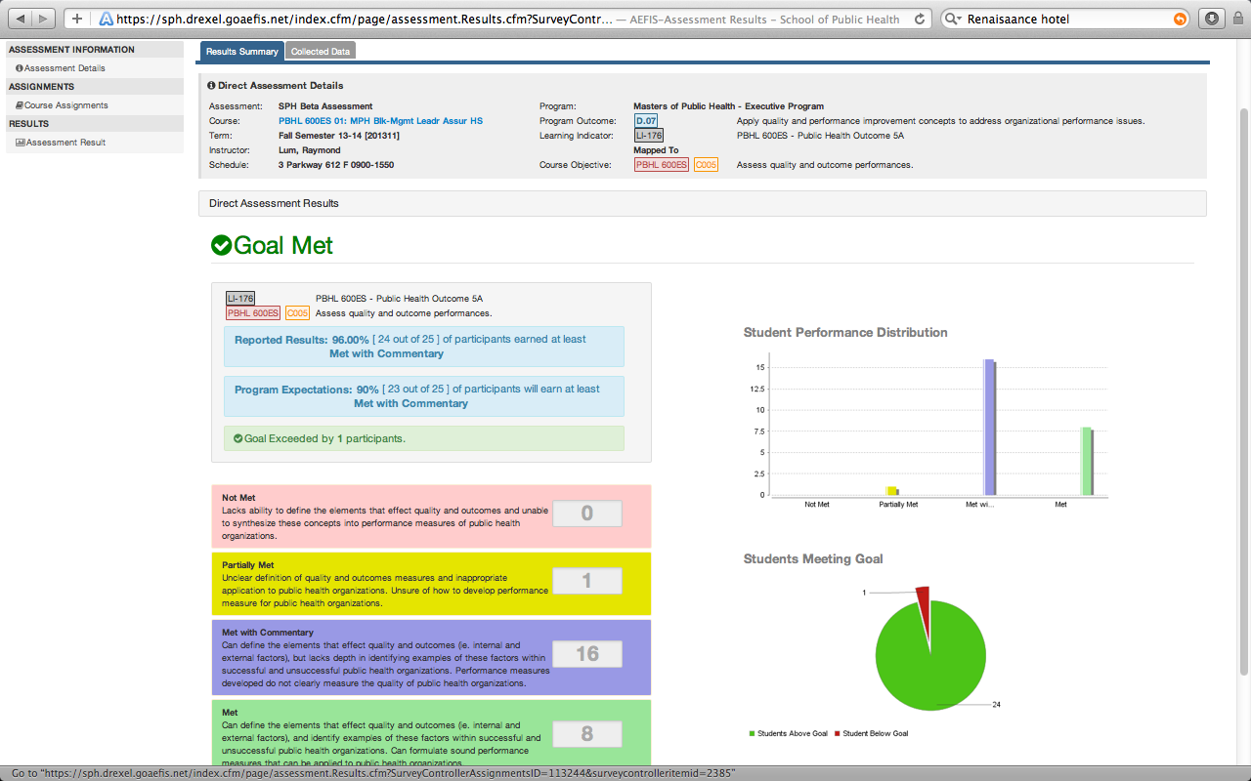
Program Outcome 5

Slide 35
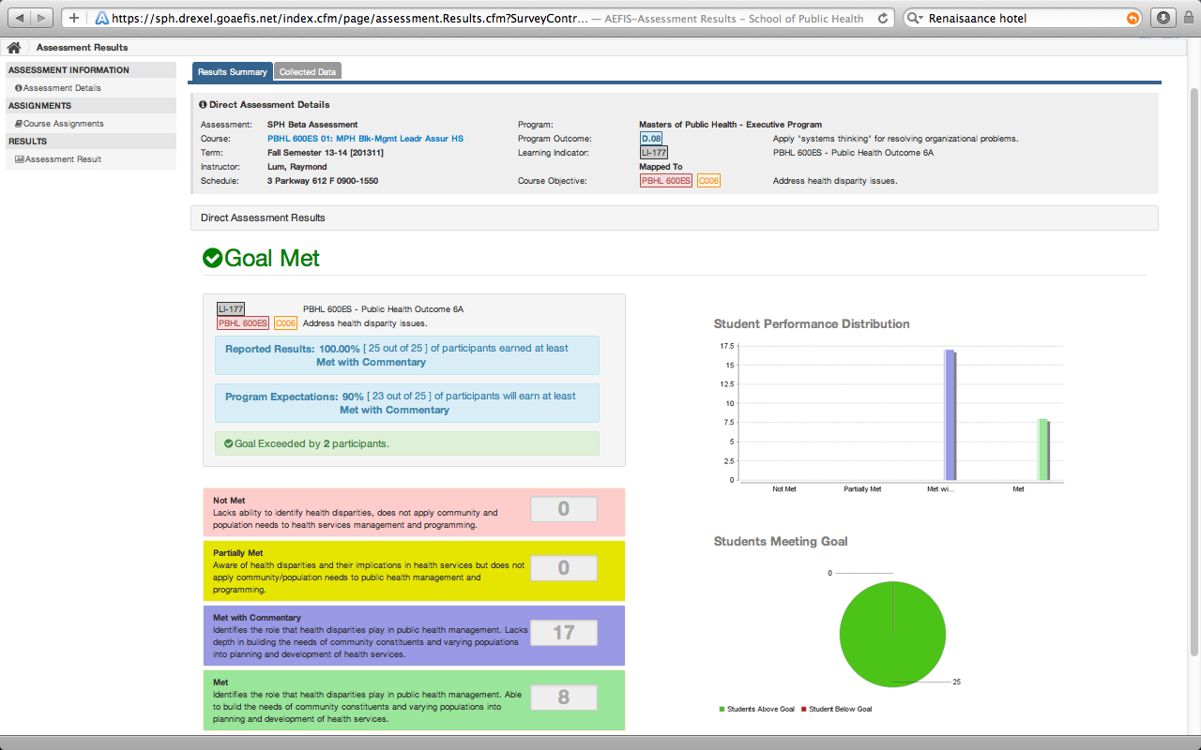
Program Outcome 6

Slide 36
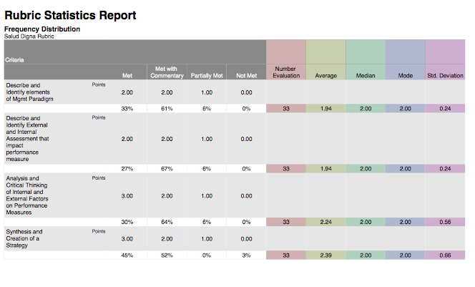
Assignment: Salud Digna Rubric Report

Slide 37
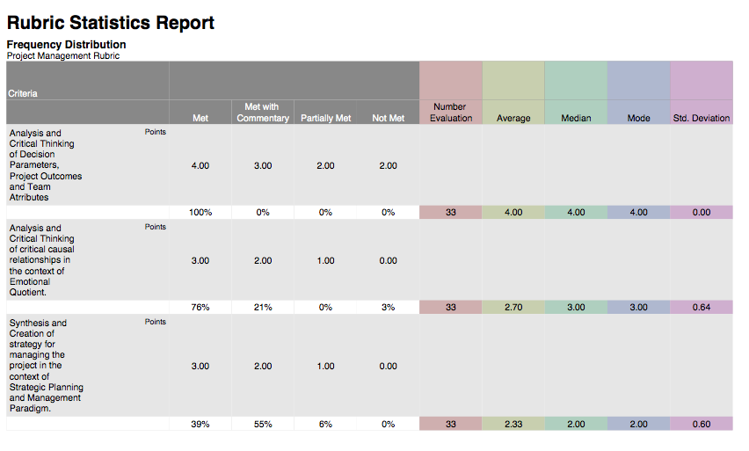
Project Mgmt Rubric Report

Slide 38
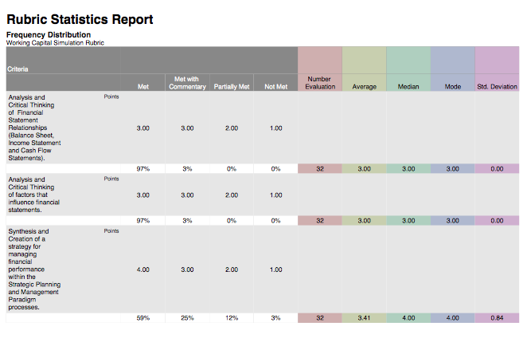
Working Capital Rubric Report

Slide 39
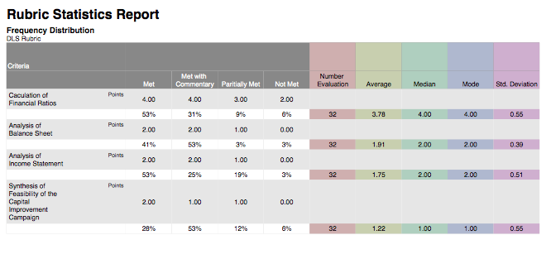
DLS Rubric Report

Slide 40
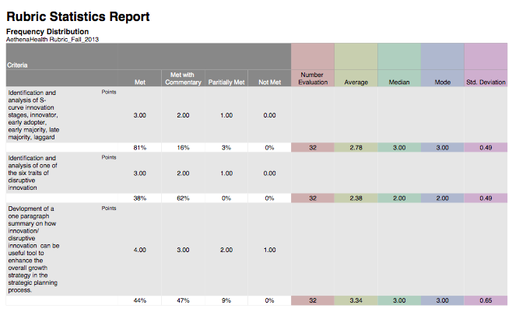
AethenaHealth Rubric Report

Slide 41
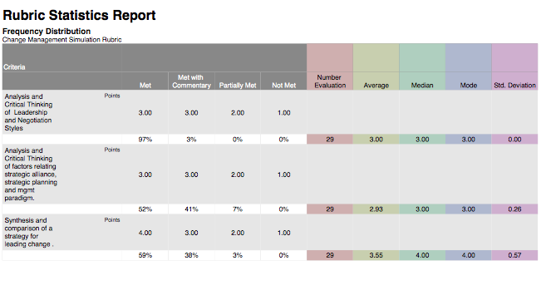
Paul Levy Report

Slide 42
Presentation Outline
First illustrate how program policies can be reframed to align programs level outcomes to course outcomes.
Secondly, it demonstrates how course assessments can be aligned to direct program level assessment to support the learning assessment narrative. In addition, it will show how grading rubrics and the grade book in Blackboard Learn can be utilized for direct program level assessments of student competencies through the use of the Academic Evaluation Feedback Intervention System (AEFIS).
Thirdly, the session demonstrates how the transparency of these learning outcomes develops an assessment culture and tone in the classroom and in faculty-student advising towards competencies.
Lastly, the session investigates interventions to improve and align course to program level outcomes that improve the quality measures in the breadth and depth of student competencies.

Slide 43
AEFIS Midcourse Results
What specific feature of the course and/or instructor is an obstacle to your learning at this point in the course?
31% Blackboard Organization
19% Assignments
31% Readings
12% Workload
What improvements would you like to see for the remaining of the course?
27% Reduce Workload
33% Better Organization on Blackboard
19% More Class Activities

Slide 44
Activity Completion Rates
Leading and Motivating Online Assessment: 100%
Negotiations Online Assessment: 91%
Project Management Assignment: 82%
Salud Digna Assignment: 70%
Finance Online Assessment: 91%
DLS Assignment: 80%
Working Capital Assignment: 68%

Slide 45
Fall Semester 2013

Slide 46
Fall Semester 2013

Slide 47
Fall Semester 2012

Slide 48
Fall Semester 2012

Slide 49
Public Heath Outcomes and DSLP 4 – Information Literacy

Slide 50
Public Heath Outcomes and DSLP 2 – Critical Thinking

Slide 51
Public Heath Outcomes and DSLP 8 – Leadership

Slide 52
Public Heath Outcomes and DSLP 7 – Global Competency

Slide 53
Modify Program Mapping PBHL 600 ES – Health Management

Slide 54
Modify Program Mapping for DSLPs for PBHL 600ES

Slide 55
Objective
Identify models that show how university, school, program policies can be modified to create a narrative and framework for learning assessment.
Apply techniques and templates to support other academic units who wish navigate their organizational structures towards a learning assessment initiative.
Apply competency documents that yield quality customize student outcomes and changes the culture and relationship between the student, faculty, staff and employer.

Slide 56
Presentation Outline
First illustrate how program policies can be reframed to align programs level outcomes to course outcomes.
Secondly, it demonstrates how course assessments can be aligned to direct program level assessment to support the learning assessment narrative. In addition, it will show how grading rubrics and the grade book in Blackboard Learn can be utilized for direct program level assessments of student competencies through the use of the Academic Evaluation Feedback Intervention System (AEFIS).
Thirdly, the session demonstrates how the transparency of these learning outcomes develops an assessment culture and tone in the classroom and in faculty-student advising towards competencies.
Lastly, the session investigates interventions to improve and align course to program level outcomes that improve the quality measures in the breadth and depth of student competencies.

Slide 57
Expanded Competency Mapping into LMs

Slide 58
Expanded Competency Mapping into Learning Activities

Slide 59
Interventions
4 Online Assessments
2 Additional Illustrations
Practice Competency Assessment
Indirect Competency Assessments

Slide 60
Addressing Competencies in HMP CBMP

Slide 61
Proposed Student Self-Assessment and Individualize Assessment via CBMP Advisor

Slide 62
Blending Together Coursework, Mentoring and Non-curricular Learning Activities
Pre-Post Assessment Course Assessment
Student Self-Assessment
Grading Rubrics
AEFIS Assessment
AEFIS Course Evaluations
Individualize Learning Activities (CBMP, Independent Study, Non-Curricular Learning Activities)
Program Assessment

Slide 63
Thank You! Questions?

