Slide 1




Whole of Degree Design -
Embedding Scaffolded Authentic Assessment
Romy Lawson romy@uow.edu.au
Myths & Movements: Reimagining Higher Education Assessment

Slide 2
WOLLONGONG AT A GLANCE

Slide 3
What are we trying to achieve when we teach?

Slide 4


Hunters & Gatherers: Strategies for Curriculum Mapping and Data Collection for Assurance of Learning
assuringlearning.com

Slide 5
How do we assure learning?
Write Degree LOS
Map Degree LOS
Collect Evidence
Use Evidence
Benchmark

Slide 6
How do we assure learning?
Write Degree LOS
Map Degree LOS
Collect Evidence
Use Evidence
Benchmark
HOLISTIC
COLLABORATION
SUSTAINABLE
INTEGRATED

Slide 7
How do we assure learning?
Design Curriculum
Write Degree LOS
Map Degree LOS
Collect Evidence
Use Evidence
Benchmark
Engage Students
Facilitate Learning
Review Practice
Assess Learning

Slide 8
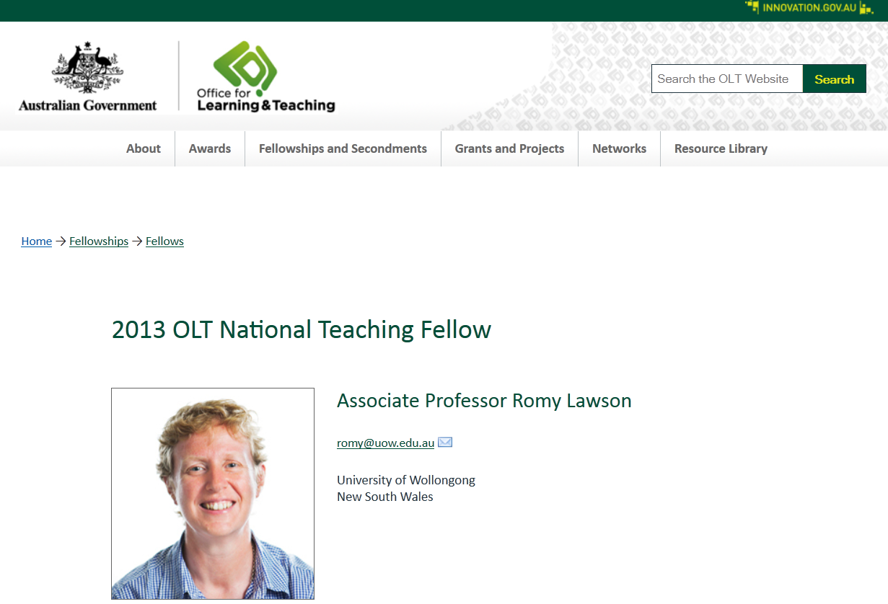
Curriculum design for assuring learning in business education - leading the way

Slide 9

Designing learning
Learning Outcomes
Learning Activities
Assessment
Evaluation

Slide 10

Whole of Degree Approach

Slide 11
Whole of Degree Approach
Critical Thinking
Ethical Awareness

Slide 12
Whole of Degree Process – How?
Writing Degree Learning Outcomes
Understanding Criteria and Standards needed to achieve the DLOs (whole of degree rubrics)
Designing Authentic Scaffolded Assessment of DLOS
Teaching DLOs with Effective Feedback/Feedforward Mechanisms
Leading the Process – Facilitating Change

Slide 13
Designing learning
Learning Outcomes
Learning Activities
Assessment
How will you/ students know if they can do it?
Evaluation

Slide 14
Considerations
National (International)
  Government Regulations
  Discipline Thresholds
  Professional Bodies

Slide 15










Slide 16
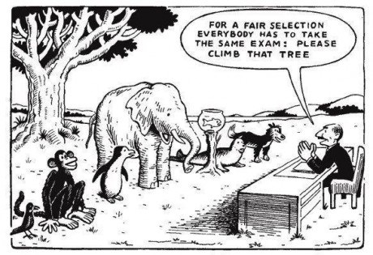

Slide 17
Considerations
National (International)
  Government Regulations
  Discipline Thresholds
  Professional Bodies
Institutional/Faculty
  University requirements (point of distinction)
Degree
  Context
  Level

Slide 18
What are you assessing?
External – Govt, Prof Bodies
Internal - University GA
Degree Level - CLO

Slide 19
Valid Data for Quality Assurance
Although quality assurance has been recognised as a critical component of educational enhancement principles there is little consistency as to how to achieve it.
Of more concern, is the validity of the data being used to assure quality.

Slide 20
Streamlined Approach
Degree LO
Unit LO
Assessment

Slide 21
Streamlined Approach
Degree LO
Unit LO
Assessment

Slide 22
Streamlined Approach
Degree LO
Unit LO
Assessment
(Context/Level)

Slide 23
Step 1 –
Design Authentic Assessment
Select a Degree LO
  How would students demonstrate the competence in industry/profession/real life?
  Where would it take place?
  How would you judge if it was good?
Translate this into an authentic assessment tasks

Slide 24
Step 2 –Rubric Development
STANDARD | BELOW EXPECTATIONS | MEETS EXPECTATIONS | EXCEEDS EXPECTATIONS
GRADE CRITERIA | Z → | P → C | D → HD
Demonstration of inter-relationships between differing business related disciplines | Limited demonstration of integration between disciplines. e.g. identification or description only. | Sound demonstration of integration between disciplines. e.g. examination, explanation, interpretation, application or analysis of interrelationships. | Comprehensive demonstration of integration between disciplines. e.g. detailed examination, insightful analysis or interpretation, synthesis, extrapolation, evaluation and/or recommendations.
Application of critical understandings of theoretical concepts underpinning perspectives in industry based scenarios. | No / little application of critical understandings demonstrated. e.g. Only one perspective drawn on to demonstrate concepts. | Application of critical understandings demonstrated. e.g. 2-3 perspectives drawn on to demonstrate concepts. | Convincing application of critical understandings demonstrated. e.g. Relevant and innovative application drawn from multiple / global perspectives.

Slide 25
Whole of Degree Rubric
Degree LO1 Demonstrate essential knowledge necessary for a career in business related professions
 | Year 1: Foundation | Year 2: Intermediate | Year 3: Competent
A Appreciation of essential concepts necessary for a career in business and related professions. | Describes essential concepts of business. | Explains essential concepts of business, demonstrating application of concepts. | Interprets essential concepts of business hypothesising, and assessing aspects of the concepts.
B Critical analysis and evaluation of essential concepts. | Demonstrates some critical analysis/evaluation of essential concepts. e.g. Reference to concepts through definition or description only. | Demonstrates sound critical analysis / evaluation of essential concepts. e.g. analysis demonstrated through explanation, discussion, investigation, application, interpretation of concepts. | Demonstrates thoughtful critical analysis and evaluation of essential concepts. e.g. involvement of reflection, judgment, problem-solving, synthesis, assessment, prediction.
C Consideration of the economic, social and cultural environments within which international businesses operate. | Demonstrates some consideration of the economic, social and cultural aspects of international business context. | Demonstrates sound consideration of international economic, social and cultural differences between cultures and how these differences impact ways that business operates. | Demonstrates high level understanding of international economic, social and cultural environmental issues in an international business situation. e.g. accurate explanation of relevant actions and prediction of responses.

Slide 26
DLO1 Demonstrate essential knowledge necessary for a career in business related professions
 | Year 1: Foundation | Year 2: Intermediate | Year 3: Competent
A Appreciation of essential concepts necessary for a career in business and related professions. | Describes essential concepts of business. | Explains essential concepts of business, demonstrating application of concepts. | Interprets essential concepts of business hypothesising, and assessing aspects of the concepts.
B Critical analysis and evaluation of essential concepts. | Demonstrates some critical analysis/evaluation of essential concepts. e.g. Reference to concepts through definition or description only. | Demonstrates sound critical analysis / evaluation of essential concepts. e.g. analysis demonstrated through explanation, discussion, investigation, application, interpretation of concepts. | Demonstrates thoughtful critical analysis and evaluation of essential concepts. e.g. involvement of reflection, judgment, problem-solving, synthesis, assessment, prediction.
C Consideration of the economic, social and cultural environments within which international businesses operate. | Demonstrates some consideration of the economic, social and cultural aspects of international business context. | Demonstrates sound consideration of international economic, social and cultural differences between cultures and how these differences impact ways that business operates. | Demonstrates high level understanding of international economic, social and cultural environmental issues in an international business situation. e.g. accurate explanation of relevant actions and prediction of responses.

Slide 27
 | Below F | Meets P C | Exceeds D HD
ULO
ULO
ULO
DLO1 | Describes essential concepts of business | Explains essential concepts of business, demonstrating application of concepts. | Interprets essential concepts of business hypothesising, and assessing aspects of the concepts.
DLO1 | Demonstrates some consideration of the economic, social and cultural aspects of international business context. | Demonstrates sound consideration of international economic, social and cultural differences between cultures and how these differences impact ways that business operates | Demonstrates high level understanding of international economic, social and cultural environmental issues in an international business situation. e.g. accurate explanation of relevant actions and prediction of responses.

Slide 28
DLO 1
8 – Synthesize complex conflict and related theories and standards for professional practice in CMR.
9 - Evaluate complex conflict and related theories and standards for professional practice in CMR.
Criteria | Grad Cert Fail | Grad Cert Pass MCMR Fail | Grad Cert Exceeds MCMR Pass | MCMR Exceeds
1(a) Understands the theories and standards for the purpose of applying them in practice | Does not identify key concepts of theories/standards and/or does not explain their relevance to practice. | Explain the key concepts of complex theories/standards in the field and their relevance to practice. | Comprehensively explains complex theories/standards in the field and their relevance to practice. | Comprehensively explains and critically analyses complex theories/standards in the field and their relevance to practice.
1(b) Demonstrate interrelationships between complex conflict and related theories and standards | Does not draw any links between theories and/or standards. | Explain the relationships between key concepts of complex conflict and related theories and standards | Comprehensively explains the relationships between complex conflict and related theories and standards. | Comprehensively explains and critically analyses the relationships between complex conflict and related theories and standards.
1 (c) Draw conclusions | Conclusions not logically linked to theories and standards. | Draws logical conclusions from theories and/or standards. | Draws and explains logical conclusions from theories and/or standards. | Draws and critically justifies conclusions from theories and/or standards.
1 (d) Apply theory/standards to practice. | Incomplete application of theories/standards to practice. | Applies theory/ standards to practice, utilising the main elements of the theory/standards | Effectively applies theory / standards to practice utilising relevant elements of the theory/standards. | Produces a comprehensive application of theory/standards to practice utilising relevant elements of the theory or shows innovation in application.

Slide 29
Step 3 – Scaffold Assessment throughout Curriculum
Now look at this collection of assessment tasks and ask
  How can you build throughout the course (increase complexity)? This is scaffolded assessment
DLO | Assessment 1 | Assessment 2 | Assessment 3 | Assessment 4
1 Written | Memo to manager | Letter to client | Executive Summary | Full report
2 Ethics | Case study (one issue) | Case study (multiple issues) | Current News Analysis | Real Wicked Problem

Slide 30
Step 4 – Map to embed into the curriculum
Assessment | Task | Subject
DLO 1 – Assess 1 | Memo to manager | HR101
DLO 1 – Assess 2 | Letter to client | Mgt 201
etc

Slide 31
Whole of Degree Marking

Slide 32
Valid Data for Quality Assurance
Sadler (2012) discusses commonly used options in assuring achievement including:
  overall results,
  external examiner systems,
  threshold standards
  and standardised testing,
  but stresses problems with each of these methods unless a
  moderation and calibration process is included.

Slide 33
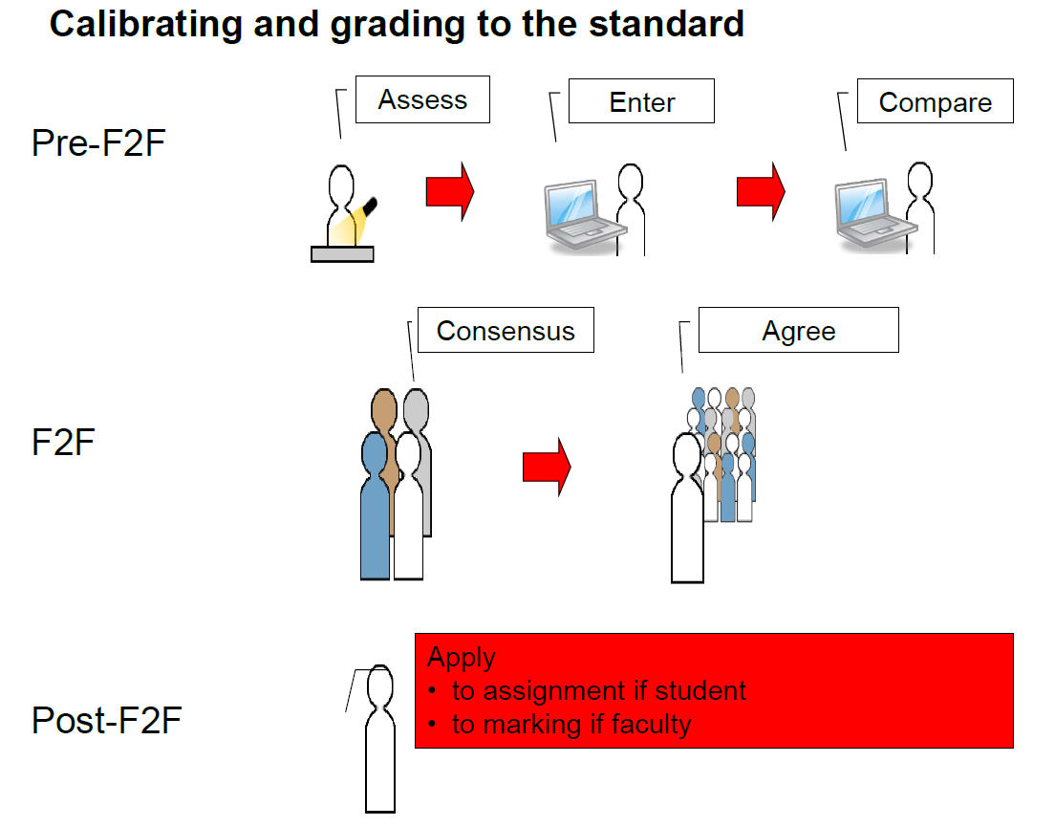
Calibration
Freeman, Hancock et al

Slide 34
Valid Data for Quality Assurance
Yorke (2008) has also raised concern about adopting overall percentages as the indicator of quality.
What does a percentage or grade point average or degree classification actually tell us;
  which capabilities were actually assessed
  at what level;
  how grading was decided.

Slide 35
Valid Data for Quality Assurance
Whole of Course ePortfolios
Yorke (2008) proposed that evidence can (some might say 'should') be created by students.
Creating ePortfolios is said to enable students to enhance their learning by giving them a better understanding of their skills and attributes, as well as where and how they need to improve to meet academic and career goals (Yancey, 1999).

Slide 36
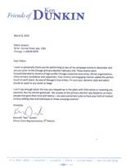


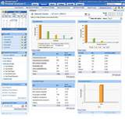


Degree LO Evidence

Slide 37
Assessment . . .
“Students can escape bad teaching: they can’t avoid bad assessment”
“Assessment methods and requirements probably have a greater influence on how and what students learn than any other single factor”

