Slide 1
Successfully Assessing Failure: Authentic Assessment
Krishna Dunston
kdunston@uarts.edu
Thursday, September 11th, 11:15 – 12:15

Slide 2
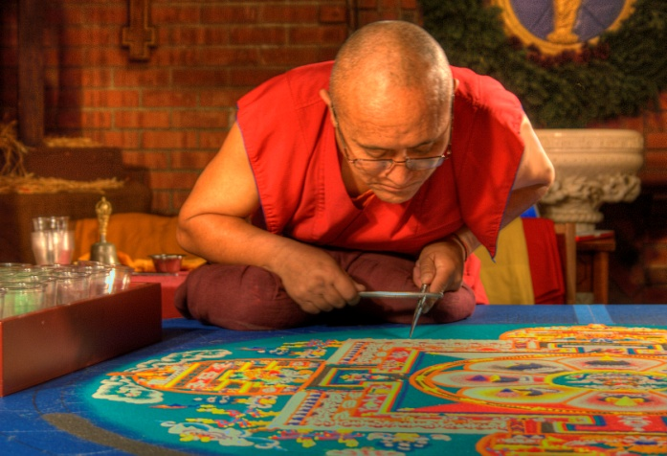
Assessing the Artifact
When is Art correct?
What is a perfect execution of Technique?
What is the timeline of Mastery?

Slide 3
The Wrong Stuff – www.slate.com
Kathryn Schultz
Search Phrase, “The Wrong Stuff” slate

Slide 4
The Wrong Stuff – www.slate.com
The Model
Mathematically perfect
No errors
Double check product
“Go” or “No Go”
High risk

Slide 5
The Wrong Stuff – www.slate.com
The Model:
Process is at the center
Test for success AND test for errors
Make a lot of attempts
Passionate people work hard
Things change
Try again
If it doesn’t work now, put it aside and maybe it will work later

Slide 6
Rubric Users/Builder Assessment
Avid! I have a rubric to evaluate my breakfast!
Moderate. I have used or built rubrics.
Curious. I have read about them, but haven’t used one myself.
What’s a rubric?

Slide 7
How do you see progress?
How do you know goals are being achieved over time?

Slide 8
Why use rubrics?
What if you had to tell the seed…
…what comes
next?

Slide 9
What is a rubric anyway?
You may already use one, but under the name, “grading scale” or “requirement checklist.”
A rubric is a tool that list requirements for an assignment, a course, a program; offers a range (Poor, Superior, etc); and describes what success/failure looks like.

Slide 10
Rubric: Participation
For instance, if you wanted to create a rubric for "Class Participation," you might choose criteria such as these:
Professionalism
Engagement
Improvement

Slide 11
Rubric: Participation
And, you want to be able to judge on a 3 scale range:
Unacceptable
Acceptable
Superior

Slide 12
Rubric: Participation
Your rubric might look like this:
 | Unacceptable | Acceptable | Superior
Professionalism
Engagement
Improvement

Slide 13
Rubric: Participation
It becomes a useful communication device when you provide your own standards and examples:
 | Unacceptable | Acceptable | Superior
Professionalism | Often tardy; turns in assignments late; fails to prepare for class; inattentive to instructor or other students. | Usually arrives on time; most assignments turned in on time; listens to others. | Always arrives on time; assignments turned in properly and on time; respectful of other students in class.
Engagement | Does not participate in class discussion; no evidence of technique; fails to contribute adequately to group projects. | Usually contributes to class discussion; has demonstrated technique; participates actively in group projects. | Always contributes appropriately to class discussion; frequently offers to demonstrate technique; shows leadership in group projects.
Improvement | Little or no development of technique; is unable or unwilling to accept critique; unable to make adjustments. | Technique is developing; has shown some ability to build on previous lessons; generally able to accept critique. | Shows an exceptional and growing understanding of technique; builds on previous lessons; accepts critique and makes proper adjustments.

Slide 14
Rubric: Participation
I like to be able to target more specifically where I'd like to see improvement. For example, have you ever had a student who was wonderful contributor to class - but chronically tardy? In the example rubric, that student's participation grade would look like this: :
 | Unacceptable (1) | Acceptable (2) | Superior (3)
Professionalism | Often tardy; turns in assignments late; fails to prepare for class; inattentive to instructor or other students. | Usually arrives on time; most assignments turned in on time; listens to others. | Always arrives on time; assignments turned in properly and on time; respectful of other students in class.
Engagement | Does not participate in class discussion; no evidence of technique; fails to contribute adequately to group projects. | Usually contributes to class discussion; has demonstrated technique; participates actively in group projects. | Always contributes appropriately to class discussion; frequently offers to demonstrate technique; shows leadership in group projects.
Improvement | Little or no development of technique; is unable or unwilling to accept critique; unable to make adjustments. | Technique is developing; has shown some ability to build on previous lessons; generally able to accept critique. | Shows an exceptional and growing understanding of technique; builds on previous lessons; accepts critique and makes proper adjustments.

Slide 15
Workshop Exercise
Build a rubric which focuses on processes which might be successful – even if product, technique, or artifact is a failure.
Share research in defining criteria, program/class/assignment requirements.
Share language, terms, definitions.

Slide 16
Processes of Art-Making
Risk-Taking

Slide 17
Search phrase: “Creative Thinking Rubric”

Slide 18
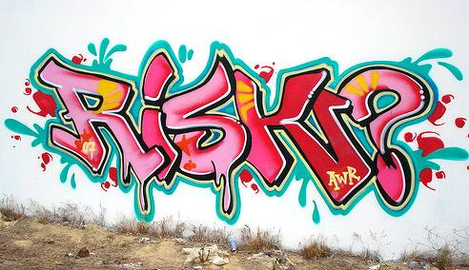
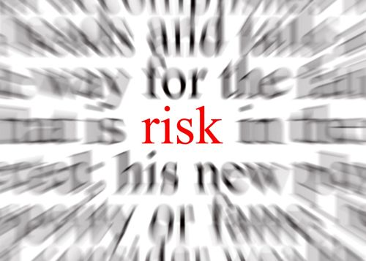
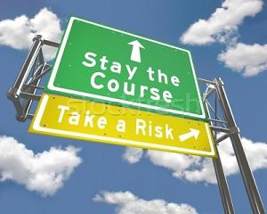
Risk-Taking
Two roads diverged in a wood, and I… I took the one less traveled by, and that has made all the difference. – Robert Frost
Only those who will risk going too far can possibly find out how far one can go. – T. S. Eliot
I am always doing that which I cannot do, in order that I may learn how to do it.
– Pablo Picasso
Do not be too timid and squeamish about your actions. All life is an experiment. The more experiments you make the better. What if they are a little course, and you may get your coat soiled or torn? What if you do fail, and get fairly rolled in the dirt once or twice. Up again, you shall never be so afraid of a tumble. – Ralph Waldo Emerson
Often the difference between a successful man and a failure is not one’s better abilities or ideas, but the courage that one has to bet on his idea, to take a calculated risk, and to act.
– Maxwell Maltz

Slide 19
Risk-Taking
Two roads diverged in a wood, and I… I took the one less traveled by, and that has made all the difference. – Robert Frost
Only those who will risk going too far can possibly find out how far one can go. – T. S. Eliot
I am always doing that which I cannot do, in order that I may learn how to do it.
– Pablo Picasso
Do not be too timid and squeamish about your actions. All life is an experiment. The more experiments you make the better. What if they are a little course, and you may get your coat soiled or torn? What if you do fail, and get fairly rolled in the dirt once or twice. Up again, you shall never be so afraid of a tumble. – Ralph Waldo Emerson
Often the difference between a successful man and a failure is not one’s better abilities or ideas, but the courage that one has to bet on his idea, to take a calculated risk, and to act.
– Maxwell Maltz

Slide 20
Please pass your rubric to the person to your right.
Share !

Slide 21
Processes of Art-Making
Risk-Taking
Persistence/Grit

Slide 22
Persistence
Search Phrase: “Grit Scale” Duckworth
Dr. Angela Duckworth, UPENN
“Grit: Perseverance and Passion for Long-Term Goals”
Grit Scale

Slide 23
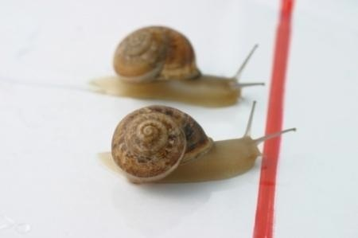
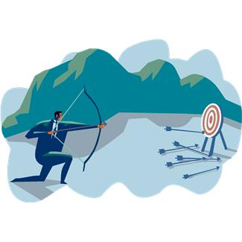
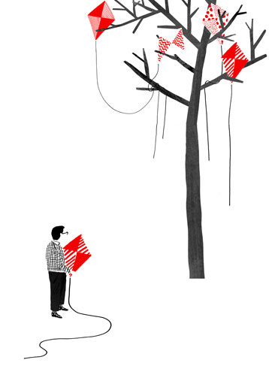
Persistence
The difference between people who believe they have books inside of them and those who actually write books is sheer cussed persistence - the ability to make yourself work at your craft, every day - the belief, even in the face of obstacles, that you've got something worth saying. - Jennifer Weiner
Try again. Fail again. Fail better. - Samuel Beckett
Many of life's failures are people who did not realize how close they were to success when they gave up. - Thomas A. Edison
It's not that I'm so smart, it's just that I stay with problems longer.
~Albert Einstein
With ordinary talent and extraordinary perseverance, all things are attainable.
~Thomas Foxwell Buxton

Slide 24
Persistence
Perseverance
Determination
Stamina
Grit
Stick-to-it-iveness
Tenacity

Slide 25
Persistence
The difference between people who believe they have books inside of them and those who actually write books is sheer cussed persistence - the ability to make yourself work at your craft, every day - the belief, even in the face of obstacles, that you've got something worth saying. - Jennifer Weiner
Try again. Fail again. Fail better. - Samuel Beckett
Many of life's failures are people who did not realize how close they were to success when they gave up. - Thomas A. Edison
It's not that I'm so smart, it's just that I stay with problems longer.
~Albert Einstein
With ordinary talent and extraordinary perseverance, all things are attainable.
~Thomas Foxwell Buxton

Slide 26
Please pass your rubric to the person to your right.
Share !

Slide 27
Processes of Art-Making
Risk-Taking
Persistence/Grit
Intention

Slide 28
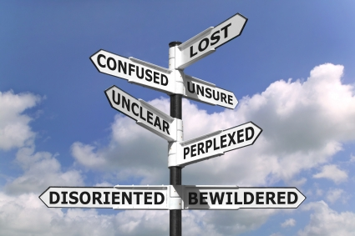
Intention
“Good fortune is what happens when opportunity meets with planning.”
- Thomas Alva Edison
"I have learned, that if one advances confidently in the direction of his dreams, and endeavors to live the life he has imagined, he will meet with a success unexpected in common hours.“
- Henry Thoreau
“By failing to prepare, you are preparing to fail.” ― Benjamin Franklin
Action is the foundational key to all success. - Pablo Picasso

Slide 29
Intention
Project
Objective
Motivation
Design
Plan
Purpose
Direction
Deliberateness

Slide 30
Intention
“Good fortune is what happens when opportunity meets with planning.”
- Thomas Alva Edison
"I have learned, that if one advances confidently in the direction of his dreams, and endeavors to live the life he has imagined, he will meet with a success unexpected in common hours.“
- Henry Thoreau
“By failing to prepare, you are preparing to fail.” ― Benjamin Franklin
Action is the foundational key to all success. - Pablo Picasso

Slide 31
Please pass your rubric to the person to your right.
Share !

Slide 32
Processes of Art-Making
Risk-Taking
Persistence/Grit
Intention
Growth

Slide 33
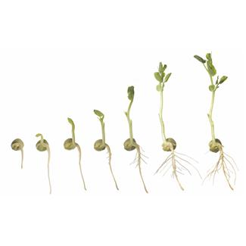
Growth
“Growth means change and change involves risk, stepping from the known to the unknown.”
Be not afraid of growing slowly; be afraid only of standing still. Chinese Proverb
Change and growth take place when a person has risked himself and dares to become involved with experimenting with his own life. Herbert Otto
“The great thing in the world is not so much where we stand, as in what direction we are moving.”
- Oliver Wendell Holmes

Slide 34
Growth
Evolution
Development
Reach
Maturation
Adaptability
Improvement
Advancement

Slide 35
Growth
“Growth means change and change involves risk, stepping from the known to the unknown.”
Be not afraid of growing slowly; be afraid only of standing still. Chinese Proverb
Change and growth take place when a person has risked himself and dares to become involved with experimenting with his own life. Herbert Otto
“The great thing in the world is not so much where we stand, as in what direction we are moving.”
- Oliver Wendell Holmes

