Slide 1
Snapshot Session: Mini presentations
2014 ASSESSMENT CONFERENCE
MYTHS & MOVEMENTS - REIMAGINING HIGHER EDUCATION ASSESSMENT
Thursday, September 11, 2014
2 - 3 p.m.

Slide 2
Assessment of Learning Environments
2014 ASSESSMENT CONFERENCE
MYTHS & MOVEMENTS - REIMAGINING HIGHER EDUCATION ASSESSMENT
DANUTA A. NITECKI
Dean of Libraries & Professor, CCI
Drexel University

Slide 3
Notes:
Let me start my story with a confession of mindset. I believe that learning is a life long sport of running inside the brain, requiring mastery, training, and practice of mental skills. Self-directed learning is part of the human spirit and an expected habit of mind for those in higher education.
Running inside the brain http://4.bp.blogspot.com/-W3CLno7EJ5Y/Tm84tm7kxII/AAAAAAAACYQ/4dzcLmc0GHo/s1600/Running%2Binside%2Ba%2Bbrain.jpg

Slide 4
Notes:
Furthermore, as a librarian I think about environments that inspire and embellish scholarly communications. In the academic context, learners are typically readers who form new ideas from engagement with published content and increasingly with digital data.
Sources
http://bildmix.com/29/die-etwas-anderen-buecherregale
Brit library http://www.kurzweilai.net/images/The_Reading_Room_at_the_British_Museum.jpg

Slide 5
Notes:
But how do we assess spaces to design effective environments for self-directed learning? How important are books, technological devices, lighting, beverages, and positioning of people? No standards exist for evaluating informal learning environments—and yet these spaces support independent learning behaviors.
Sources
http://bildmix.com/29/die-etwas-anderen-buecherregale
Brit library http://www.kurzweilai.net/images/The_Reading_Room_at_the_British_Museum.jpg

Slide 6
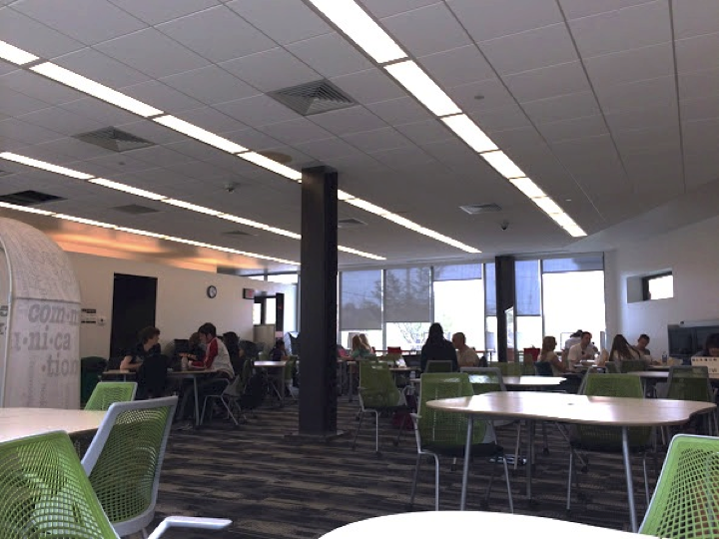
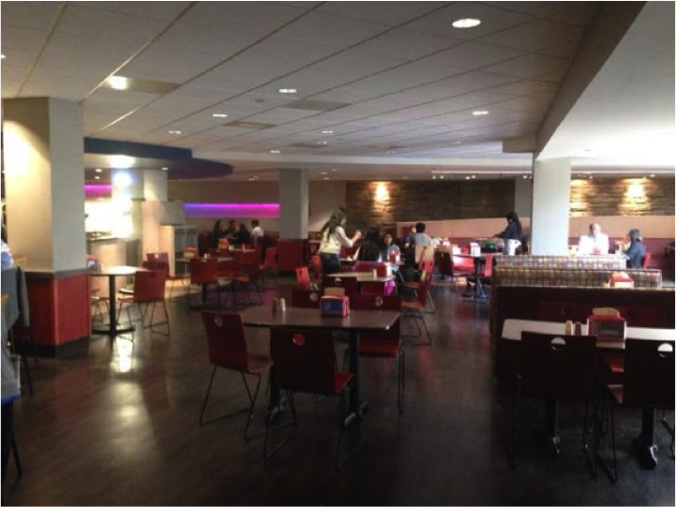
Drexel-tried assessment methods
2013 Rubric application
2014 Student defined
… well lighted
….Plenty of plugs to charge laptops
Notes:
I will highlight two approaches to assess learning environments tried at Drexel University. In 2013 students and staff applied a rubric to eleven sites specifically designated for learning; and in spring 2014, students were hired to identify learning environments and their important features.

Slide 7
Learning Spaces Collaboratory http://www.pkallsc.org
Actively engage with peers
Practice skills and profession’s thinking
Practice communicating and critiquing
Become refreshed and renewed
Become self-aware and self-motivated
Notes:
The Learning Spaces Collaboratory suggests five ways that space enhances the student experience to engage in robust learning—through engaging with others, individual practice, communicating, rejuvenating, and reflection.

Slide 8
Learning Spaces Collaboratory Assessment Rubric
4 types of learning spaces, for:
Collaborative social learning
Acquiring and enhancing understanding
Communicating
Renewal and reflection
Levels of success:
*exemplary, *competent, *needs attention
Notes:
It offers a rubric for assessing four types of learning spaces intended to support these activities. We applied this rubric to study lounges, a writing center, a foreign language center, tutoring service sites, and libraries. Student and staff differed in evaluating levels of success.

Slide 9
Drexel main campus
Notes:
This year a small group of students identified 146 learning destinations within 29 of 36 buildings on campus. As directed, they posted their images and written comments to record what they found important or missing in places conducive for student self directed learning.

Slide 10
Notes:
Here are a few examples, starting with an illustration of differing perceptions between students and staff. One student chose this study lounge as a “Nice place for a personal learning.” And yet my thought is that its drab functionality lacks inspiration or any appeal

Slide 11
Notes:
Here a student selected a space specifically designed for self-directed learning, where students can take ownership of the environment by rearranging anything. The recorded perception: “Quiet space, lots of room, provides all needs for learning and is naturally lit.”

Slide 12
Notes:
Another selection is this space in our multicultural center. Its description is: “Students would like to come here because there is large space. Also, because …they can [be] free to talk. And…..It's a convenient place if the library is full. The couches are comfortable.”

Slide 13
Notes:
The entrance to our athletic center was selected and described as: “This would be a nice place to informally meet for a group project. There is lots of natural light and the small tables would be ideal for one person to spread out his or her stuff or to work on a partner project.”

Slide 14
Notes:
Among less appealing space for learning, one student photographed and described this main dinning center, noting. “This place is not good for learning. Students can eat food here, they do not want to study here.” We take note that presence of food must be an option but not a requirement for learning

Slide 15
Notes:
This is one of my favorites selections--the stairs above remodeled squash courts. “It's a good place to watch Squash AND do work.” Other students noted less appealing characteristics for learning environments to include “Drop by” spaces for social interactions, lack of natural light, and insufficient electric outlets.

Slide 16
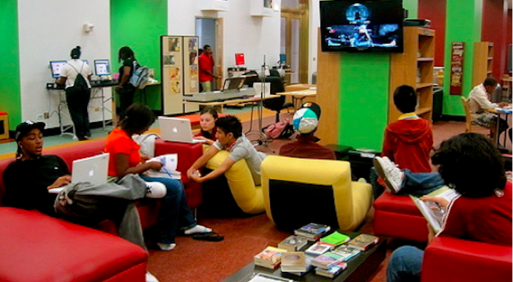
Notes:
Assessment of behavior offers input to design environments--Hunt library at NCSU for example exemplifies embedding technologies on the left and the YouMedia area in Chicago PL reflects research showing that learning involves “hanging out, messing around, and geeking out.”

Slide 17
…and where will you inspire them?
Notes:
I end with a questions Australian colleagues posed and I augmented in thinking about the future. [pause] I look forward to your answers.
http://roxannnys.pbworks.com/w/page/6883448/21st%20Century%20Learners%20vs%2020th%20Century%20Teachers

Slide 18
The Art of Assessment
2014 ASSESSMENT CONFERENCE
MYTHS & MOVEMENTS - REIMAGINING HIGHER EDUCATION ASSESSMENT
DAWN HAYWORD
Assistant Vice President for Assessment & Compliance
Gwynedd Mercy University

Slide 19
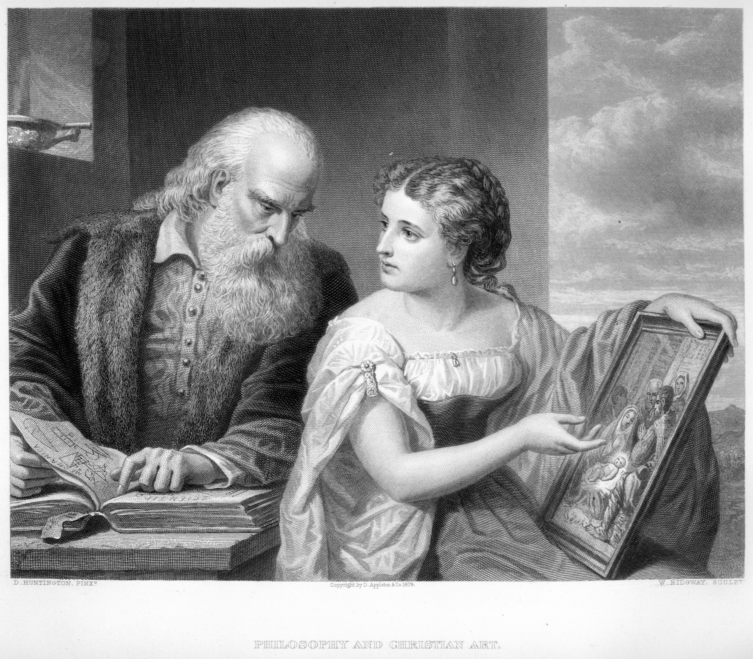
The Art of Assessment

Slide 20
The Art of Assessment

Slide 22
THIS?

Slide 24
OR THIS?

Slide 29
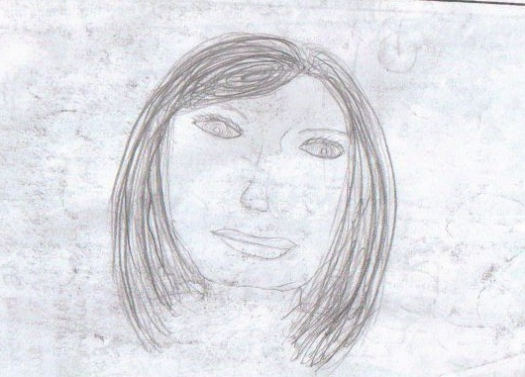
“Art Critique”
Notes:
BUT ARTISTS HAVE LONG USED A TECHNIQUE CALLED THE “CRITIQUE”. YOU PUT TWO PAINTINGS SIDE BY SIDE. AND YOU TRAIN YOUR EYE TO SEE THE DIFFERENCE BETWEEN THE TWO. YOU TALK TO YOUR FELLOW ARTISTS ABOUT WHAT YOU SEE.
THERE IS NO RUBRIC IN THE WORLD THAT CAN CAPTURE ALL THE NUANCED DIFFERENCES BETWEEN THESE TWO PORTRAITS. BUT ARTISTS MOVE FROM THE FIRST TO THE SECOND LEVELS OF ABILITIES ALL THE TIME. THE ARTIST WHO PAINTED THE PORTRAIT ON THE RIGHT ALSO—AT A MUCH EARLIER DATE—DREW THE PORTRAIT ON THE LEFT. IMPRESSIVE, ISN’T IT? THE ART OF ASSESSMENT DOES NOT COME SOLELY FROM RUBRICS AND MEASUREMENTS—IT COMES FROM LOOKING VERY VERY CLOSELY AT WHAT YOU PAINTED. MAKING ADJUSTMENTS ALL THE TIME. AND, REALLY? IT TAKES ALL OF US—TOGETHER—TO MAKE THE RESULT, BEAUTIFUL.

Slide 30
“Art Critique”
Notes:
BUT ARTISTS HAVE LONG USED A TECHNIQUE CALLED THE “CRITIQUE”. YOU PUT TWO PAINTINGS SIDE BY SIDE. AND YOU TRAIN YOUR EYE TO SEE THE DIFFERENCE BETWEEN THE TWO. YOU TALK TO YOUR FELLOW ARTISTS ABOUT WHAT YOU SEE.
THERE IS NO RUBRIC IN THE WORLD THAT CAN CAPTURE ALL THE NUANCED DIFFERENCES BETWEEN THESE TWO PORTRAITS. BUT ARTISTS MOVE FROM THE FIRST TO THE SECOND LEVELS OF ABILITIES ALL THE TIME. THE ARTIST WHO PAINTED THE PORTRAIT ON THE RIGHT ALSO—AT A MUCH EARLIER DATE—DREW THE PORTRAIT ON THE LEFT. IMPRESSIVE, ISN’T IT? THE ART OF ASSESSMENT DOES NOT COME SOLELY FROM RUBRICS AND MEASUREMENTS—IT COMES FROM LOOKING VERY VERY CLOSELY AT WHAT YOU PAINTED. MAKING ADJUSTMENTS ALL THE TIME. AND, REALLY? IT TAKES ALL OF US—TOGETHER—TO MAKE THE RESULT, BEAUTIFUL.

Slide 34
Beyond the Classroom: Using Co-Curricular Activities to Assess General Education
2014 ASSESSMENT CONFERENCE
MYTHS & MOVEMENTS - REIMAGINING HIGHER EDUCATION ASSESSMENT
JANE PHELPS
Associate Professor, Communication
Bergen Community College, Paramus New Jersey

Slide 35
Assessment Myths
Course based
Requires new rubric
Separate assessment event
Every student has to be assessed
Faculty will be evaluated based on students’ performance
Assess Student Learning Outcomes with Direct Measures
Notes:
Direct and Indirect Assessment of SLO
Direct: Course, Program and Institutional
Course: most familiar with.
Program: capstone projects, these, exhibits, performances; licensure exams, certifications; student pubications, conference presentations; employer and internship supervisor rating of students’ performance
Institutional: performance on tests of writing, critical thinking or general knowledge; rubrics for Gen Ed courses or other courses; performance on achievement tests; students’ self-reflections on learning in institutional programs such as service learning. (Figure 5, “Examples of Direct and Indirect Measures of Student Learning (Course, Program and Institutional Levels), ? Middle States (page 29.)
Common assumption is rubric has to be separate; assignment has to be separate, every student has to be assessed
Perhaps biggest misconception: faculty will be evaluated on students’ performance. Not true
I

Slide 36
Assessment Myths Busted
Can assess co-curricular activities related to academic skills
Can use existing rubrics
Can incorporate current criteria of competence
Can Evaluate Student Learning at:
Course Program Institutional
&
Co-Curricular Levels
Notes:
Institutional measures include performance on tests of writing, critical thinking or general knowledge. Rubric scores assignments in Gen Ed interdisciplinary core courses. (Bergen is now collecting assignments for students who have competed more than 45 credits).
Achievement tests
Self reflection on what students learned in service learning, for example.
Segue: Classroom and program/discipline measures of student learning are well established. A goal of current assessment programs is to broaden the focus to include general education.
One of the commonly agreed upon goals of higher education is to produce educated citizens. One way students demonstrate citizenship is through their participation in co-curricular activities.
Clasroom and disciplinary measures of SLO aer well established. Can broaden assessment to focus on gen ed skills.
Goal of higher education generally agreed upon is educated citizens. One way students demonstrate citizenship Is through their participation in co curricular activities.

Slide 37
21st Century Essential Learning Outcomes*
Area * Source: LEAP, AACU
Learning Outcomes
Knowledge of Human Cultures; Physical and Natural World
Intellectual and Practical Skills
Personal and Social Responsibility
Integrative and Applied Learning
Big questions
Inquiry & analysis Critical, creative thinking Written, Oral skills Teamwork
Civic knowledge, Intercultural, Ethical reasoning
Synthesis
Notes:
Association of American Colleges and Universities
Grouped skills into 4 areas
Knowledge of Human Cultures, Physical and Natural World – includes
Humanities, social sciences
Intellectual and practical skills
Personal and social responsibility
Integrative and applied learning
Specific learning outcomes

Slide 38
Co- Curricular Activity
Speech Competition on Contemporary Issues
Encourages Transfer of learning
Notes:
Segue: Classroom and program/discipline measures of student learning are well established. A goal of current assessment programs is to broaden the focus to include general education.
One of the commonly agreed upon goals of higher education is to produce educated citizens. One way students demonstrate citizenship is through their participation in co-curricular activities.
Clasroom and disciplinary measures of SLO aer well established. Can broaden assessment to focus on gen ed skills.
Goal of higher education generally agreed upon is educated citizens. One way students demonstrate citizenship Is through their participation in co curricular activities.
Broad Appeal – to students of all abilities; most disciplines; not just students taking speech; honors, student government
Broad Reach – faculty across disciplines; administration, board of trustees, foundation
Broad Support – Foundation prizes, departments across college who help; participants
Theme: Contemporary Issues is intentionally broad – topics from many disciplines. From Anthropology and Biology to Sociology and Zoology.
Students encouraged to speak about global issues. But all topics of significance are permitted.
Advertised on both campuses, all buildings. involves student life, student aides, various offices, and me!. Flyers mailboxes of arts, humanities division
Emails – blasts, pr notes, vp letters,
Involves many communities in the college

Slide 39
Competition Goals
Apply classroom learning to real life situations of significance
Gain experience in public speaking, valued by employers
Participate in college life
Reinforce academic skills
Inquiry and Analysis
Critical Thinking
Oral and Written Skills
Moral Reasoning
Notes:
Broad appeal, support, reach
Themes are broad;
Can involve braoder community at the college – e.g. facluty judges from 22 dif departsments
Board of trustees, families
Help maintain public credibility about the quality and performance in higher edu.
Redefining effective assessment practices. Ongoing assessment. This is a way to refine slo.,by evaluating gen ed outcomes. Provides value, as direct assessment is another way to use informaiton
The competiti9on encourages leanning transfer in which students can transfer their skills & know,ledbe to different environments.
Rosefsky

Slide 40
How the Competition is Run
Horizontal First Round
12:30 – 1:30 p.m.
6 students to a room, 3 judges
Judges rate and rank students on 9 areas of public speaking
Notes:
Takes place during lunch hour between 12:15 and 1:30
6 students – all speeches on same day at same time
Judges are volunteers from around the college
Lead judge and 2 others
Give judges orientation session: a good speech is a good speech”
Explain the rubric
Everyone shows up between 12:00 and 12:15 – 109 studensts registered, 79 showed up (33% attrition_ typical. Average has been 24%
Assigned to rooms, begin as soon as the judges assemble.

Slide 41
How Speeches Are Scored
Rubric Normed by NCA
Orientation for judges
“A good speech is a good speech.”
Top 6 advance to Awards Round
Notes:
Over the …. Years
Judges come from all over the college. 22 departments, administration, etc.
Judges information packets
No experience necessary
Over the 7 years:
Participants
Each rooms pairs lead and newer judge
Judges don’t have to be from communication department
Last year 21 new judges out of 39; represented 22 departments; judges are given orientation in how to assess speakers: “A good speech is a good speech.”
Many of the judges from administration; don’t get to see students in the classroom. Particularly useful for them to see range of student abilities
Top 6 students go to Awards Round. Scores 41 – 45. Ranking # 1 in their room
Will win cash prizes, trophies
Scores of : average
Next 7 win Honorary Mention and Special Merit cash prizes
All speakers receive Certificate at Awards Ceremony
Judges are excited when their students move on.

Slide 42
Annual Competition since 2008
Students of all abilities
Scores consistent with department’s goal:
80% of students will be assessed as competent
Notes:
Competitions held annually since 2008. RReport of 5 years of compettiion (295 students)
Average scores of speakers in each of the 5 years of study were in “good” range. Evaluated on 9 areas of Public Speaking Competence. Rating scale of 1 to 5, 1 low and 5 high. Total points of top speakers from 41 to 45; average of 4.4 or better on all 9 measures.
1. 2.
3.4.
5. 6.
7. 8. 9
Scores for each area are totaled.
Top speakers: 41 to 45
Excellent Speakers 37 to 39
Good 30 to 36
Avrage 25 to 29 average of 2.7 or better on 9 measures
Below Average 19 to 24
Not competent 18 or lower
Judgs instructed: “good speech is a good speech.” like a real life situation: can they go into a room and present information in a way that is understood. Demonstrates Critical Thinking; oral skills, written; . Etc.

Slide 43
Awards Round
Top 6 finalists Scores 41 – 45
Audience of faculty, administrators, fans
Awards Ceremony
$4000 in prizes
Honorable Mention & Special Merit
All Students recognized
Notes:
The top speakers score 41 – 45
Also need top ranking in a room.
High degree of inter rater reliability: a good speech is a good speech.
The finalists speak in front of audience. Taped,
Judges from department
Different rubric
Awards ceremony

Slide 44
STUDENT SURVEY RESULTS
399 students since 2008
69% responded to surveys
Notes:
Worthwhile experience:
Would you do this again:
Some of the survey comments from students:

Slide 45
Judges Survey Results, 2008 - 2014
178 Judges, 88% Survey Response
22 Departments, Administration
Notes:
Judges were polled each year. Over the8 years a total of 178 judges (individuals; some judge each year, like comm dept.)
Dif departments: art to radiography; cinema to psychology; business to sociology;
Regulars: English, Speech,
Welcome it as an opportunity to do a

Slide 46
JUDGES SURVEY 2013 - 2014
Notes:
Key finding is that judges find this useful as a direct assessment of oral and written communication skills.
Added this question 2 years ago. The findings go across disciplines

Slide 47
Transfer of Learning
“Learning 21st Century skills requires 21st Century Teaching” (Rosefsky)
Benefits of Co-Curricular participation
Can encourage learning transfer to different environments when coupled with examples (Billings)
Has been shown to lead to an increase in students’ moral reasoning (Mayhew)
Was cited as one factor contributing to a decrease in attrition (Maher)
Academic co-curricular participation is thought to support students’ transferring their skills and knowledge to different environments
Rosefsky Saavedra, Anna, Opfer, V. Darleen. Phi Delta Kappan. Oct 2012, Vol. 94 Issue 2 .
Notes:
“Congruence between co-curricular supports and educational framework is one of the strategies identified in a study as contributing to a drop in attrition rates. Maher, Higher Education Studies
There is more attention now to cocurricular activities:
Published in the ……….

Slide 48
ESSENTIAL LEARNING OUTCOMES
ACADEMIC CO-CURRICULAR ACTIVITIES
Newspaper
Model United Nations Club
Literary Magazine, Conference
Service Learning projects
Honors Colloquia
Knowledge of human cultures, physical & natural world: big questions
Intellectual and Practical Skills: Inquiry & analysis Critical, creative thinking Written, Oral skills Teamwork
Personal and Social Responsibility: Civic knowledge Intercultural Ethical reasoning
Integrative and Applied Learning: Synthesis
Notes:
The 4 areas of academic skills are listed on the left. On the right are some of the co-curricular activities that contribut to learning.
There are others: service learning projects in a student’s field (?)

Slide 49
Challenges of Co-Curricular Assessment
STUDENTS
FACULTY
Voluntary
Inconsistent participation
Goal is to enjoy
May not agree to assessment
Develop assessment process, find rubric
Apply consistently
Assure confidentiality
Track down students
Not part of advisors’ responsibilities
Voluntary
Uncompensated
Notes:
The advantages of assessing co-curricular activities are great. But there are some challenges..
Students: participation is voluntary. Their attendance may be inconsistent. Their goal is to enjoy the activity, they may not agree to being assessed.
Faculty: would have to think about and develop an assessment process. Easy in the speech competition, because students know that is what happens in a competition. So they are comfortable with being rated.
If decide to assess have to have a consistent process, that is applied to all of the participants ; e.g., those who are in the club at the end of the semester; or those who contribute 2 or more articles to the paper. The process has to be identified in advance, to be useful.
Has to be a way to report on the results with confidentiality. When I tally the rating results for all participants following the competition, there are no names attached.
To be administered fairly faculty would have to be able to track down students.
Big problem is time: assessment is not part of advisors
responsibilities. Some of my colleagues describe their role as advisory, not directive.. Unlike a classroom in that regard. So if a student does not submit an article for the paper, there are no direct assessment consequences. (editor may not give him/her another assignment). So the assessment would be of students who contribute/complete a particular assignment.
The advisors’ role is uncompensated. See above

Slide 50
Have You Hugged Your Assessment Professional Today?
2014 ASSESSMENT CONFERENCE
MYTHS & MOVEMENTS - REIMAGINING HIGHER EDUCATION ASSESSMENT
JEFF BONFIELD
Director of Assessment Operations
Office of Institutional Research, Assessment & Evaluation
Drexel University

Slide 51
What does
assessment
look like on
your campus?

Slide 52
When I say:
higher Ed
you say:
How higher?
Notes:
In most successful organizations, freedom is limited to achieve goals. In the case of America, we choose to limit the means by which we can attain wealth and power without risk of negative consequences. We sacrifice the freedom to murder or steal, for instance, so we can live with relative security and safety. In even less democratic organizations, the limits to our freedoms are typically defined for us.

Slide 53
The HERI Faculty Survey
Self-report data from the 23,824 full-time undergraduate faculty from 417
baccalaureate institutions that met HERI’s norm sample criteria.

Slide 54
3rd most common source of stress

Slide 55
So much remediation!
“Forty percent of your high-school graduates are taking remedial classes when they go to four-year universities. That’s a staggering number… Four in 10 of your high school graduates aren’t ready for college.”
—Arne Duncan, Education Secretary
March 14, 2014

Slide 56
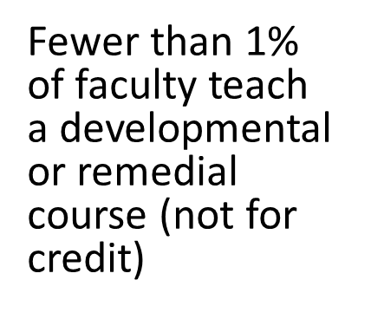
So much remediation?
National Center for Education Statistics, January 2013

Slide 57
Remediation?

Slide 58
most common source of Job satisfaction

Slide 59
3rd most common source of stress
Most common source of job satisfaction

Slide 60
3rd most common source of stress
Most common source of job satisfaction

Slide 64
Notes:
In most successful organizations, freedom is limited to achieve goals. In the case of America, we choose to limit the means by which we can attain wealth and power without risk of negative consequences. We sacrifice the freedom to murder or steal, for instance, so we can live with relative security and safety. In even less democratic organizations, the limits to our freedoms are typically defined for us.

Slide 65
We want the same things in life
Notes:
In most successful organizations, freedom is limited to achieve goals. In the case of America, we choose to limit the means by which we can attain wealth and power without risk of negative consequences. We sacrifice the freedom to murder or steal, for instance, so we can live with relative security and safety. In even less democratic organizations, the limits to our freedoms are typically defined for us.

Slide 66
Against the Odds: Considerations for Community College’s Adoption of Established Performance Measurements
2014 ASSESSMENT CONFERENCE
MYTHS & MOVEMENTS - REIMAGINING HIGHER EDUCATION ASSESSMENT
Marva R. Mack
Assistant Dean, Retention & Academic Advisement
Essex County College

