Slide 1


How to Schedule Your Exam Using Clockwork

Slide 2
What is Clockwork?
An online booking system that allows students to schedule exams/quizzes with the ODR Testing Center.
Allows ODR to ensure your approved test accommodations are met.
Ensures that a student’s professor(s) is aware that a student will be using the Testing Center instead of testing in the classroom.

Slide 3

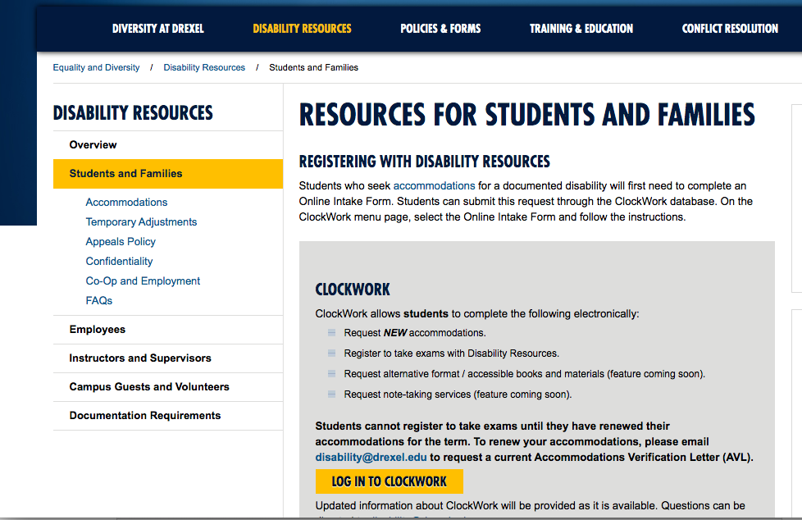
How to Access Clockwork
To schedule an exam/quiz, please go to the Office of Disability Resources webpage and select the Students and Families tab

Slide 4
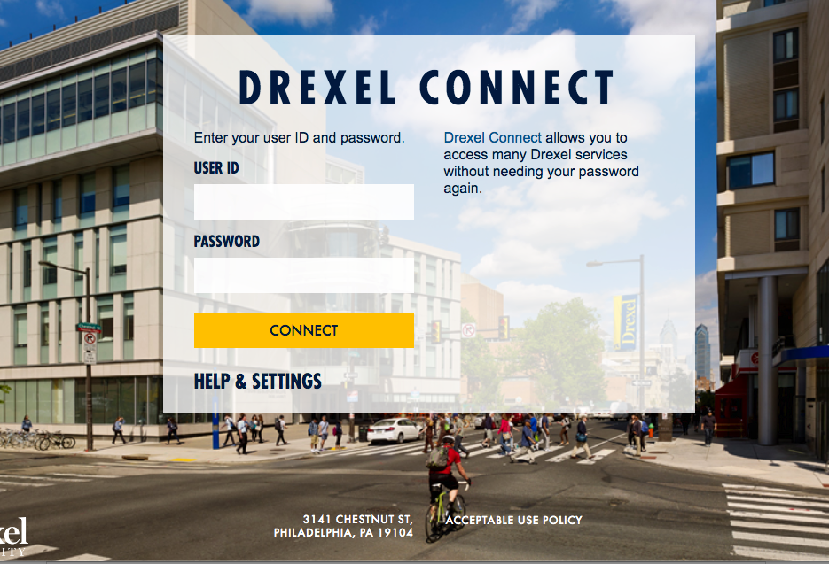
To access the ClockWork scheduling feature, you may be prompted to log into Drexel Connect.

Slide 5
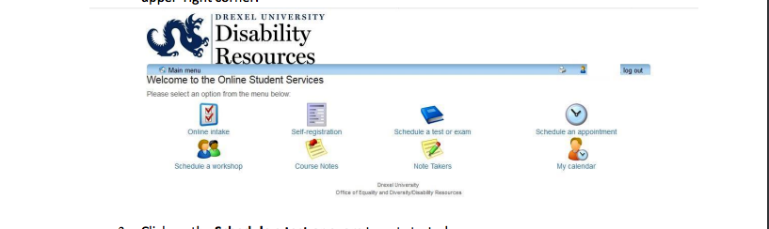
Clockwork Menu

Slide 6
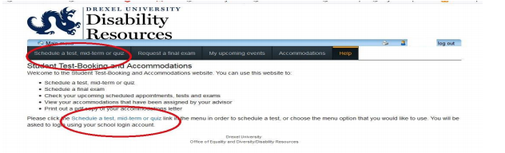
Selecting the Correct Tab

Slide 7
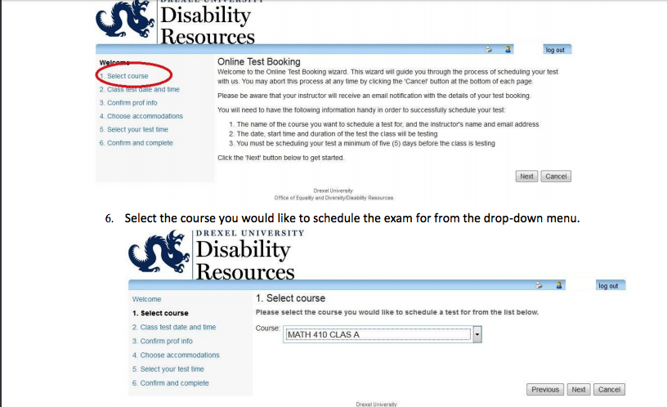
Step 1:Select Your Course

Slide 8
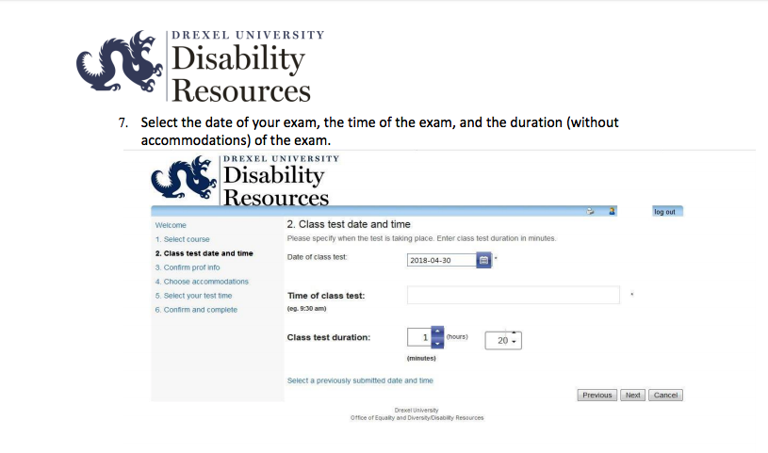
Step 2: Selecting a Date & Time

Slide 9
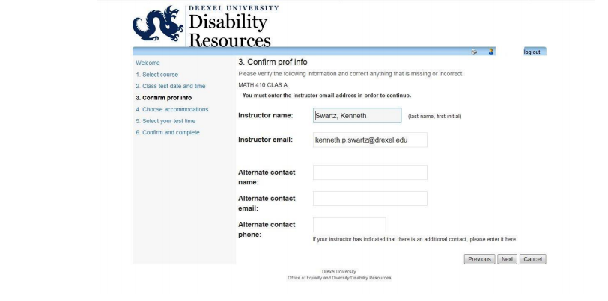
Step 3: Confirm Professor Information

Slide 10
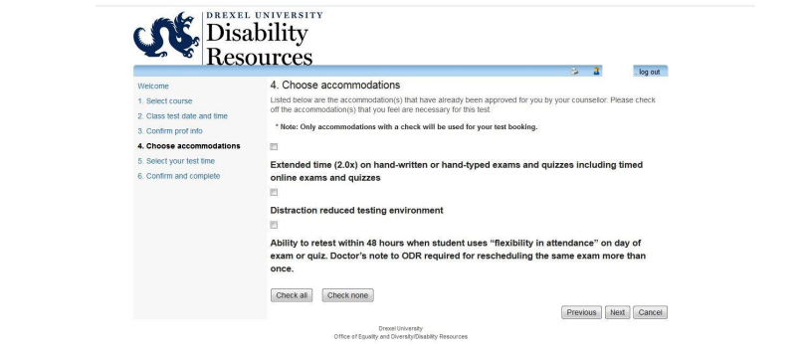
Step 4: Select Accommodations

Slide 11
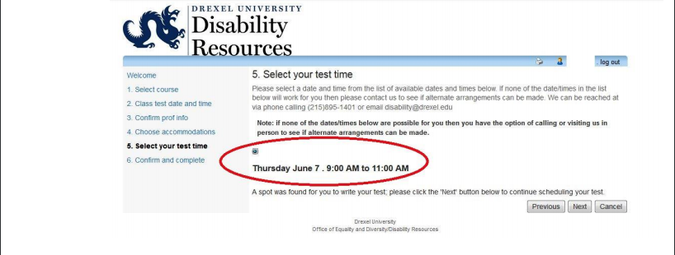
Step 5: Review Test Information

Slide 12

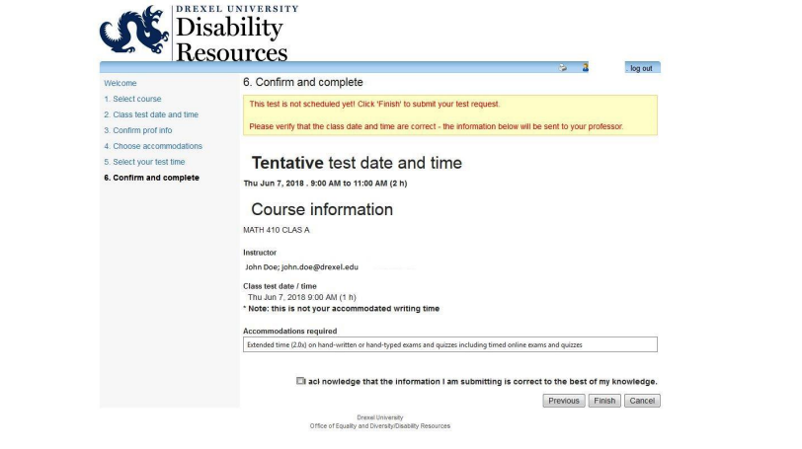
Step 6: Confirm & Complete

Slide 13
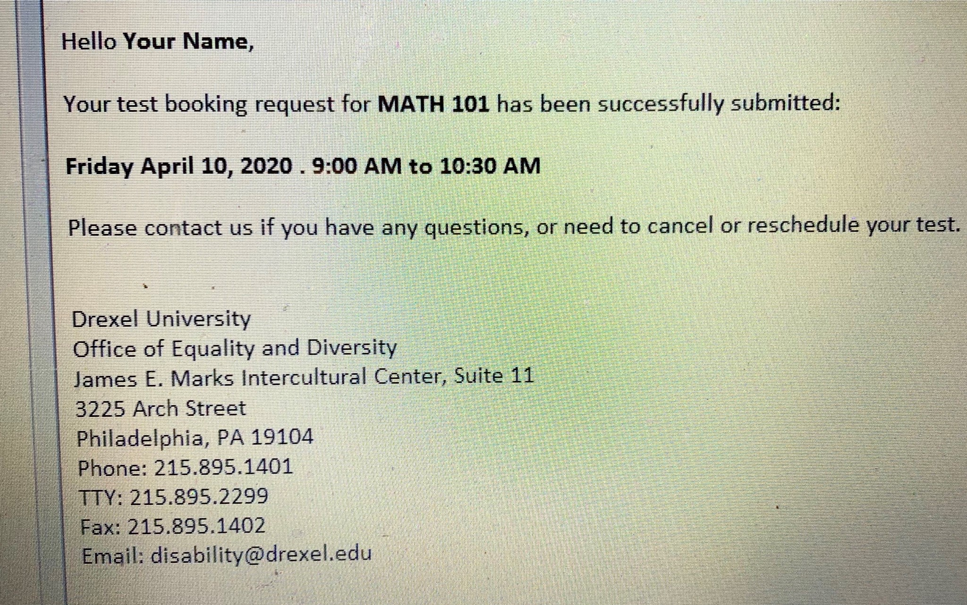
Confirmation Email

Slide 14
Are you having difficulty scheduling an exam/quiz?
There could be various reason why you may be unsuccessful with scheduling. Some possible reasons are:
Your AVL has not been renewed.
You have attempted to book your exam less than 5 day (120 hours) before the exam is supposed to take place.
You have attempted to book an exam that starts or ends after 5PM
For further assistance please contact testproctoring@drexel.edu –
Please note that emails received outside of the Testing Center’s operating hours (Monday – Friday: 8AM-5PM EST) will not receive a response until the next business day.

Slide 15
Testing Center Locations
The Testing Center has two locations:
  University City (Main Campus):
  James E Marks Intercultereral Center
  3225 Arch Street
  Room 015
  Philadelphia, PA 19104
Center City Campus:
3 Parkway Building
Room 1041 (10th Floor)
1601 Cherry Street
Philadelphia, PA 19102
Students should go to the Testing Center location on the campus where they take classes.

Slide 16
Thank You !

