Slide 1


Business Travel at a Glance
A Quick Guide To Help You Prepare for Travel

Slide 2

Business Travel
What You Need to Know Before Booking>>

Slide 3
Review and Understand Business Travel and P-Card Policies & Guidelines which are found on the following links:
Procurement: https://drexel.edu/procurement
Business Travel: https://drexel.edu/procurement/travel/services
Notes:
Procurement: https://drexel.edu/procurement
Business Travel Services: https://drexel.edu/procurement/travel/services/

Slide 4

Create a Checklist
Are additional approvals for my specific travel accommodations needed?
Airfare*
Rail*
Car Services*
Lodging accommodations*
Meals
Business Travel Meals*
*May be authorized if prior written approval via an email or memo is obtained from the relevant Senior Vice President, Vice President, CFO, chair or dean of the applicable unit. Written approval must be obtained for each travel occurrence and made part of TAR and TERR documentation.
More information can be found in Drexel’s Business Travel Guidelines.
Notes:
Booking flights in excess of 5 hours; seat upgrades/ Rail Acela: If planning to travel by Amtrak's Acela train, / Limosine services: Use of limousine or black car service is allowable / room upgrades

Slide 5
Ready…Set…Let’s Book
DrexelOne Portal
Travel Management Company

Slide 6

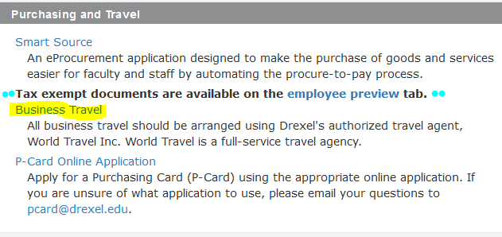


Slide 7
Booking Travel
You may access the online booking portal through Drexel One or
You may call a dedicated agent at, (855) 809-8166
Air travel is authorized for coach class. However, if a flight exceeds five hours in duration, business class or first class (if business class is not available) may be authorized if prior written approval is obtained.
The preferred method of payment for Business Travel is the P-Card or Travel Card
Register your travel, both domestic and international, in GRAND
Provide your full itinerary to your department
Notes:
The online booking tool can used by Drexel Employee who is has full-time status.
Global Research & Academic Network Database, GRAND, so the University is aware of your itinerary in the event of an emergency.

Slide 8
Business Travel Wrap-Up
Complete either your Transaction Allocation Report(TAR) or Travel Expense Reconciliation Report(TERR) upon return
Keep all itemized receipts and all prior written approvals, if applicable.
Who should sign my TAR or TERR?
Cardholder/Employee (traveler’s) signature,(should never approve their own travel).
Expense Approver reviews, approves and signs
defined as a Faculty or Professional Staff Member who is designated by a budget owner or financial administrator to approve business expenses, who is at a higher level in the organization than the Traveler whose expenses they are approving; Depending on traveler’s role, may be a Dean, Provost or President.
Who should not sign my TAR or TERR?
A Cardholder/Employee (Traveler) cannot function as their own Expense Approver,
Temporary employees cannot be the sole or role of Expense Approver.

Slide 9
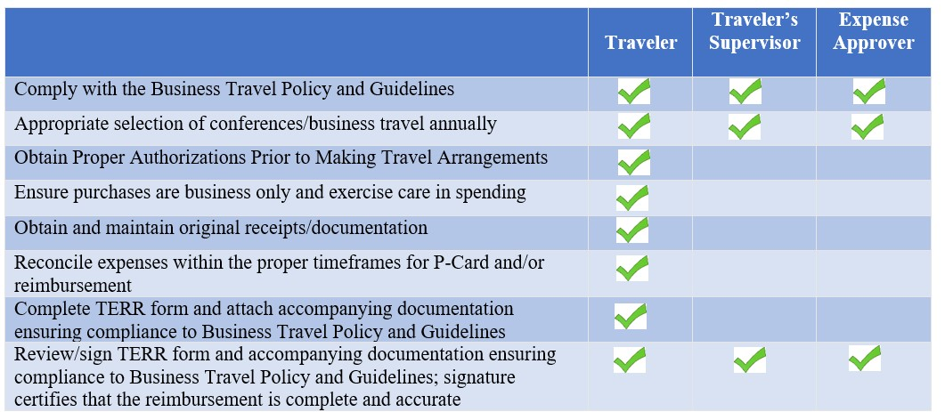
TERR Roles &Responsibilities

Slide 10

P-Card Roles and Responsibilities
 | Cardholder | Expense Approver | Budget Owner
Comply with the P-Card Policy and Guidelines
Keep P-Card secure and report lost, stolen or compromised cards
Ensure purchases are business only with defined business purpose and reconciled to the correct cost center
Obtain and maintain original receipts
Ensure sales tax is not charged in applicable states
Submit to Expense Approver for review, approval and signature and submit completed report to P-Card Team
Approve Transaction Allocation Report
Review transactions for receipts, documentation; charges are business only; defined business; reconciled to correct cost center
Immediately report abuse or misuse to the P-Card Team
Notify the P-Card Team regarding any updates related to the Cardholder, Expense Approver or Budget Owner within 48 hours
Complete yearly refresher training
Review Cardholder documents to ensure P-Card Policy & Guidelines Compliance
Notes:
The following is a list of the Cardholder’s Responsibilities
Cardholders must complete the P-Card Training and yearly Refresher Training
Ensure purchases are university related business only
Maintain the security of the P-Card
Obtain and maintain original receipts for each applicable transaction
Ensure that sales tax is not charge in states where Drexel is tax exempt
Review all transactions and provide a detailed Transaction Note and Cost Center for all P-Card Transactions
Prepare and submit the monthly Transaction Allocation Report to the Expense Approver in a timely manner
Forward completed and approved Transaction Allocation Report to pcard@drexel.edu on time
Respond to Audit inquiry requests
Notify the P-Card Office prior to any inter-department transfer, department transfer, termination/departure, or extended leave

Slide 11
Procurement Services
Contact Information:
P-Card Email: pcard@drexel.edu
Travel Email: travel@drexel.edu
Business Support: askprocure@drexel.edu
Sourcing: sourcing@drexel.edu
Accounts Payable: acctpay@drexel.edu
FAQs available on the Procurement Services webpage
Notes:
The following is a list of P-Card contact information
You may contact the P-Card Team regarding:
Temporary limit increases
Cost Center additions or deletions
User ID requests or Password Resets
Application status or credit card issues

Slide 12

Stay Safe and Happy Travels
This Photo by Unknown Author is licensed under CC BY-NC-ND

