Slide 1


The Academies of Nashville: From Implementation to Integration
Paula Barkley, Academy Coach
Aimee Wyatt, Executive Lead Principal for High Schools
Metropolitan Nashville Public Schools

Slide 2
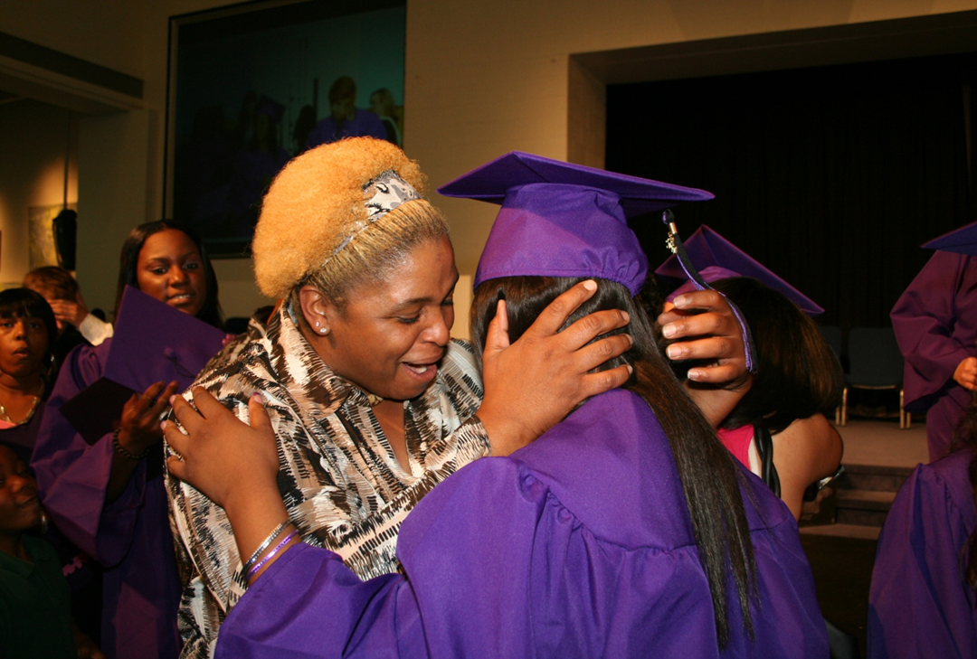
Metropolitan Nashville Public Schools
Approximately 81,000 students, 76% FARM, diverse
10,000 school system employees, 5,200 teachers
$671m School budget, $11,080 per pupil expenditure
26 high schools,12 large zoned high schools (16,000 students, 1,000 teachers)
Began the journey to redesign high schools in
2006

Slide 3

High School Mission
All high school students will belong to a personalized smaller learning community engaged around interests where relationships are valued. Instruction will be project-based, applied and integrated where meaningful business engagement is evident, post secondary institutions are involved and the community is supportive.

Slide 4
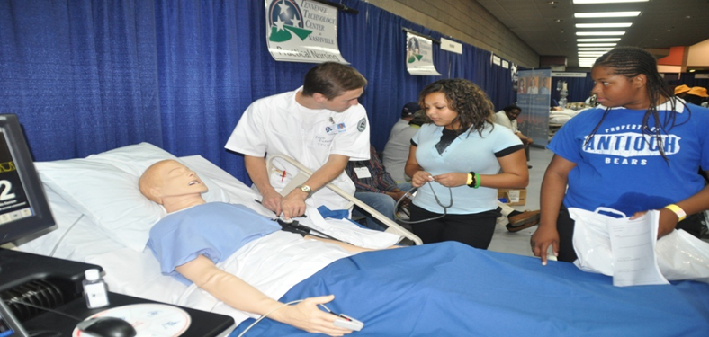
Academy Structure
Academies of Nashville characteristics:
Freshmen Academies
Academies with career/thematic focus for grades 10-12
Teacher teams with common planning time
Each school has an Academy Coach
Each academy has an Assistant Principal, Counselor, and a Lead Teacher
Academies selected based on workforce projections, college offerings, stakeholder surveys, resources, and partnerships

Slide 5

In the Beginning…
Ninth grade Academies were created using the 4 Rs as the foundation: Rigor, Relevance, Relationship, and Readiness
Teacher teams developed on the middle school concept
Advisory addressed relationship issues
Over-aged, under-credited 9th graders were the norm; developed Freshman Seminar was introduced as a drop out prevention program
  College and career readiness
  Experiential learning
  Professional skills rubric

Slide 6
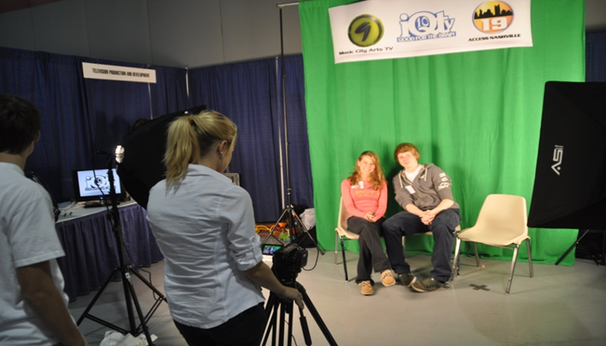
Career Development Ninth Grade
Freshman Seminar Career Exploration Curriculum
Freshman Seminar Business and Community Speakers
Shoney’s Career Exploration Fair
Career Academy Showcase
Career Academy/Pathway Tours

Slide 7

College Planning in Ninth Grade
Freshman Seminar Transition to high school curriculum
College Prep Program of Studies for all (TN Diploma Project)
Freshman Seminar College Speakers
College Fair
College Visit

Slide 8

Eighth Grade
Introducing High School 101 Spring 2014
Freshman Academy
Credits and course progression
Goal setting
Career Academies
College Access
Introducing Academy Choice Fall 2015
8th graders will be able to select the school they want to attend based on Academy interest

Slide 9


Slide 11
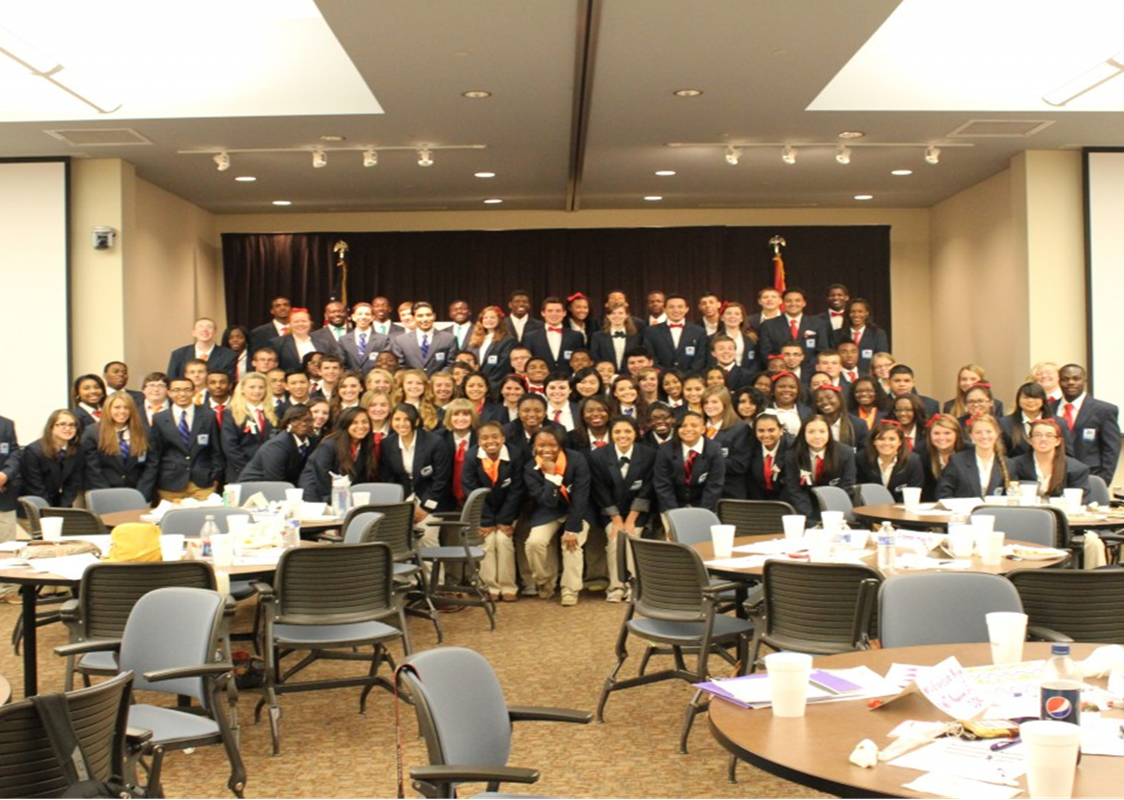
Continued Development in Academies
Advisory Period
Data Chats
College Access Information pertinent to grade level
Inviting former students or business and community partners to speak about college experience
Developing a College Going Culture
College Door Decorating Competitions
College Apparel Days
Implementation of School-wide AVID

Slide 12
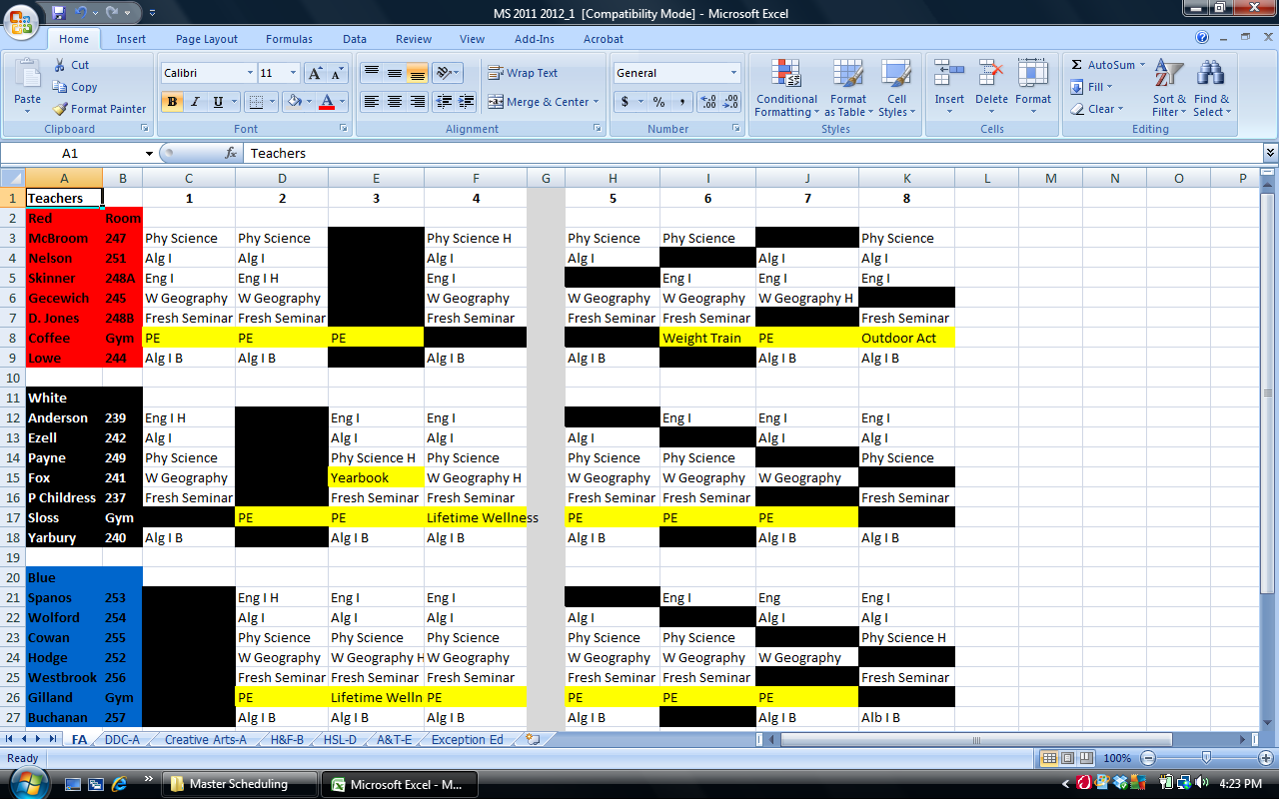

Slide 13
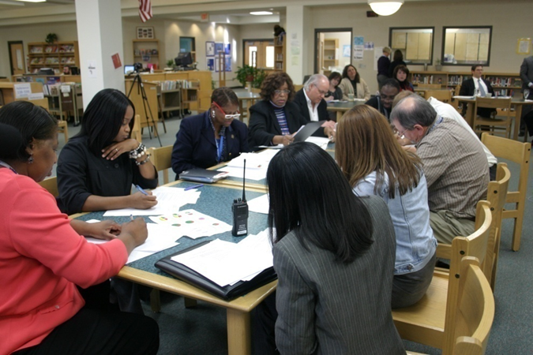
Teams of Teachers
Support Teams of Students
Integration of Teams Leads To:
Academic and behavioral support
Accountability and responsibility for learning
Inter-disciplinary connections and relevance
Intervention and enrichment opportunities

Slide 14

Transforming Teaching and Learning
Project and Inquiry-based, real world application
Work-based learning experiences
Acceleration options – AP, IB, Cambridge AICE, and dual enrollment
Virtual/online learning
PD: blended learning, project-based learning, ACT Prep, highly effective teaming, and Merit Scholar Prep
Teacher externships

Slide 15
Inter-disciplinary Team Planning
(Math, English, Science, Social Studies, CTE)
Weekly Team Meetings During Scheduled Common Planning
Provide Responsive Interventions
Ensure Relevant, Real World Connections
Design Inter-disciplinary, Standards-based,
Project-based Units of Instruction

Slide 16
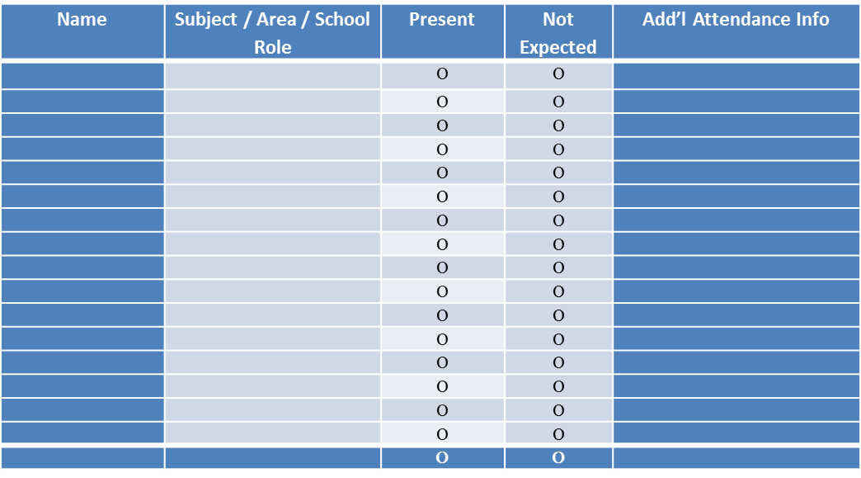
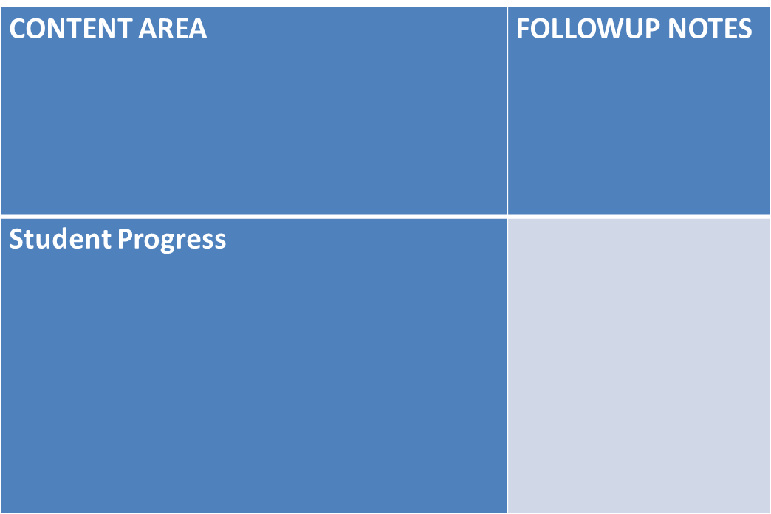
ACADEMY TEAM COMMON PLANNING TIME
MEETING DOCUMENTATION

Slide 17

Template Categories
Student Progress
Curriculum
Instruction
Professional Development
Analysis of Outcomes
Structure
Parent Involvement
Community Involvement
Academy Business
Supporting Documentation

Slide 18
Content/Course Alike Planning
Weekly Team Meetings During Scheduled Common Planning
Pace and Sequence Instruction
Discuss Effective Teaching Strategies
Create Common Summative Assessments
Analyze Assessments (Building Level, District Level, and State Level Testing Data)

Slide 19
Content/Course Alike Teams
Provide EOC Support
Standards-based Teaching
Use of Formative Assessment for Instructional Decisions
Teach Deficit Skills Essential to Mastery of Standards
Use Summative Assessment for Determining Mastery
Re-Teach Non-Mastered Standards
Reassess as Needed

Slide 20
Professional Development
SLC Principles
Team Leader Training
Highly Effective Teaming
Standards-based Teaching and Assessment
Teaching on the Block
Data Warehouse/Data Driven Decision Making
Inter-Disciplinary Teaching and Learning
Project-based Learning
Teacher Externship

Slide 21
Parent Engagement
Career Planning
Parent Orientation
Career Exploration
Career Academies
Parent Communication
Academy Brochures, Academy Website, Academy Newsletters
Academy Events, Parent Tours, Academy Showcase
Parent Input
Academy Advisory Board
TLG, Parent Ambassador Program

Slide 22

Parent Engagement
College Planning
Parent Orientation
TN Diploma Project
Testing Information
Parent Communication
Call-outs, newsletters, website, emails
Individual and Team Conferences
Registration Information
Transcript Updates
Dual Enrollment, Advanced Placement, AICE Information Night (Parent Signature Required)
Redefining college
College Access Assistance
College Information Night
FAFSA Night
College Fairs
TN Achieves

Slide 23
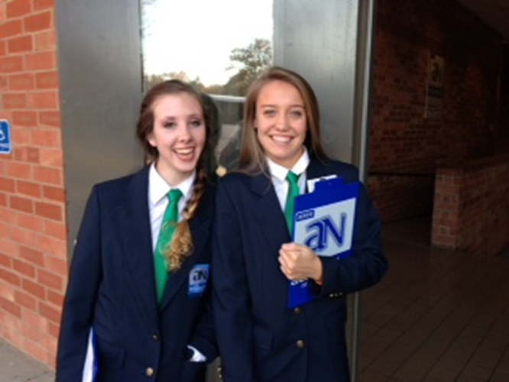
What is an academy partner?
An Academy Partner is a PENCIL Partner that has formalized a partnership with a high school academy.
Partnership activities vary, depending on the academy’s needs and a business’s interests and resources.
Goals for partnerships between businesses and academies are to improve graduation rates, build relationships between students and positive adult role models, and support positive outcomes after high school graduation, including further education and entry into high-wage, high-demand careers.

Slide 24
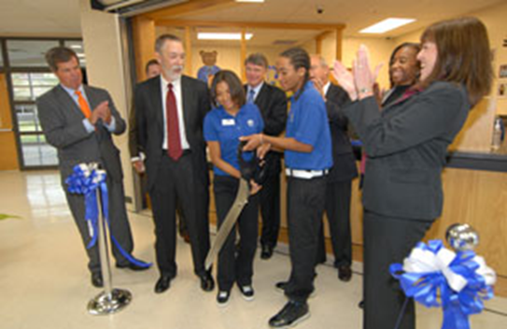
What are the expectations of an academy partner?
Commit to work together for at least one school year.
Identify a partnership coordinator who will be the chief contact for the school.
Participate in a planning session with the school’s Academy Advisory Board to determine how best to work together with the school and with other academy partners.
Support the goals of the academy in at least one activity.
Report the time your organization spends on the partnership through www.schoolvolunteers.org.

Slide 25










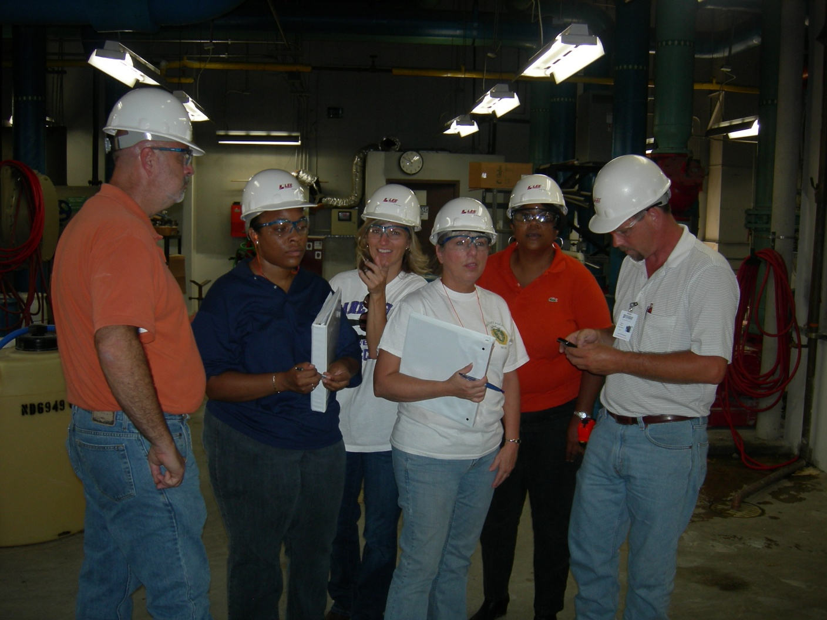





TEACHER EXTERNSHIPS
TEACHER EXTERNSHIPS

Slide 26
2012-2013 Academy Action Plan Academy Coach: Paula Barkley Academy of Health Science and Law/Aegis Labs
Goal | Action Plan | Lead Person(s) | Evidence | Timeline / Due Date
Guest Speakers | Provide weekly speaker for Friday advisory classes | Tina Starr | Weekly Advisory Schedule | 2012-2013
Showcase | Provide tradeshow booth for Academy Showcase | Kristie Shafer | Event Booth | Jan. 29, 2013
Curriculum Advice | Provide input, presentation, and presenter for Henrietta Lacks Inter-disciplinary unit. | Kristie Shafer; Dr. Cadwallader | PBL Unit Plan Event | Spring 2013
Field Trips/Tours/Job Shadowing | Provide tours of Aegis Labs for all tenth graders in Health Science and Law; provide job shadowing for all eleventh graders in Health Science and Law | Kristie Shafer | Schedule of tours/ Schedule of Shadowing | 2012-2013
Intersession | Provide Aegis Labs Boot Camp for eight seniors | Kristie Shafer; Darcie Duckworth | Agenda for Boot Camp | March 19-21 2013
Accreditation | Write letter of support; participate in NCAC academy review | Kristie Shafer | NSOP Notebooks; NCAC Review | May 2013
School Tours and FordHub | Present to guests about the power of business engagement | Kristie Shafer | 2013-2014 Academy Calendar | 2012-2013
Community Investment | Track community service hours in schoolvolunteers.org | Kristie Shafer | Pencil Report | 2012-2013
Academy Advisory Board | Serve on advisory board for 2012-2013 school year. Attend quarterly meetings; meet with academy coach and teachers to plan for 2013-2014 experiential learning and calendar events | Kristie Shafer or designee | Sign in sheets/minutes | 2012-2013

Slide 27





Alignment Nashville facilitates the process for the High School Committee to align community organizations with resources for schools on every level.
Academy Partner Recruitment Process
Prospective Academy Partners can be identified in a variety of ways and at any level. Prospects are forwarded to PENCIL Foundation and the MNPS SLC Director to ensure that Partners are finding the most appropriate places to become engaged.
Assist
Needs of individual academies are assessed by the Academy Advisory Boards who:
Ensure academy curricula meets industry standards
Provide work-based learning opportunities for faculty and students
Identify additional academy needs
This information along with related academy data is presented to the Partnership Councils.
The Nashville Area Chamber of Commerce supports the work of the Academies of Nashville Partnership Councils and convenes the Chamber CEO Champions.
Advise
Partnership Councils look across academy lines to:
Ensure equitable academy resources
Ensure adequate academy resources
Identify untapped resources
Ensure workforce demands are met
Partnership Council needs and successes are presented to CEO Champions.
Advocate
Communicate needs and successes to the broader Nashville Area community.
www.nashvillechamber.com

Slide 28
Tracking Results
School | District | Community
Academy Dashboard and Accreditation | 5 Characteristics Dashboard | Partnership Dashboard
School Improvement Plan and Advisory Boards | Strategic Plan and High School Action Plan | Partnership Councils, CEO Champions, PENCIL report
Improvements in:
Achievement
Attendance
Discipline
Climate
Community engagement
According to the Nashville Police Department, the average
age of a gang member went from 16 in 2006 to 22 in 2012.

Slide 29
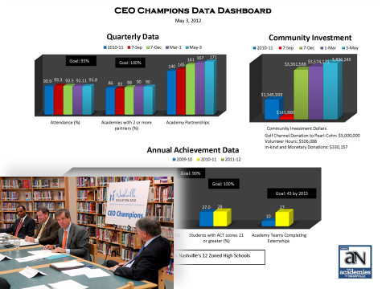

Slide 30
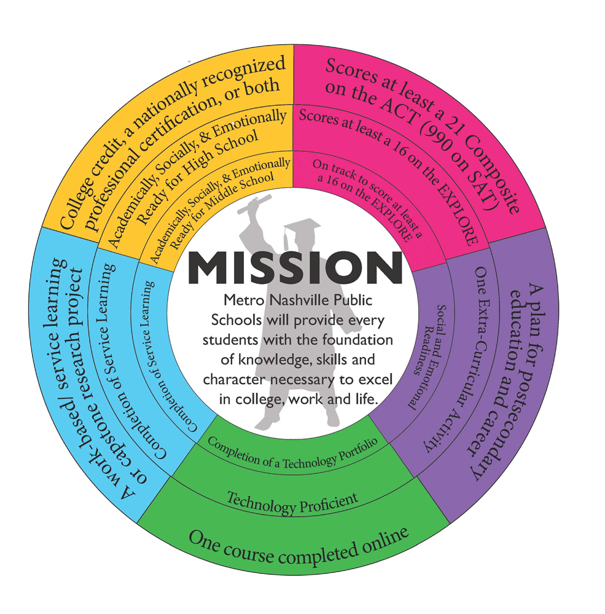
Characteristics of a High School Graduate:
a plan for postsecondary education and career
at least a 21 composite score on the ACT
a work-based or service learning experience, or a capstone research project
at least one course completed online
college credit, a nationally-recognized professional certification, or both

Slide 32
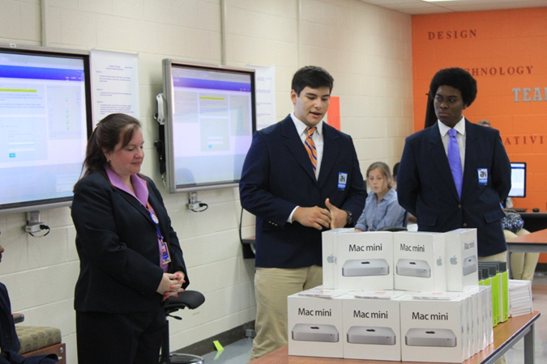
National Standards of Practice (NCAC)
Defined Mission and Goals
Academy Structure
Host District and High School
Faculty and Staff
Professional Development
Governance and Leadership
Curriculum and Instruction
Employer, Higher Education, and Community Involvement
Student Assessment
Cycle of Improvement

Slide 33
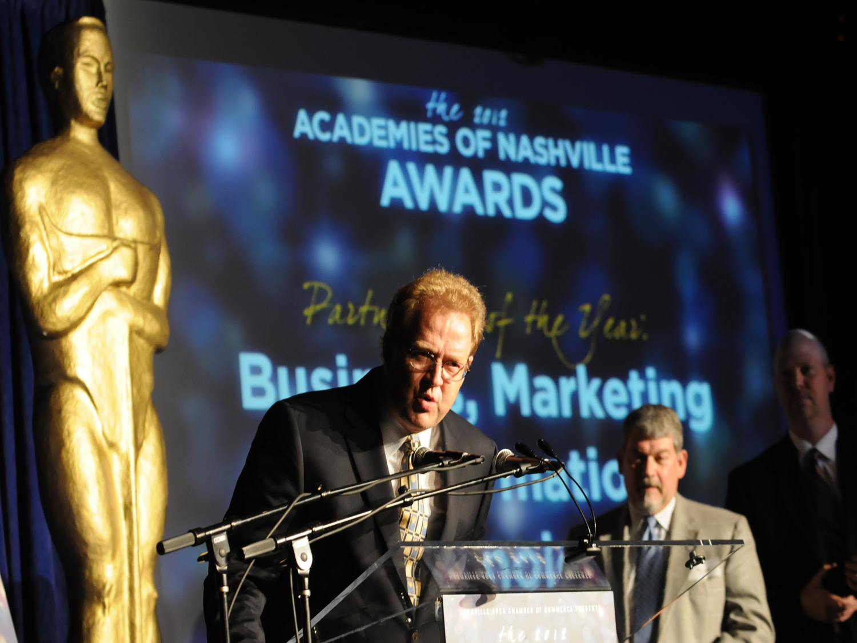
Successes and Challenges
Successes:
Increase in Graduation Rate
Increase in English and math achievement results
Increase in Attendance
Decrease in Discipline
Increase in positive responses to culture surveys of teachers, students, and parents
Increase in community engagement
Increase in positive public relations and media coverage
Recognized by the President of the United States
Challenges:
Data dip in the
beginning
Finding the right leadership
Onboarding and developing PD for new personnel
Keeping team integrity
Continuous Improvement Model – reassessing while trying to move forward
Keeping partners engaged and clear lines of communication

Slide 34


Visit Nashville!
Nashville Ford Next Generation Learning Hub Study Tour
March 31-April 2
Contact: Starr.herrman@mnps.org
Webinar information: Paula.barkley@mnps.org or Aimee.wyatt@mnps.org

