Slide 1
Higher Education’s Future: The Digital University
“Men’s [and Women’s] courses will foreshadow certain ends…”
Drexel University Online | Online Learning Council
January 22, 2019
Anthony G. Picciano
Hunter College and Graduate Center - City University of New York

Slide 2
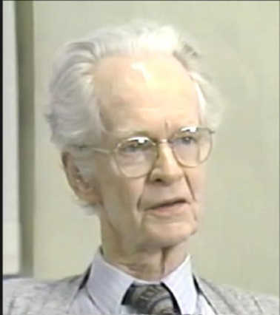
“There are more people in the world than ever before, and a far greater part
of them want an education. The demand cannot be met simply by building more
schools and training more teachers. Education must become more efficient. To
this end curricula must be realized and simplified, and textbooks and classroom
techniques improved. In any other field a demand for increased production would
have led at once to the invention of labor-saving capital equipment. Education
has reached this stage very late, possibly through a misconception of its task.
Thanks to the advent of technology…These tools are finding their way
into American schools and colleges...
allowing each student to proceed at his own pace
to receive immediate feedback
to play an active role [where] there is constant interchange between program and student
to have access to charts, maps, graphs, models…”
Skinner, B.F. (1958). Teaching machines. Science, 128 , 969-977.
Sidney Pressey designed his own teaching machine in the 1920s at Ohio State University.
Edward Thorndyke developed the design for a teaching machine in 1912 at Teachers College.

Slide 3
Predicting what will happen in the future is easy.
When it will happen is the hard part!

Slide 4
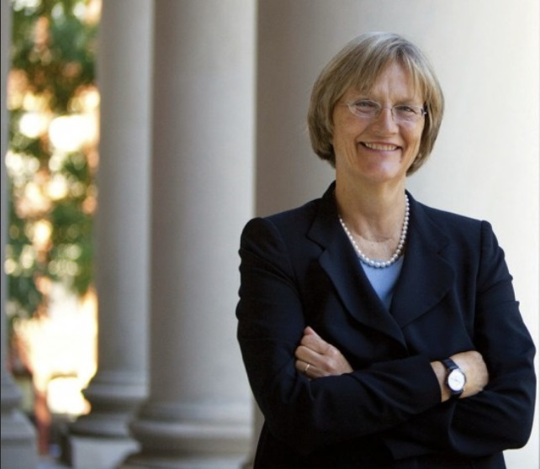
The Future of Higher Education
Drew Faust, the president of Harvard University, in a message to the World Economic Forum in 2015, described three major forces that will shape the future of higher education:
the influence of technology
the changing shape of knowledge
the attempt to define the value of education.
“So much of what humanity has achieved has been sparked and sustained by the research and teaching that take place every day at colleges and universities, sites of curiosity and creativity that nurture some of the finest aspirations of individuals and, in turn, improve their lives—and their livelihoods. As the landscape continues to change, we must be careful to protect the ideals at the heart of higher education, ideals that serve us all well as we work together to improve the world.” (Faust, 2015)

Slide 5
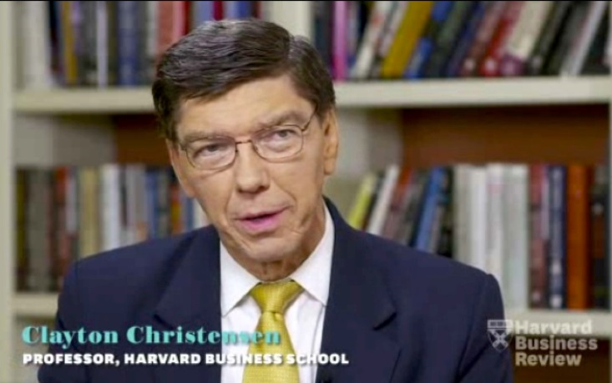
The Future of Higher Education
Clayton Christensen, Harvard Business School Professor and author of The Innovator’s Dilemma, in 2017, during a speech at a Higher Education Summit, spoke at length about disruption theory broadly and discussed its application to colleges and universities. Higher education, he explained, was among the industries that "for several centuries was not disrupted," but "online learning has put a kink in that.“
He predicted that half of American universities would close
or go bankrupt within 10 to 15 years.
He went on to say that “Technology itself is never the disruptor, a new business model is. But "it is technology that enables the new business model to coalesce, and that's what is happening in higher ed now.

Slide 6
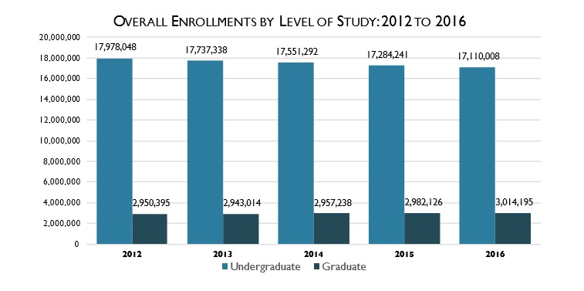
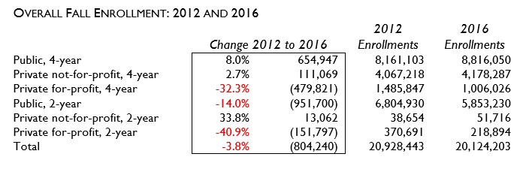
Higher Education Enrollments

Slide 7
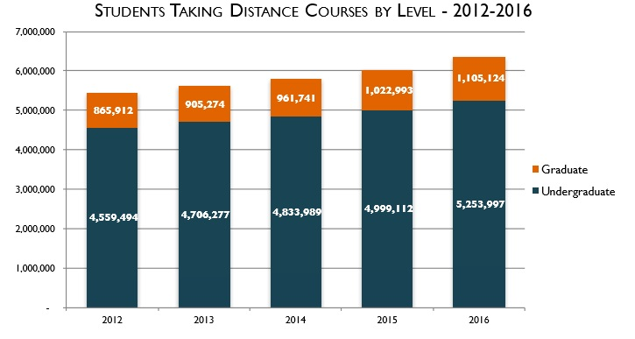
The Extent of Distance Education

Slide 8
How Did We Get to Here
The Evolution of Online Education
Timeline
1990s
The 1st Wave
2000
The 2nd Wave
2008
The 3rd Wave
2014 ->
The 4th Wave
?
2

Slide 9
The 1st Wave (Beginnings) – 1990s
Technology – Slow-speed Internet
Model – Pedagogical – Asynchronous Learning Network (ALN)/Largely Text-Based
Key Players – Four-year Colleges and Universities, Community Colleges, and For-Profit Colleges with already established distance learning programs (i.e., UMUC, Penn State World Campus, SUNY Empire State, APUS) For-Profits (i.e., U of Phoenix) invest tens of millions of dollars into online education.
.Enrollment – 100,000s of students enrolled each year in fully-online, for-credit courses – 1 million by 2000.
9

Slide 10
The 2nd Wave (Blending Into the Mainstream) – Early 2000s to 2008
Technology – High-Speed Internet (Cable modems, DSL)
Model – Pedagogical - Blended Learning /Social and Multi-Media/Open Resources Evolve
Key Players – Mainstream Public Higher Education, Tuition-Driven Non-Profits, For-Profits, Global Enterprises
.Enrollment – Millions of students enrolled each year in fully online, for-credit courses – 4+ million by 2008.

Slide 11
The 3rd Wave (Massive Open Online Courses - MOOCs)
– 2008 to 2013
Technology – High-Speed Internet – Wi-Fi – Mobile Computing
Pedagogical Model – MOOC – Access/Cost Benefit Model/
Multi-Media Infused
Open Source Expands
Key Players – Non-Profit Private Universities (Stanford, M.I.T., Harvard).
Venture capitalists and corporate-affiliated foundations spur MOOC development.
MOOC companies – Udacity, Coursera, edX
.Enrollment – Millions of students enrolled each year in credit and non-credit bearing courses.
5 million students enrolled in fully online for-credit courses in 2013.
Millions more enrolled in blended courses.
Notes:
2008 George Siemens offers first MOOC type course – enrolls 10,000.
2011 Sebastian Thrun offers a MOOC that enrolls 160,000 students.

Slide 12
The 4th Wave (The Present)– 2014 ->2020s
Technology – Super High-Speed Internet – Wi-Fi - Mobile Computing/Tablets – Cloud Computing
Model – Reconciliation of the 2nd Wave Blended Learning Pedagogy & 3rd Wave Access/MOOC Models PLUS
I. Learning Analytics/Big Data
II. Adaptive Learning/Differentiated Instruction/Personalized Learning
III. Social Media – Mobile Technology
IV. Open Sources/Learning Objects
V. Gaming/MUVE
.Key Players – All of education plus online learning companies funded by venture capitalists and corporate foundations.
New Models - Western Governors, U of Southern New Hampshire, Purdue-Kaplan Partnership
.Enrollment – Millions of students enrolled each year in credit and non-credit bearing courses.
Over 6 million students were enrolled in fully online for-credit courses by 2016.
Millions more enrolled in blended courses.

Slide 13
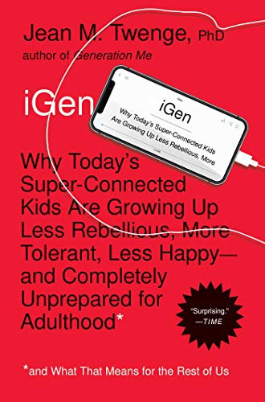
Theme for the 4th Wave - One Size Will Not Fit All!
Different strokes for different folks.
Different types of schools will approach
Online and Blended Learning and MOOC technology differently.
Different programs/disciplines/faculty will approach
Online and Blended Learning and MOOC technology differently.
Different students will approach
Online and Blended Learning and MOOC technology differently.

Slide 14
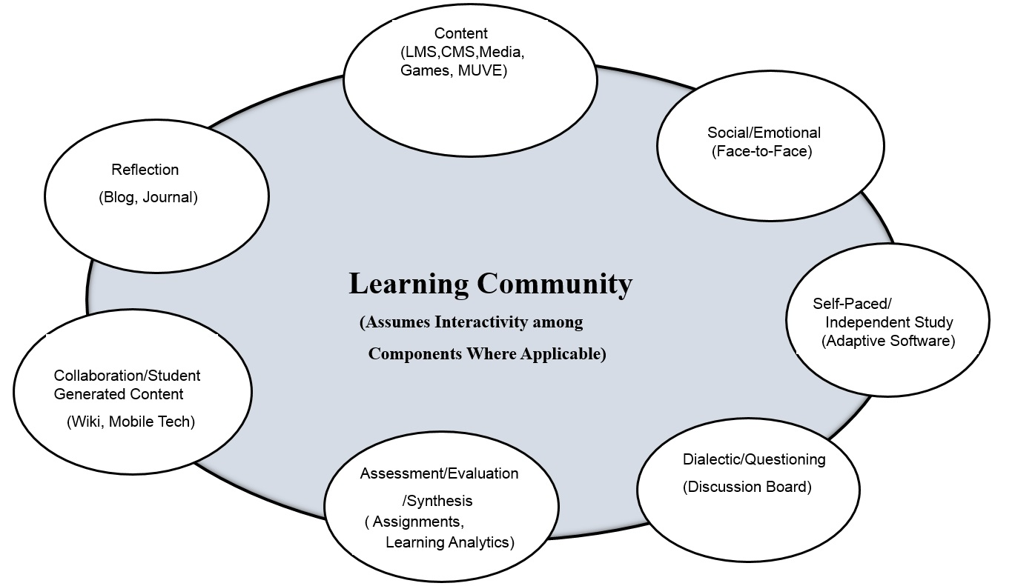
The 4th Wave – 2014 -> 2020s –
Integrated Multimodal Model

Slide 15
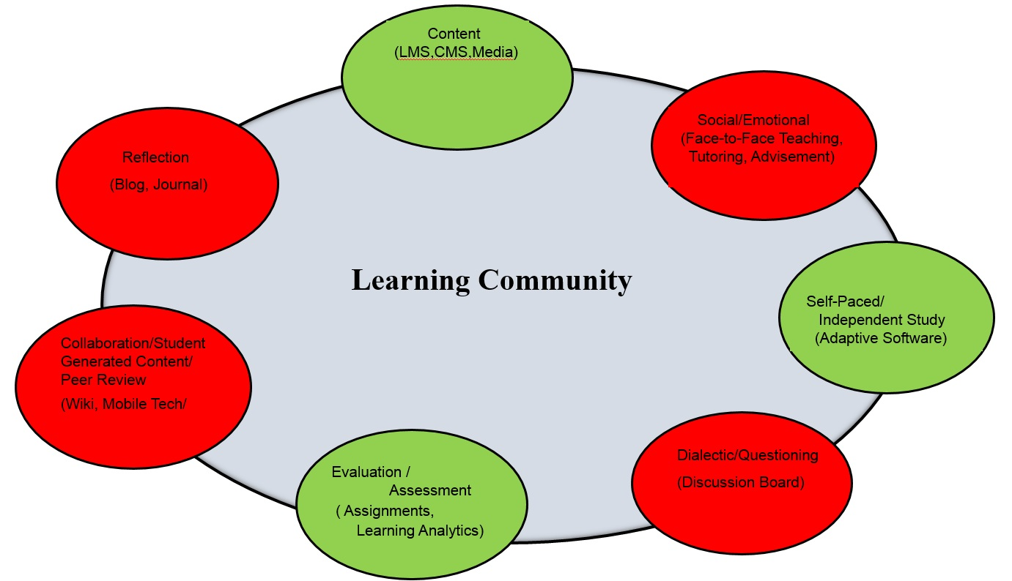
The 4th Wave – 2014 -> 2020s -
Integrated Multimodal Model
Applied to a Self-Paced, Adaptive, Fully Online Course

Slide 16
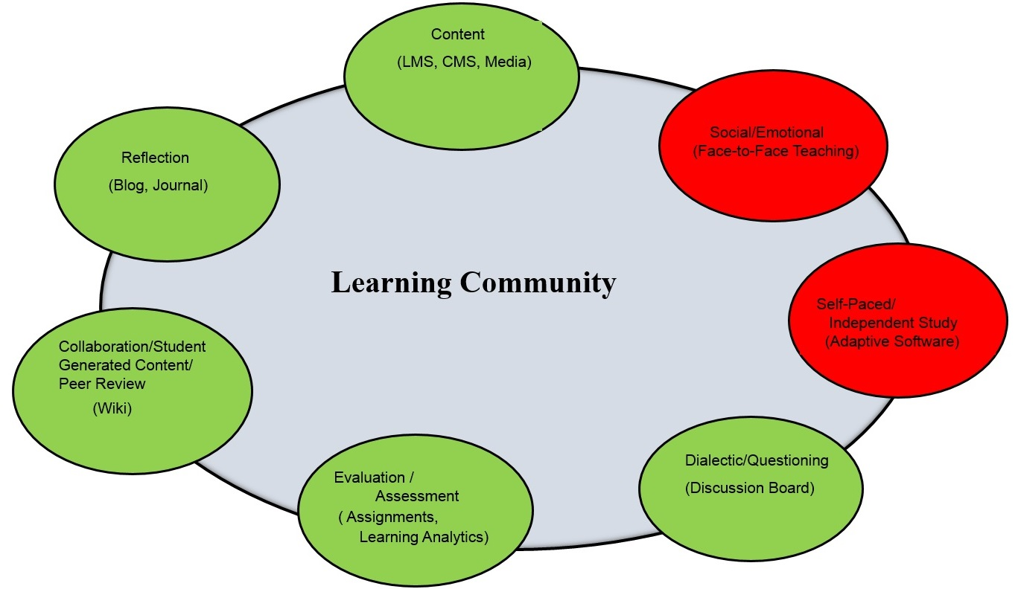
The 4th Wave – 2014 -> 2020s -
Integrated Multimodal Model
Applied to a Teacher-Led, Fully Online Course

Slide 17
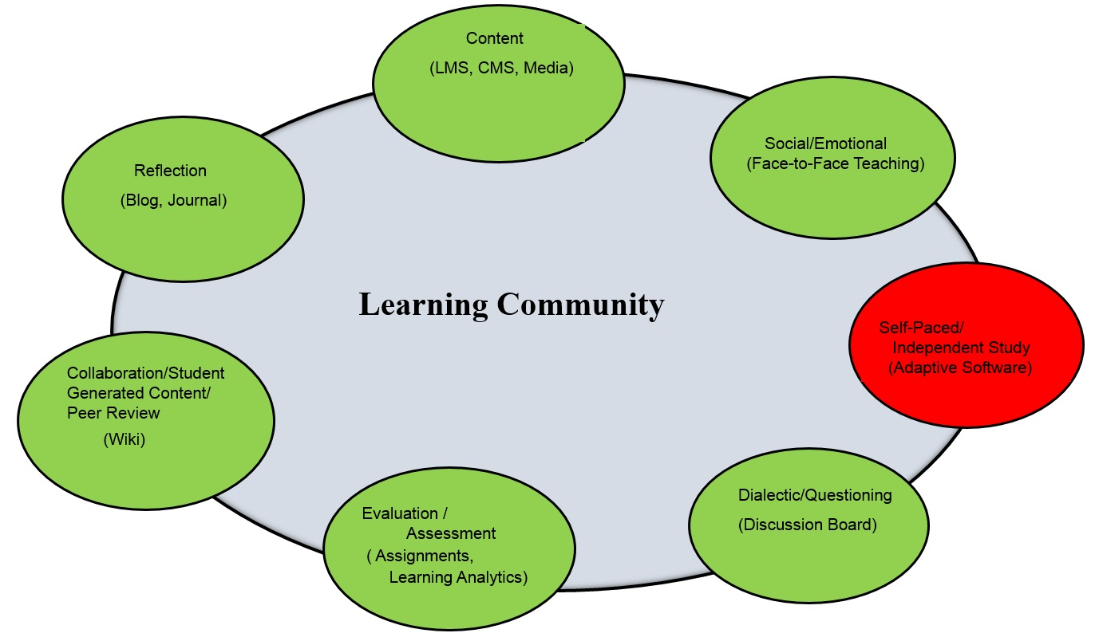
The 4th Wave – 2014 -> Early 2020s –
Integrated Multimodal Model
Applied to a Mainstream Blended Learning Course

Slide 18
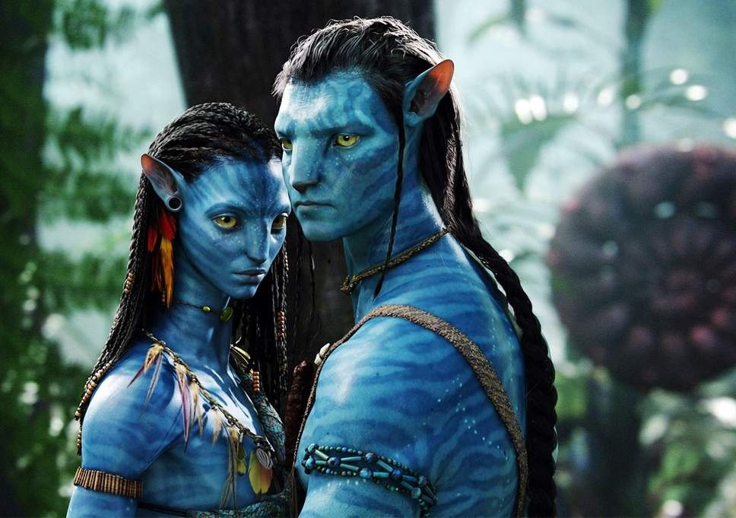
The 5th Wave – 2020s →
Online Learning Technologies Continue to Evolve and Augmented by
Nanotechnology -> Early Quantum Computing – billionths of a meter or the size of five carbon atoms -> subatomic size
Artificial Intelligence – Amazon Alexa/Apple Siri Will Evolve into Mobile Personal Assistants
Massive Cloud Computing – move from low cloud (i.e. email) applications to mission-critical applications (i.e., financial, personnel, student databases, CMS/LMS))
Low Cost/High Quality Digital Media and Animation –
Lucasfilms Starwars: Rogue 1,
20th Century’s Avatar
Conversion of non-instructional academic support, student counseling, and library services to mostly digital systems. Consolidation and centralization of administrative support services especially in the public sector.
Key Players – Higher education will see more mergers and partnerships.
Rise of the mega-universities.
Teaching -> Tutoring

Slide 19
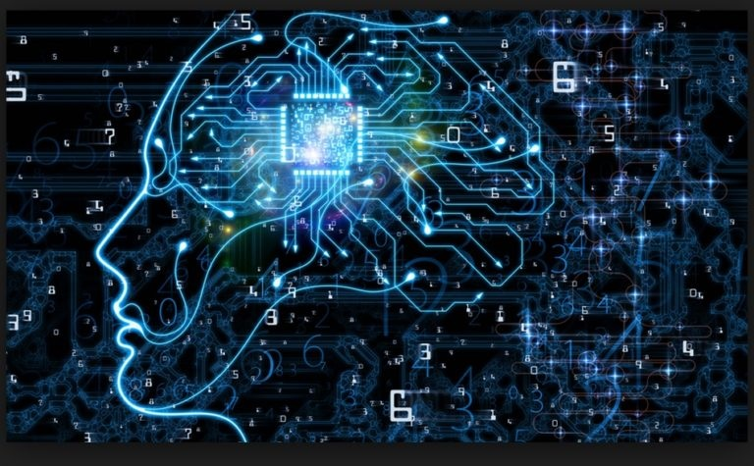
2030s and Beyond…..
New Technologies
Quantum Computing – subatomic-based technology
Computing and the Mind (Biosensing)
Neuroprostheses
Brain nets
Nanobots
3. Superclouds – Watson + Big Brother
4. Robotics
5. Fully Developed Artificial Intelligence Applications including teaching and learning.

Slide 20
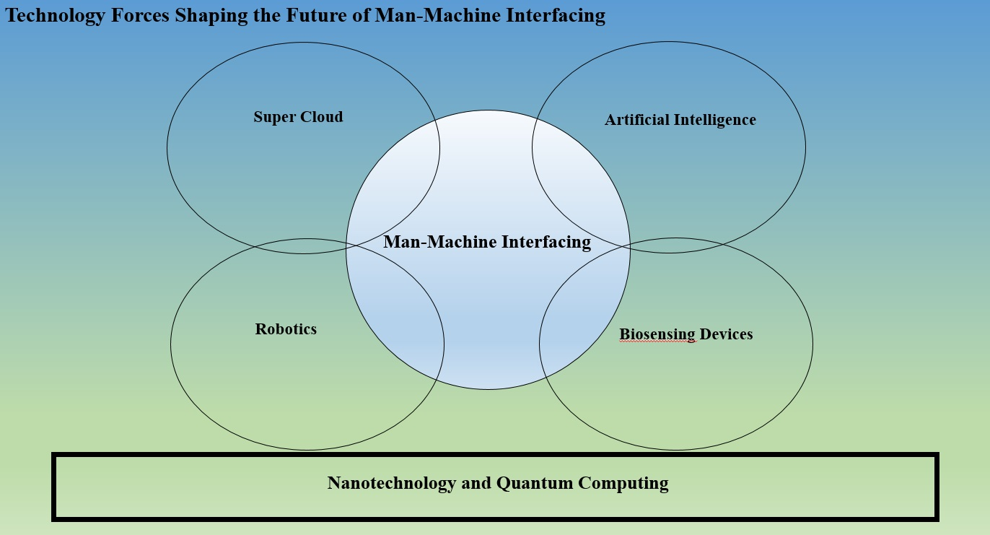
2030s and Beyond…..
20

Slide 21
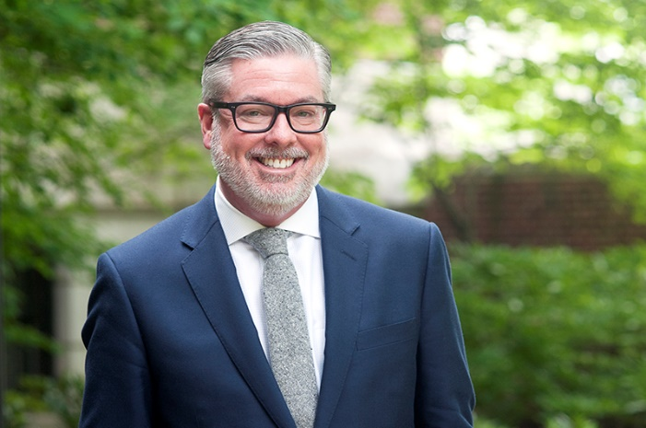
What Do College Presidents Think about Higher Education’s Future?
The Chronicle of Higher Education in a survey of college presidents (N=349) focused on the future of innovation in higher education.
Direction: Two-thirds of presidents of public institutions think that higher education is headed in the right direction, as do well over half of their private campus peers.
Modality: An overwhelming majority of presidents—three quarters at private institutions and even more at public campuses—think that blended courses that contain both face-to-face and online components will have a positive impact on higher education
Focus: Presidents say that when it comes to innovation in higher education, reformers pay too much attention to cutting costs and not enough to changing the model of teaching and learning.
Change drivers: Two-thirds of public-institution presidents think that politicians are the most influential drivers of change in higher education and half of private-campus presidents agree with that assessment. The presidents on both types of campuses believe strongly that faculty should be the number one drivers of change.
21
Notes:
President of Drexel University John Fry recently had his contract extended for five years.

Slide 22
Challenge to Educators
Test / Experiment with the technology.
Use / Improve that which works.
Discard that which does not work.
Whatever you do, do not ignore it.

Slide 23
Final Thoughts!
Stephen Hawking (Just before he passed way last year).
“I think the development of full artificial intelligence could spell the end of the human race. Once humans develop
artificial intelligence, it will take off on its own and design itself at an ever-increasing rate.”
Yuval Noah Harari (Author of Sapiens, in his latest book, 21 Lessons for the 21st Century (2018).
“What we are facing is not the replacement of millions of individual human workers by millions of individual
robots and computers; rather, individual humans are likely to be replaced by an integrated network.”
Steven Strogatz, professor of mathematics at Cornell and author of the forthcoming Infinite Powers: How Calculus Reveals the Secrets of the Universe, in an op-ed in the New York Times in December 2018)
On the rise of machine learning. By playing against itself and updating its neural network as it learned from experience, AlphaZero discovered the principles of chess on its own and quickly became the best player ever…
Most unnerving was that AlphaZero seemed to express insight. It played like no computer ever has, intuitively and beautifully, with a romantic, attacking style.”

Slide 24
Charles Dickens (1843)
In A Christmas Carol by Charles Dickens, the miserly Ebenezer Scrooge is visited on Christmas Eve by the ghost of his former business partner Jacob Marley as well as the Ghosts of Christmases Past, Present, and Future. The visit to the future ends as Scrooge faces his own mortality in the form of a tombstone inscribed with his name. He asks the Ghost:
“Before I draw nearer to that stone to which you point, answer me one question. Are these the
shadows of the things that Will be, or are they shadows of things that May be..?”
The Ghost continued to point downward to the grave by which it stood.
“Men’s courses will foreshadow certain ends, to which, if persevered in, they must lead,” said
Scrooge. “But if the courses be departed from, the ends will change. Say it is thus with what you
show me!” (Dickens, 1843)

Slide 25
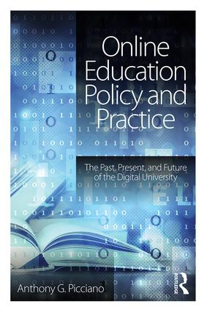
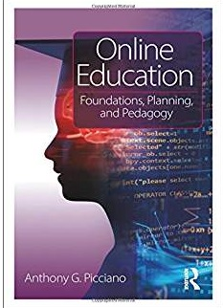
Thank You!
Visit me at: anthonypicciano.com

