Slide 1

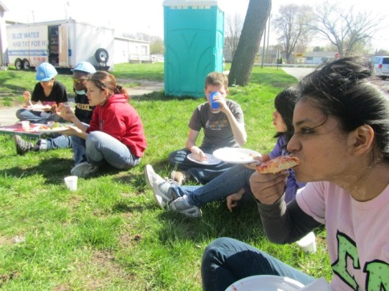
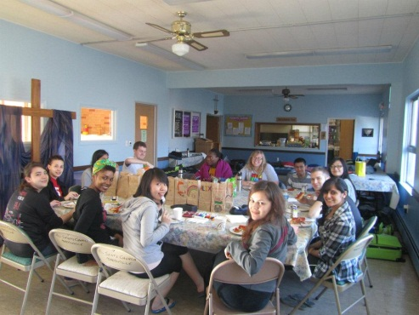


2013 Service Immersion Program
LIVE
LEARN
SERVE
LOCAL ● NATIONAL ● INTERNATIONAL

Slide 2
What is a service immersion program?
The Service Immersion Program is designed to enrich students learning experiences through civic engagement opportunities with local, national, and global communities.
Service: an act of helpful activity; help; aid
Immersion: state of being deeply engaged or involved
Program: a plan of action to accomplish a specified end

Slide 3
Service Immersion Program vs. Alternative Spring Breaks (ASB)
SERVICE IMMERSION PROGRAM | ASB TRIPS
Identify location in need of volunteer support | Identify location in need of volunteer support
Fundraising & Teambuilding | Fundraising & Teambuilding
Helping/aiding in work related to issues of public concern within communities | Helping/aiding in work related to issues of public concern within communities
Transforming participant perspective of their place in society | Transforming participant perspective of their place in society
Experience tied to academic credit | Traditionally non-academic
Intentional pre/post education experience | Traditionally optional pre/post education experience
Focus on sustainability & long-term partnerships | Usually trip is in a new locations each year
Notes:
-Specified Program Ends
-Final point/difference: Trip is the culmination of the project and the starting point for the following year.

Slide 4
Fundraising & Teambuilding
Service Week
Post-service Reflection
Educational Sustainability Projects (independent study)
Service immersion selection of participants and leaders
Pre-service Education & Orientation
Education & Reflection
Teambuilding
Community Activities
Service to Community

Slide 5
Academic Credit
1 credit: All program participants are eligible after completing pre-service educational activities, fundraising, teambuilding, and full trip participation
3 credits: Students may register for an independent study for participation in all aforementioned activities as well as an educational sustainability project.
  Sustainability Projects are co-defined by community-based organization (CBO), the Lindy Center and the student. Projects are designed to continue supporting the efforts of the CBO once students return (i.e. promotional & marketing material; survey; research; educational material for future volunteers)
        Flexible Credit Administration = can receive credit from 1 to 4 terms after service immersion trip.

Slide 6
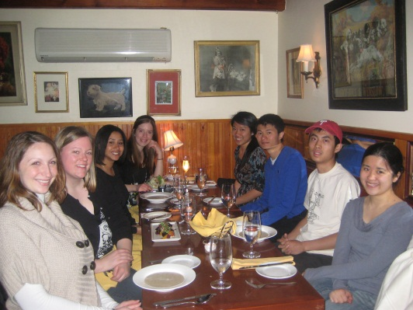
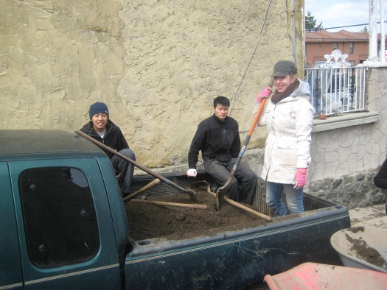
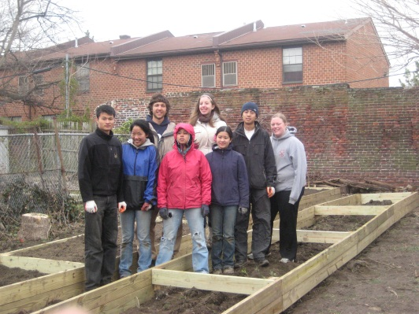
Local Immersion
During break between Spring and Summer terms:
June 16-21, 2013
Urban Agriculture, Food Access, & Sustainability Focus serving with Urban Tree Connection

Slide 7

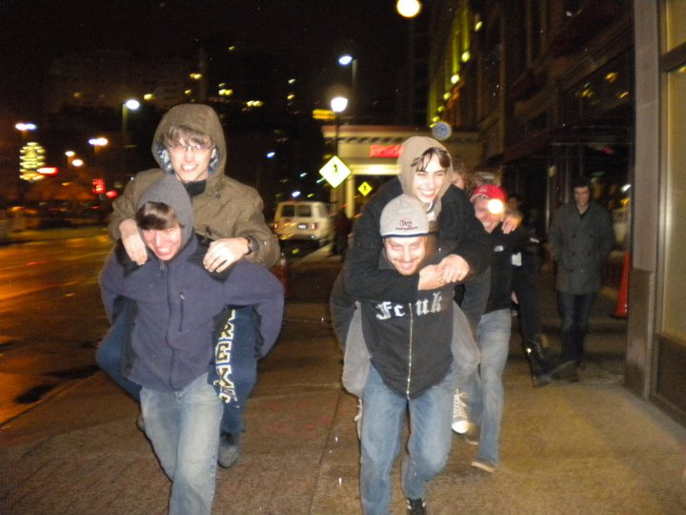


National Immersion
During Spring Break: March 24th – 31st in a Southern U.S. State
Serving with Habitat for Humanity, Collegiate Challenge
Notes:
Can see Canada. May be able to watch the ice melt from the Great Lakes as it travels south.

Slide 8
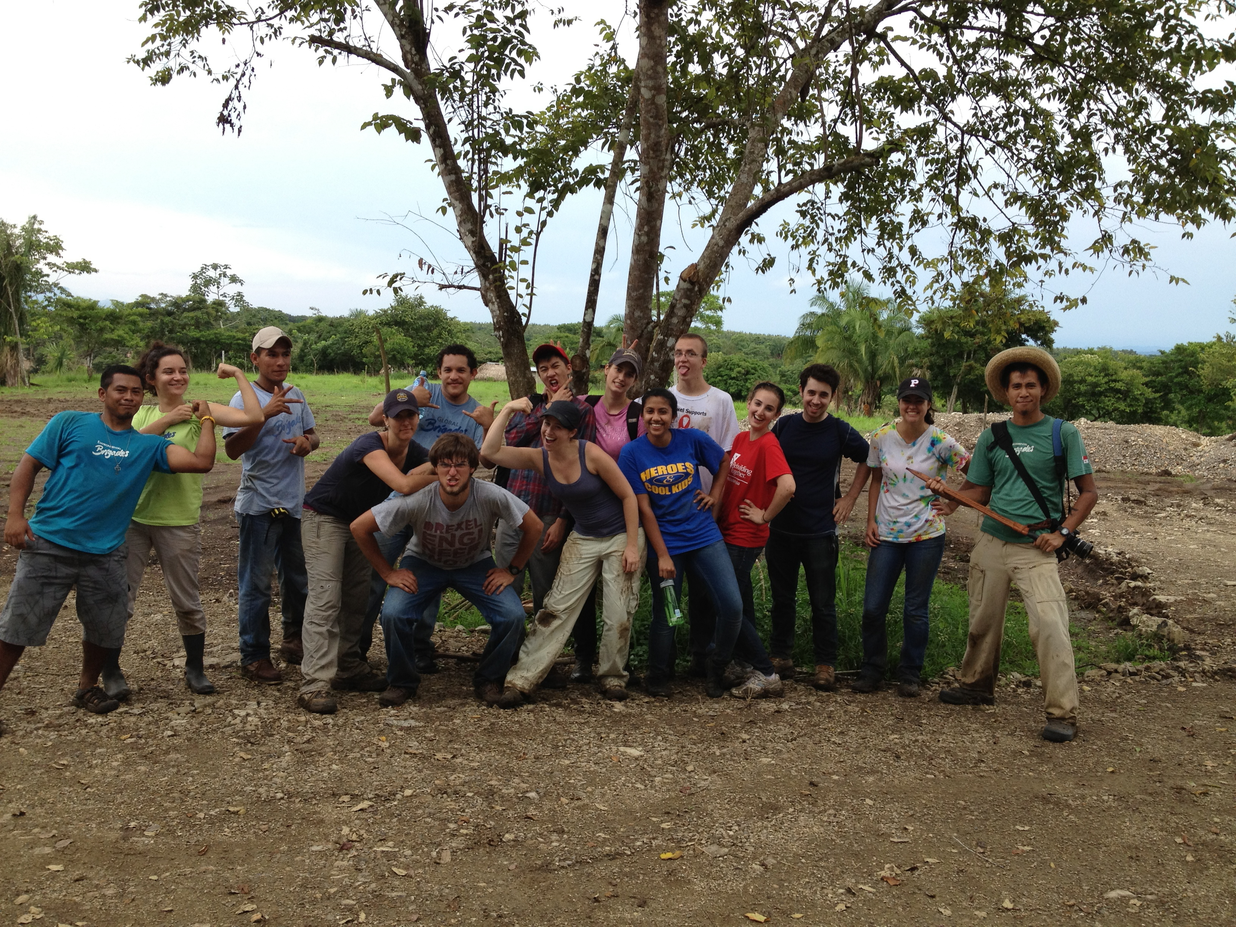


International Immersion
During break between Summer and Fall terms: September 6 – 15, 2013
Republic of Panama with Global Brigades’ “Environmental Brigade”

Slide 9
Costs
Subsidized by Lindy Center & Honors Program
Fundraising opportunities
Participation fee:
  Local Immersion = $250
  National Immersion = $350
  International Immersion = $500
      Projected Expenses Include
      HOUSING
      TRANSPORTATION
      FOOD
        SOCIAL ACTIVITIES
        TRAVEL VACCINES (if necessary)
        CBO FEE
          MISC. MATERIAL

Slide 10
Next Steps
APPLY!
  www.drexel.edu/lindycenter - click the box labeled 2013 Service Immersion
  Interview Days on December 1st & 2nd, 10am-2pm
  Committee will decide on immersion assignment for 2013
  Accept/decline immersion assignment
  Accepted students will begin pre-service trainings/orientation/education, teambuilding, fundraising , background checks, clearances, etc.
    *National Immersion participants will begin in January!

Slide 11
Contact Information
Local Service Immersion
Jennifer Johnson Kebea, jpj38@drexel.edu
National Service Immersion
Seth Jacobson, saj33@drexel.edu
International Service Immersion
Dan Dougherty, dd446@drexel.edu
or Elaine O’Loughlin, epo23@drexel.edu

