Slide 1
ApprenNet
The Modern Apprenticeship
Karl Okamoto
Notes:
Last year LawMeets set out to discover how to effectively teach skills at scale? To answer this question, we first asked ourselves...

Slide 2
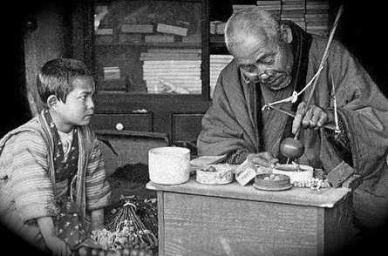
How do you teach skills best?
Notes:
We discovered the answer was apprenticeships. We then asked ourselves...

Slide 3
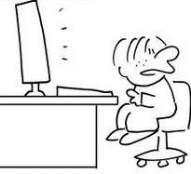
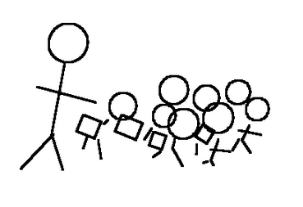
How do you scale learning?
Notes:
The obvious answer is the classroom. More recently, people have leveraged technology to expand the reach of a traditional classroom. Click Now one teacher can post their video lecture + online quizzes and teach thousands at one time. Great: Increase Access + Lowers cost. The problem is...

Slide 4
Notes:
This type of learning can be quite boring.
LawMeets set out to solve the boredom problem by building something we call Meets.

Slide 5
Modern Apprenticeship

Slide 6
Watch our Movie!
http://youtu.be/SisSvY0b2EY

Slide 7
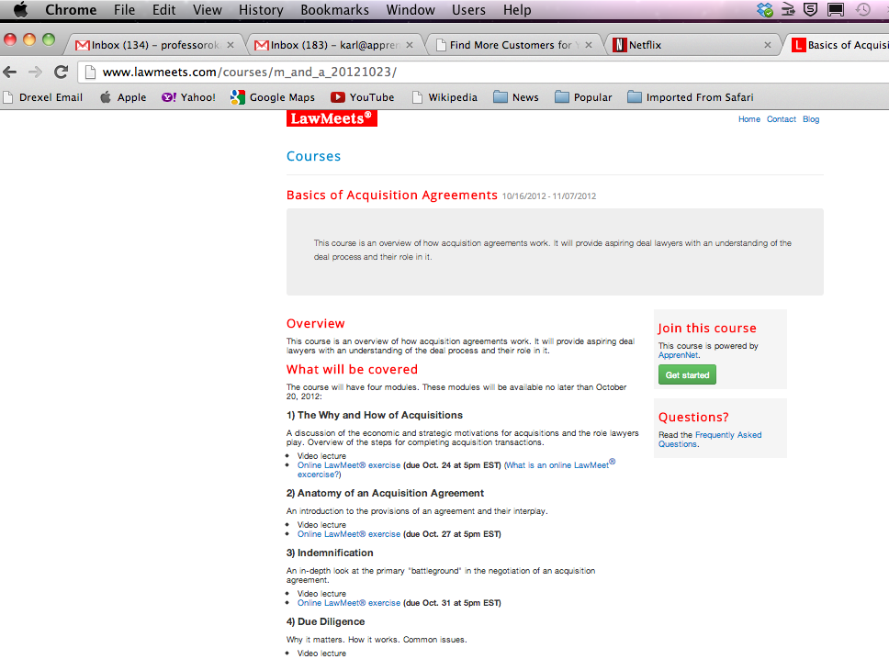
The MOOC

Slide 8
838 people registered for the MOOC
426 law students
226 law graduates
45 law professors
28 business students
16 partners
12 general counsels
9 human resource professionals
7 executives
2 instructional designers
1 prospective law student

Slide 9
Broad Interest
116 law schools (106 from US)
Law professors from 45 law schools
86 associates and 16 partners from 56 law firms
47 companies and organizations
19 countries

Slide 10
Persistency
132 individual participants completed a full Meet, BUT
32 individual participants completed the Course
61 participants fully completed three or more Meets
103 participants fully completed two or more Meets

Slide 11
ApprenNet Use Cases
The MOOC
Law School Use
Business Law Classes
Legal Methods/Research
Evidence
Professional Responsibility
Non-Law Pilots (Nursing, Math Forum, Relay, RC)

Slide 12
Student Surveys
90.2% agreed that the challenges were realistic.
90.2% agreed that the experience enhanced their learning.
88.2% found it valuable to submit video responses.
82.6% found it valuable to watch peers.
97% found it valuable to watch expert demos.
“The learning is good for students to make the video. The learning is better once we vote and watch other student responses. The learning is phenomenal when we get additional feedback by reading and watching the responses of practicing attorneys.”
- Student Participant
Notes:
What do users (students) think?

Slide 13
www.ApprenNet.com
Karl@ApprenNet.com

