Slide 2
Online Recruiting System
Hiring Manager Presentation
This presentation will take about 15 minutes.
Click on your mouse to go to the next slide
OR click on the green box at the bottom of each page.
To go back a slide, click on the gray box.

Slide 3
Helpful Hints:
Do not use your browser's "Back", "Forward" or "Refresh" buttons to navigate the site. This may cause unexpected results, including loss of data or being logged out of the system. Please use the navigational buttons within the site.
To protect the security of your data, the system will log you out if it detects no activity for 60 minutes. This will cause ALL the data you entered during that session to be lost. Please do not leave your computer for more than 60 minutes while completing your application for employment.
Now, You’re Ready To Begin The Tutorial!

Slide 4
Type your
User Name & Password
in boxes here
Then click here

Slide 5
You will click here
This is the Home page
- or -
Main Screen for all Hiring Managers
From here you can:
Create a new Requisition

Slide 6
You will click here
From here you can:
View your active positions

Slide 7
You will click here
From here you can:
View a Requisition submitted to HR for approval (pending)

Slide 8
You will click here
From here you can:
View past (historical) positions that are now filled or cancelled

Slide 9
You will click here
You can change your password at any time.
Note: You should always Logout when you leave the site or walk away from your desk for more than a few minutes.

Slide 10
Creating a Requisition

Slide 11
You will create a Requisition from a Template or from a Previous Posting.
In this example, we will create from a Template.

Slide 12
You can move from one section to another by clicking on the links in the boxes at the top of your screen.

Slide 13
Complete the information requested by clicking in the field and typing.
This form is similar to the Requisition form you previously submitted.
Any required information is denoted with an asterisk (*) on the left.

Slide 14
When finished entering information on this screen, click the Continue to Next Page button.

Slide 15
If you choose to ask job-related questions, click the “Posting Specific Questions” box.

Slide 16
Then click Add a Question.

Slide 17
A question may already exist that relates to your topic. Enter a keyword in the “Search by Keyword” box. Otherwise, leave this space blank, and click “Search”.

Slide 18
To view a question (and possible answers) click the View/Add link to the right of each question. If one of the questions relates to your position, you may submit it by clicking ‘Add’.

Slide 19
If you’d prefer to compose your own job-related question, click the “Create a Question” at the bottom of the screen.

Slide 20
You can create a Closed-Ended question by:
(1) Typing the question
(2) Choosing “Closed Ended”
(3) Typing possible answers

Slide 21
For Open-Ended questions:
(1) Type the question
(2) Choose ‘Open Ended’
(3) Choose type of answer (Long Text in this example)

Slide 22
If you ask closed-ended questions, you have an opportunity to disqualify candidates based on their answers. Click on the “Disqualifiers” label.

Slide 23
Select any answer that should disqualify someone by checking the box in this column

Slide 24
To allow Search Committee Members to review applicants, click on the box, labeled “Guest User” then click on the “Activate Guest User” link.

Slide 25
The system will automatically assign a “User Name”.
You will need to type in a password of your choosing. Write down the user name / password combination so that you can give it to the members of your search committee.

Slide 26
The Last Step
On the View Summary screen, scroll down to view the complete Requisition.
If satisfied, select the appropriate action and click Continue.

Slide 27
You must hit the CONFIRM button to save or submit your requisition.

Slide 28
Viewing Applications, Resumes, & Other Documents

Slide 29
Click on the View Active link to view your open positions.

Slide 30
Click “View” below a title.

Slide 31
You can sort the data by clicking on the arrow at the top of each column:

Slide 32
To review the first Application, click “View Application” under an applicant’s name
The Application will come up in a a separate window. To print a paper copy, select File: Print from your browser window.

Slide 33
To see an applicant’s resume and/or cover letter, click on the link (if any) in the “Documents” column.

Slide 34
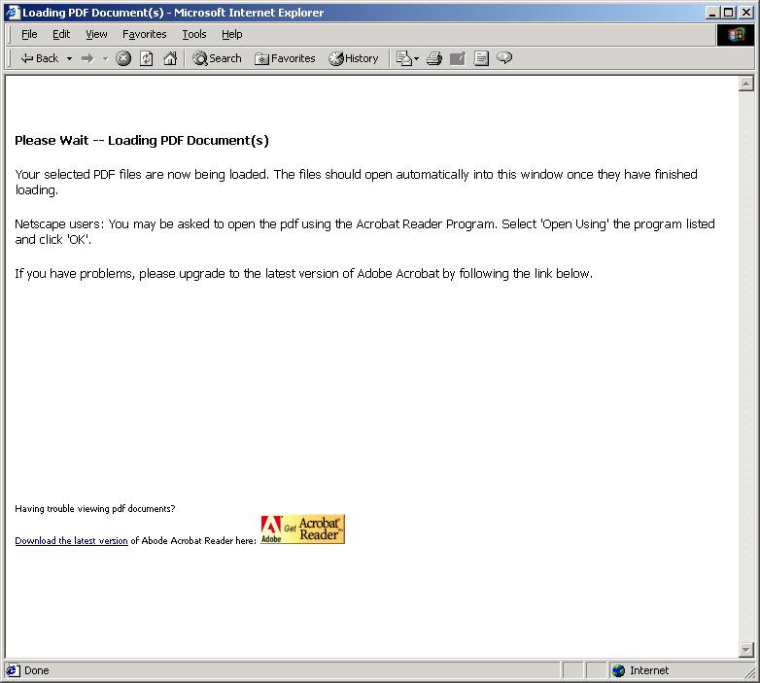
Resumes and cover letters will be submitted to you by the applicant in PDF format.
If you do not have Adobe Acrobat Reader 5.0 installed, you must click and install this FREE version.

Slide 35
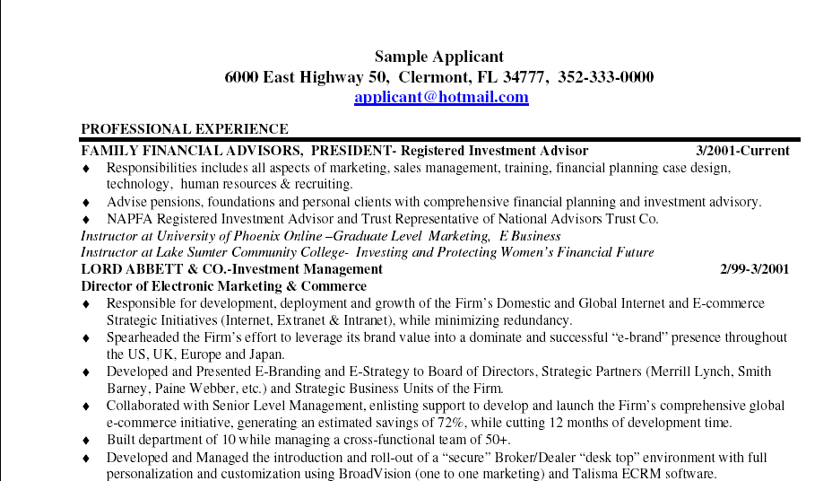
The resume, cover letter and/or other submitted documentation will appear in a separate window.

Slide 36
Changing an Applicant’s Status

Slide 37
Every applicant has an active status that shows where they are in the hiring process.
During the review process you will change their status to reflect their progress by clicking “Change Status”.

Slide 38
The Status menu contains the Statuses you may move an applicant to.
The applicant whom you eventually hire will have a Status of “Hired”.
Those not hired will have a Status of “Not Hired”

Slide 39
Click the Save Status Changes button to confirm your action.
You will be asked to confirm actions by clicking on “Confirm”.

Slide 40
All status changes are recorded in an applicant’s“History”.
HR may post other information in this section.

Slide 41
Sample Notes / History:
This screen indicates that this applicant applied on 12/10/2003

Slide 42
Final Section:
Registering your Account

Slide 43
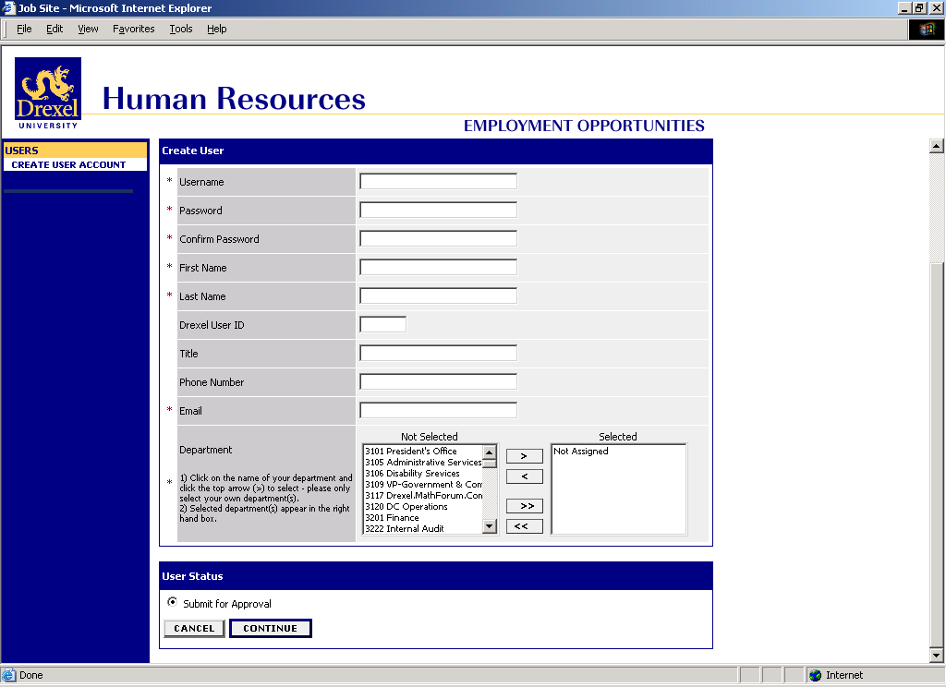
To register, complete the following steps:
(1) Click the ‘Create User Account’ link at left
(2) Complete the information on the page
The Human Resources Office will contact you when your account is active.
Remember, we are available to answer questions throughout the hiring process.

Slide 44
Congratulations!
You have completed the Online Recruiting System Training and are ready to register!

