Slide 1
Blood and Oil in the Risk Society
Scott Gabriel Knowles
Drexel University
30 June 2010

Slide 2
Blood and Oil in the Risk Society
What is a Disaster?
i. What does the use of language tell us about a person or organization’s point of view on a disaster?
ii. How does the identity, ideology, and/or analytical approach of an individual or organization shape a disaster?
2. A Tour of Analytical Approaches
What are the types, and the strengths and weaknesses, of various analytical approaches focused on disasters?
i. The Sociological Approach
ii. The Cultural Approach
iii. The Historical Approach
iv. The Public Policy Approach
iv. The Economic Approach
v. The Ecological Approach
vi. The Information Approach
vii. The Technological Systems Approach
viii. The Therapeutic Approach
ix. The Applied Emergency Management Approach

Slide 3
What is a Disaster?
i. What does the use of language tell us about a person or organization’s point of view on a disaster?

Slide 4
“The oil spill in the Gulf is this nation’s largest natural disaster and stopping the leak and cleaning up the region is our top priority.”
--Joint Statement of John Boehner, Eric Cantor, and Mike Pence, 17 June 2010
“Already, this oil spill is the worst environmental disaster America has ever faced. And unlike an earthquake or a hurricane, it’s not a single event that does its damage in a matter of minutes or days. The millions of gallons of oil . . . are more like an epidemic, one that we will be fighting for months and even years.
But make no mistake: We will fight this spill with everything we’ve got for as long as it takes. We will make BP pay for the damage their company has caused.”
--Barack Obama, 15 June 2010
“Now, Therefore, I . . . do herby call for a Day of Prayer . . . urging citizens to pray for comfort for the families of those killed in the Deepwater Horizon initial blast; that God would crown with success efforts to stop the flow of oil in the Gulf; that He would interpose to mitigate further damage and strengthen the hands of clean up crews . . . and that He would prevent future recurrences of this oil spill.”
--Florida Lt. Gov. Jeff Kottkamp, 27 June 2010
“’Other parties besides BP may be responsible for costs and liabilities arising from the oil spill, and we expect those parties to live up to their obligations,’ said Tony Hayward, BP’s chief executive . . . ‘What they all want to do is have the insurance companies pay, if possible,’ said Tom Baker, a professor at the University of Pennsylvania Law School who specializes in insurance. . . BP might also argue that, since its plans were approved by the federal government, it should not be found grossly negligent.” --New York Times, “Liability Questions Loom for BP and Ex-Partners,” 25 June 2010

Slide 5
Talking About Disasters
Disaster
Natural
Environmental
Epidemic
Fight
Priority
Cleaning Up
Prayer
Mitigate
Responsible
Costs
Obligations
Negligent
What happened? Who knows the most about this? Will it end; how can we be normal again? Who is responsible? How do we allocate blame? How do we keep this from happening again?

Slide 6
I take “disaster” to mean “an event focused in time and place causing significant disruptions to normal activities and incurring unacceptably high losses of property and/or life.”
I take risk to mean “a likelihood, which may be described either quantitatively or qualitatively, that a disaster will occur.”

Slide 7
1. What is a Disaster?
ii. How does the identity, ideology, and/or analytical approach of an individual or organization shape the framing of a disaster?

Slide 8


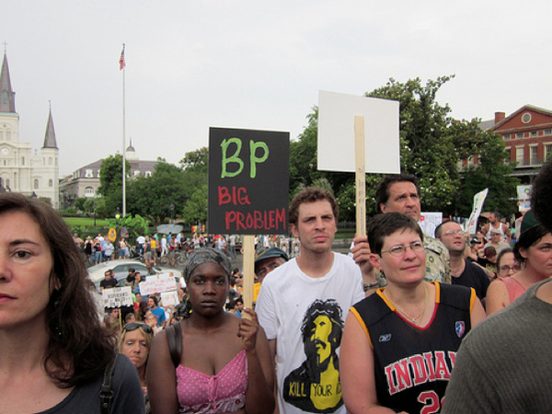

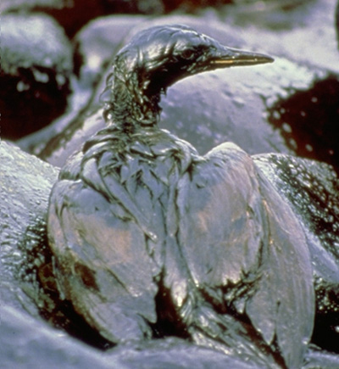
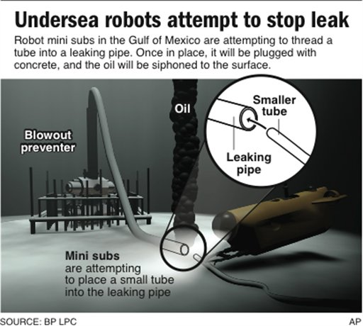
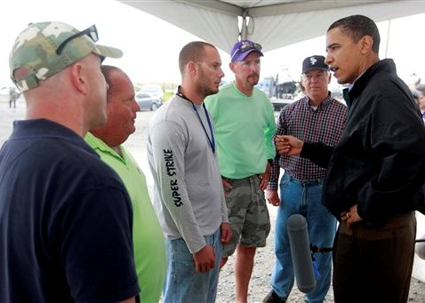

Slide 9
2. A Tour of Analytical Approaches
What are the types, and the strengths and weaknesses, of various analytical approaches focused on disasters?
i. The Sociological Approach
ii. The Cultural Approach
iii. The Historical Approach
iv. The Public Policy Approach
v. The Economic Approach
vi. The Ecological Approach
vii. The Information Approach
viii. The Technological Systems Approach
ix. The Therapeutic Approach
x. The Applied Emergency Management Approach

Slide 10
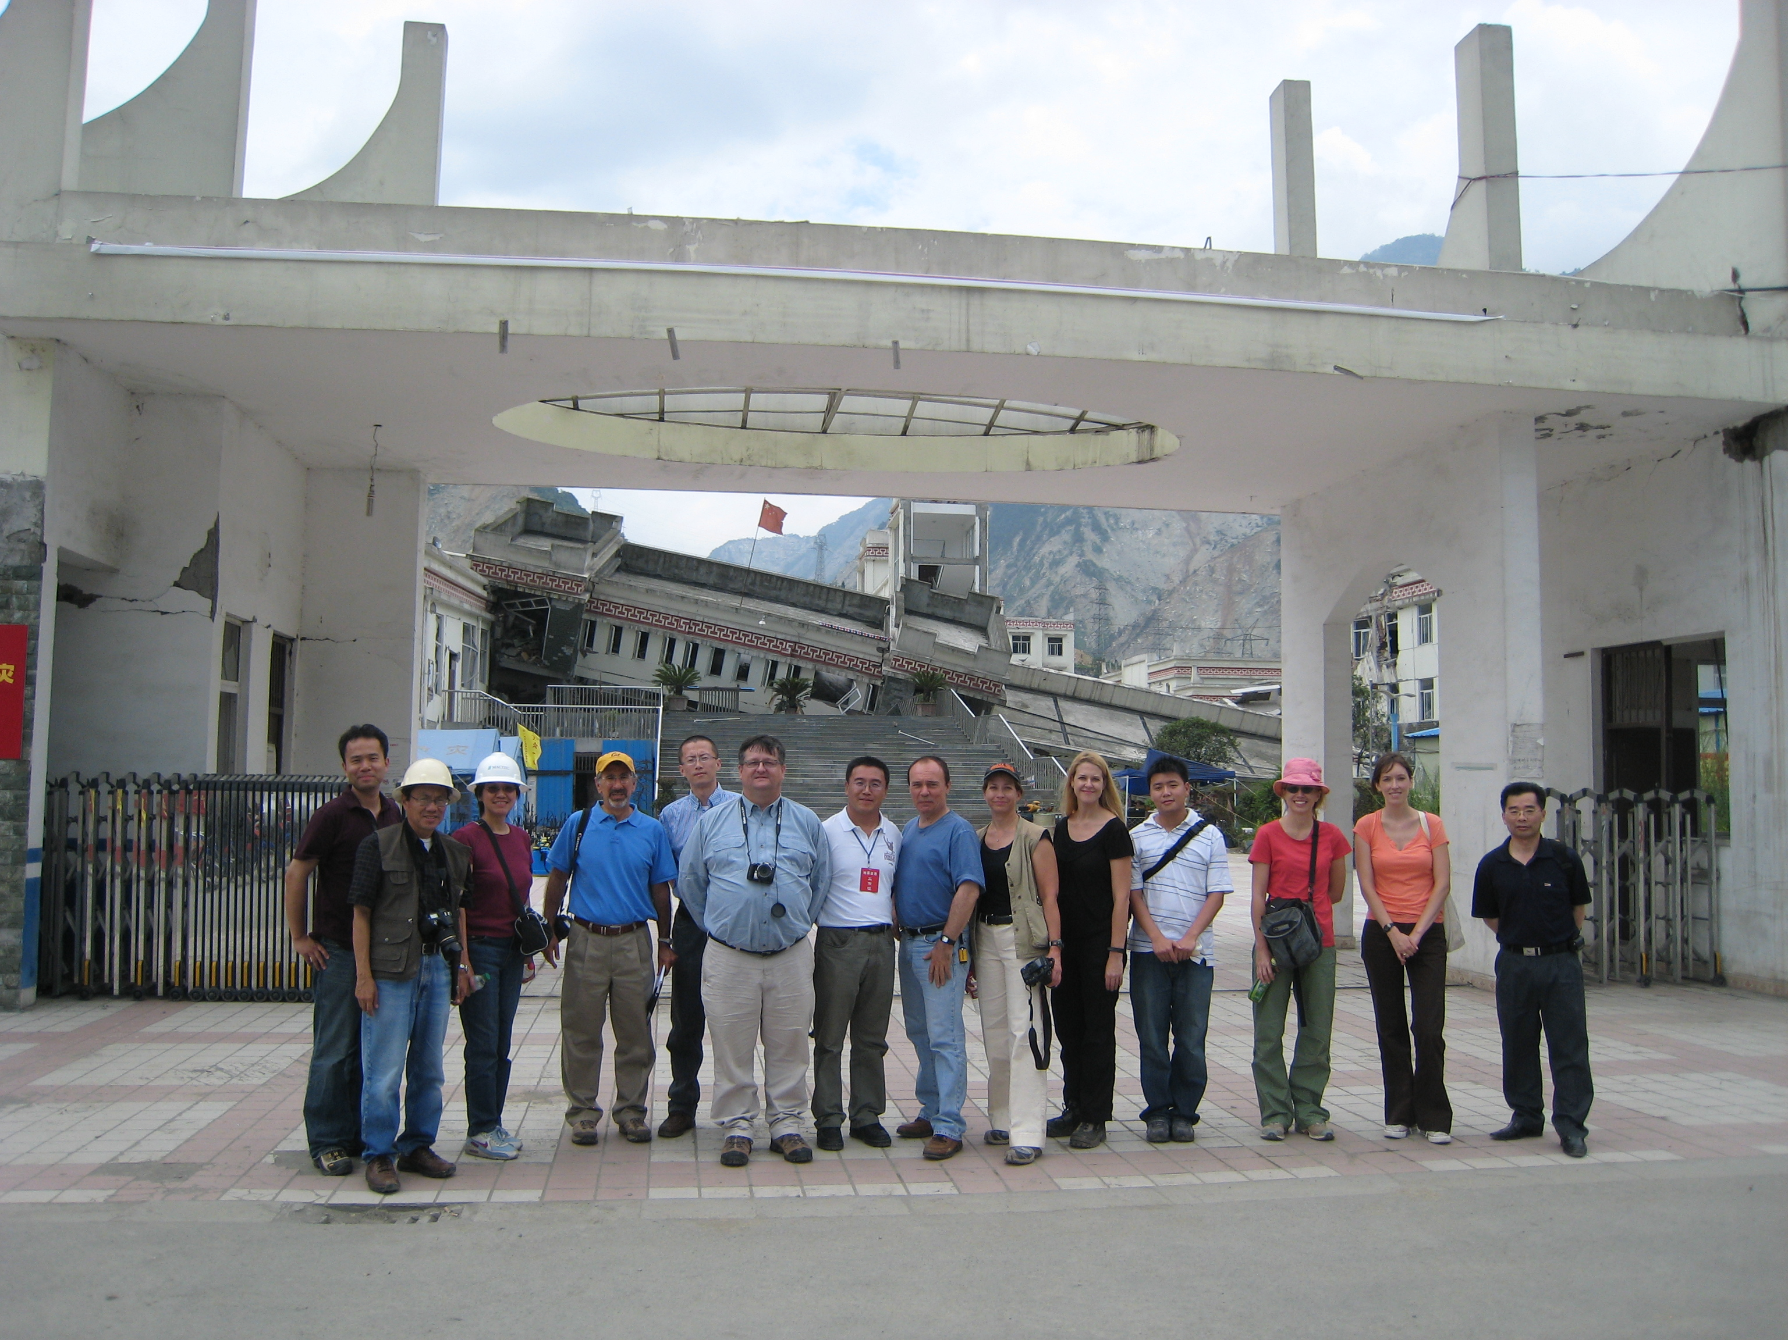
The Sociological Approach
--The society and the community are the focus of analysis
--Findings: communities are resilient, vulnerabilities predict disaster effects
--Modernization is a process of risk manufacturing—we live in a “risk society”
--Poverty is hierarchic, smog is democratic
--There is no such thing as a natural disaster

Slide 11
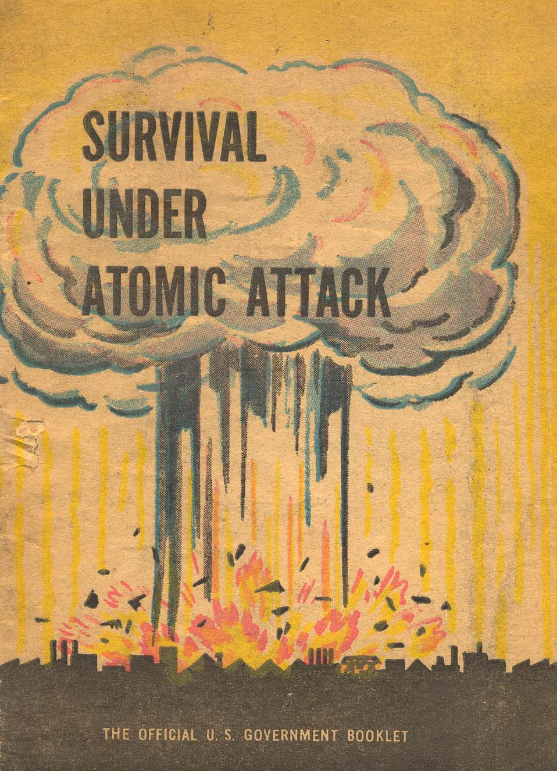
The Cultural Approach
--Shared values and ways of understanding are the focus of analysis
--Risk is shaped by perception, fear is constructed and contingent
--Sense-making, blaming, and recovery are common across cultures

Slide 12
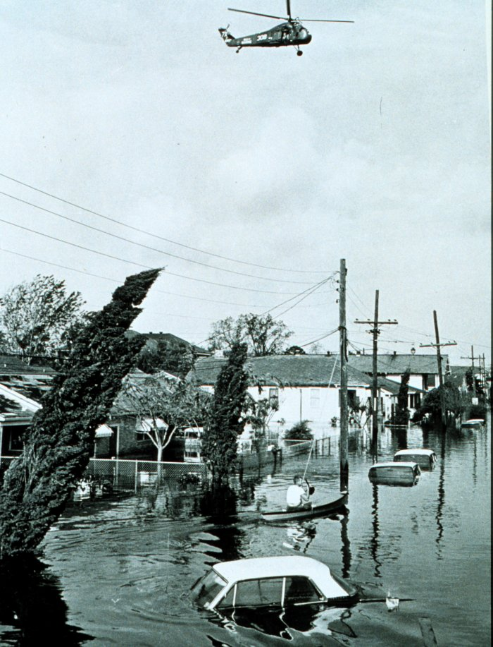
The Historical Approach
--Patterns of risk-taking are historically discernible, and historically contingent
--Law, the built environment, individual and community memory, expertise and professional practice all offer clues to the historical impacts of disasters

Slide 13
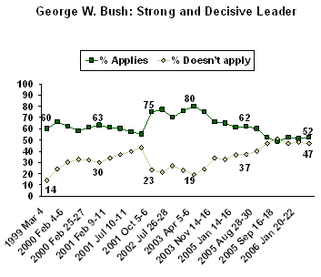
The Public Policy Approach
--The actions of elected officials are the focus of analysis
--In political argument and law we find the key actors, the important points of view, and the acceptable compromises that explain how a society defines and reacts to disasters

Slide 14
The Economic Approach
--The action of markets is the focus of analysis
--Cost-benefit analysis is a critical tool
--A key task is to locate the level of “acceptable risk”

Slide 15
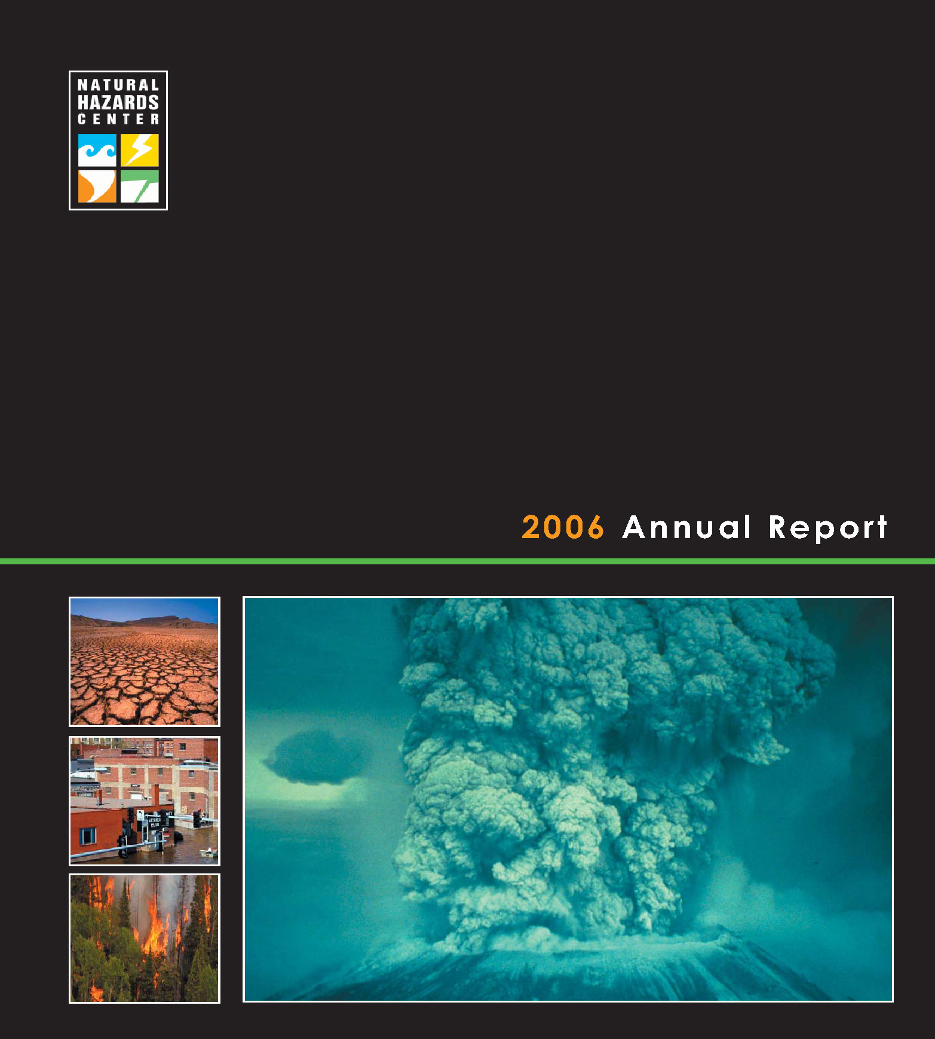
The Ecological Approach
--Hazards reside in the land and water
--Development choices either mitigate or exacerbate inherent risks
--Ecosystem dynamics predict disaster occurrence and impact

Slide 16
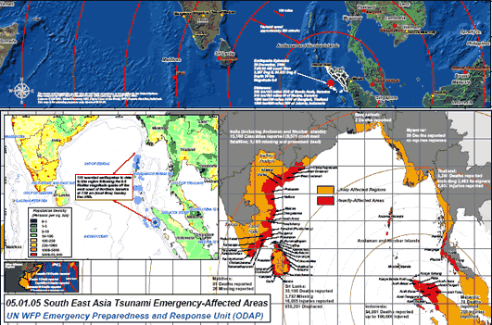
The Information Approach
--Content and availability of “risk information” will predict disaster effects
--Different messages are appropriate in different contexts
--Perfect information is a goal, new media makes it more likely

Slide 17
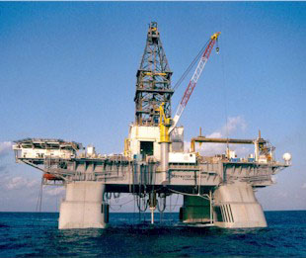
viii. The Technological Systems Approach
--Interlocking systems of machines and technological knowledge are the focus of analysis
--Technical solutions are privileged through claims of objectivity and efficacy

Slide 18
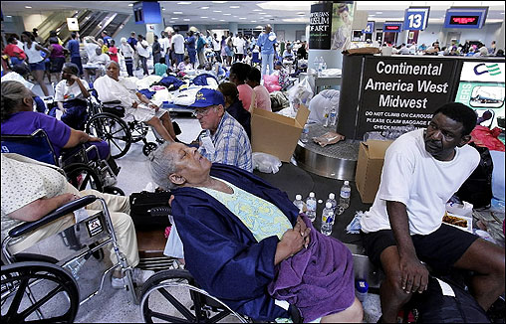
The Therapeutic Approach
--Disaster impacts on individual and community health are the focus of analysis
--Health disparities predict disaster effects

Slide 19
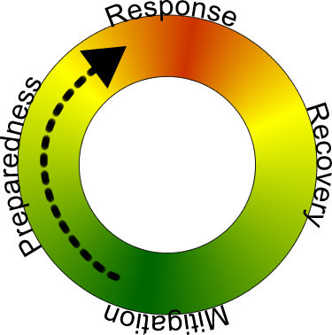
The Applied Emergency Management Approach
--Disasters can be managed
--There are four phases to consider: mitigation, preparedness, response, and recovery
--Effective disaster management cuts across jurisdictions
--Effective disaster management integrates the above nine approaches

Slide 20
QUESTIONS
What are the dominant trends in language around “blood and oil”?
What are the most successful constructions of risk and disaster around “blood and oil”?
Which analytical approach(es) do you find useful? Which not, and why not?
What do Susan Cutter, Scott Frickel, Rodriguez and Dynes, and Wachtendorf and Kendra add to the conversation?

