Slide 1
Drexel Biodiesel Club

Slide 2
Mission
“To produce Biodiesel from the supply of waste vegetable oil (WVO) created on campus by the various dining establishments, to use as a fuel supplement for Drexel’s diesel needs. To promote knowledge and understanding for students of the biodiesel process. To promote research on new and emerging biodiesel production technologies.”

Slide 3
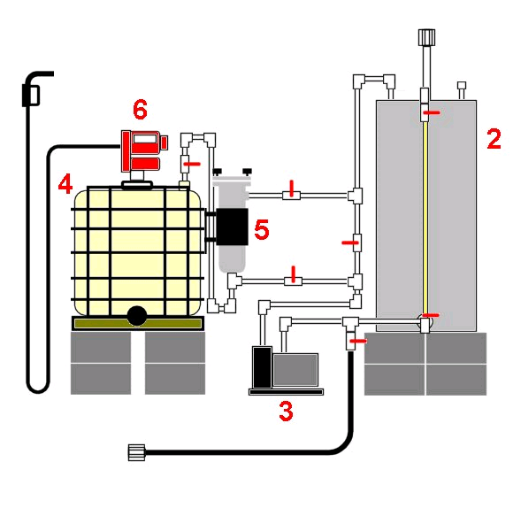
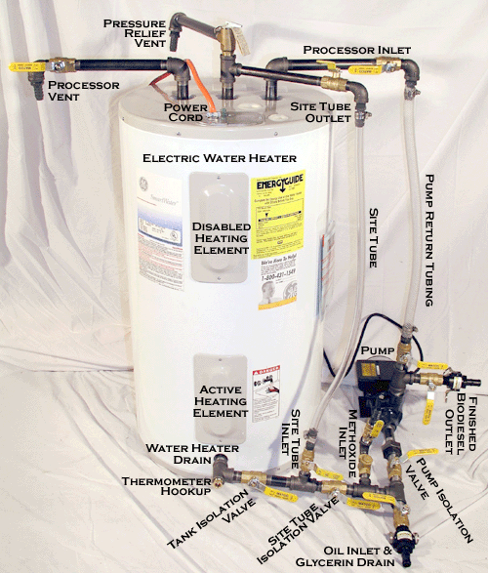
Current Systems
Appleseed Processor
Frybrid Still

Slide 4
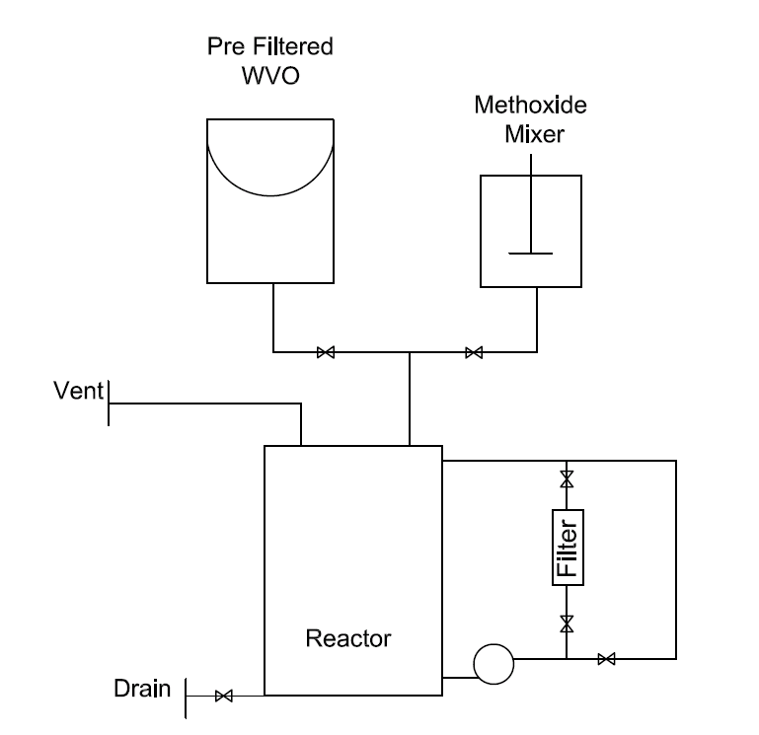
Proposed System
Combines Current Designs Into a Compact Model
Can Be Fabricated Out of 50% Recycled Material
Energy Reduction Due to Gravity Fed Material

Slide 5
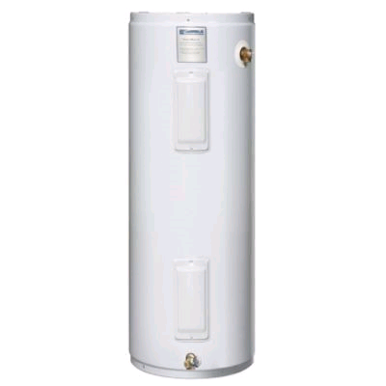
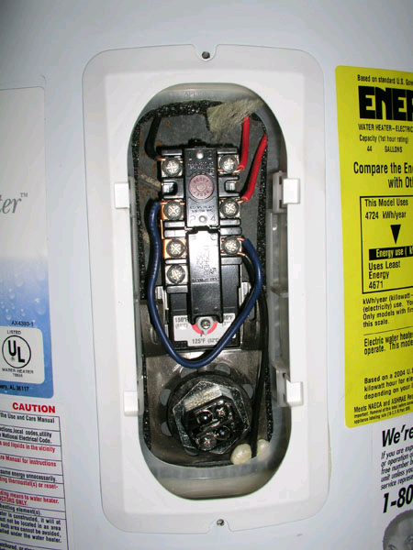
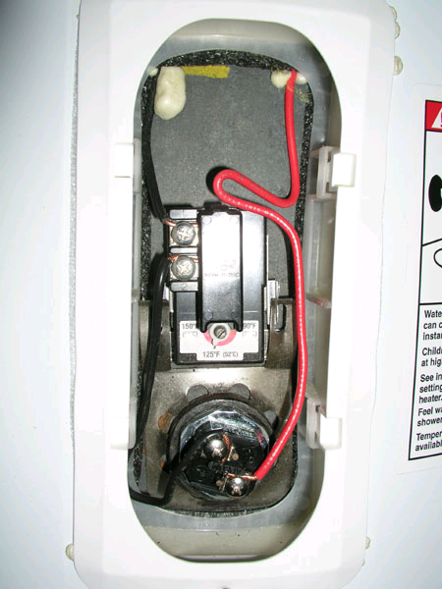
Processor
Converted Hot Water Heater
Elements Rewired For Safety and Lower Heat Application
Existing Fittings and Insulation Ideal for Processor Retrofit
Can Be Recycled From Dump

Slide 6
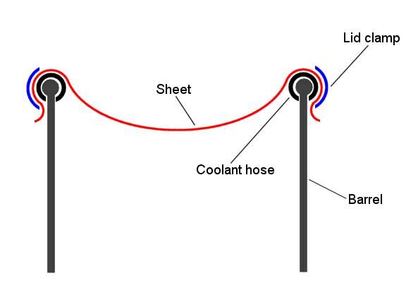
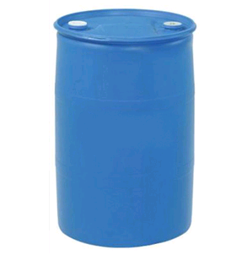
Prefilter
Converted 55 Gallon Barrel
Uses Scrap Fabric as Filter Media
Gravitational Filtration Cuts on Power Usage
Barrels Can Be Recycled From Car Wash

Slide 7
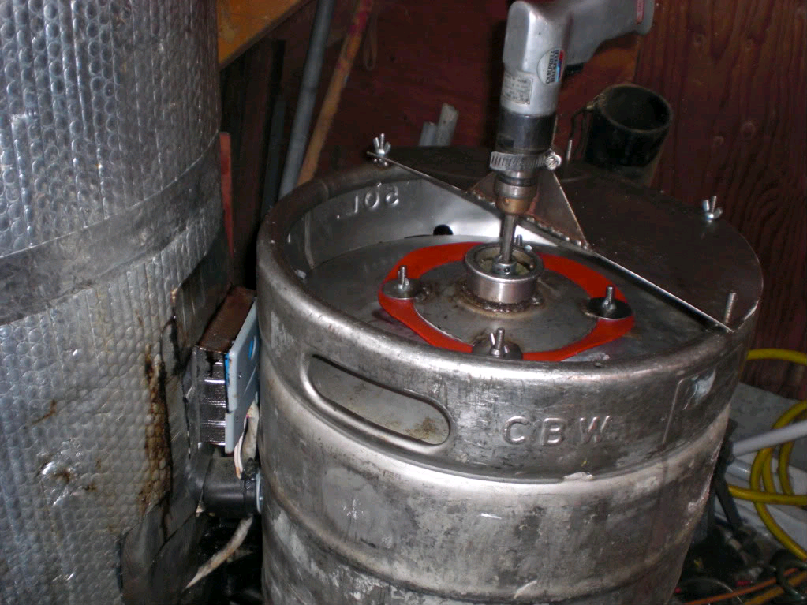
Methoxide Mixer
Made From Recycled Barrels
Sealed Intakes to Minimize Fumes
Throttling Valve to Restrict Flow to Optimum Rate

Slide 8
Finances
 |  | Number | Price | Total
Reactor | Hot Water Heater | 1 | Recycled | -
 | Pump | 1 | 600 | 600.00
Filter | Housing | 1 | 300 | 300.00
 | Filter Media | 1 | 5 | 5.00
Prefilter | 55 Gallon Drum | 1 | Recycled | -
 | Hasp | 1 | Recycled | -
 | Filter Media | 1 | Recycled | -
Methoxide Mixer | Barrel | 1 | Recycled | -
 | Mixer | 1 | 10 | 10.00
 | Motor | 1 | 40 | 40.00
Plumbing | Tube | 40 | 1.5 | 60.00
 | Valves | 6 | 5.65 | 33.90
Total |  |  |  | 1,048.90
System Uses 20% Methanol Per Gallon of Vegetable Oil
Methanol Prices at $5.00 a Gallon
Bringing the cost to $1/Gallon of Biodiesel
System Uses .03lb of Lye Per Gallon of Vegetable Oil
Lye Priced at $5.50 a Pound
Bringing the cost to $0.17/Gallon of Biodiesel
Startup Cost $1,050.00 Operating Cost: $1.17/Gallon + Cost of Electricity

Slide 9
Return
One Gallon of Biodiesel will save the school approximately $2.50/Gallon
Producing 80 Gallons a Week Would Save Drexel $200/Week or $2,400/Year
By Collecting All WVO on Campus (estimated 250gal/week) Drexel Could Save $625/Week or $7,500/Year
Club Would Pay Back SAFAC Funding in Approximately 8 Months!

