Slide 1
Why Do I Have To Take This Course?!!!!
STEM Connections and Community Based Learning

Slide 2
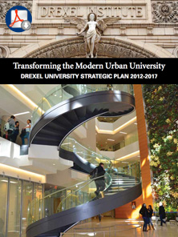
First a little history….
Drexel’s ongoing strategic plan: "Transforming the Modern Urban University"
Drexel has committed to being the nation’s most civically engaged university, with community partnerships integrated into every aspect of service and academics.

Slide 3
Why do I have to take this course?
Civic Engagement
+ academics
_____________________________________
= Community Based Learning
What else can I give them in the process? What other gaps can we fill?

Slide 4
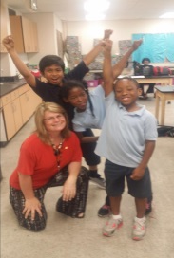
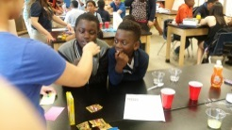
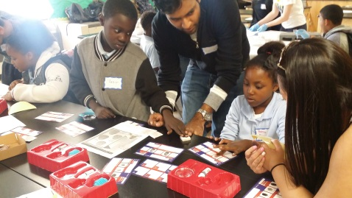
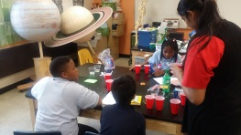
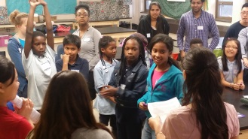
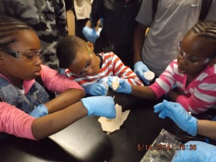
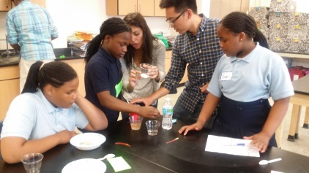
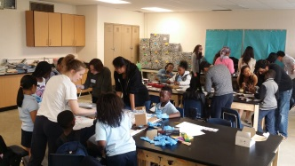
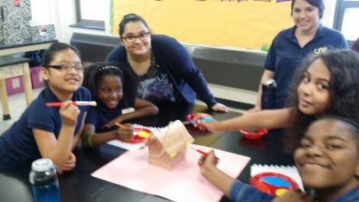
STEM Connections
“make Drexel the most civically
engaged university in the country”
Design classes for Drexel students to
work with outside partners: example
BIO 200 Connections in Biology – CBL course
Drexel student run after school science club
at Alain Locke Elementary
Connect to Society:
Drexel student reflective analysis:
“How does this scientific concept intersect with or impact society?”
“Why should a typical citizen care about Microbiology, etc.?”
What is the scientific concept being
investigated for the week?
Various concepts from Drexel courses:
“Aspects of Microbiology”
“Forensic Science”, etc.
Connect to Research / Industry:
Drexel student reflective analysis on specific careers,
graduate programs and research areas, and industries
involved with the scientific techniques or concepts demonstrated in science club each week
Science at Locke Elementary
Drexel students create lesson plans, order
supplies, plan and perform science club
activities at Locke Elementary
Connect to Drexel:
Drexel student reflect on techniques
and experience and relate them to
courses taken at Drexel
(reflective analysis)

Slide 5
Connections in Biology is an open enrollment course which will give students the opportunity to make exactly that: connections. Building upon a new theme in biology each week, student will connect that material to their current Philadelphia community as well as to their future professional and personal pursuits. The course is designed on the Community Based Learning platform (CBL) and is scheduled to meet twice a week: one meeting will be a formal lecture on campus and one meeting will be at a partnered middle school with the instructor and Drexel students leading an 9 week after school science club.

Slide 6
Course Objectives (What you can expect to get out of this course)
This course will help you gain civic engagement experiences that directly apply learning from Drexel STEM (Science, Technology, Engineering, and Math) courses and research labs.
This course will help you expand your cultural literacy through opportunities to work with children and staff from diverse backgrounds.
This course will help you gain leadership skills, refine your idea of the role of a scientist, and be prepared to address the broader impacts of your research interests and work.
This course will help you define yourself as a scientist, as a community member, as a Drexel student, as a team member, as a mentor and role model, and as an individual.

Slide 7
STEM Connections
“make Drexel the most civically
engaged university in the country”
Design classes for Drexel students to
work with outside partners: example
BIO 200 Connections in Biology – CBL course
Drexel student run after school science club
at Alain Locke Elementary
Connect to Society:
Drexel student reflective analysis:
“How does this scientific concept intersect with or impact society?”
“Why should a typical citizen care about Microbiology, etc.?”
What is the scientific concept being
investigated for the week?
Various concepts from Drexel courses:
“Aspects of Microbiology”
“Forensic Science”, etc.
Connect to Research / Industry:
Drexel student reflective analysis on specific careers,
graduate programs and research areas, and industries
involved with the scientific techniques or concepts demonstrated in science club each week
Science at Locke Elementary
Drexel students create lesson plans, order
supplies, plan and perform science club
activities at Locke Elementary
Connect to Drexel:
Drexel student reflect on techniques
and experience and relate them to
courses taken at Drexel
(reflective analysis)

Slide 8
STEM Connections
“make Drexel the most civically
engaged university in the country”
Design classes for Drexel students to
work with outside partners: example
BIO 200 Connections in Biology – CBL course
Drexel student run after school science club
at Alain Locke Elementary
Connect to Society:
Drexel student reflective analysis:
“How does this scientific concept intersect with or impact society?”
“Why should a typical citizen care about Microbiology, etc.?”
What is the scientific concept being
investigated for the week?
Various concepts from Drexel courses:
“Aspects of Microbiology”
“Forensic Science”, etc.
Connect to Research / Industry:
Drexel student reflective analysis on specific careers,
graduate programs and research areas, and industries
involved with the scientific techniques or concepts demonstrated in science club each week
Science at Locke Elementary
Drexel students create lesson plans, order
supplies, plan and perform science club
activities at Locke Elementary
Connect to Drexel:
Drexel student reflect on techniques
and experience and relate them to
courses taken at Drexel
(reflective analysis)

Slide 9
STEM Connections
“make Drexel the most civically
engaged university in the country”
Design classes for Drexel students to
work with outside partners: example
BIO 200 Connections in Biology – CBL course
Drexel student run after school science club
at Alain Locke Elementary
Connect to Society:
Drexel student reflective analysis:
“How does this scientific concept intersect with or impact society?”
“Why should a typical citizen care about Microbiology, etc.?”
What is the scientific concept being
investigated for the week?
Various concepts from Drexel courses:
“Aspects of Microbiology”
“Forensic Science”, etc.
Connect to Research / Industry:
Drexel student reflective analysis on specific careers,
graduate programs and research areas, and industries
involved with the scientific techniques or concepts demonstrated in science club each week
Science at Locke Elementary
Drexel students create lesson plans, order
supplies, plan and perform science club
activities at Locke Elementary
Connect to Drexel:
Drexel student reflect on techniques
and experience and relate them to
courses taken at Drexel
(reflective analysis)

Slide 10
STEM Connections
“make Drexel the most civically
engaged university in the country”
Design classes for Drexel students to
work with outside partners: example
BIO 200 Connections in Biology – CBL course
Drexel student run after school science club
at Alain Locke Elementary
Connect to Society:
Drexel student reflective analysis:
“How does this scientific concept intersect with or impact society?”
“Why should a typical citizen care about Microbiology, etc.?”
What is the scientific concept being
investigated for the week?
Various concepts from Drexel courses:
“Aspects of Microbiology”
“Forensic Science”, etc.
Connect to Research / Industry:
Drexel student reflective analysis on specific careers,
graduate programs and research areas, and industries
involved with the scientific techniques or concepts demonstrated in science club each week
Science at Locke Elementary
Drexel students create lesson plans, order
supplies, plan and perform science club
activities at Locke Elementary
Connect to Drexel:
Drexel student reflect on techniques
and experience and relate them to
courses taken at Drexel
(reflective analysis)

Slide 11
STEM Connections
“make Drexel the most civically
engaged university in the country”
Design classes for Drexel students to
work with outside partners: example
BIO 200 Connections in Biology – CBL course
Drexel student run after school science club
at Alain Locke Elementary
Connect to Society:
Drexel student reflective analysis:
“How does this scientific concept intersect with or impact society?”
“Why should a typical citizen care about Microbiology, etc.?”
What is the scientific concept being
investigated for the week?
Various concepts from Drexel courses:
“Aspects of Microbiology”
“Forensic Science”, etc.
Connect to Research / Industry:
Drexel student reflective analysis on specific careers,
graduate programs and research areas, and industries
involved with the scientific techniques or concepts demonstrated in science club each week
Science at Locke Elementary
Drexel students create lesson plans, order
supplies, plan and perform science club
activities at Locke Elementary
Connect to Drexel:
Drexel student reflect on techniques
and experience and relate them to
courses taken at Drexel
(reflective analysis)

Slide 12
Oh….what about assessment?
Participation at the Site: 25%. We will observe interactions at the club and talk with site staff, making sure you arrive prepared to lead your Science Club and uphold your commitment to the children at the school.
Class participation: 25% - We will track your attendance & contributions to class discussions, lesson planning and activities.
Journal assignments: 25% - Feedback will be given for your journal assignments. We are interested in your ability to connect your experiences in class with your Science Club, and reflect on your progress.
Final Posters: 25% - your culminating project of the semester

Slide 13
This course will help you define yourself as a scientist, as a community member, as a Drexel student, as a team member, as a mentor and role model, and as an individual.
My new response: make the STEM connection
“You tell me…and I want a poster on it”

Slide 14
Acknowledgements
Students, teachers and administration at Alain Locke Elementary
Drexel Students
Cyndi Rickards and Dean Murasko (CoAS)
Lindy Center for Civic Engagement
Laura Duwel and Biology Dept. faculty and staff
Goob Togna and his wonderful ideas

