Slide 1
Focus, Focus, Focus!
Using the “Laser Point” Process to Create Assessment Based Plans for Improvement
Presented by:
Janet McNellis, PhD, School of Education, Holy Family University
Claire Sullivan, EdD , School of Education, Holy Family University
Roseanna Wright, PhD , School of Education, Holy Family University
Drexel Assessment Conference. September 2015, Philadelphia, PA

Slide 2
The Problem
AKA
The “Opportunity”
State-mandated teacher certification tests are Assessment Instruments for our Teacher Certification program. We had set a benchmark goal of a 90% passing rate.
Our recent Education graduates obtained significantly less than a 90% passing rate on the tests.
A practical, innovative Plan for Improvement (PFI) needed to be quickly created and implemented.

Slide 3
The Challenges
Need for many individuals to work together to impact a problem as multifaceted as developing effective and innovative Assessment Based Plans for Improvement.
There are many barriers to developing effective PFIs including unsureness on how to proceed, focusing on factors that cannot be changed, and limited time.
The Assessment Committee planned a two-day summer work session. The University provided lunch and stipends for faculty.

Slide 4
The “Laser Point” Strategy
A collaborative method developed by a faculty member who had extensive experience using this general approach previously in a non-profit training setting.
Can be used by assessment facilitators to quickly and efficiently guide faculty through the formulation of practical, innovative, results-based PFIs.
Primary assumption : the laser point (the discussion) needs to remain focused on solutions

Slide 5
Benefits of the Laser Point Strategy
Helps provide structure to focus conversations on developing innovative solutions to problems.
Consists of a few well-defined, easy to accomplish steps.
A “bottom-up,” collaborative process which promotes faculty buy-in, participation and follow-through.
Time-efficient, non-threatening, inclusive

Slide 6
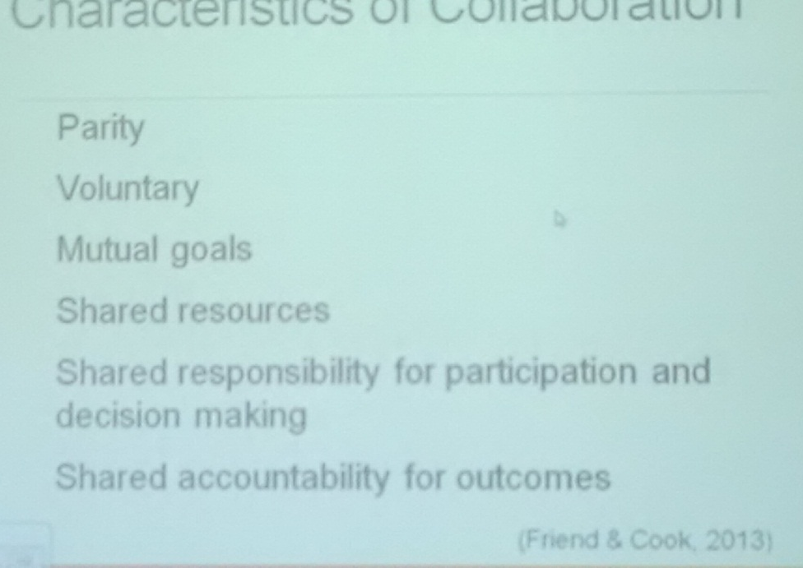
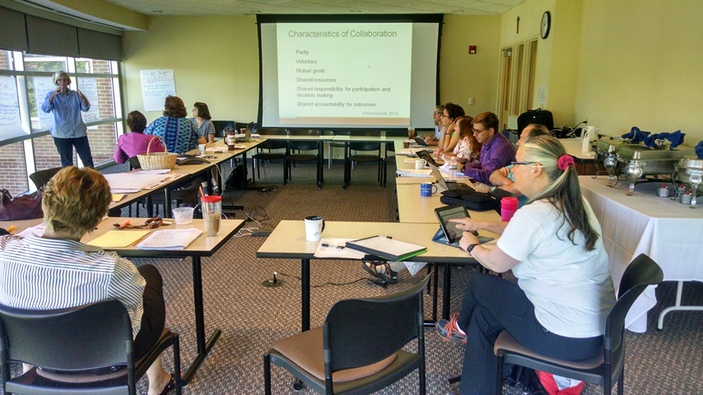
Step One
Establish Ground Rules for Collaborative Work
Faculty, Administrator, Professional Staff

Slide 7
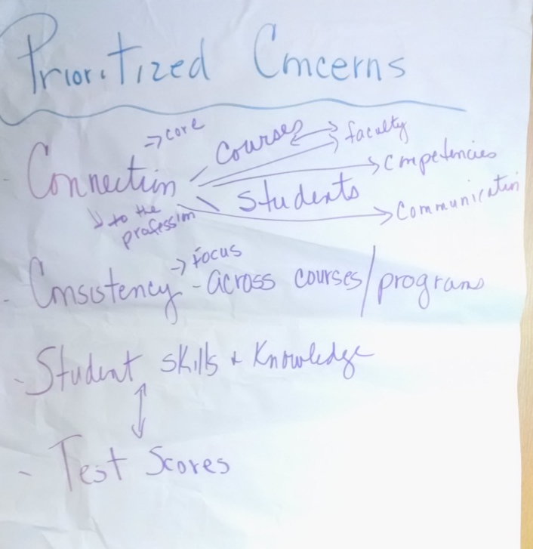
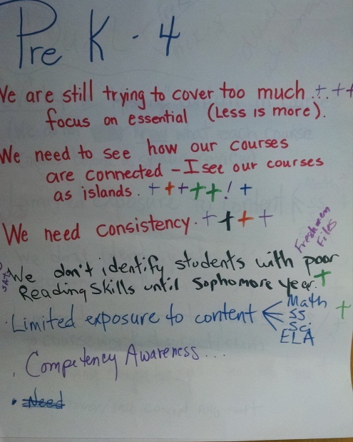
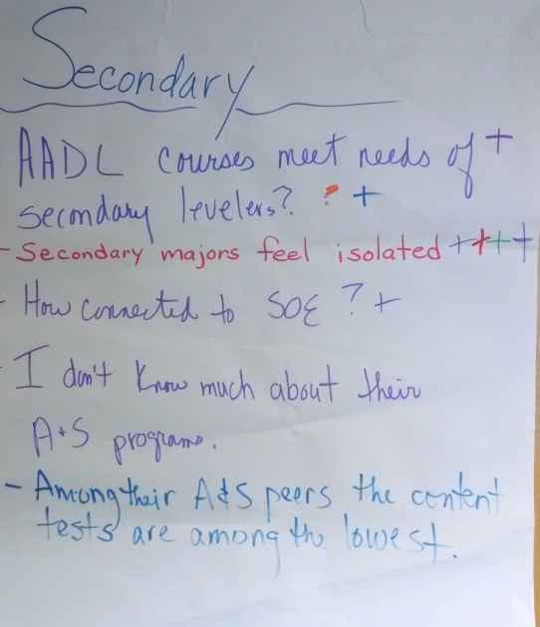
Step Two
Identify Concerns
Iterative process, culminate in prioritized list

Slide 8
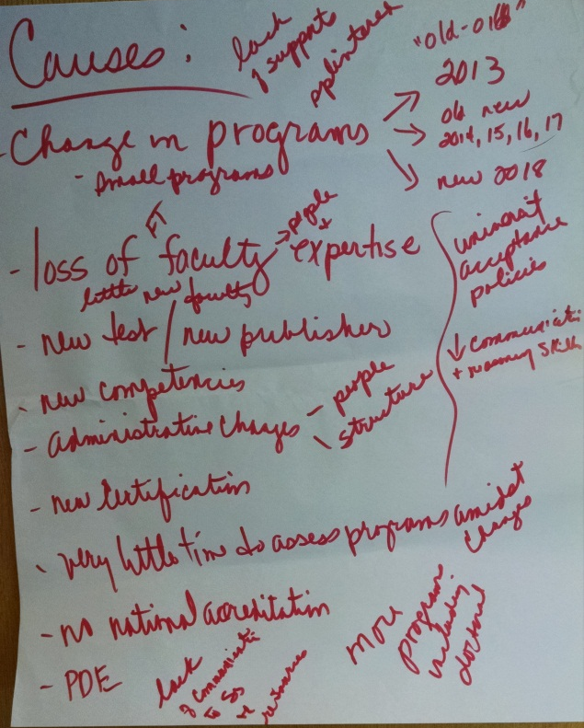
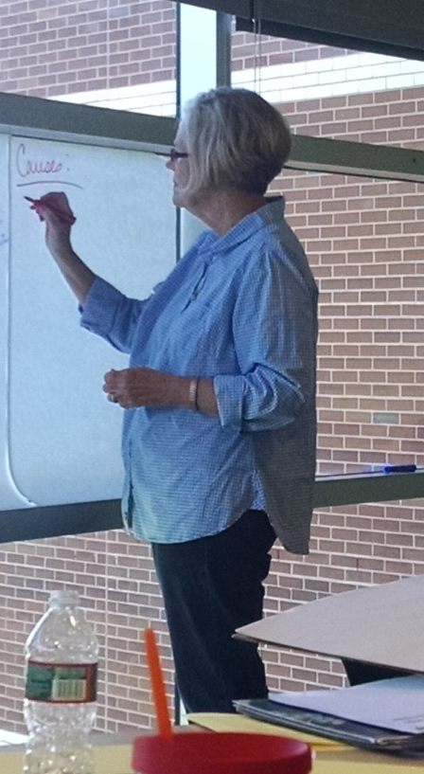
Step Three
Brainstorm Possible Causes
Simple listing, no evaluation or discussion

Slide 9
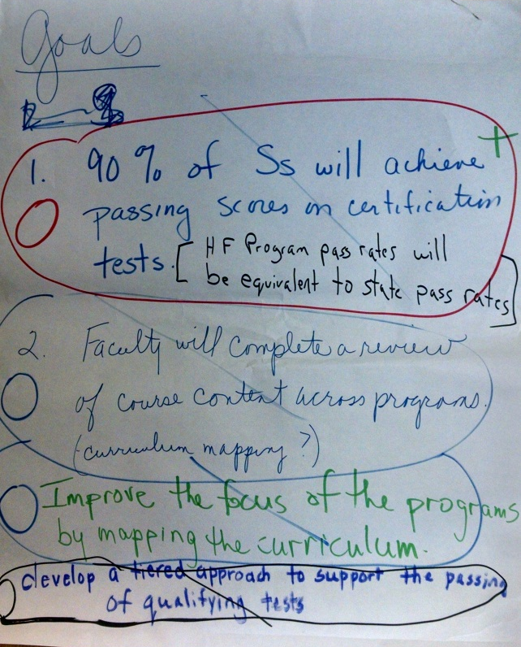
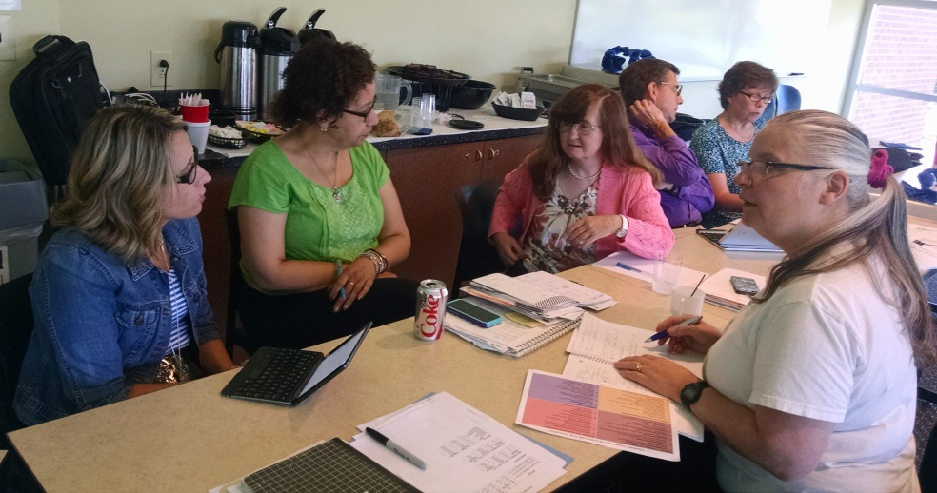
Step Four
Develop Goals
Iterative process, working in small groups and individually then review in large group

Slide 10
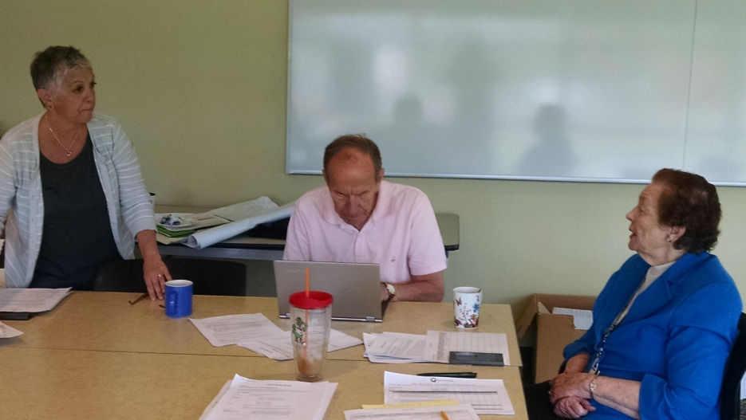
Step Five
Develop Action Plan for Each Goal
Working in small groups - one goal per group

Slide 11
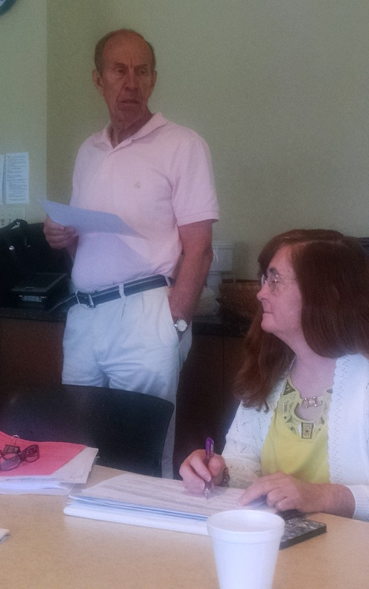
Step Six
Whole Group Evaluation
Obtain feedback, trouble-shoot, revise

Slide 12
Results of Two-day Worksession
Realistic, innovative Plan for Improvement created
Input and buy-in from important stakeholders
Working together on common goals helped team-building
Skilled facilitator is crucial to success

Slide 13
Summary of Steps
Establish Ground Rules for Collaborative Work
Identify Concerns
Brainstorm Possible Causes
Develop Goals
Develop Action Plan for Each Goal
Whole Group Evaluation
Laser point keeps focus on developing solutions

Slide 14
Lessons Learned
Participants had many similar/overlapping concerns and goals.
The process used really impacts the outcomes achieved
A collaborative process generates high quality outcomes with all participants committed to/invested in the solutions generated
Together we can make a difference!

