Slide 1
I Can See Clearly Now the Pain is Gone:
Identifying and Removing the Obstacles in Your Way
Drexel Assessment Conference
September, 2015
Dr. Bonnie Kirkpatrick
Senior Director of Faculty Development
1-877-967-5464 | wilmu.edu

Slide 2
When it comes to assessment, a common barrier experienced by many institutions is a lack of education/training of faculty in assessment practices. This snapshot session will help you to identify the barriers that exist within your institution and will provide you with a roadmap for developing a culture of assessment through strategic faculty development initiatives.
1-877-967-5464 | wilmu.edu

Slide 3
Obstacles
Complicated process
Many moving parts
Requires everyone to be on the same page
Not everyone will readily admit that they don’t understand assessment
1-877-967-5464 | wilmu.edu

Slide 4
Institutions taking action to improve their assessment practices:
A Self-Assessment and Planning Tool (Handout)
The Fundamentals of Assessment
Assessment at the Course Level
Assessment Methods
Measures, Rubrics, and Tools for Assessing Student Learning Outcomes
Gathering Evidence
Assessment at the Program/Department Level
Assessment at the Institutional Level
1-877-967-5464 | wilmu.edu

Slide 5
Institutions taking action to improve their assessment practices:
A Self-Assessment and Planning Tool
1-877-967-5464 | wilmu.edu

Slide 6
1-877-967-5464 | wilmu.edu

Slide 7
1-877-967-5464 | wilmu.edu

Slide 8
1-877-967-5464 | wilmu.edu

Slide 9
So….. Now What?
Identify the Gaps
Your gaps become your goals
Match your goals with the appropriate faculty development activities.
The Fundamentals of Assessment
Assessment at the Course Level
Assessment Methods
Measures, Rubrics, and Tools for Assessing Student Learning Outcomes
Gathering Evidence
Assessment at the Program/Department Level
Assessment at the Institutional Level
1-877-967-5464 | wilmu.edu

Slide 10
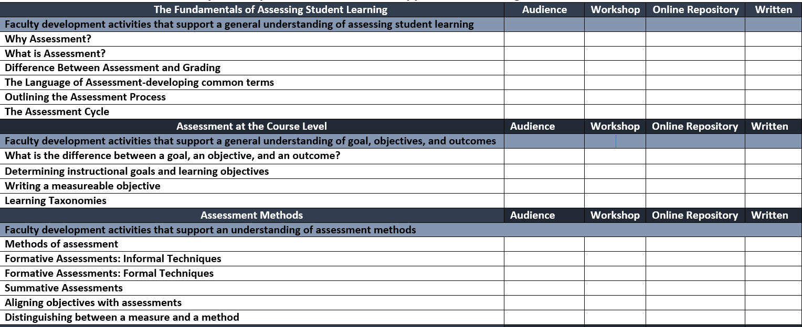
An Overview of Faculty Development Activities that Support Course, Program, and Institutional Assessment
1-877-967-5464 | wilmu.edu

Slide 11
1-877-967-5464 | wilmu.edu

Slide 12
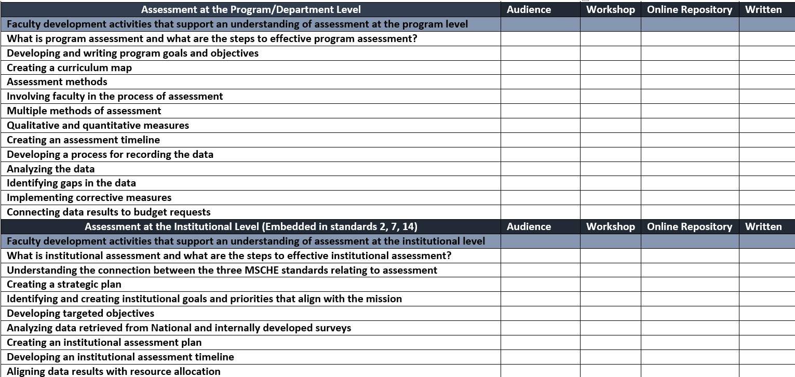
1-877-967-5464 | wilmu.edu

Slide 13
-Assess the needs of your institution -Start small -Maintain modest goals -Keep it manageable -Remind yourself that it is a process-and will continue to evolve over time -Plan your work and work your plan -Document your work -Exhaust your resources National Institute for Learning Outcomes Assessment
Where do you go from here?
1-877-967-5464 | wilmu.edu

Slide 14
What is the difference between an obstacle and an opportunity?
Our attitudes towards it. Every opportunity has a difficulty and every difficulty has an opportunity J. Sidlow Baxter
1-877-967-5464 | wilmu.edu

Slide 15
What are your opportunities?
1-877-967-5464 | wilmu.edu

