Slide 1
How Do You Like Me Now?
Using a Google Form to Get Students to Provide You with Formative Assessment
Krishna Dunston
Assistant Provost
University of the Arts
@ArtAssessAdvice
Krishna_dunston@yahoo.com

Slide 2
Harnessing CATs and CoLTs
Linking Classroom Assessment and Collaborative Learning Techniques The Inaugural Conference on Learning and Assessment Materials for a Brief Workshop on 10 September 2014 Tom Angelo
Professor of Higher Education
Assistant Provost and Founding Director Center for the Advancement of Faculty Excellence
Queens University of Charlotte (NC)
Teaching & Learning Pyramid

Slide 3
Script Analysis: About my Class
Play from the Cannon |  | Faculty Lecture |  | Discussion |  | Quiz or Paper |  | REPEAT!
Identify major themes, characters, plots
Demonstrate close reading skills needed for ‘table work’ in rehearsals
Organize ideas orally and in writing
Collaboratively develop ideas regarding major themes, plots, characters
Demonstrate respect for others ideas in discussion
Real world exercises?
Did they know these texts already?

Slide 4
Teaching and Learning Pyramid I HAD:
Independent
Cooperative
Faculty

Slide 5
Teaching and Learning Pyramid I Wanted:
Independent
Cooperative
Faculty

Slide 6
But would it Work?

Slide 7
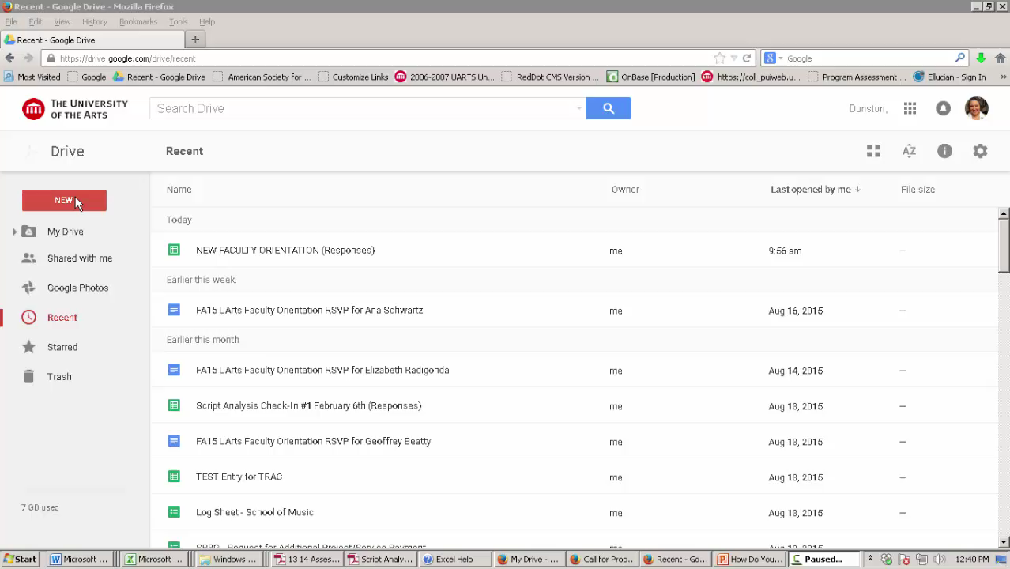
Google FOrM

Slide 8
What Did I want to know?
What was your familiarity with [Text] BEFORE this term?
Rate the in-class activity:
As an aid to your understanding of the text.
As an aid to improving your ability to analyze a script.
As relevant to you as a theater major and aspiring professional.

Slide 9
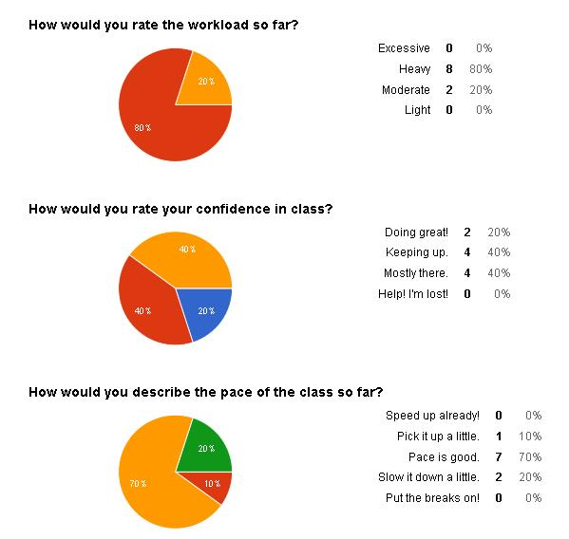

Slide 10
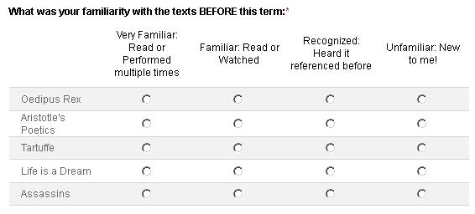
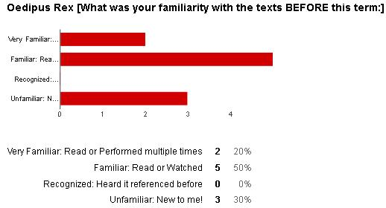
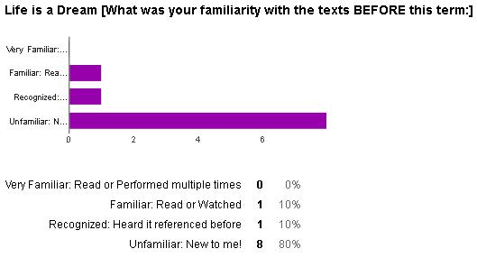
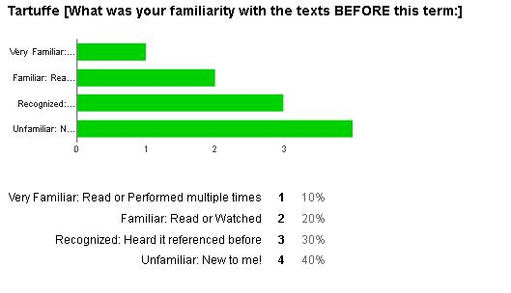
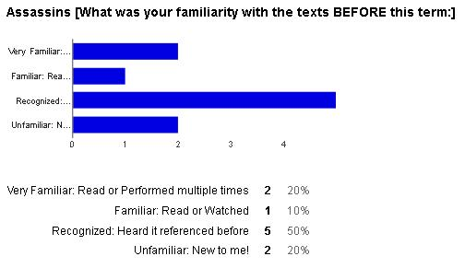
Grid Type
on Google

Slide 11
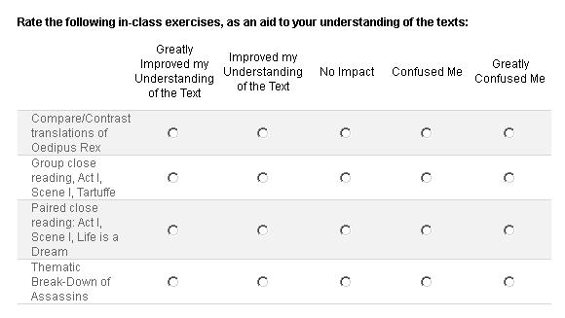

Slide 12
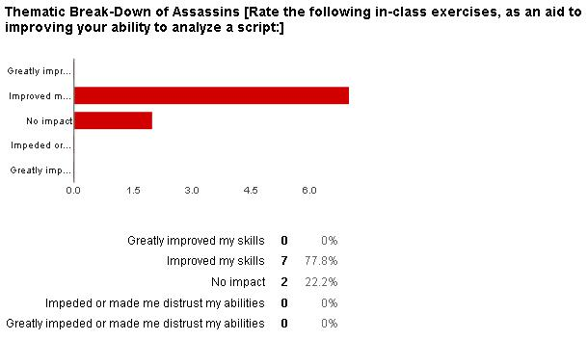
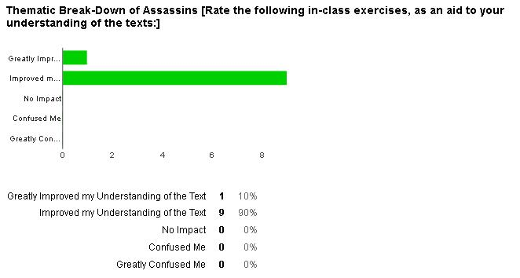
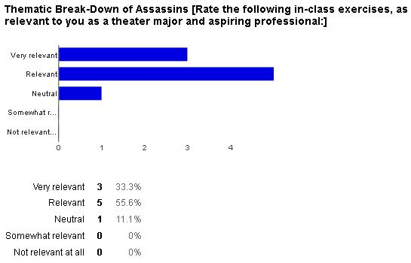

Slide 13
What did I learn?
Timing matters…
Play from the Cannon |  | In-Class Active Learning Activity |  | Discussion |  | REPEAT!
Assessments:
Mid-Term / Final
Unit Tests with Student Check-In

Slide 14
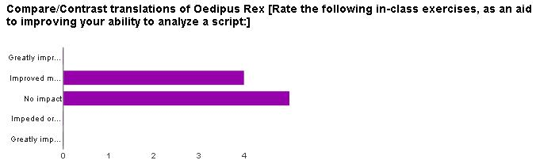
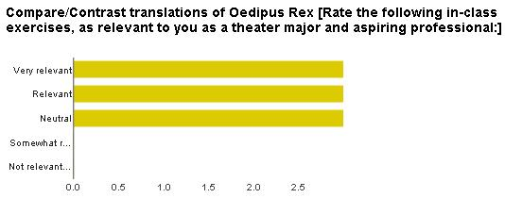
What did I learn?
Peel back the onion…

Slide 15
What Did I Learn?
Informed Teaching-Learning Action Plan
Unfamiliar
Activity to impact understanding of text
Mixed
Activity to impact analysis skills
Familiar
Real-world relevance

