Slide 1
An Efficient and Collaborative Model for Collecting, Processing and Reporting Student Learning Outcome Data
Bina Daniel
Director of Assessment
Assessment Office
302-857-7403, bdaniel@desu.edu
Notes:
My name is Bina Daniel. I am the director of assessment at Delaware State University. Today’s I would like to tell you about an innovative tool we developed to help us with assessment data collection and reporting.

Slide 2
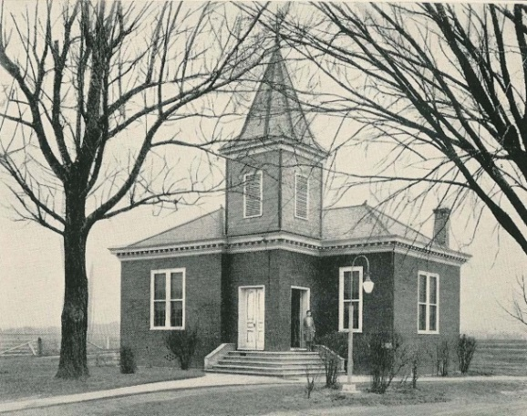
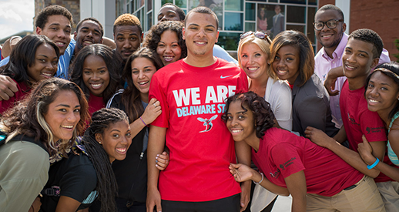
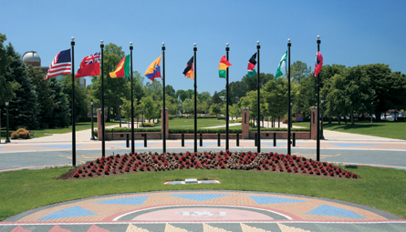
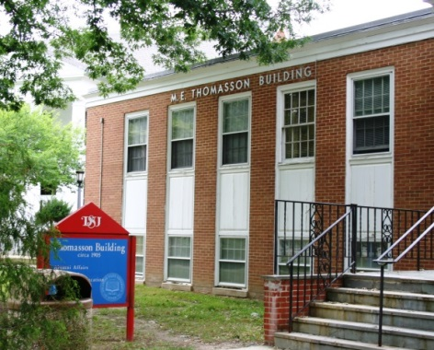
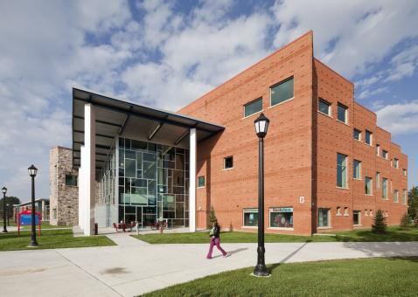
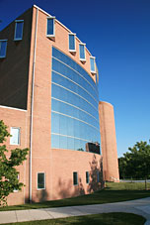
Notes:
Public, comprehensive 1891 land-grant Historically Black College & University (HBCU)
4644 Students: 90% full-time & 55% live on campus, 51% in-state, 49% Out-of-state
Carnegie Classification: Master's - Medium Programs (52 Undergrad, 25 Masters, 5 Doctoral programs)

Slide 3
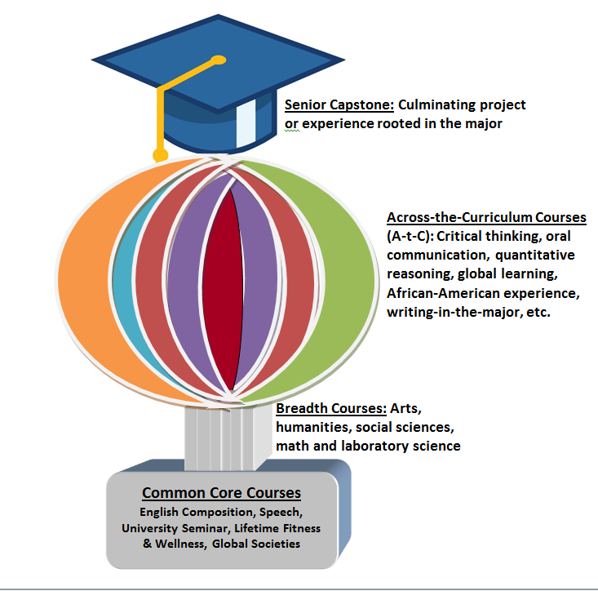
General Education Program
Notes:
There are four components to this program:
Core Courses: University Seminar I & II, English Composition I & II, Lifetime Fitness & Wellness, Speech, Global Societies
Breadth Areas: broad goals of the liberal arts including the arts, humanities, social sciences and math and science. These Courses provide breadth and well-roundedness of a liberal arts education in arts, humanities, social sciences, mathematics and natural science with laboratory
Senior Capstone Experience: senior year project or other experience rooted in the major
Across-the-Curriculum Learning Outcomes: learning outcomes student must demonstrate through varied assessments; each department identifies courses that support the achievement of these outcomes (critical thinking, oral communication, quantitative reasoning, global learning, wellness, etc..)
All students must take Core courses, primarily in their first 2 years, with the exception of Global Studies which was designed as a junior year program.
Breadth areas seek to expose students, regardless of their major course of study, to the broad goals of the liberal arts including the arts, humanities, social sciences and math and science. Apart from the Core courses each program can identify courses which they think their major really need but there is also room for open electives.
Senior Capstone: each senior must complete a capstone project that is rooted in their major and thus comes in a variety of forms: a research project, presentation or performance, a portfolio, etc…
Lastly we identified learning outcomes that we want students to achieve throughout their learning experiences but we needed a way to determine their levels of success.
As we all know there’s a difference between grading and assessment so we needed to develop a system that could be utilized by all academic programs and faculty to let us discover our students success in meeting these learning goals.

Slide 4
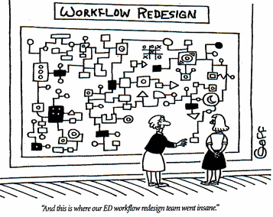
Old Process (Problems: time consuming, complicated data flow, difficulty in generating reports, only 1 course assessed)
1. Request list of capstone courses for each term
2. Request rosters for each capstone
8. Analyst compiles data, creates pivot tables of university data; identifies missing data
3. Created Excel spreadsheet for each class roster and rubric
5. Instructors insert data on capstone assessment; email to GEP Director & Chair
4. Email spreadsheet to capstone instructor
7. GEP Director forwards instructor emails to Technical Analyst
6. Departments expected to review data & implement action plans if needed
9. Data shared at workshops & faculty institutes; Departments analyze their own data
“And this is where our work flow redesign team went insane...”
Notes:
This slide shows the previous process we used but it had some problems.
1 & 2. AO Request capstone courses for each term and request rosters
3. AO then had to create spreadsheet with information which was then sent to the instructor.
5. Instructors expected to insert data the end of the semester and email back to AO as well as Chair
6. At that point the departments, theoretically, could review their data and make changes as needed.
To get it into a larger system the AO sent the data to a technical analyst who would create a report for the University overall.
That data could then be shared with entire university at workshops, institutes, etc.
Problems:
Time-consuming to create Excel spreadsheets for each instructor and capstone course section.
There was a high margin of error for missing data because data transferred through too many channels.
Many chairpersons and faculty did not take the extra step to analyze data.
Proposed Solutions:
Centralized assessment data collection and reporting system that directly communicates with Banner EMS, while facilitating data input and review.
Expansion of system to other general education rubrics.
Streamlined process that would allow smoother communication between GEP Director, Technical Analyst, chairpersons, deans, and instructors.
Assistance from Information Technology Division (IT) for creating and supporting the Assessment Office (AO) as it maintains a custom application with the above capabilities

Slide 5
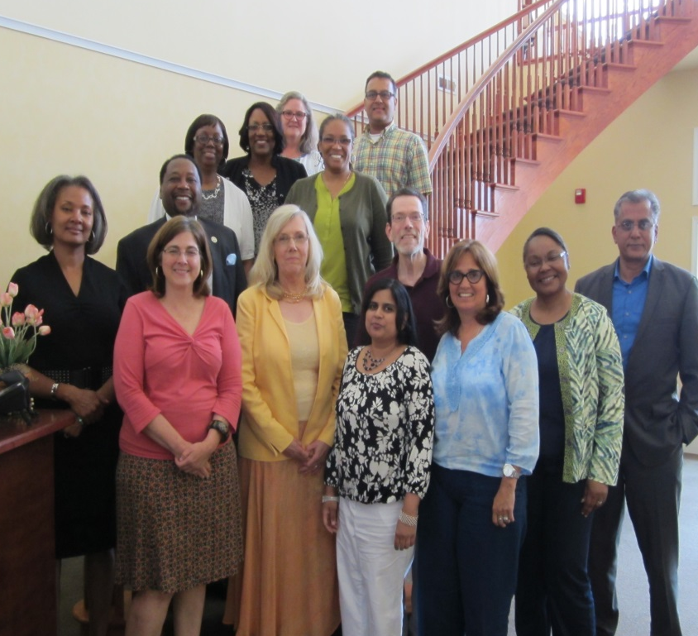
Collaboration
Notes:
Assessment Office – submitted IT project request and oversaw all aspects of design/testing, data collection, etc.
Information Technology Developers – used programming and Banner to develop ADCS
General Education faculty – created or modified rubrics for A-t-C outcomes (AAC&U value rubrics)
Chairs/Assessment coordinators – communication
Faculty – rated students

Slide 6
Efficient Process: Assessment Data Collection System (ADCS)
Notes:
Custom web-application tool that is linked to Banner, so courses can be “designated” using an online form in ADCS.
Different levels of access (faculty, Chair, Dean, Administrator)
ADCS custom email form can be used by Assessment Office (AO) to remind instructors to complete general education assessments each term.
Instructors can share rubrics with students and submit assessment data in ADCS using the data entry form for each course.
Reporting feature for faculty, chairs, deans, assessment staff

Slide 7
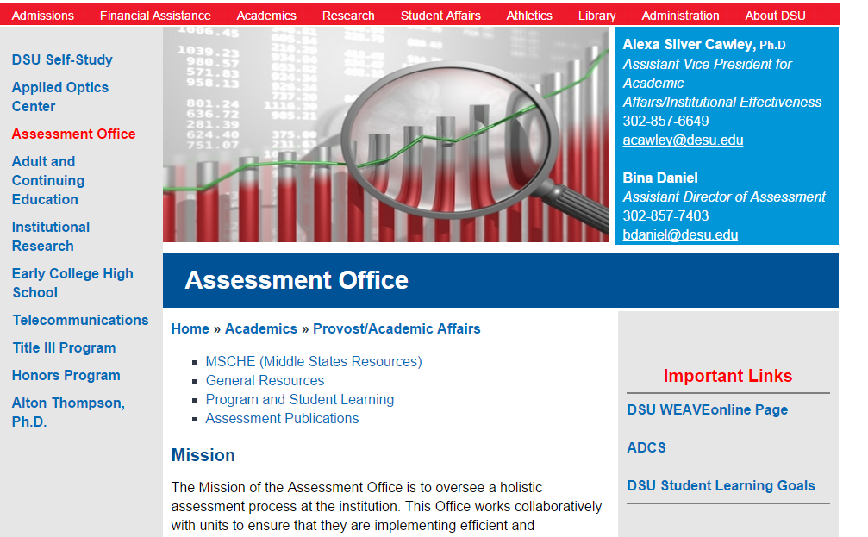
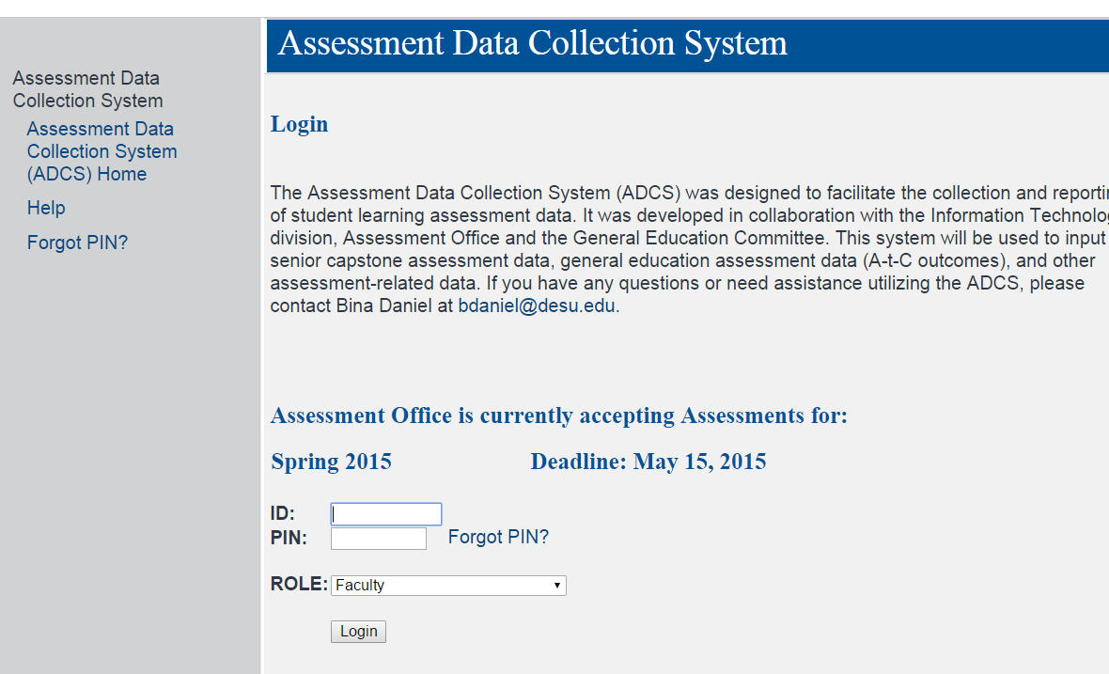

Slide 8
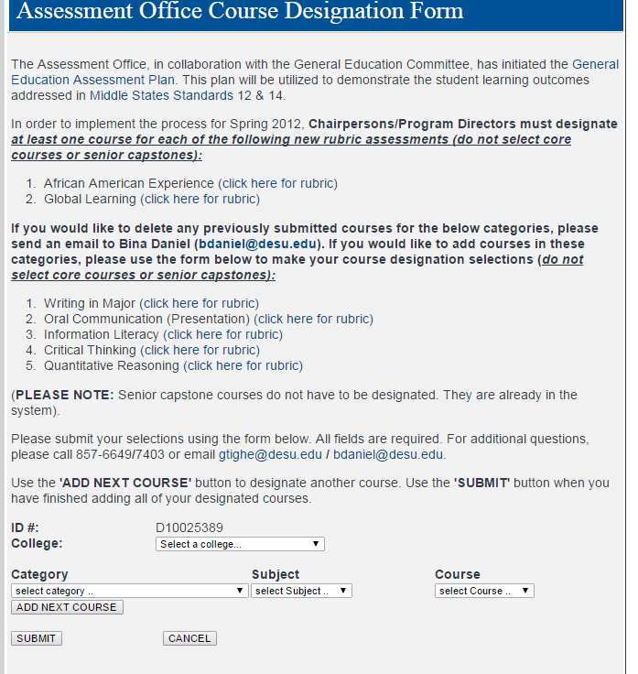
Chairs use Course designation form

Slide 9
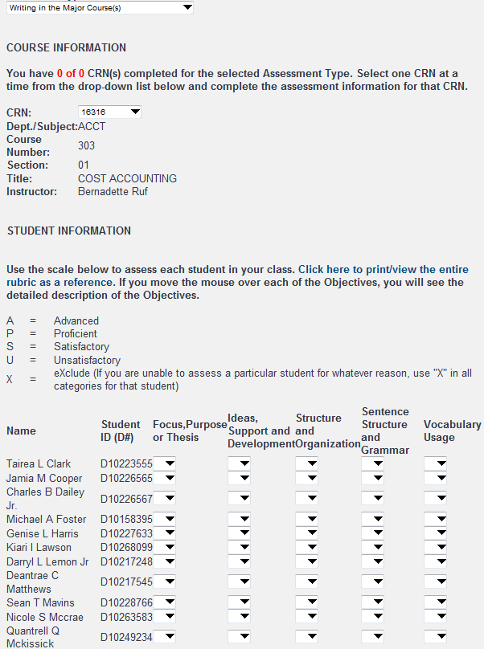
Faculty Login

Slide 10
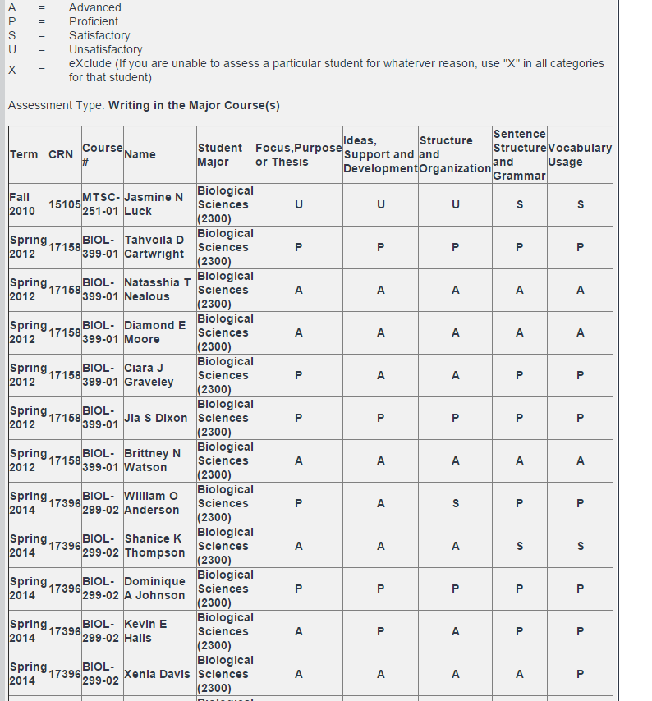
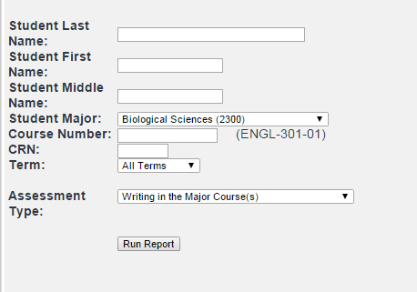
Reports (Data entry – Ad-hoc)
Instructor names do not appear on any reports with assessment data

Slide 11
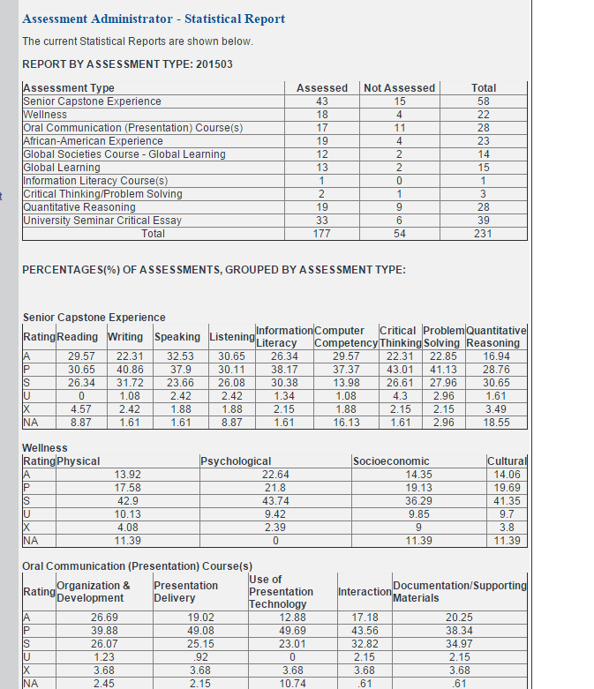
Stat Report
Raw counts of course sections that have data submitted
Percentage Report
Top – contains raw counts of A-t-C assessments submitted/not submitted
Bottom – Percentage reports
Percentage of students rated A, P, S, U, N/A for each category on the different rubrics

Slide 12
Admin features
Manage users & courses
List of instructors with outstanding A-t-C outcomes assessments and instructors who submitted data: Excel CSV file

Slide 13
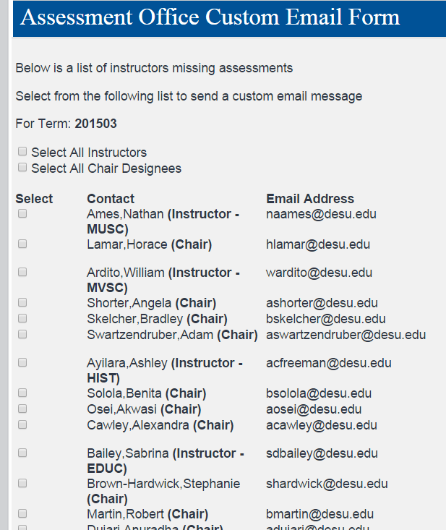
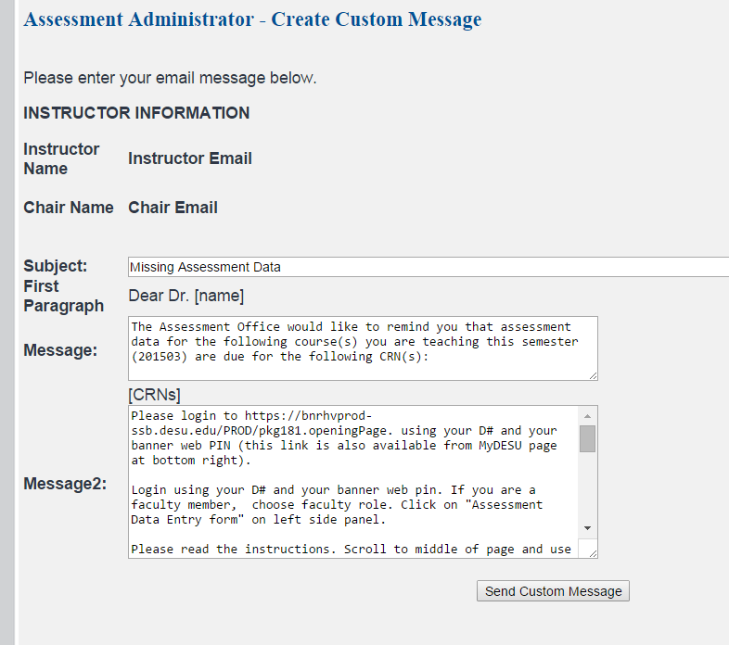
Custom Email form similar to Mail Merge
Instructor name, email pulled from Banner
Chair name, Email pulled from Banner
This allows the option to CC chairs emails that are generated to faculty

Slide 14
Adding additional A-t-C outcomes rubrics

Slide 15
How ADCS data have been used
Institutional level: Program level:
General Education
Program review:
Notes:
Institutional level: Faculty feedback led to modification to capstone rubric from . 3 ratings (Target, Acceptable, Unacceptable) to 4 ratings (Advanced, Proficient, Satisfactory, Unsatisfactory).
Program level: Sociology & Criminal Justice Department assessment data indicated a need for improvement of students’ writing skills (based on capstone and writing data). Instructors increased writing opportunities in three critical courses in the program and also implemented a new Writing in the Major course.
General Education Program review: PR process revealed need for longitudinal & cross-sectional analysis of students over time. Enhanced reporting and faculty training are needed.

Slide 16
Homegrown ADCS
Advantages
Cost-effective
Increased collaboration
Custom-tailored to allow expansion/new features
Integration with other Univ. systems
Disadvantages
Remote IT Developers
Troubleshooting glitches
Time-consuming for Assessment Office to serve as Help Desk
Reports are still not utilized by all departments

