Slide 1

Using the Right Tools: Rejuvenating Campus-Wide Assessment
Drexel Assessment Conference / Philadelphia
9 September 2015
David Garrison
Provost
dgarrison@lagrange.edu
Carol Yin
Director of Institutional Effectiveness
cyin@lagrange.edu

Slide 2
From Involvement to Consequences
“Often it is a question not of providing evidence that assessment is occurring, but rather of demonstrating in real, tangible ways that the assessments are actually being used to inform planning, decision making, and resource allocation at the institution.”
- Michael Middaugh, Planning and Assessment in Higher Education: Demonstrating Institutional Effectiveness.

Slide 3
About LaGrange College
*
Founded in 1831 (as a female academy)
Private college with liberal arts ethos
Affiliated with the United Methodist Church
Currently 1,036 students, 919 undergraduates
Highest Degree – Ed.S.
71 full-time faculty
16 varsity sports teams

Slide 4
The Question
*
How do you assess the effectiveness of everything that’s going on, do it in such a way that internal constituencies trust that assessment and learn from it, and do it in such a way that external constituencies find that assessment compelling and authentic?

Slide 5
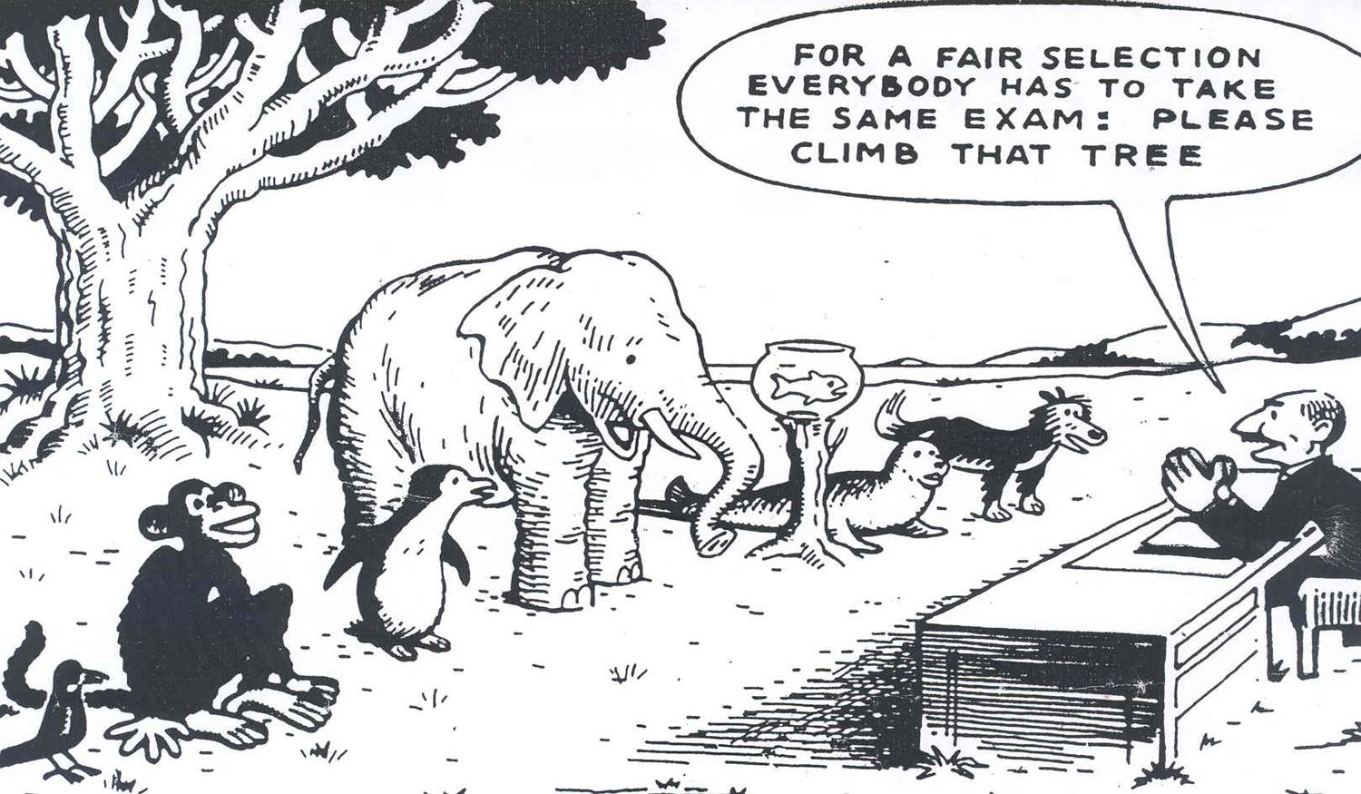
“One Law for the Lion & Ox is Oppression.”*
* William Blake, The Marriage of Heaven and Hell

Slide 6
The Answer
Particular tools that bring together people, processes, and structures make the work of improving institutional effectiveness more rewarding and – for external reviewers – more evident.

Slide 7
What to Expect from Us Today
*
Useful and tested examples to improve structures and practices related to institutional effectiveness
Methods for gathering and sharing compelling information

Slide 8
Tools You Can Expect to Learn about Today
*
Assessment handbook
Functional assessment template
Workable annual calendar
Workflow and information-sharing plans

Slide 9
ACCREDITATION AGENCIES

Slide 10
Higher Learning Commission
The institution works systematically to improve its performance.
The institution develops and documents evidence of performance in its operations.
The institution learns from its operational experience and applies that learning to improve its institutional effectiveness, capabilities, and sustainability, overall and in its component parts.

Slide 11
Middle States Commission
Institutional planning integrates goals for academic and institutional effectiveness and improvement, student achievement of educational goals, student learning, and the results of academic and institutional assessments.

Slide 12
New England Association
The institution undertakes planning and evaluation to accomplish and improve the achievement of its mission and purposes. It identifies its planning and evaluation priorities and pursues them effectively.

Slide 13
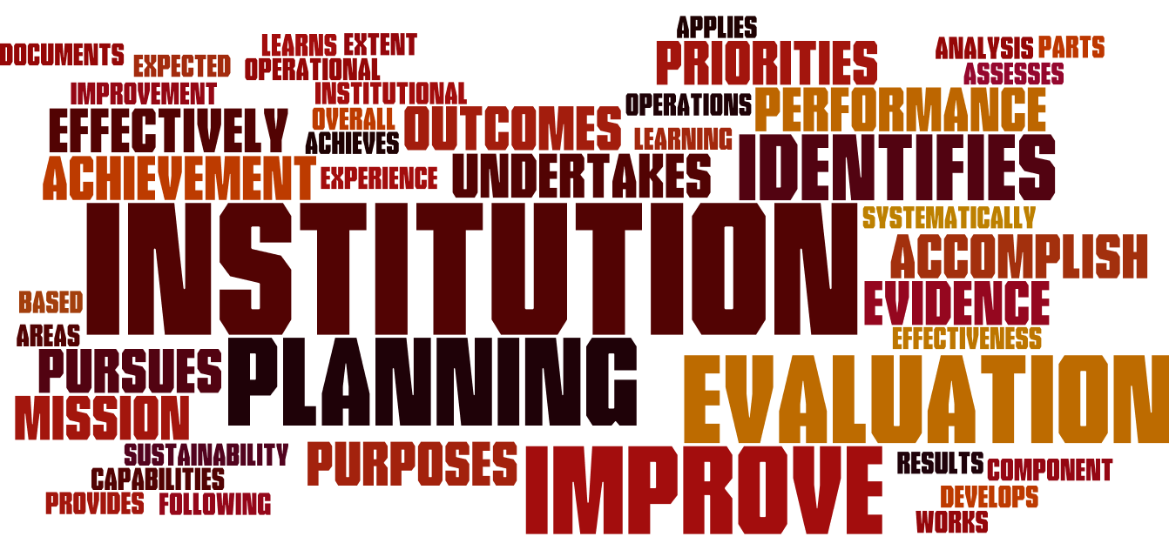

Slide 14
SACSCOC

Slide 15
Comprehensive Standard Regarding IE (3.3.1. . . .)
*
“The institution identifies expected outcomes, assesses the extent to which it achieves these outcomes, and provides evidence of improvement based on analysis of the results in each of the following areas : . . .”

Slide 16

3.3.1.1
*
educational programs, to include student learning outcomes . . .
In Freshmen Cornerstone class, first-time, first-year students focus on outcomes related to creative, critical and communicative abilities.

Slide 17
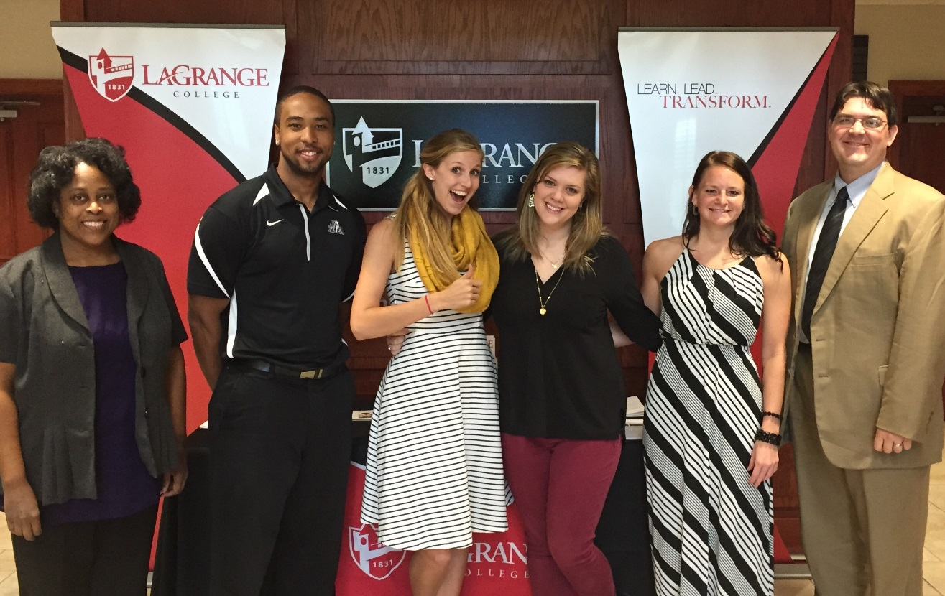
3.3.1.2
*
administrative support services . . .
The Admission Office focuses on outcomes related to enrollment and marketing efforts.

Slide 18
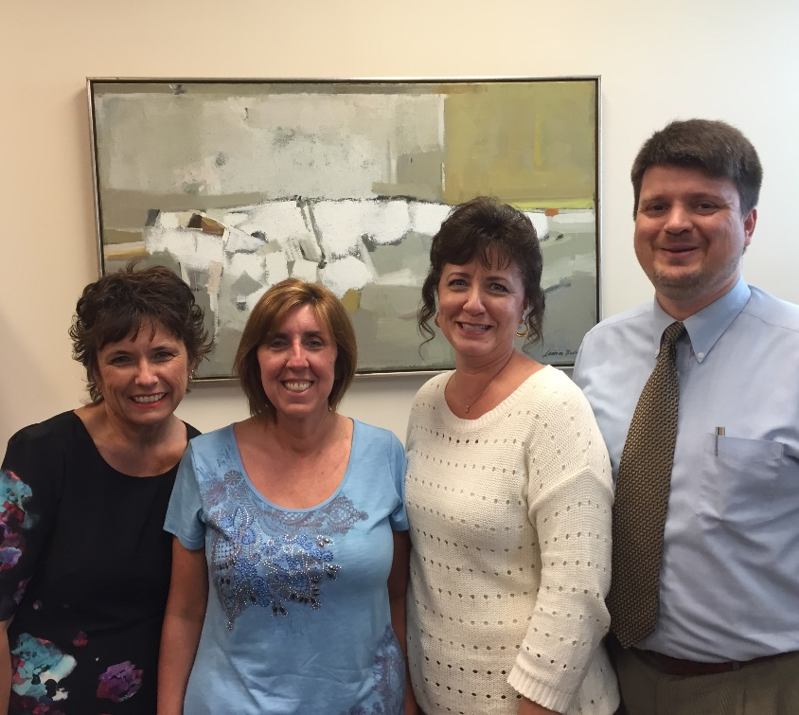
3.3.1.3
*
academic support services . . .
The Office of the Registrar focuses on outcomes related to maintaining academic records, enforcing academic policies, and excellent consumer satisfaction.

Slide 19
SACSCOC IE Non-Compliance Data (2013)
Standard Under Review | Non-Compliant In the Off-Site Review | Non-Compliant In the On-Site Review
3.3.1.1 (Educational Programs)
3.3.1.2 (Administrative Support)
3.3.1.3 (Educational Support)
64%
36%
52%
24%
53%
24%

Slide 20
What We Learned from the Reaffirmation Process
*
Old annual report template overwrought and disconnected
Inappropriate assessment measures in some programs (i.e., course grades)
Insufficient analysis of results (and sometimes absence of results)
Overt connection lacking between annual report assessment and strategic plan, and between assessment and budget decisions

Slide 21
Be Prepared!
*
Have something – an assessment manual, an annual plan, etc. – in place so that three annual assessment cycles can occur, i.e., three years of reporting, analyzing, fixing, etc.
OR
Be prepared to scramble.

Slide 22
Organized Anarchies
“. . . most academic institutions are ‘organized anarchies,’ in which faculty ‘wander in and out of the decision-making process depending on circumstance and inclination.’”
    - Richard L. Morrill, Strategic Leadership (2007), quoted in Andrew Delbanco’s College: What It Was, Is, and Should Be (2012).

Slide 23
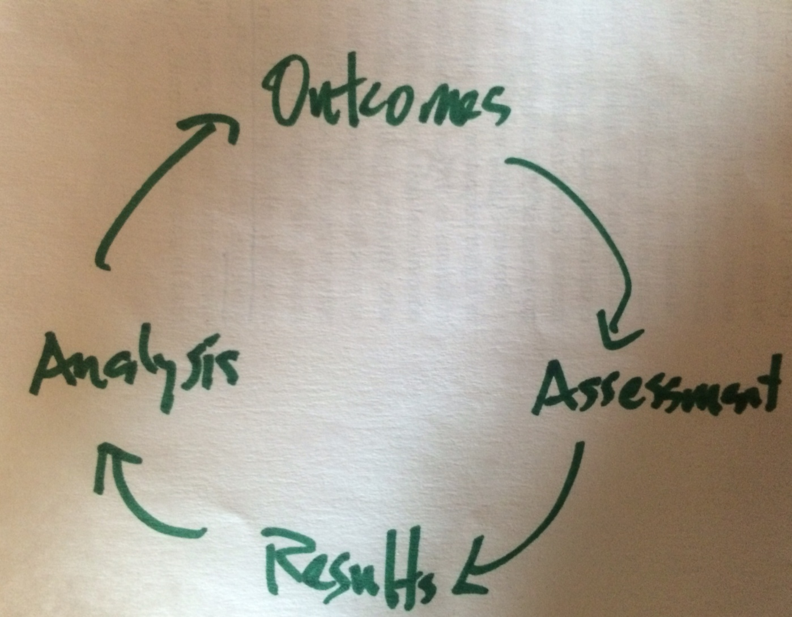
Bogus Map

Slide 24
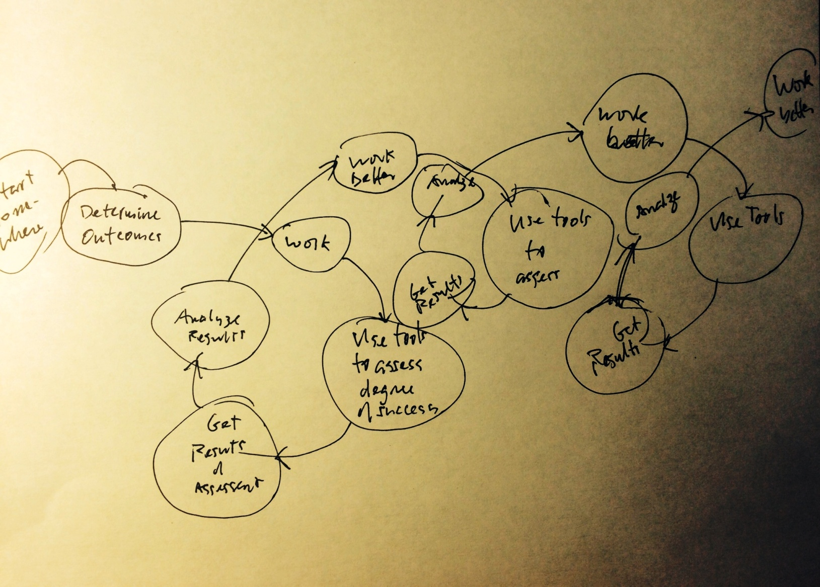

Slide 25
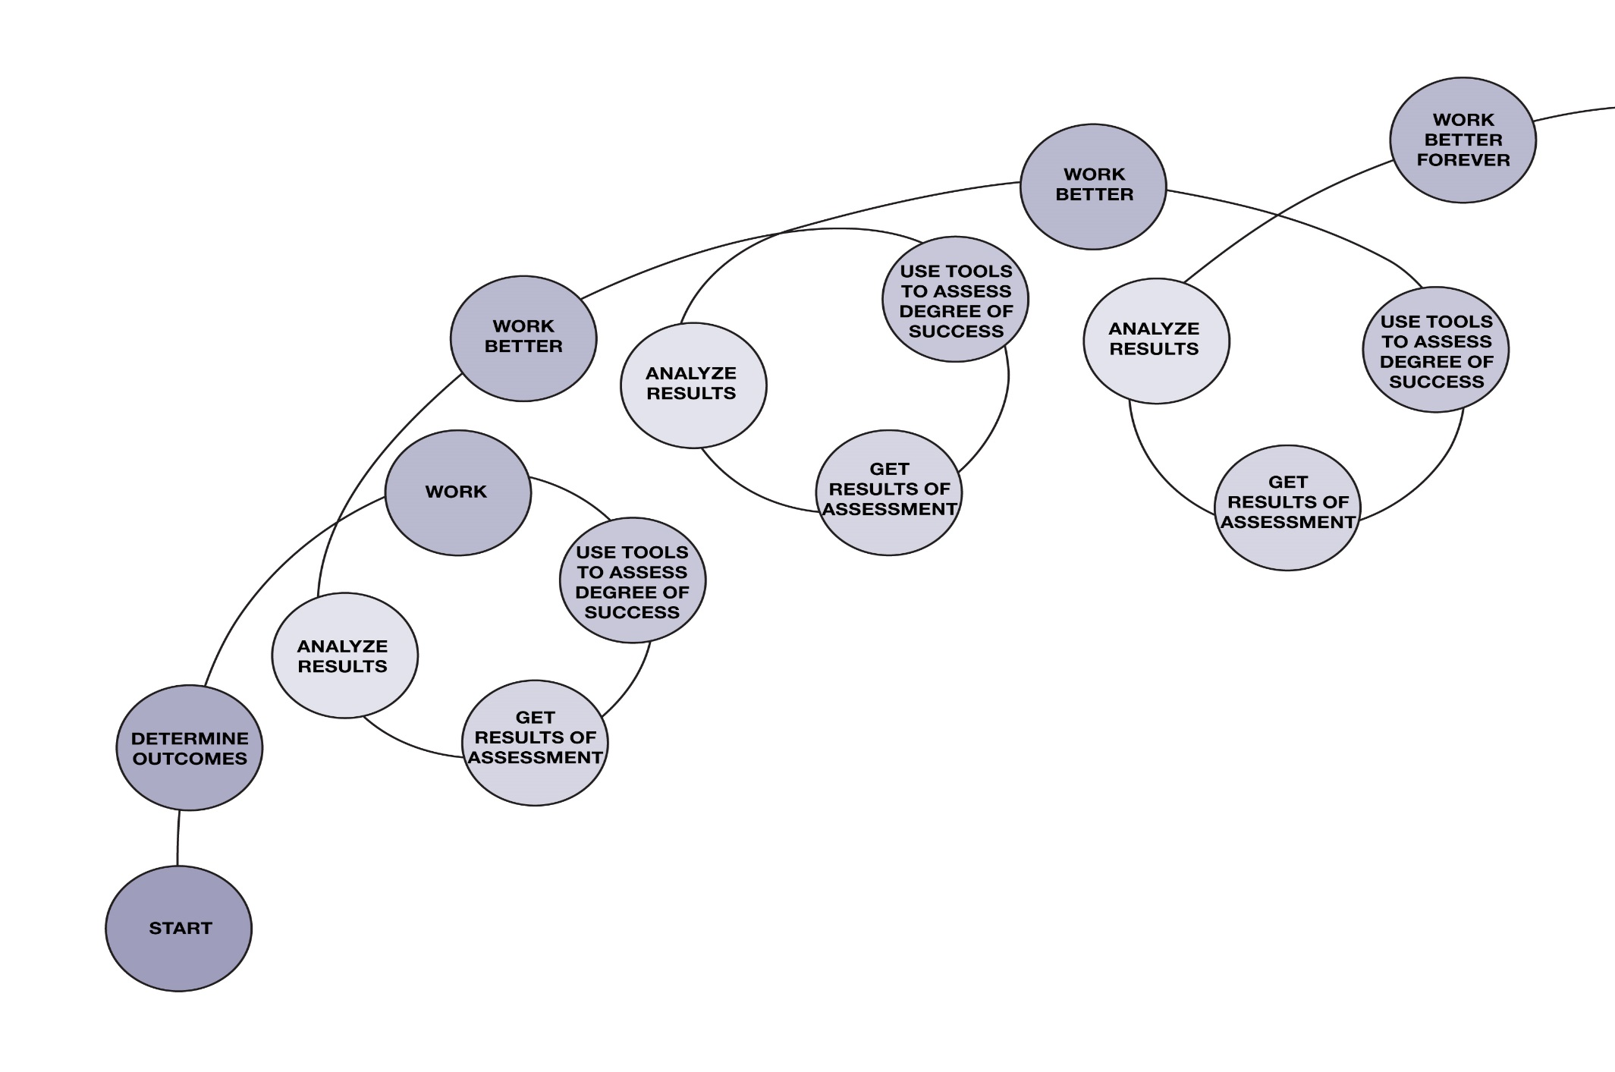
Learning How to Work Better
The process of improving is a moving bicycle wheel, not a circle.

Slide 26
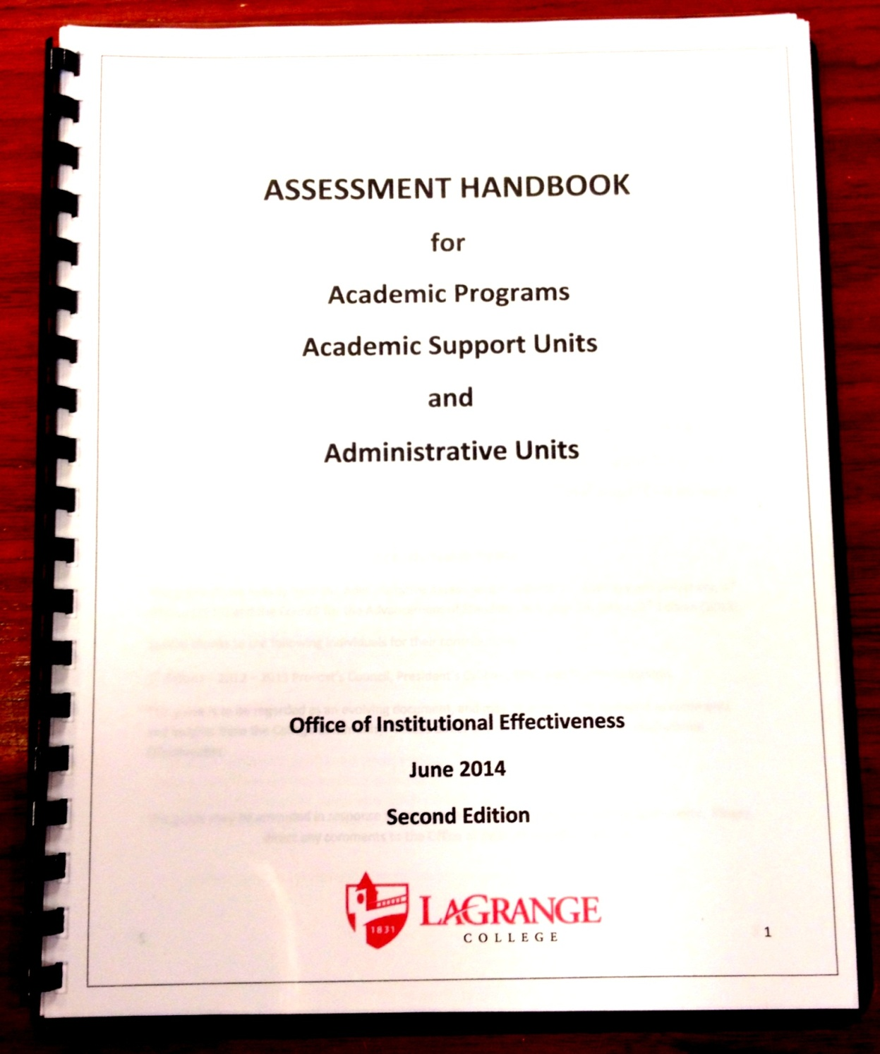

Slide 27
*
ASSESSMENT HANDBOOK
for
Academic Programs
Academic Support Units
and
Administrative Units
Thanks to Southwestern University in Georgetown, TX!

Slide 28
*

Slide 29
High Points of the Annual Report
*
Executive Summary of findings – highlight one goal you have worked deliberately to improve over the past year (emphasize assessment tools, resources needed, etc.).
Progress report on goals from past year (templates provided for program/unit and student learning outcomes)
Progress report on faculty/staff scholarship
Progress report on recent graduates
Rubric to measure the effectiveness of annual report
Program goals for next year (template)

Slide 31
Guidelines for Each Section of Template Given in Assessment Manual
*
Information
And
Examples
can be found on page 14.

Slide 33
*

Slide 34
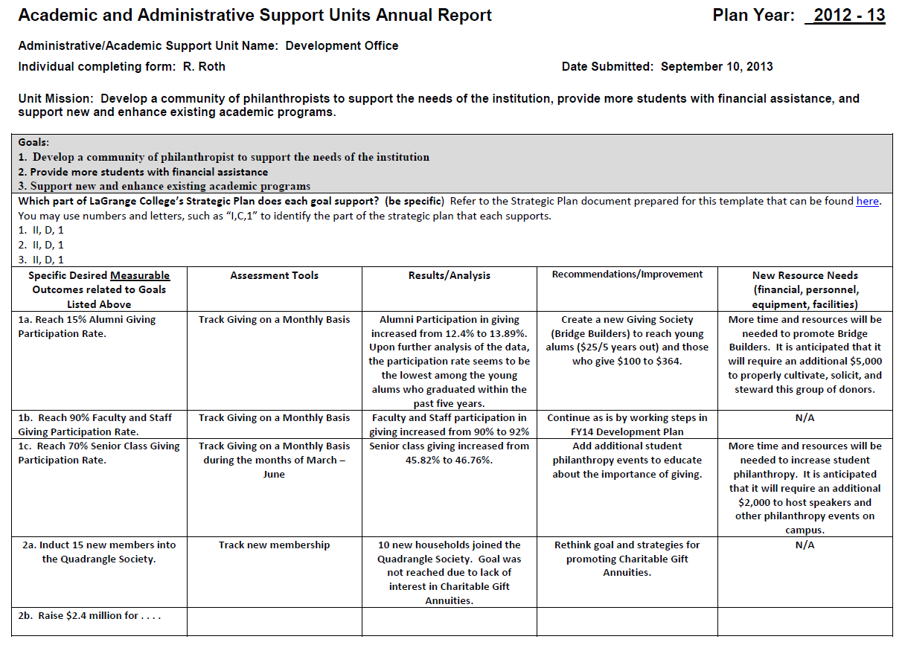

Slide 36
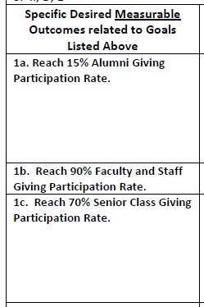

Slide 38
Examples of Assessment Tools are Given in the Assessment Manual
Examples:
  Simple tracking tools (attendance, percent giving, response time, etc.)
  Satisfaction surveys
  Professional Standards used for comparison
  Many other ideas on page 16 of the handbook

Slide 41
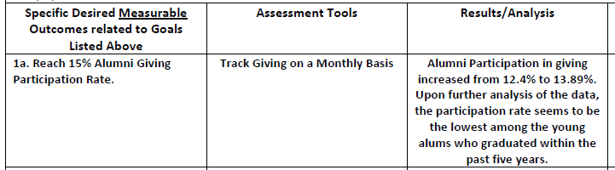

Slide 42
Whether you meet the goal or not, try to
analyze the data to see if
there is something that can be learned.

Slide 43

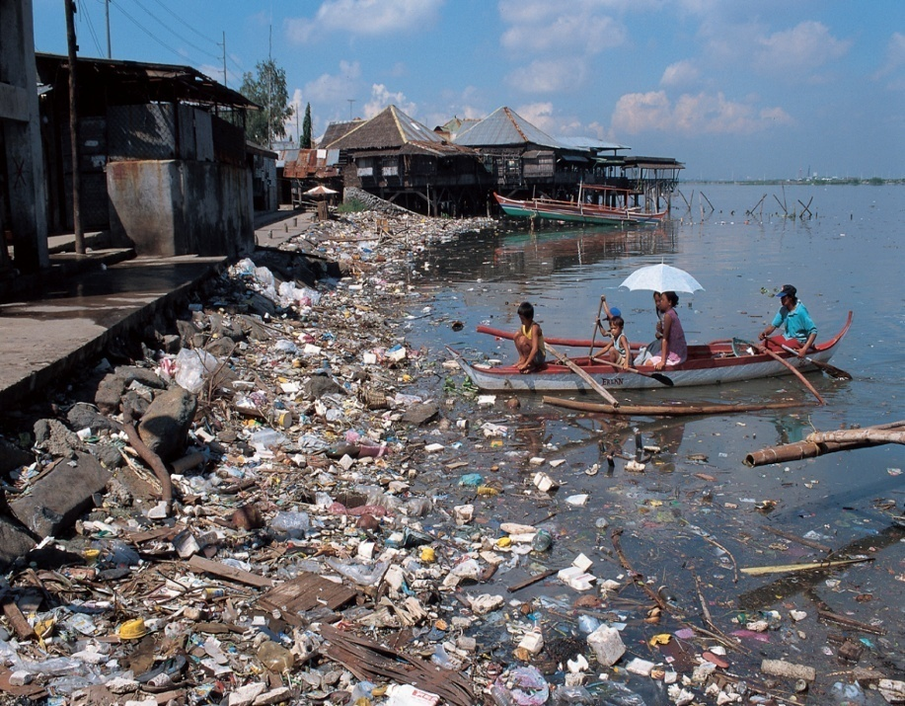
Dig deep on analysis.
*

Slide 44
We look great! Our goal was that every graduate would pass the test with an overall average of 80% or higher.
Student | Overall Average
I. Newton | 80%
G. Leibniz | 80%
G. L’Hopital | 80%

Slide 45
We look great! Our goal was that every graduate would pass the test with an overall average of 80% or higher.
Student | Algebra | Calculus | Discrete Math | Overall Average
I. Newton | 100 | 65 | 75 | 80%
G. Leibniz | 90 | 60 | 90 | 80%
G. L’Hopital | 95 | 50 | 95 | 80%

Slide 46
Note that more than just the facts have been presented, showing that a further analysis has been conducted to determine why the goal was not reached.
In addition, even if a goal has been reached, further analysis should be conducted.

Slide 47
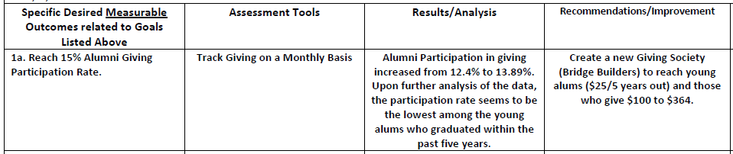
Based on what you learn here,
what will you do?

Slide 48
Note that more than just the facts have been presented, showing that a further analysis has been conducted to determine why the goal was not reached.
In addition, even if a goal has been reached, further analysis should be conducted.

Slide 49
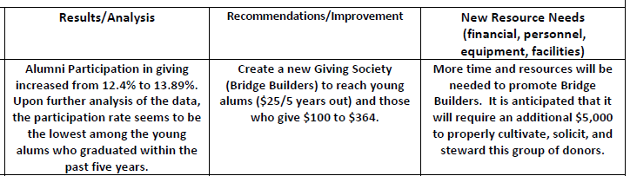
Based on what you
recommended here . . .
What type of resources are needed (money, people, time, etc.)?

Slide 50
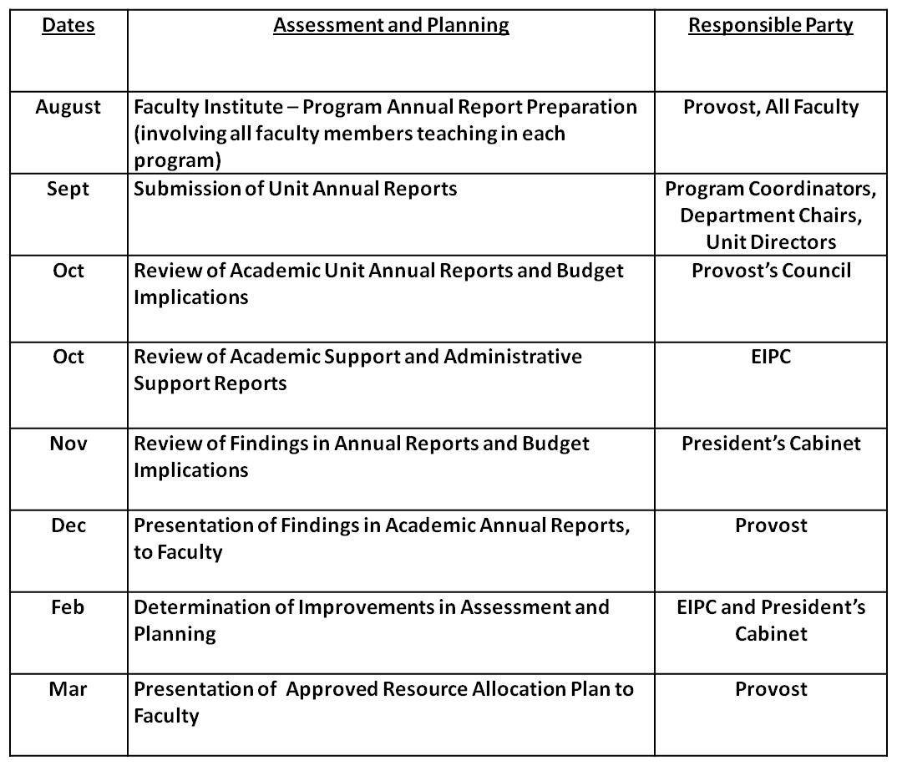

Slide 51
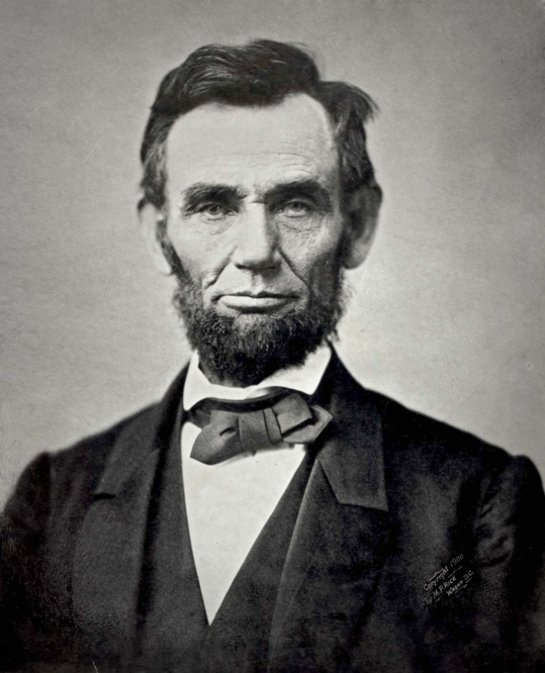




Incidental Lessons Learned . . .
Add example
of program
template to
Handbook.

Slide 52
Summary
*
Consider useful structures and practices related to institutional effectiveness that will enhance IE practices – assessment handbook, annual calendar, workflow and information-sharing plans
Develop methods for gathering and sharing compelling information – annual report and assessment template

Slide 53
Questions?

Slide 54
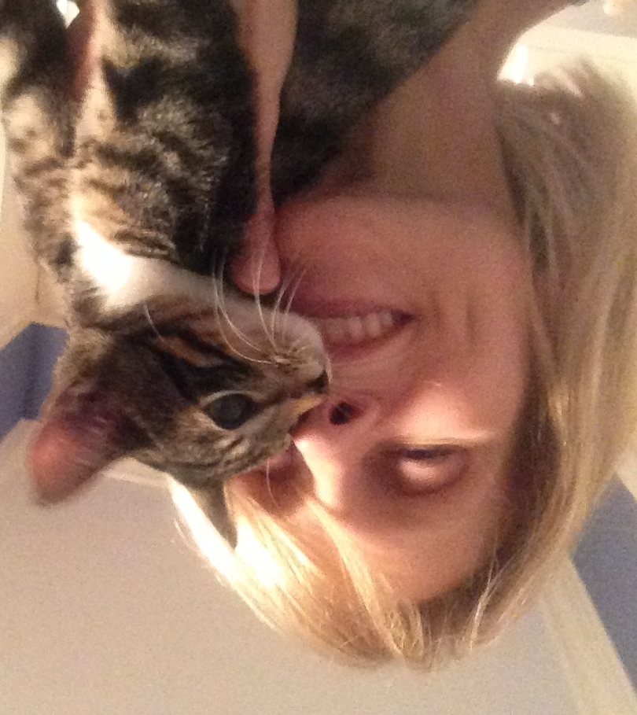
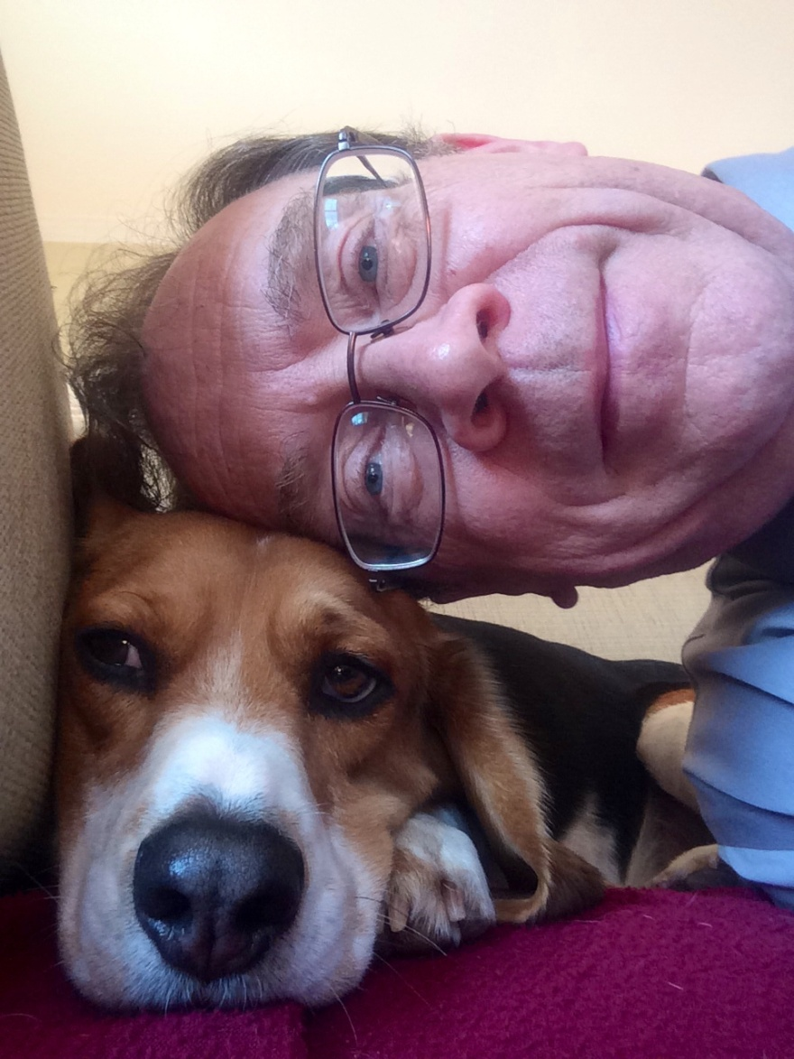
Swarley Nate, with Carol Yin
Director of Institutional Effectiveness
cyin@lagrange.edu
Mr. Charles Dickens, with David Garrison
Provost
dgarrison@lagrange.edu

Slide 56
