Slide 1
Strategic Moves: Building Consensus in Service of Lasting Teaching and Learning Reform
Debora hinderliter ortloff, & Jacob E. Amidon
Finger lakes community college

Slide 2
Background
Personal
Institutional

Slide 3
Key Features
4 college-wide values
All outcomes driven
First year experience
Capstone experience
Explicit inclusion of co-curricular

Slide 4
Five Key Strategies
Appealing to Higher Ideals
Strategic Leadership
Visual Presence
Building Capacity
Political Thinking

Slide 5
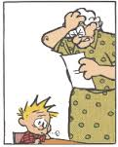
Appealing to Higher Ideals
Educators are idealists
Be bold and let everyone know it
Tailor your message
This underpins all other strategies

Slide 6
Q: Why do you and I do this?
A: Because education matters
Notes:
Need to check this transition… not part of higher ideals???

Slide 7
Q: Why do we have faculty?
A: To define and defend the curriculum
Notes:
Yep this section does not sit quite right

Slide 8
Q: What is the purpose of assessment?
A: To define and defend the curriculum
through a process of professional inquiry
in order to improve student learning

Slide 9
Strategic Leadership: Be Faculty Led
Faculty care
Faculty need opportunities to lead
Mistrust of administration

Slide 10
Strategic Leadership: Use Governance
Faculty has a voice
Shared decision making
Facilitates communication
Gives the initiative a home

Slide 11
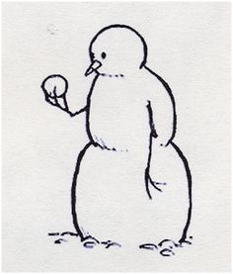
Strategic Leadership: Incremental Voting
Milestones
Precludes backtracking
Forms a record

Slide 12
The following three questions are being put forth for consideration by the Curriculum and Assessment Committees to determine the next steps in determining “What is an FLCC Degree”?
1) Do we cease to use the ten “FLCC Learning Outcomes (Competencies)” as a basis for our assessment purposes?
(Note: If we do not cease to use them we will need to decide how to integrate them with Middle States and SUNY.)
2) Do we integrate Middle States and SUNY requirements as presented on the hand-out?(Note: If we do not integrate we will need to decide how to address them both in some other way.)
3) Do we endorse the following as a set of overarching FLCC learning outcomes? (We would still be able to modify/tweak/wordsmith the text.) (Note: If we do not endorse the above we will need to decide whether to create some other overarching FLCC learning outcomes or to not have them at all.)

Slide 13
Strategic Leadership: Have a Good Partner
Political flexibility
Office proximity

Slide 14
Visual Presence: Leadership Presence
Be available
Be persistent
Have high expectations

Slide 15
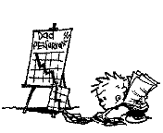
Visual Presence: Graphical Representations
People remember the picture
Graphic organizer
These change and grow

Slide 17
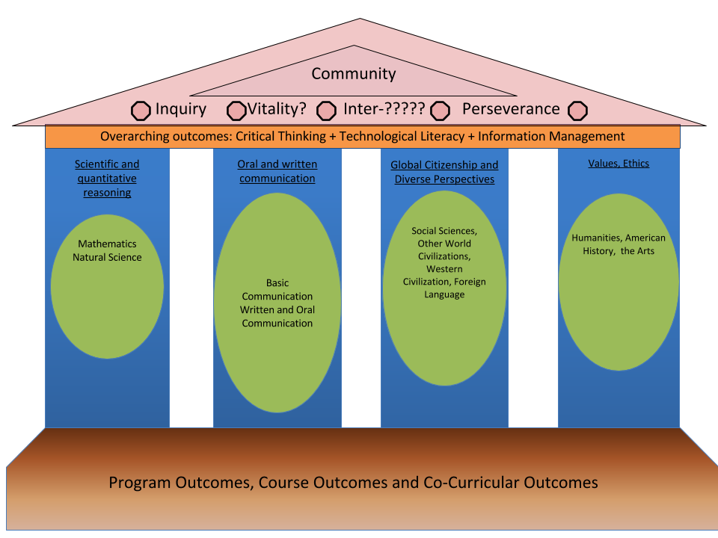
Notes:
Legend: Green = SUNY ; Blue = Middle States. An overarching outcome is a complex outcome that is fed by multiple other outcome. A competency is a skills based outcome that cuts across academic areas. NOTE: in the model all of our 10 FLCC learning outcomes are present.

Slide 19
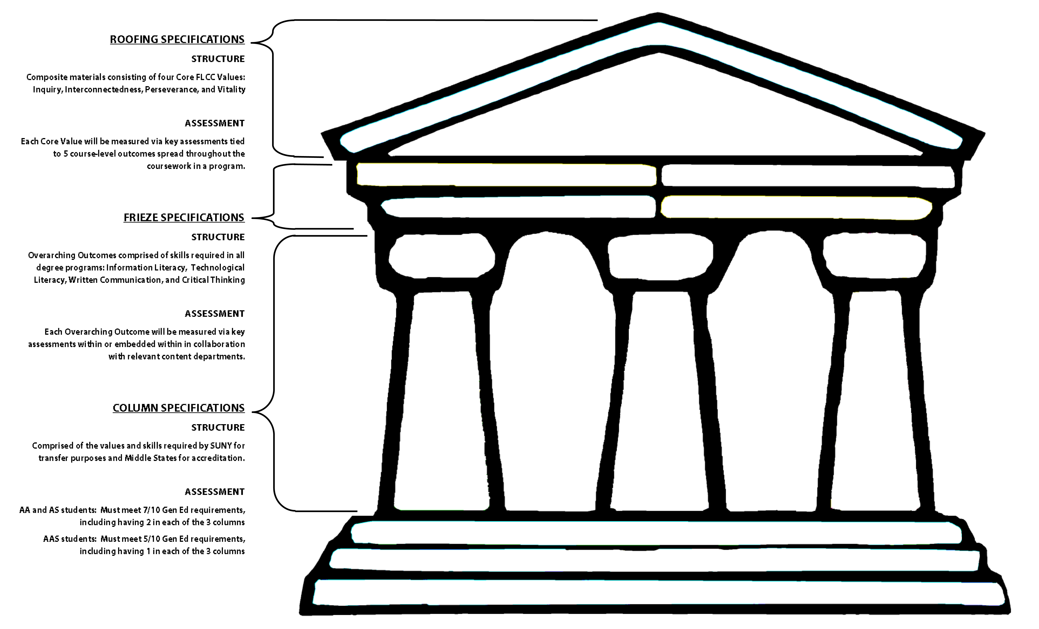
Notes:
Could we do a series of slides with several renditions of the Parthenon? That we could flip through really quickly.

Slide 20
Building Capacity: Involve and Train
Must be ongoing
Must be flexible and multifaceted
Give assignments
Bring to conferences

Slide 21
Building Capacity: Create Leaders
Assessment coaches
Ad-Hoc committee
Working groups

Slide 22
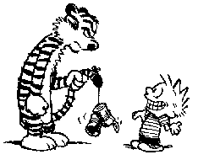
Political Thinking: Manipulate
Engage key players
Be pragmatic
Create a timeline that delays divisive decisions
Acknowledge “elephants in the room”

Slide 23
Political Thinking: Be Visible and Persistent
Vary input methods
Walk the halls
Manage up
Manage momentum

Slide 24
Political Thinking: Manage Saboteurs
Meanies, jealous heads, derailers, bandwagon jumpers
Kill with kindness
Involve them

Slide 25
Political Thinking: Vinick Method
https://youtu.be/TApuihxNsKU

Slide 26
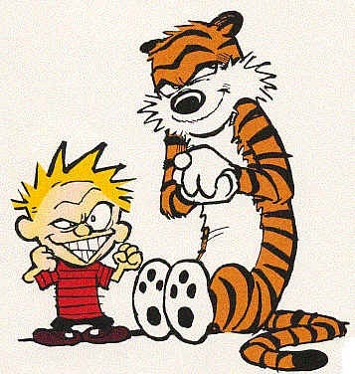
Five Key Strategies
Appealing to Higher Ideals
Strategic Leadership
Visual Presence
Building Capacity
Political Thinking

Slide 27
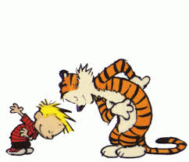
Thank you
We would love to talk to you more about anything we have done here or what you are doing on your campus.
Jacob.Amidon@flcc.edu
Debora.Ortloff@flcc.edu

