Slide 1
INTEGRATING ASSESSMENT TO CREATE A HEALING CLASSROOM: A STRENGTHS- BASED APPROACH
Susan L. Brooks
Earle Mack School of Law
Drexel University

Slide 2
Quick Write: Instant Feedback
Three things you hope to see in the next 45 minutes
Three things you hope to avoid
(please write them down on an index card)

Slide 3
I’m really convinced that there’s a terrible problem when … we become utterly obsessed with outcomes and results. When that happens, what else happens is that we keep taking on smaller and smaller tasks because those are the only ones we can get results with.

Slide 4
The standard [we need to aspire to] is faithfulness…..
Am I faithful to the gifts that I possess, to the strengths and abilities that I bring to the world?
To the needs I see around me? To those points at which I intersect the needs of the world and have a chance to serve?
How do you remain "faithful" to self, others and/or the vision you serve?
-Parker J. Palmer

Slide 5
Re-Thinking Assessment:
Assessment as informed decision-making
Self-assessment as a tool for reflection (and vice versa)
Assessment/self-assessment as processes that can lead to transformative learning

Slide 6
Transformative Learning
A process by which we shift our taken-for-granted frames of reference (meaning perspectives, habits of mind, mind-sets) enabling us to be more inclusive, discriminating, open, emotionally capable of change, and self reflective to guide action.
(Jack Mezirow, 2000)
PREPARED BY ILENE C. WASSERMAN, PH.D, PLEASE DO NOT REPRODUCE WITHOUT PERMISSION
iwasserman@icwconsulting.com; 610. 667.5305

Slide 7
Communication leads to community, that is, understanding, intimacy and mutual valuing. -Rollo May
Our words make our worlds.
- Ludwig Wittgenstein

Slide 8
Relational Communication Approaches
Appreciative Inquiry (Cooperrider and others)
Coordinated Management of Meaning (Pearce and Cronen)
Mindfulness (Kabat-Zinn and others)
Haven Communication Model (McKeen and Wong, with Satir)

Slide 9
Appreciative Inquiry vs. Problem Solving
Problem Solving
Appreciative Inquiry
Identification of Problem
Analysis of Causes
Analysis of Possible solutions
Action Planning (Treatment)
Appreciating and Valuing the Best of “What Is”
Envisioning “What Might Be”
Dialoguing “What Should Be”
Innovating “What Will Be”
-

Slide 10
CMM Model:
Coordination
Coherence
Mystery

Slide 11
CMM:“DIALOGIC MOMENTS” (Martin Buber)
Holding dearly your perspective side by side with my own without needing to resolve them.
In that moment you are expanded in relationship to the other

Slide 12
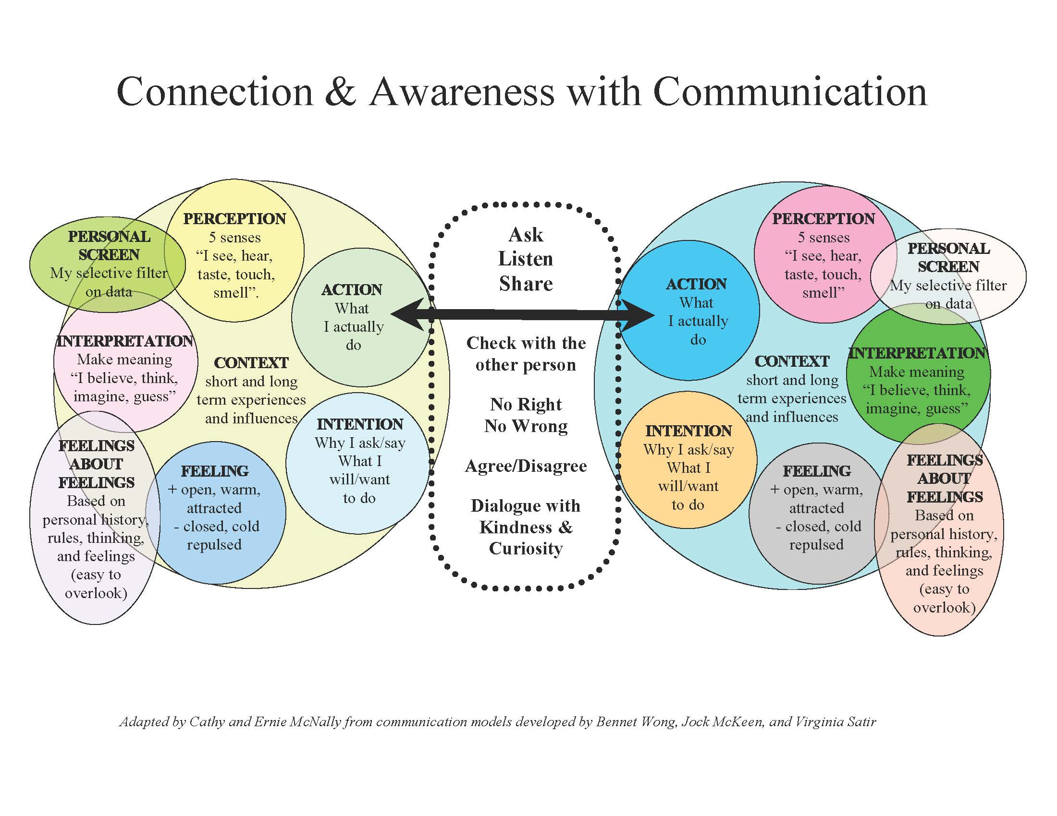

Slide 13
Haven Communication Model:
Check it Out:
Ask
Listen
Share
No one is ever wrong; no one is ever right.
We may agree or disagree

Slide 14
Teaching Relational Communication:
Appreciating Importance of Context
Encouraging a Posture of Curiosity
Promoting Mindfulness
Demonstrating “Mattering” (Everyone Wants To Be Seen and Heard)
Believing that effective communication and reflection can bring about transformative learning

Slide 15
Healing Practices:
Creating a Safe Cognitive and Emotional Space
Encouraging Everyone to Show up, Be Fully Present, and Be Their Authentic, Vulnerable Selves
Exercising Courage, Compassion--including Self-Compassion--and Connection
Sharing Our Stories
Listening Generously to the Stories of Others

Slide 16
Healing Practices Cont’d
Focusing on Strengths
Cultivating Resilience
Engendering Hope and Creativity
Finding Joy and Gratitude
Making Room for Stillness and Reflection

Slide 17
Resilience Exercise:
Think about a time when you faced a challenging teaching situation related to assessment:
How did you navigate that challenge?
What was it about you, or the circumstances or the people around you?

Slide 18
Mid-Point Informal Assessment
What teaching methods are you finding to be most effective?
What teaching methods are you finding to be least effective?
Are there additional teaching methods you would like to see?

Slide 19
Optimistic Classroom∗
Consider giving feedback that is:
Temporary
Specific
Hopeful
∗ From Corie Rosen, Creating the Optimistic Classroom: What Law Schools Can Learn From Explanatory Style Effects, 42 McGeorge L. Rev. 319 (2011).

Slide 20
Rubric for Assessing Written Reflection:∗
Identifying and focusing on salient issues;
Analyzing your own communication and the communication of others;
Drawing upon a variety of resources (with appropriate attribution);
Providing contextualized analysis;
Identifying your learning achievements and further learning needs and goals; and
Writing clearly and coherently.
Rachel Spencer, Holding Up the Mirror: A Theoretical and Practical Analysis of the Role of Reflection in Clinical Legal Education, 18 Int’l J. Clinical Legal Educ. 181 (Appendix B).

Slide 21
Sample (Final) Self-Evaluation
The main purpose of this assignment is to give you a structured opportunity to reflect on what you have learned and on your participation in this class.
Please look back at your first journal entry and reflect on your original goals and expectations for the class. How did the course fit (including perhaps the ways it differed) with your goals and expectations overall?
What topic(s) did you find most useful? Please describe one or two new insights you think you gained from the exploration of the topics you found most useful.

Slide 22
Sample (Final) Self Evaluation (cont’d)
What topic(s) did you find most challenging? Please describe one or two things you found challenging about those topics.
Were there any topics you would like to have covered that weren’t covered? Please explain.
How would you describe your participation in the class? What do you think you did well? Is there anything you would do differently if you had the chance to re-take this class from the beginning?
How would you describe this class to another student who might be asking you about this class? What advice would you give them?

